Slide 2
HOW TO CONDUCT ONLINE KIDS ASSEMBLY

Slide 6
Kids Assembly
Even in the online world!

Slide 7
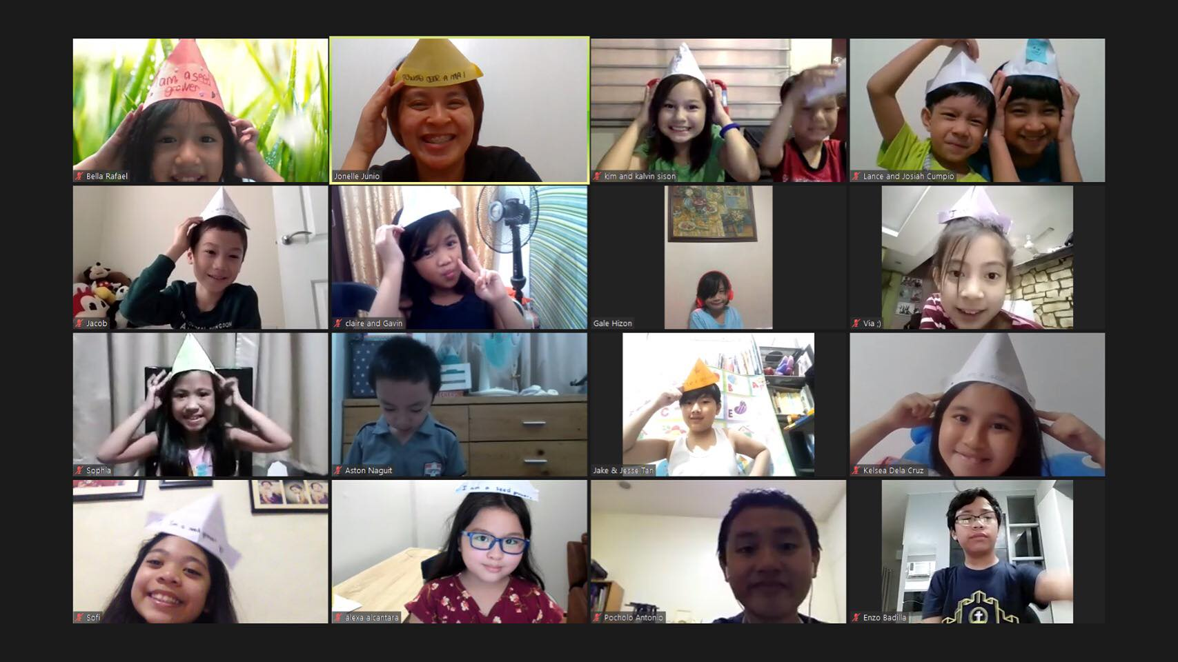

Slide 8
Basic Principles we need to keep in mind!

Slide 9
Kids Assembly should be done
Once a month!
1
Frequency and consistency is the key!

Slide 10
Format of the kids Assembly stays the same!
2
Make sure it’s still fun

Slide 11
Kids meeting format
Kids Praise
Game
Pep Talk
Activity
Homework
Kids Praise

Slide 12
Screen time should be observed at all times!
3
Too much is not good!

Slide 13
https://www.eyepromise.com/wp-content/uploads/2019/05/Screentime-Recommendation-Chart-Final_AAP-WHO.pdf

Slide 14
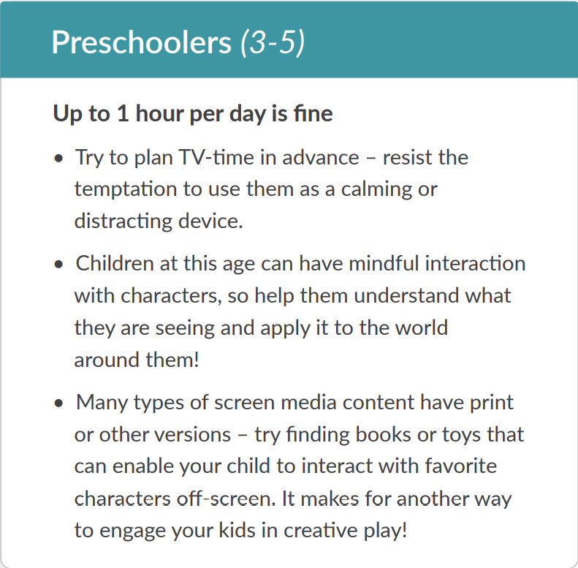

Slide 15
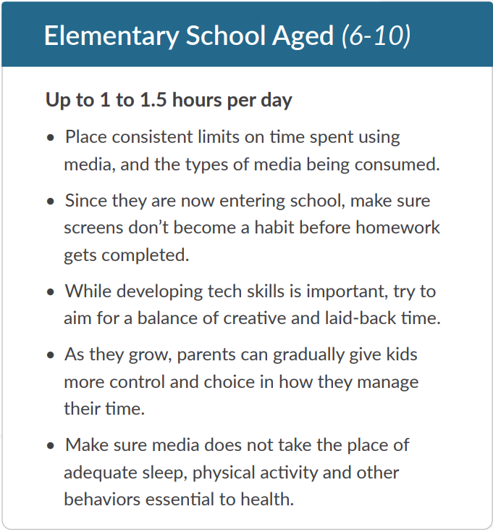

Slide 16
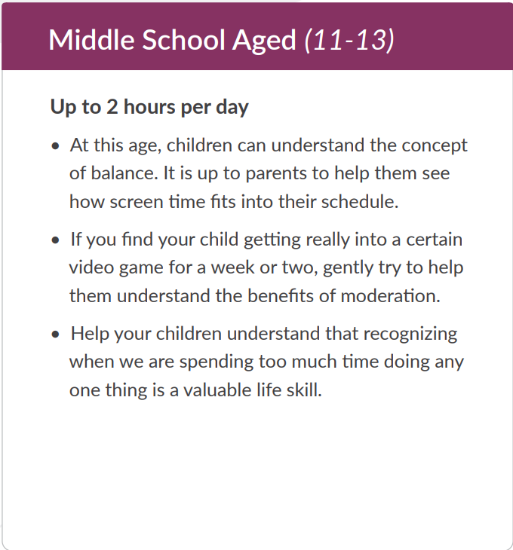

Slide 17
Screen time should be observed at all times
Start on time! Lessen the waiting time.
Go straight to the things that should be done: kids praise, game, pep talk, activity, homework!
Put less focus about Y0U! Make it child-centered.
Allot more time for the activity to make it really personal.

Slide 18
Screen time should be observed at all times
Total Time
1 HOUR
Kids Praise: 5 mins
Game: 10 mins
Pep Talk: 10 mins
Activity: 25 mins
Homework: 5 mins
Kids Praise: 5 mins

Slide 19
SERVICE TEAM
4
How many do we need?

Slide 20
Online service team
Tech Person (ex. Zoom Admin)
Visuals
Sounds
Facilitator (ex. Emcee)
Welcomes everyone
Speaker
Facilitates the pep talk and the activity
Gives out homework

Slide 21
PRACTICAL TIPS!
Because sharing is caring!

Slide 22
General Practical tips
Assess your area which application is better to be used by your participants (Zoom, Google meet, Messenger)
Open your chosen application 30 minutes before your schedule so you can have your team prayer and tech run
You may record your Kids Assembly for future use
Contact parents/ guardians 3 days before, 1 day before and on the day of the assembly

Slide 23
General Practical tips
Have a spiritual preparation such as fasting and setting up team’s common prayer time.
Make sure that you have planned the whole activity well by having a service meeting
Prepare all the needed materials beforehand: Art materials, Video, PowerPoint presentation
OPEN YOUR CAMERAS AT ALL TIMES!

Slide 25
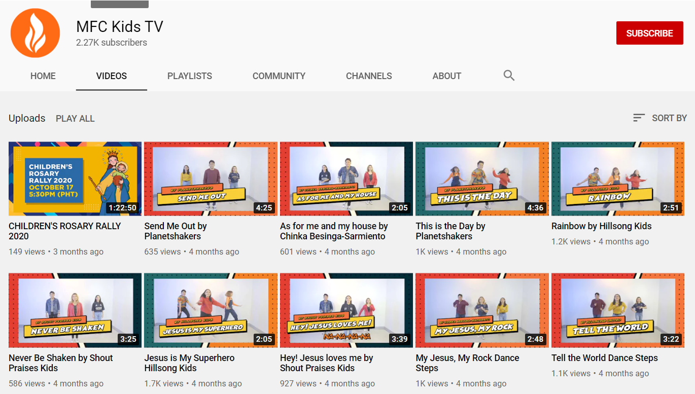
KIDS PRAISE

Slide 26
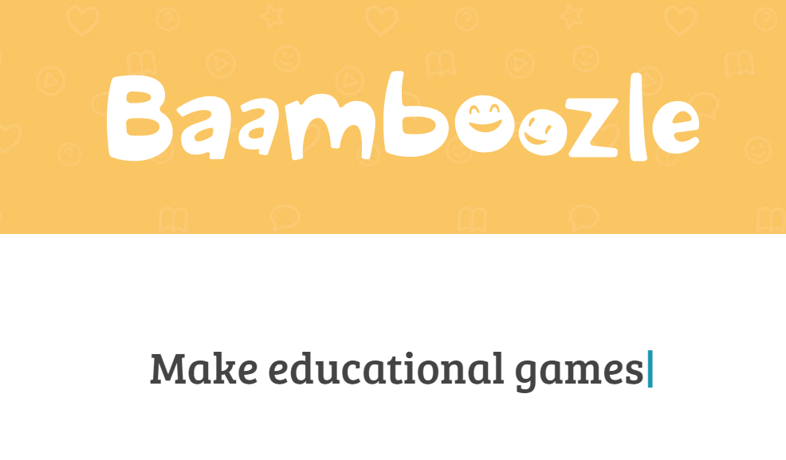
GAMES

Slide 27
TALK & POWERPOINT

Slide 28
Practical tips for Tech admin
Make sure to play music or video at a low volume
Assess if the kids are participating so you know when to off chat in the chat box
Be alert in muting and unmuting the participants

Slide 29
Practical tips for The Facilitator
Make it lively, talk to them and get the chance to get to know your participants
Use simple words
Listen and participate to the speaker also so you can conclude the activity in a more personal way.

Slide 30
Practical tips for The Facilitator
You can ask from the kids who among them wants to lead the prayer
Be mindful if the leader will be able to do the sign of the cross and if the leader will be able to invite the participants to stand up.
Encourage them to participate and listen well
Remind them to prepare their materials beside them

Slide 31
Practical tips for The Speaker
Get straight to the point, limit your points up to three if you are going to make your talk
Animate your voice, your facial expressions and your action
Prepare your materials and your finished artwork

Slide 32
Practical tips for The Speaker
Be creative in making your presentation!
You can start your session with a video
Make it fun and interactive
Do the activity with them step by step!

Slide 33
Don't forget to report your assembly using our monitoring form
http://bit.ly/mfckids-amf

Slide 34
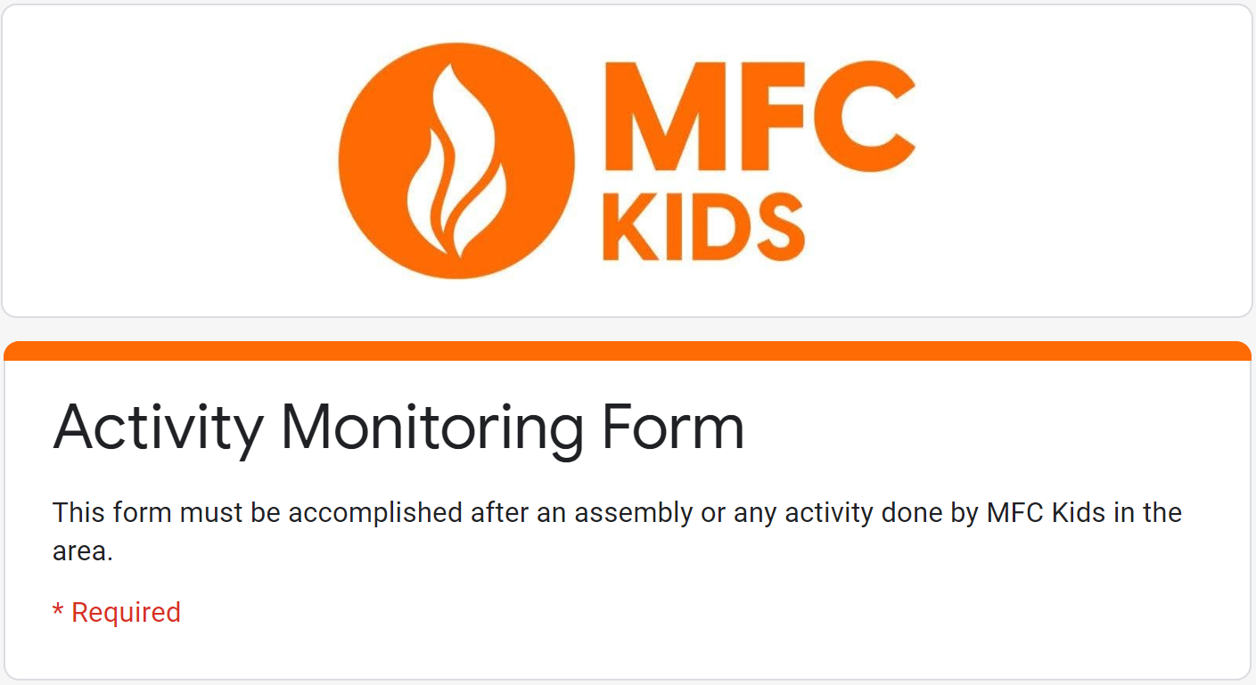
Don't forget to record your attendance using our google form
https://forms.gle/sBSzMiVcRkCF2Bg96

Slide 35
PARENT-CHILD ACTIVITY EVERY AFTER KIDS ASSEMBLY

Slide 36
WHY IS IT IMPORTANT?
The relationship between a parent and their child is a unique bond that nurtures the holistic growth and development of a child. It lays the foundation for their behavior, personality, traits and most importantly, values.

Slide 37
WHY IS IT IMPORTANT?
The relationship between a parent and their child is a unique bond that nurtures the holistic growth and development of a child. It lays the foundation for their behavior, personality, traits and most importantly, values.

