Slide 1




Live the Word Kids

Slide 2

Twenty-Third Sunday in Ordinary Time
September 6, 2026 | Cycle A Year 2

Slide 3
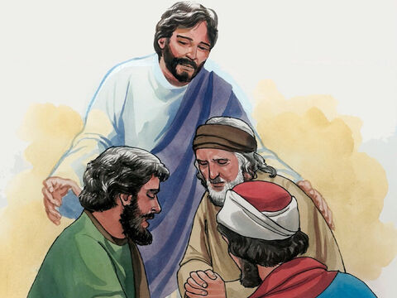
Restoring Christian Relationship
Matthew 18:15-20

Slide 4


Leader:
A reading from the Holy Gospel according to Matthew.
All:
Glory to You, Oh Lord.

Slide 5
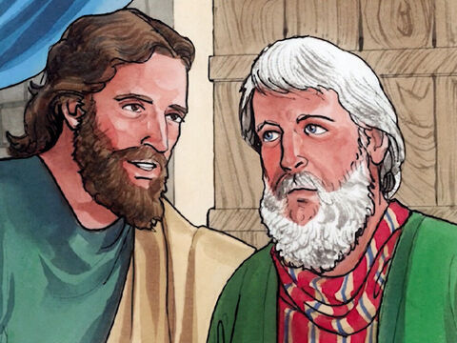
15
“If your brother sins against you, go to him and show him his fault. But do it privately, just between yourselves. If he listens to you, you have won your brother back.

Slide 6
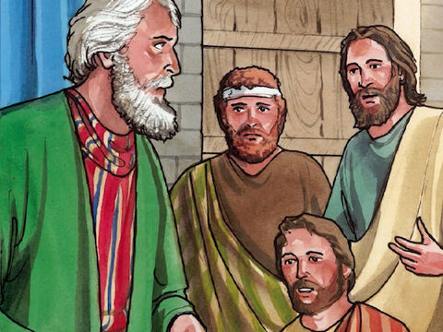
16
But if he will not listen to you, take one or two other persons with you, so that ‘every accusation may be upheld by the testimony of two or more witnesses,’ as the scripture says.

Slide 7
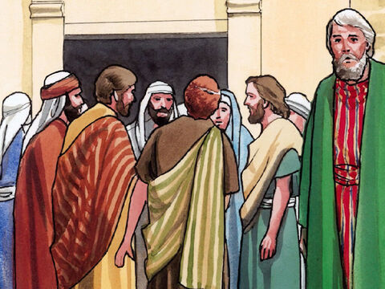
17
And if he will not listen to them, then tell the whole thing to the church. Finally, if he will not listen to the church, treat him as though he were a pagan or a tax collector.

Slide 8
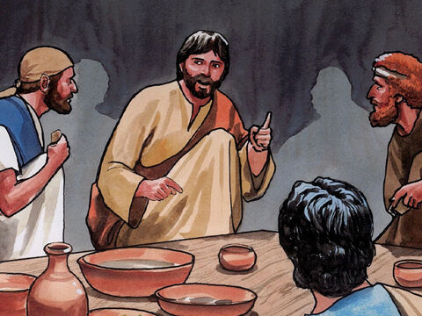
18
“And so I tell all of you: what you prohibit on earth will be prohibited in heaven, and what you permit on earth will be permitted in heaven.

Slide 9
19
“And I tell you more: whenever two of you on earth agree about anything you pray for, it will be done for you by my Father in heaven.

Slide 10
20
For where two or three come together in my name, I am there with them.”

Slide 11
Leader:
The Gospel of the Lord
All:
Praise to you, Lord Jesus Christ.

Slide 12
Gospel Message

Slide 13

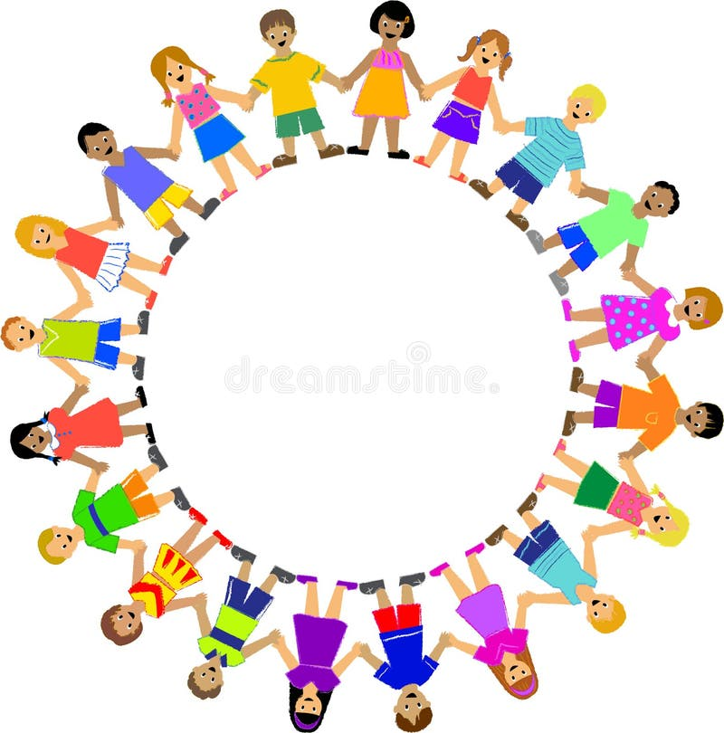
Activity:
“Jesus is With Us” Prayer Circle
Materials Needed:
  Bond paper
  Crayons

Slide 14
Activity:
“Jesus is With Us”
Prayer Circle
1.Draw a circle of children holding hands.
2.Write at the center: “Where two or three are gathered in My Name, I am there.”
3. Color and decorate the circle with hearts.
4. On each heart, write the name of someone you want to pray for.

Slide 15
Dear Jesus,
Thank You for being with us whenever we gather and pray in Your name. Help us to forgive others, speak kindly, and solve our problems with love. Teach us to pray for our family, friends, and those who need Your help. May we always remember that You are with us.
Amen.
Closing Prayer

Slide 16
Live the Word Kids

