Slide 1


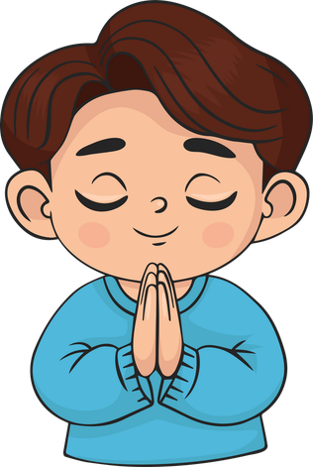
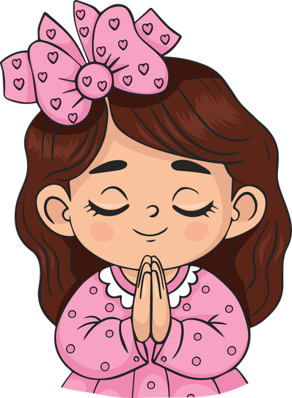
Live the Word Kids

Slide 2
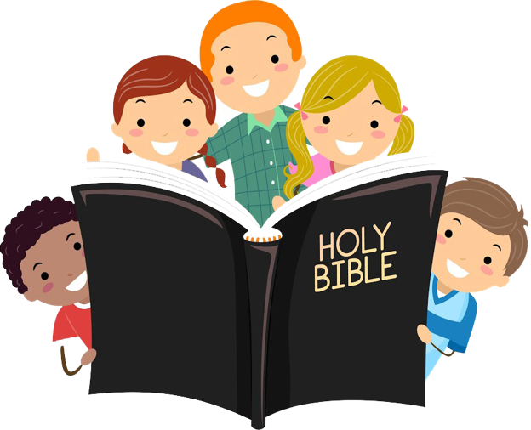
Twenty-Sixth Sunday in Ordinary Time
September 27, 2026 | Cycle A Year 2

Slide 3
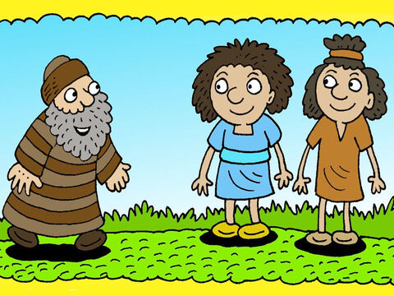
The Parable of the Two Sons
Matthew 21:28-32

Slide 4
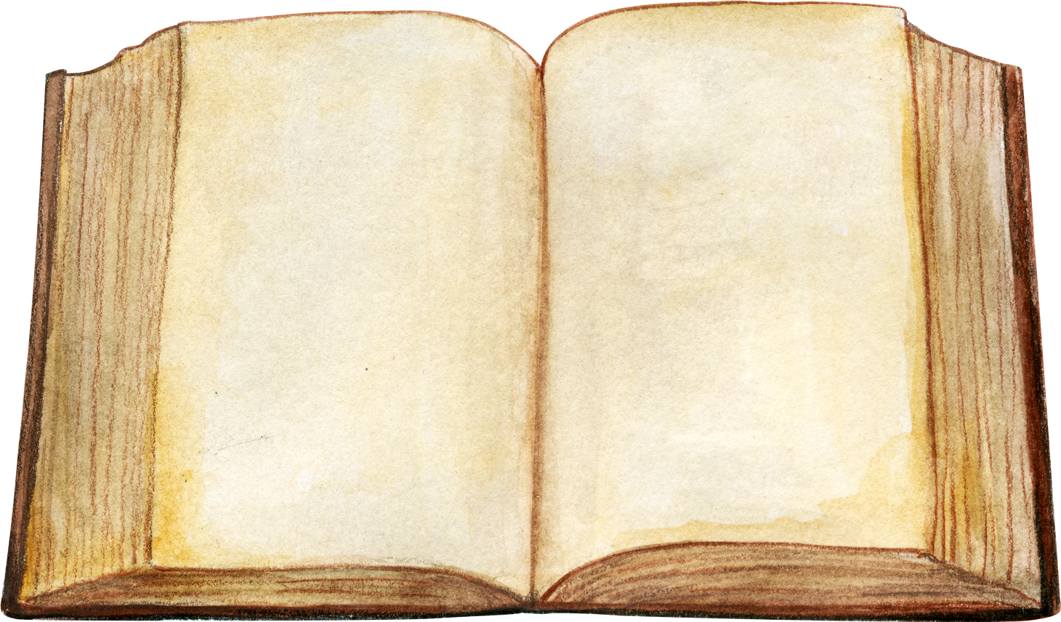

Leader:
A reading from the Holy Gospel according to Matthew.
All:
Glory to You, Oh Lord.

Slide 5
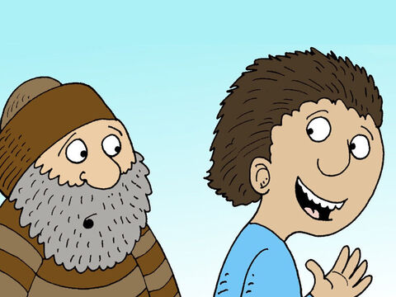
28
“Now, what do you think? There was once a man who had two sons. He went to the older one and said, ‘Son, go and work in the vineyard today.’

Slide 6
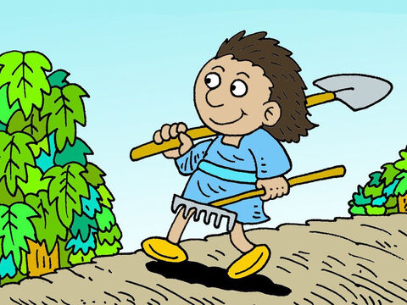
29
‘I don't want to,’ he answered, but later he changed his mind and went.

Slide 7
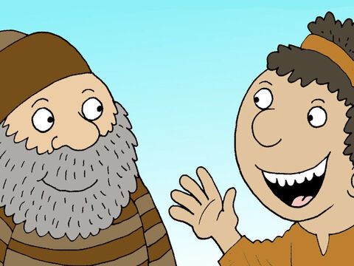
30
Then the father went to the other son and said the same thing. ‘Yes, sir,’ he answered, but he did not go.

Slide 8
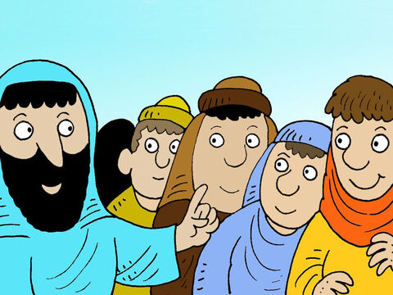
31
Which one of the two did what his father wanted?”
“The older one,” they answered.
So Jesus said to them, “I tell you: the tax collectors and the prostitutes are going into the Kingdom of God ahead of you.

Slide 9
32
For John the Baptist came to you showing you the right path to take, and you would not believe him; but the tax collectors and the prostitutes believed him. Even when you saw this, you did not later change your minds and believe him.

Slide 10
Leader:
The Gospel of the Lord
All:
Praise to you, Lord Jesus Christ.

Slide 11
Gospel Message

Slide 12

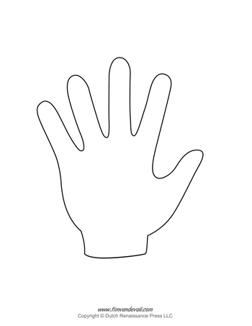
Activity:
“My Yes to God” Handprint
Materials Needed:
  Paper
  Pencil
  Crayons

Slide 13
Activity:
“My Yes to God” Handprint
1. Trace your hand on a piece of paper.
2. On each finger, write one way you can say “YES” to God through your actions, such us: Help my parents, Share with others, Pray every day, Be kind, and Tell the truth.
3. In the center of the hand, write: “I will say YES to God!”.
4. Decorate the hand and color.

Slide 14
Dear Jesus,
Thank You for teaching us that our actions are important. Help us not only to say “yes” to You, but also to show our love by helping others, obeying our parents, sharing, and being kind.
Give us a loving and obedient heart so that we can always choose to do what is right.
Amen.
Closing Prayer

Slide 15
Live the Word Kids

