Slide 1


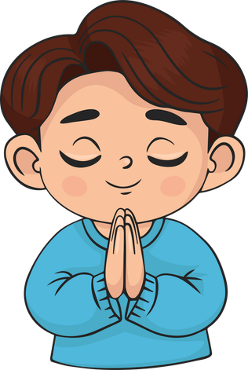

Live the Word Kids

Slide 2

Twenty-Fifth Sunday in Ordinary Time
September 20, 2026 | Cycle A Year 2

Slide 3
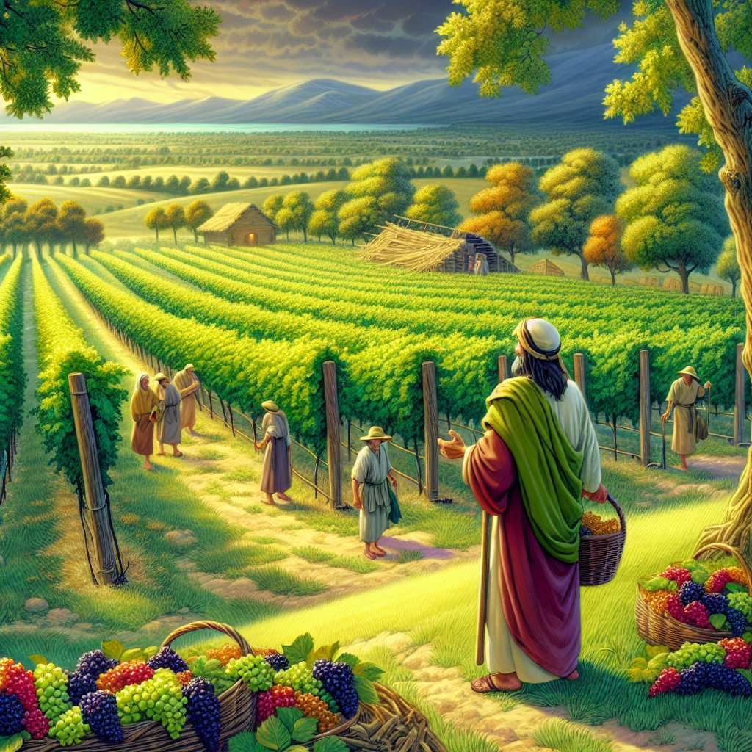
The Parable of Workers in a Vineyard
Matthew 20:1-16a

Slide 4


Leader:
A reading from the Holy Gospel according to Matthew.
All:
Glory to You, Oh Lord.

Slide 5
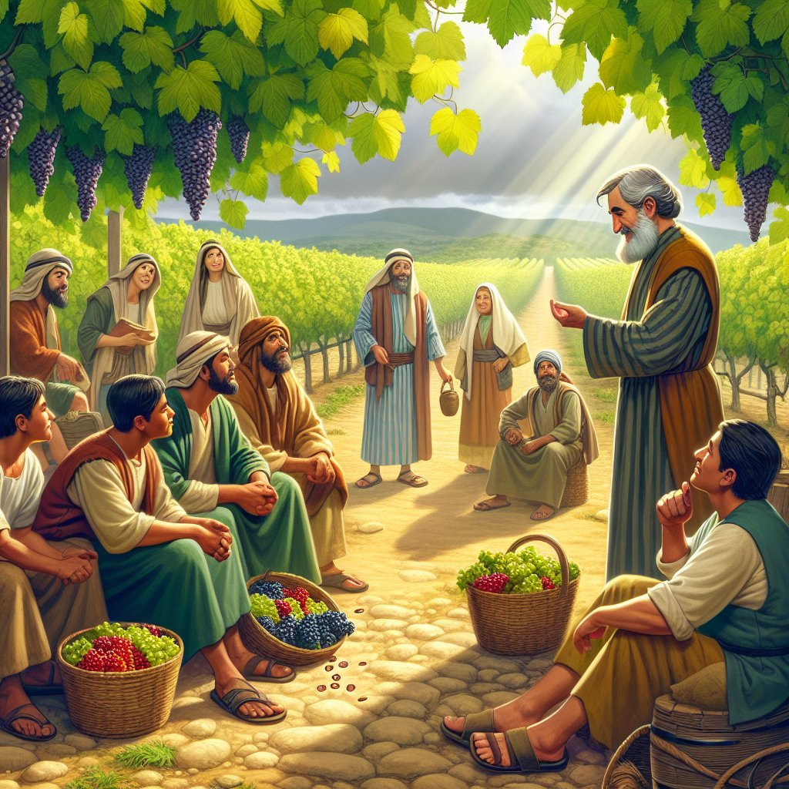
1
“The Kingdom of heaven is like this. Once there was a man who went out early in the morning to hire some men to work in his vineyard.

Slide 6
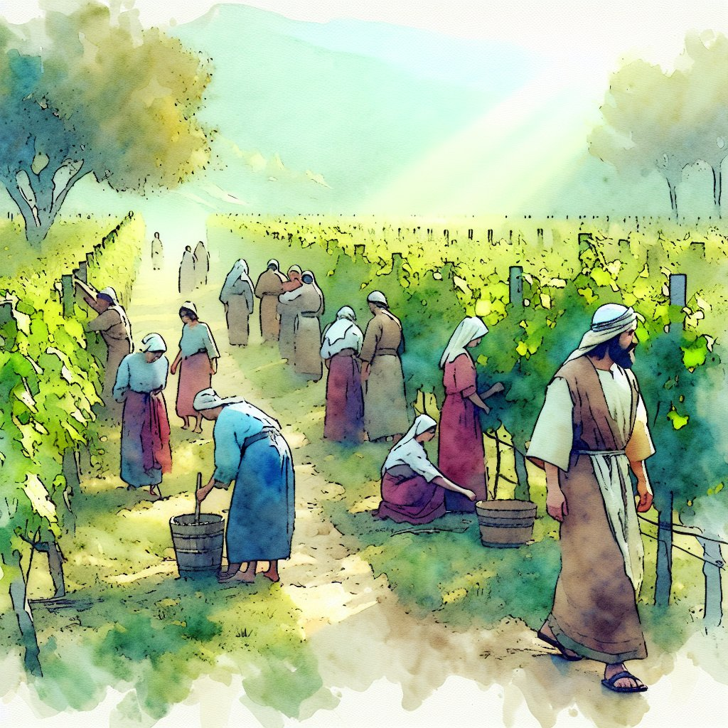
2
He agreed to pay them the regular wage, a silver coin a day, and sent them to work in his vineyard.

Slide 7
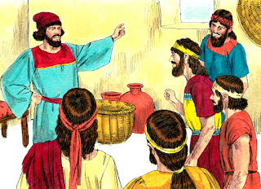
3
He went out again to the marketplace at nine o'clock and saw some men standing there doing nothing,

Slide 8
4
so he told them, ‘You also go and work in the vineyard, and I will pay you a fair wage.’

Slide 9
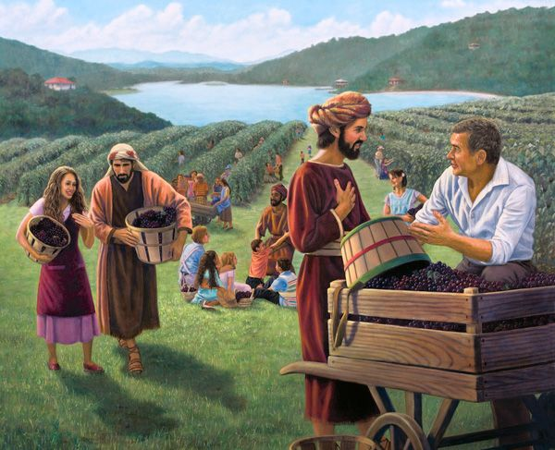
5
So they went. Then at twelve o'clock and again at three o'clock he did the same thing.

Slide 10
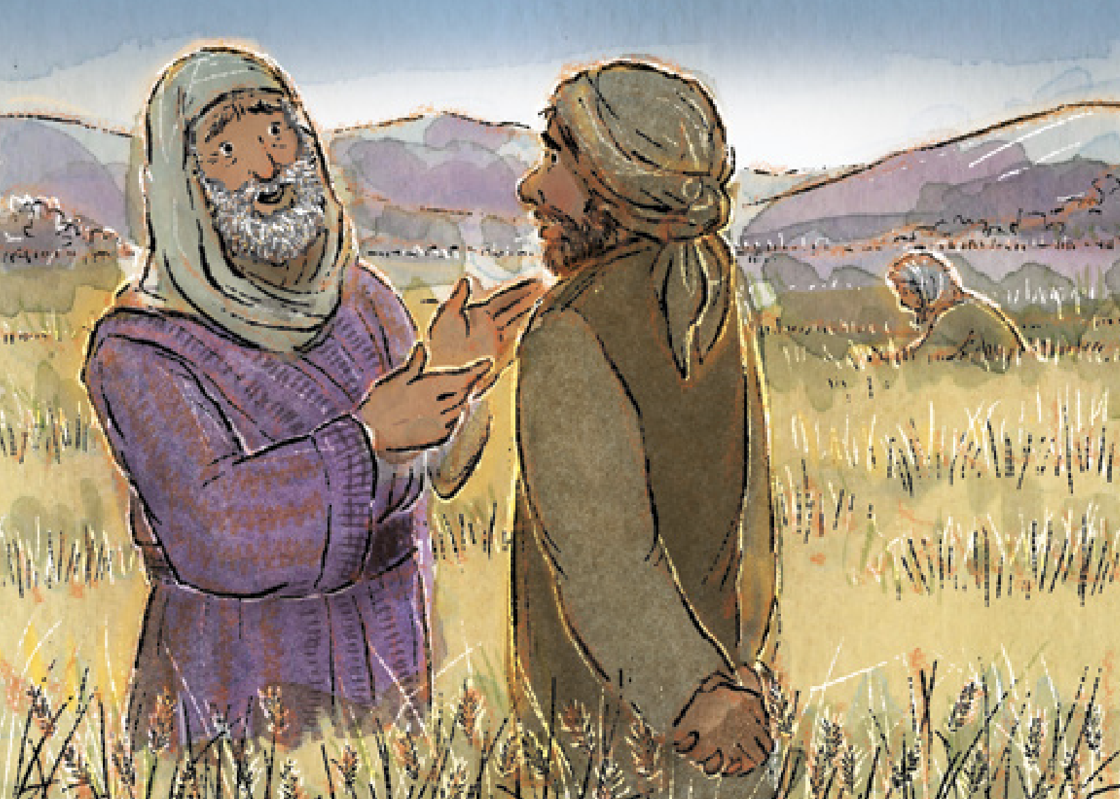
6
It was nearly five o'clock when he went to the marketplace and saw some other men still standing there. ‘Why are you wasting the whole day here doing nothing?’ he asked them.

Slide 11
7
‘No one hired us,’ they answered. ‘Well, then, you go and work in the vineyard,’ he told them.

Slide 12
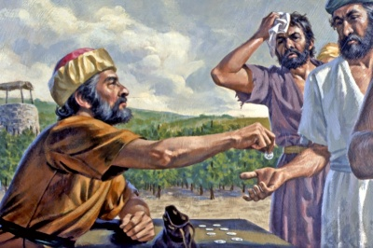
8
“When evening came, the owner told his foreman, ‘Call the workers and pay them their wages, starting with those who were hired last and ending with those who were hired first.’

Slide 13
9
The men who had begun to work at five o'clock were paid a silver coin each.

Slide 14
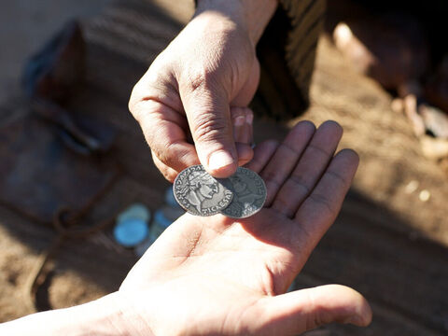
10
So when the men who were the first to be hired came to be paid, they thought they would get more; but they too were given a silver coin each.

Slide 15
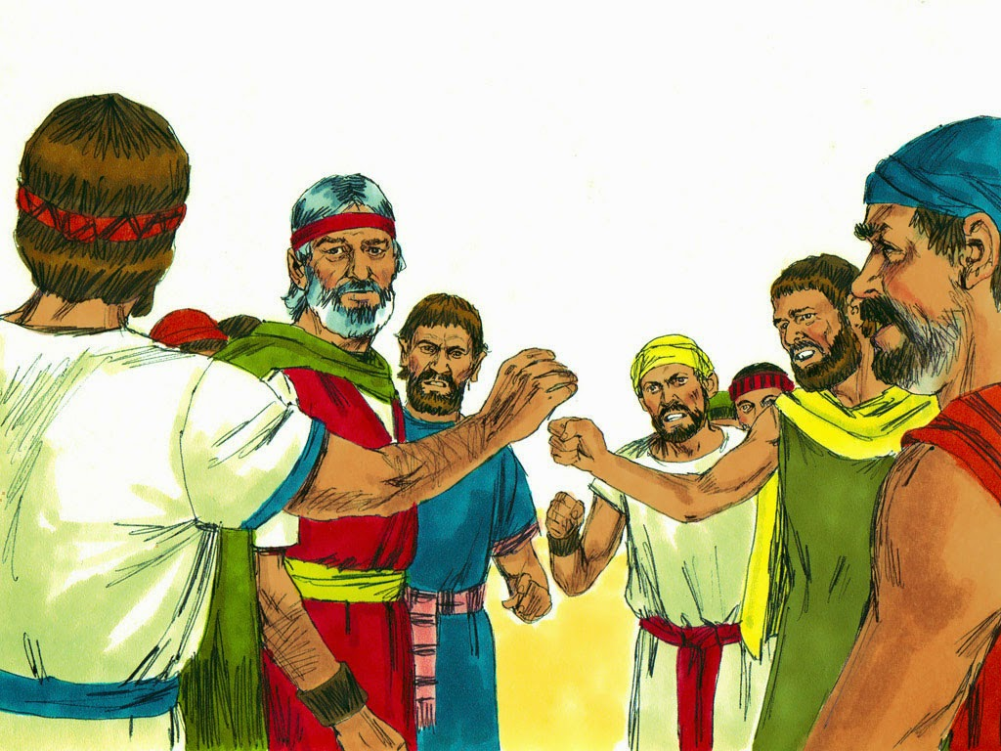
11
They took their money and started grumbling against the employer.

Slide 16
12
‘These men who were hired last worked only one hour,’ they said, ‘while we put up with a whole day's work in the hot sun—yet you paid them the same as you paid us!’

Slide 17
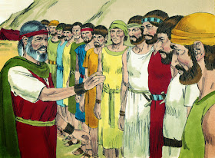
13
‘Listen, friend,’ the owner answered one of them, ‘I have not cheated you. After all, you agreed to do a day's work for one silver coin.

Slide 18
14
Now take your pay and go home. I want to give this man who was hired last as much as I gave you.

Slide 19
15
Don't I have the right to do as I wish with my own money? Or are you jealous because I am generous?’”

Slide 20
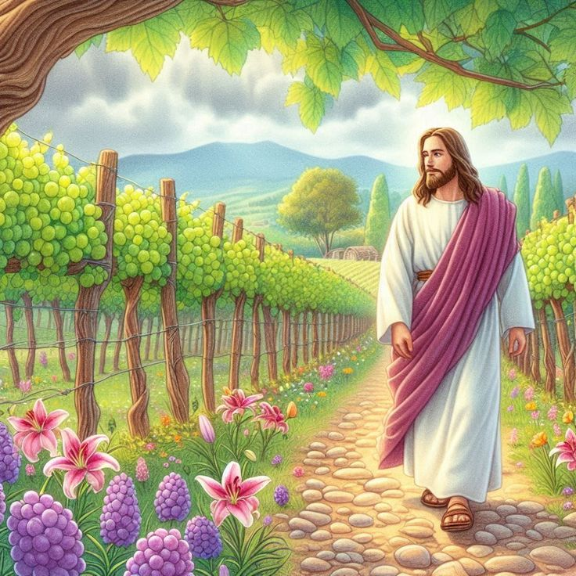
16a
And Jesus concluded, “So those who are last will be first, and those who are first will be last.”

Slide 21
Leader:
The Gospel of the Lord
All:
Praise to you, Lord Jesus Christ.

Slide 22
Gospel Message

Slide 23


Activity:
“God’s Generous Heart”
Materials Needed:
  Red Colored Paper
  Scissors
  Pen

Slide 24
Activity:
“God Generous Heart”
1.Cut out a large heart from red colored paper
2.Write at the center: “God is Generous to everyone.”
3. Around the heart, write ways they can be generous.

Slide 25
Dear Jesus,
Thank You for Your love and generosity.
Teach us not to be jealous of others,
but to be happy for their blessings.
Help us to share, help, and love others
with a generous heart.
May we always remember that Your love is a gift for everyone.
Amen.
Closing Prayer

Slide 26
Live the Word Kids

