Slide 1


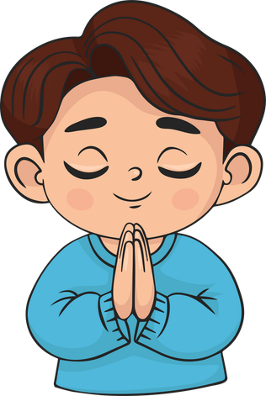
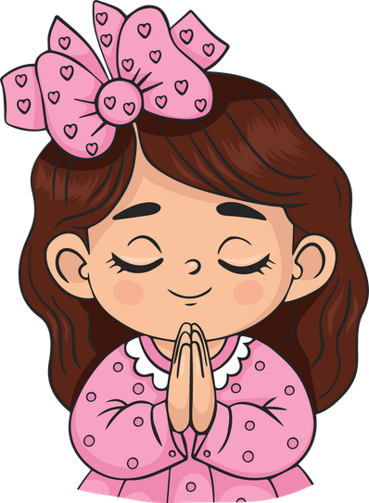
Live the Word Kids

Slide 2

Twenty-Fourth Sunday in Ordinary Time
September 13, 2026 | Cycle A Year 2

Slide 3
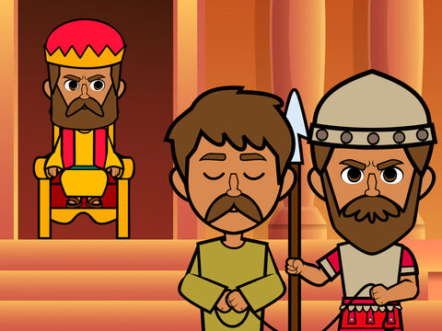
The Parable of the Unforgiving Servant
Matthew 18:21-35

Slide 4
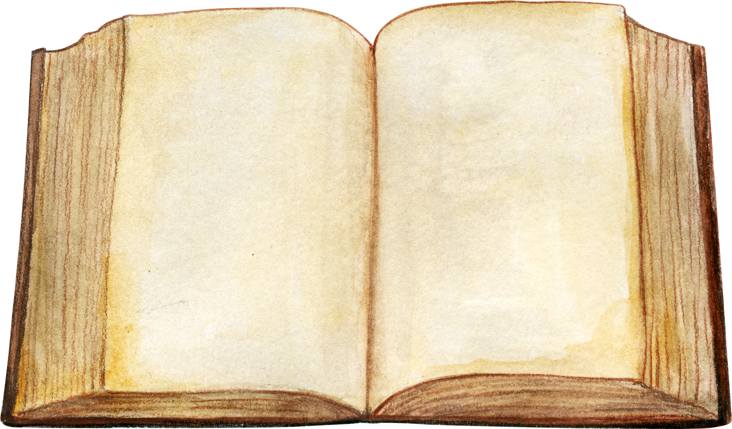

Leader:
A reading from the Holy Gospel according to Matthew.
All:
Glory to You, Oh Lord.

Slide 5
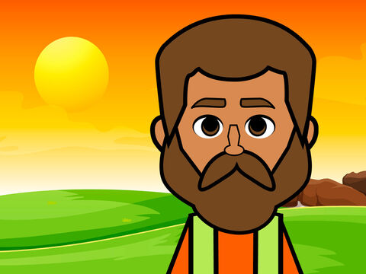
21
Then Peter came to Jesus and asked, “Lord, if my brother keeps on sinning against me, how many times do I have to forgive him? Seven times?”

Slide 6
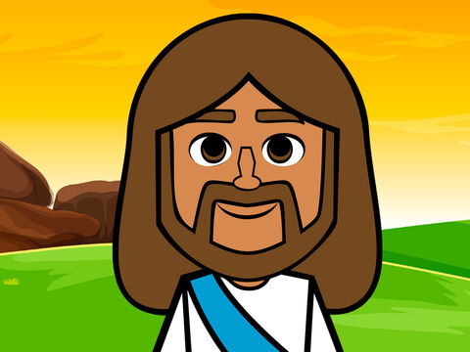
22
“No, not seven times,” answered Jesus, “but seventy times seven,

Slide 7
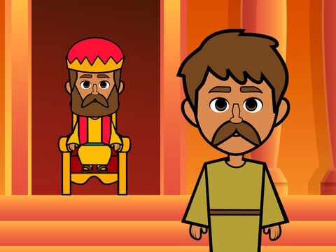
23
because the Kingdom of heaven is like this. Once there was a king who decided to check on his servants' accounts.

Slide 8
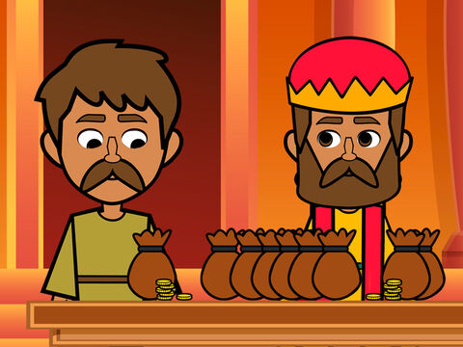
24
He had just begun to do so when one of them was brought in who owed him millions of dollars.

Slide 9
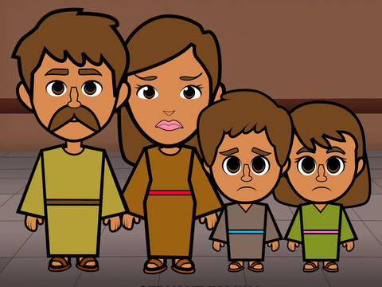
25
The servant did not have enough to pay his debt, so the king ordered him to be sold as a slave, with his wife and his children and all that he had, in order to pay the debt.

Slide 10
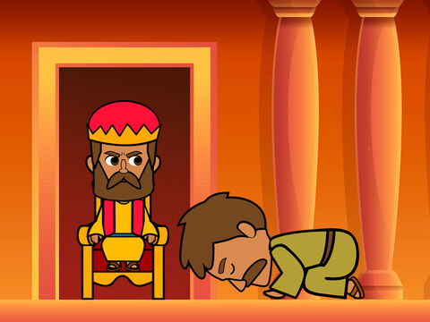
26
The servant fell on his knees before the king. ‘Be patient with me,’ he begged, ‘and I will pay you everything!’

Slide 11
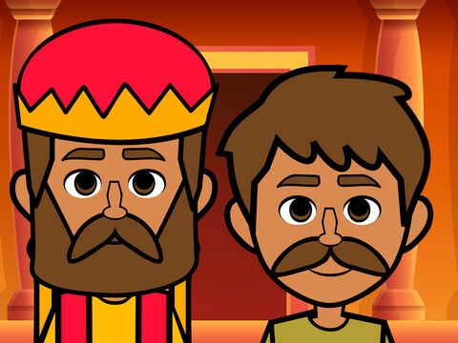
27
The king felt sorry for him, so he forgave him the debt and let him go.

Slide 12
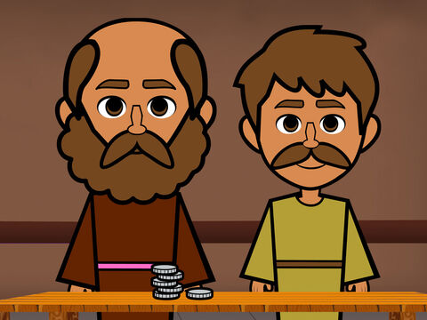
28
“Then the man went out and met one of his fellow servants who owed him a few dollars. He grabbed him and started choking him. ‘Pay back what you owe me!’ he said.

Slide 13
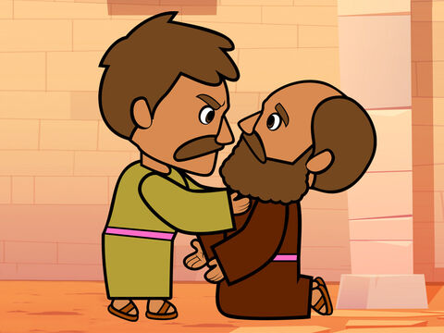
29
His fellow servant fell down and begged him, ‘Be patient with me, and I will pay you back!’

Slide 14
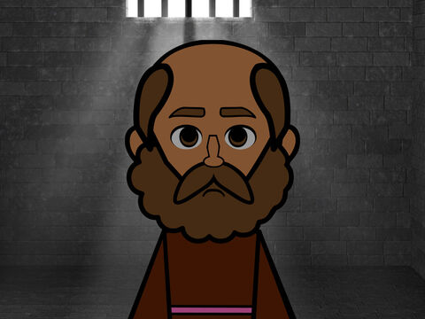
30
But he refused; instead, he had him thrown into jail until he should pay the debt.

Slide 15
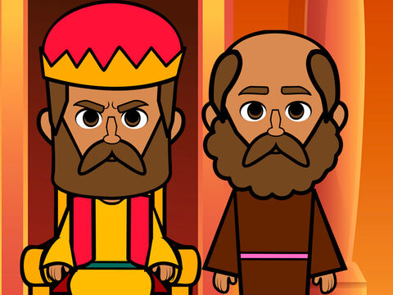
31
When the other servants saw what had happened, they were very upset and went to the king and told him everything.

Slide 16
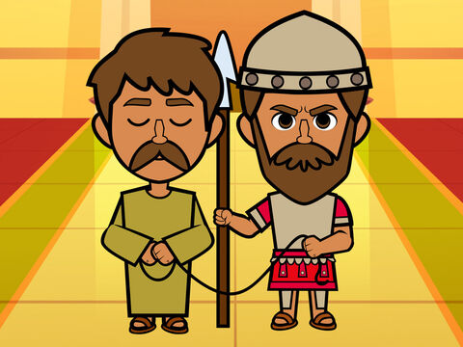
32
So he called the servant in. ‘You worthless slave!’ he said. ‘I forgave you the whole amount you owed me, just because you asked me to.

Slide 17
33
You should have had mercy on your fellow servant, just as I had mercy on you.’

Slide 18
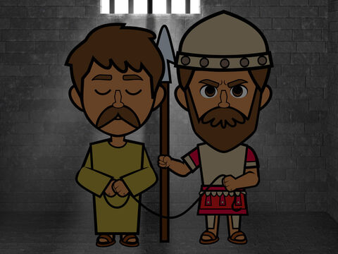
34
The king was very angry, and he sent the servant to jail to be punished until he should pay back the whole amount.”

Slide 19
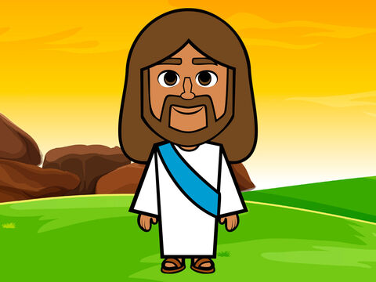
35
And Jesus concluded, “That is how my Father in heaven will treat every one of you unless you forgive your brother from your heart.”

Slide 20
Leader:
The Gospel of the Lord
All:
Praise to you, Lord Jesus Christ.

Slide 21
Gospel Message

Slide 22


Activity:
“The Heart of Forgiveness”
Materials Needed:
  Red Colored Paper
  Scissors
  Pen

Slide 23
Activity:
“The Heart of Forgiveness”
1.Cut out a large heart from red colored paper
2.Write at the center: “Forgive Others as Jesus Forgives Me.”
3. Around the heart, write the names of people you want to forgive or pray for.

Slide 24
Dear Jesus,
Thank You for always forgiving us when we make mistakes. Help us to forgive others just as You forgive us. Take away anger and hurt from our hearts, and fill us with love, kindness, and peace.
Teach us to be forgiving and loving every day.
Amen.
Closing Prayer

Slide 25
Live the Word Kids

