Slide 1



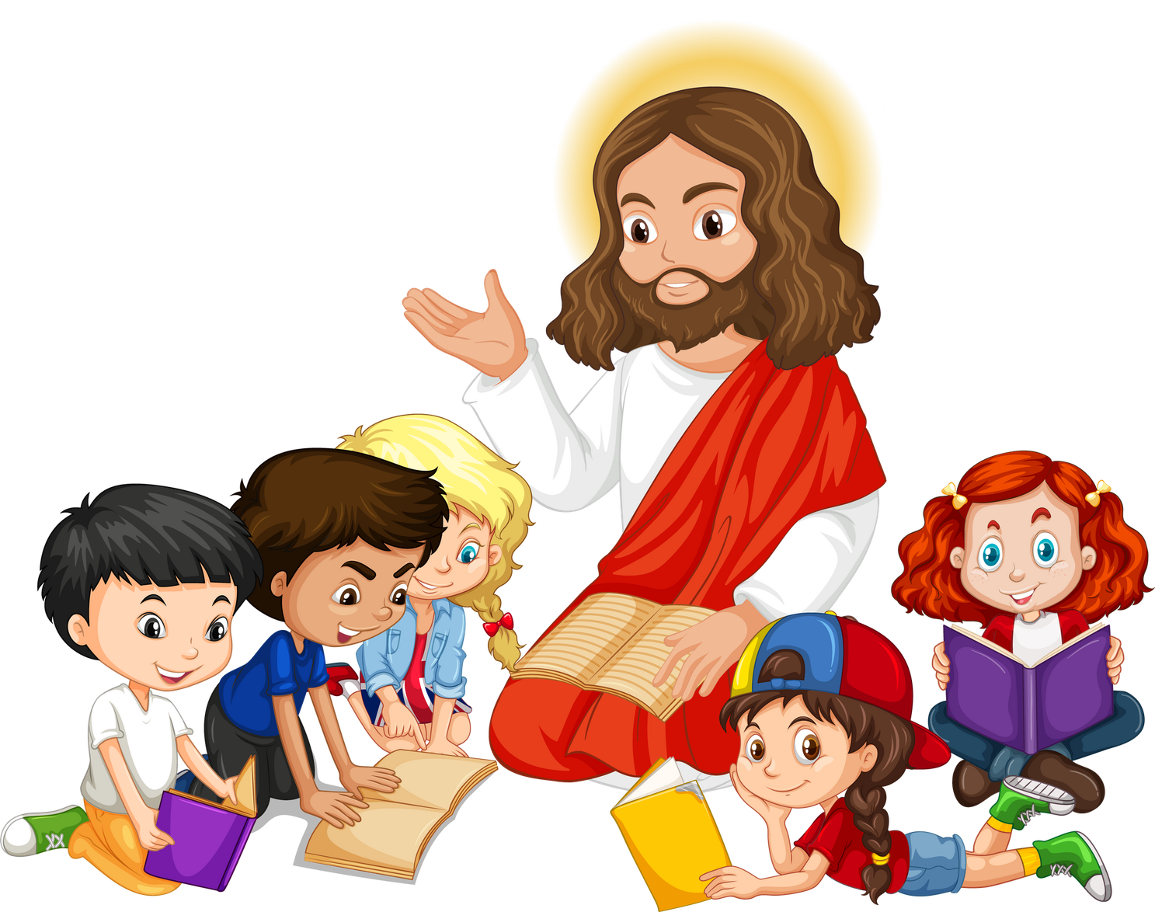


Live the Word Kids

Slide 2
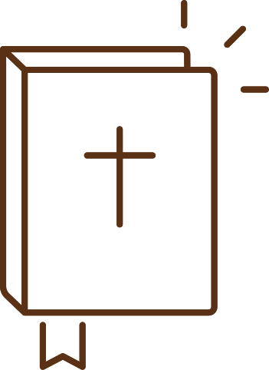




"Twenty-Seventh Sunday in Ordinary Time"
October 04, 2026 | Cycle A Year 2

Slide 3
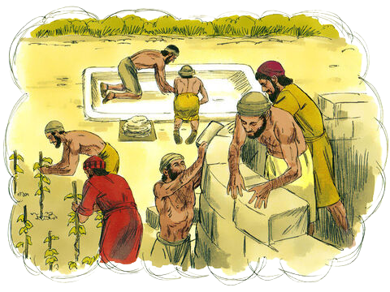

The Parable of the Tenants in the Vineyard
Matthew 21:33-43

Slide 4
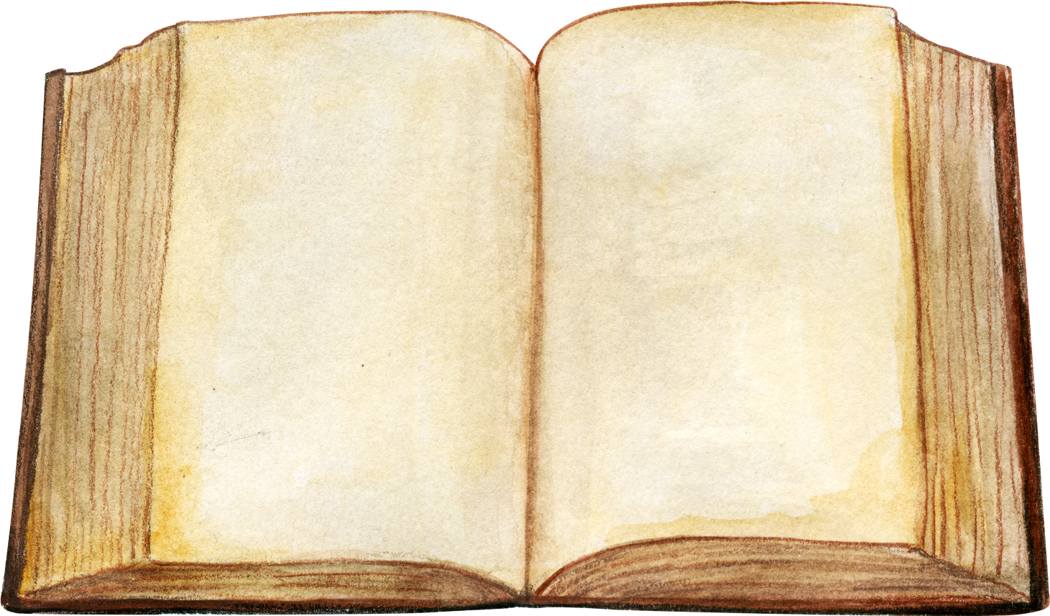
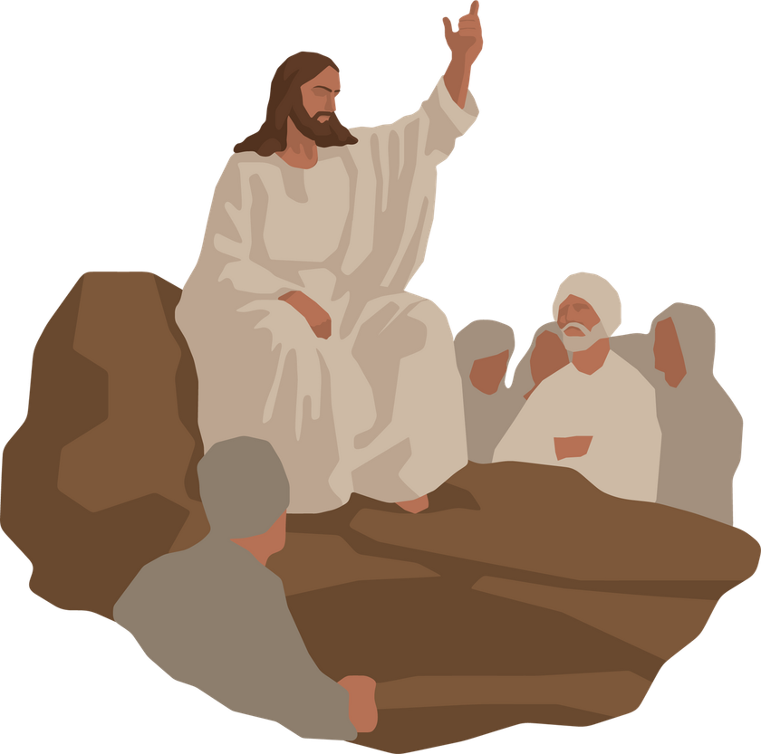
Leader:
A reading from the Holy Gospel according to Matthew.
All:
Glory to You, Oh Lord.

Slide 5
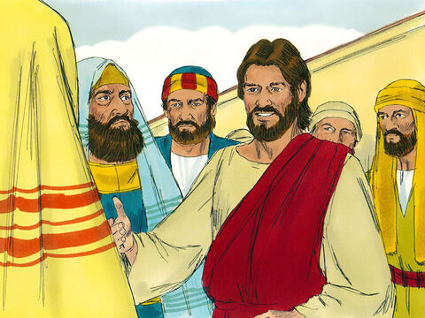
33
“Listen to another parable,” Jesus said. “There was once a landowner who planted a vineyard, put a fence around it, dug a hole for the wine press, and built a watchtower. Then he rented the vineyard to tenants and left home on a trip.

Slide 6
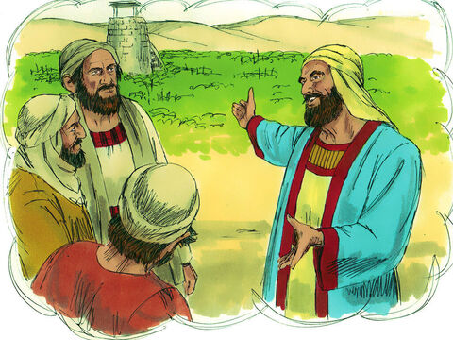
34
When the time came to gather the grapes, he sent his slaves to the tenants to receive his share of the harvest.

Slide 7
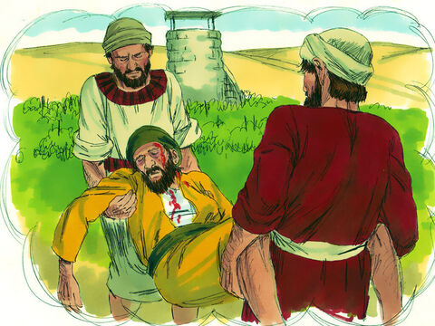
35
The tenants grabbed his slaves, beat one, killed another, and stoned another.

Slide 8
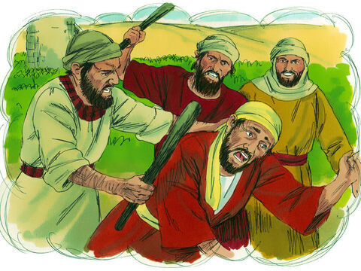
36
Again the man sent other slaves, more than the first time, and the tenants treated them the same way.

Slide 9
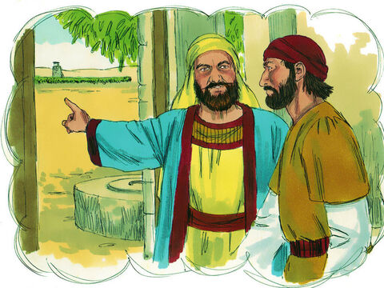
37
Last of all he sent his son to them. ‘Surely they will respect my son,’ he said.

Slide 10
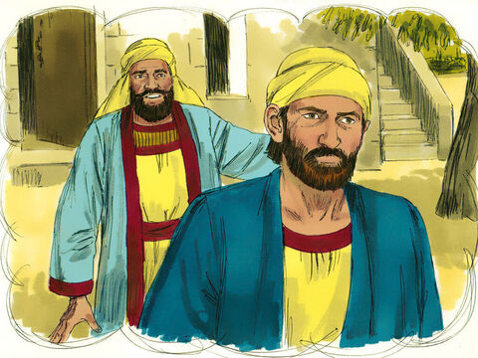
38
But when the tenants saw the son, they said to themselves, ‘This is the owner's son. Come on, let's kill him, and we will get his property!’

Slide 11
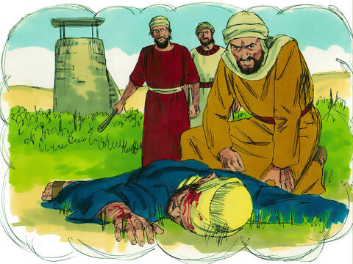
39
So they grabbed him, threw him out of the vineyard, and killed him.

Slide 12
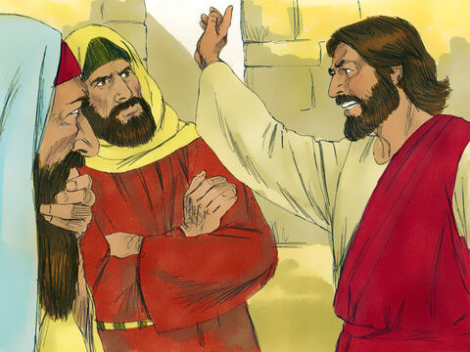
40
“Now, when the owner of the vineyard comes, what will he do to those tenants?” Jesus asked.

Slide 13
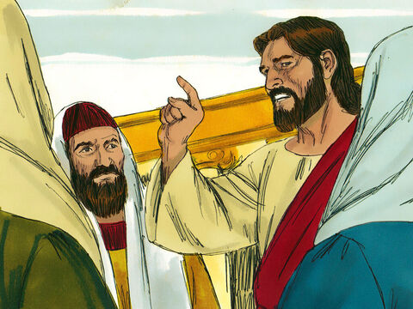
41
“He will certainly kill those evil men,” they answered, “and rent the vineyard out to other tenants, who will give him his share of the harvest at the right time.”

Slide 14
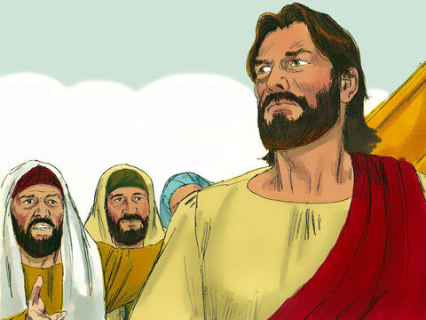
42
Jesus said to them, “Haven't you ever read what the Scriptures say?
‘The stone which the builders rejected as worthless
turned out to be the most important of all.
This was done by the Lord;
what a wonderful sight it is!’

Slide 15
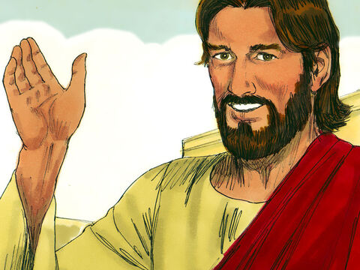
43
“And so I tell you,” added Jesus, “the Kingdom of God will be taken away from you and given to a people who will produce the proper fruits.”

Slide 16
Leader:
The Gospel of the Lord
All:
Praise to you, Lord Jesus Christ.

Slide 17

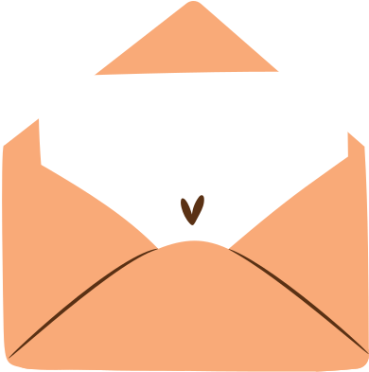
Gospel Message

Slide 18
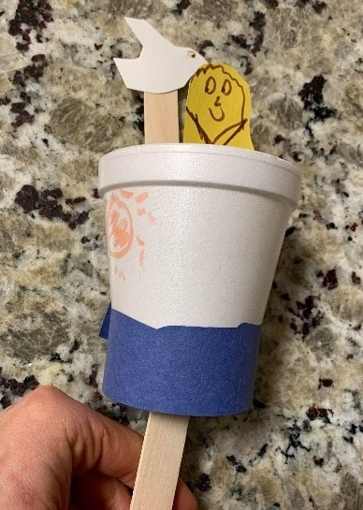
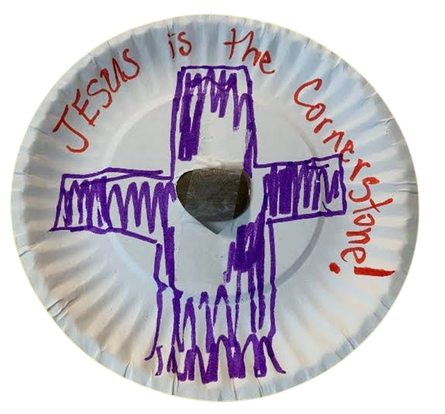
Activity:
Christ is our Cornerstone
Materials Needed:
  Paper plate
  Small decorative stone or real rock
  Markers, crayons, paint
  Scissors and clear tape
  Yarn (optional, for hanging)

Slide 19
Instructions:
• Draw a cross on the paper plate and write "Jesus is the Cornerstone."
• Carefully cut a small hole in the center of the plate.
• Push a small stone into the hole and tape it securely from the back.
• Punch a hole at the top and thread yarn through it to hang it up.

Slide 20


Dear God,
Thank you for sending your Son, Jesus, to be our cornerstone and the firm foundation of our lives. Help us to listen to your words, share your love, and be good helpers in your world. Thank you for always loving and protecting us.
In Jesus’s name,
Amen!
Closing Prayer

Slide 21
Live the Word Kids

