Slide 1



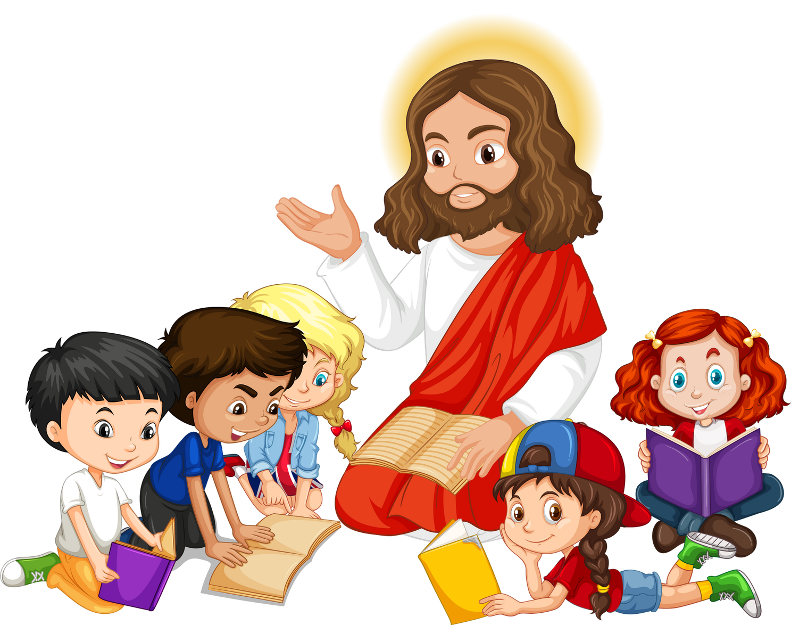
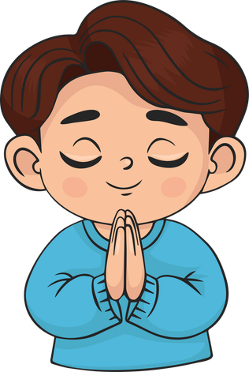
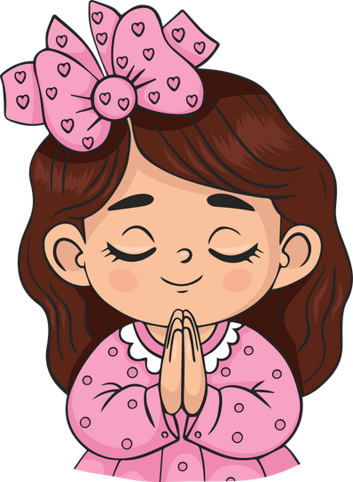
Live the Word Kids

Slide 2

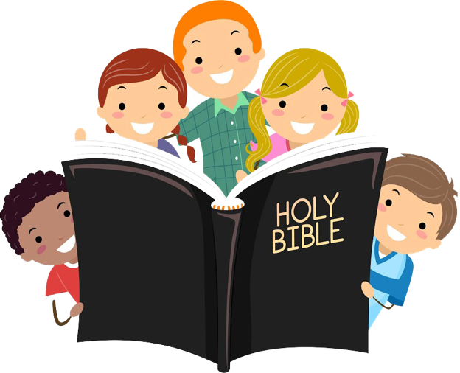



"Thirtieth Sunday in Ordinary Time"
October 25, 2026 | Cycle A Year 2

Slide 3
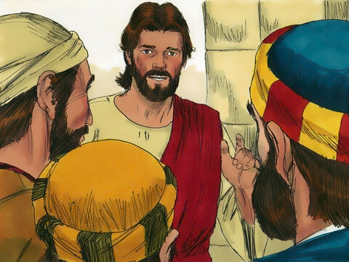

The Great Commandment
Matthew 22:34–40

Slide 4
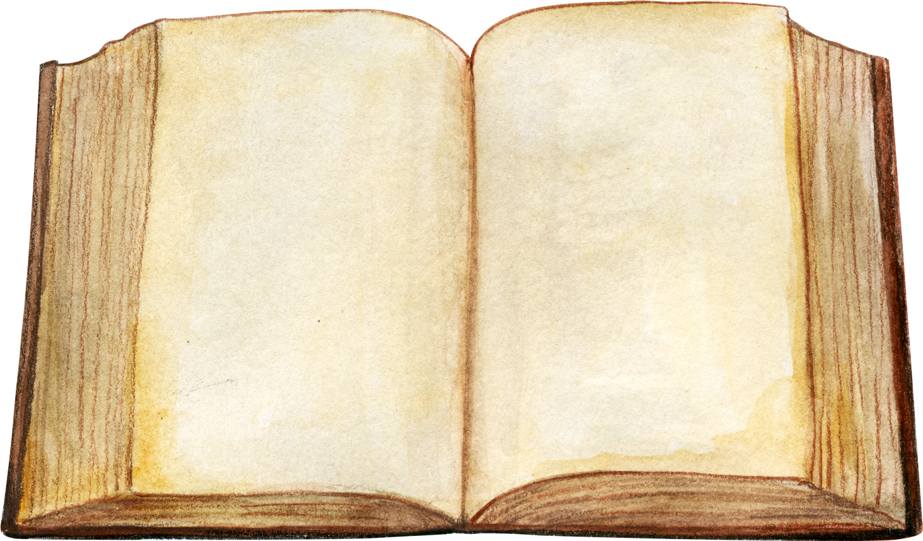
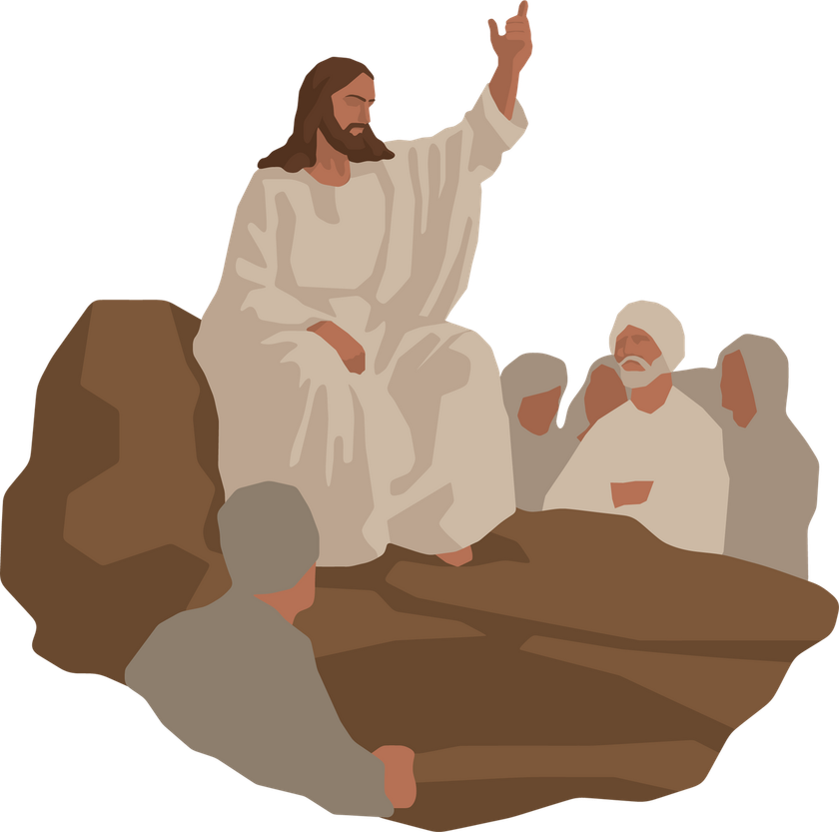
Leader:
A reading from the Holy Gospel according to Matthew.
All:
Glory to You, Oh Lord.

Slide 5
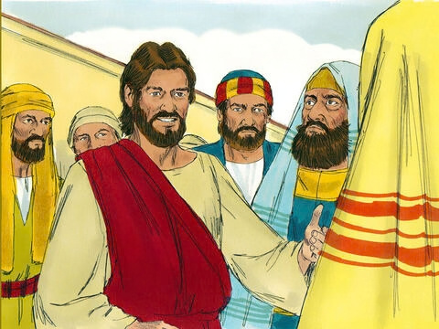
34
When the Pharisees heard that Jesus had silenced the Sadducees, they came together,

Slide 6
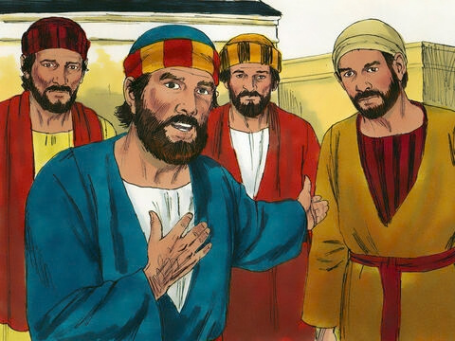
35
and one of them, a teacher of the Law, tried to trap him with a question.

Slide 7
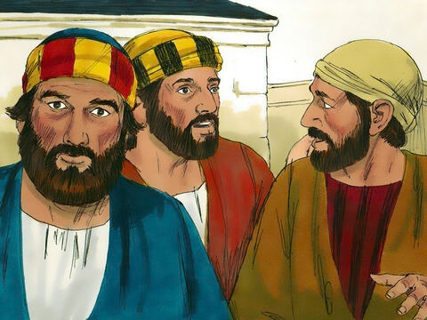
36
“Teacher,” he asked, “which is the greatest commandment in the Law?”

Slide 8
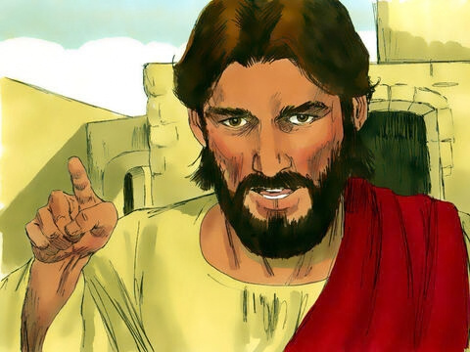
37
Jesus answered, “‘Love the Lord your God with all your heart, with all your soul, and with all your mind.’

Slide 9
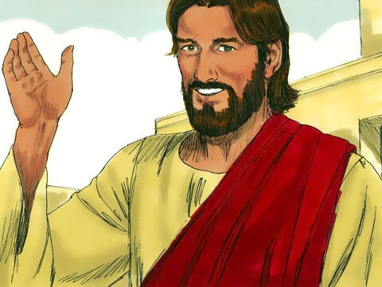
38
This is the greatest and the most important commandment.

Slide 10
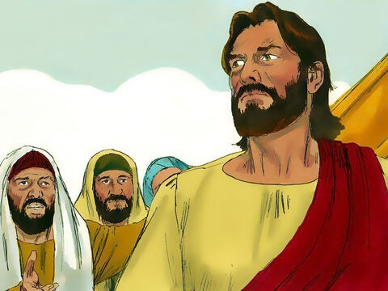
39
The second most important commandment is like it: ‘Love your neighbor as you love yourself.’

Slide 11
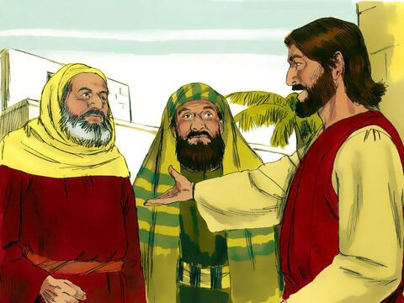
40
The whole Law of Moses and the teachings of the prophets depend on these two commandments.”

Slide 12
Leader:
The Gospel of the Lord
All:
Praise to you, Lord Jesus Christ.

Slide 13


Gospel Message

Slide 14
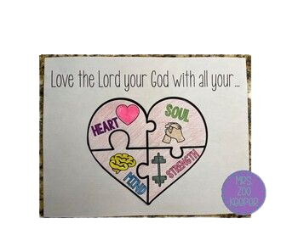
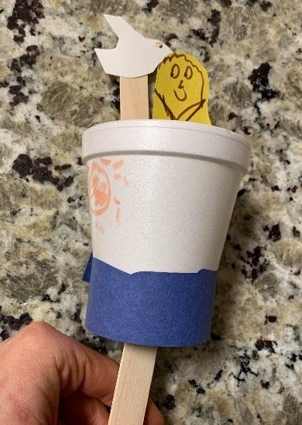
Activity:
The Greatest Commandment
Materials Needed:
  Paper
  Pencil
  Eraser
  Crayons or colored pencils
  Scissors
  Glue

Slide 15
Instructions:
  Use your pencil to draw a large heart on your paper.
  Draw lines inside the heart to make four sections. Label each section:
  Heart
  Soul
  Mind
  Strength
  Draw one way you can show your love for God using your heart, soul, mind, and strength.
  Use your crayons or colored pencils to make your artwork colorful and beautiful.

Slide 16


Dear God,
Thank You for teaching us to love God with all our heart, soul, mind, and strength. Help us to show our love for You by praying, obeying, helping others, and being kind.
Teach us to love our neighbors just as You love us.
May we always carry Your love in our hearts.
In Jesus’s name,
Amen!
Closing Prayer

Slide 17
Live the Word Kids

