Slide 1



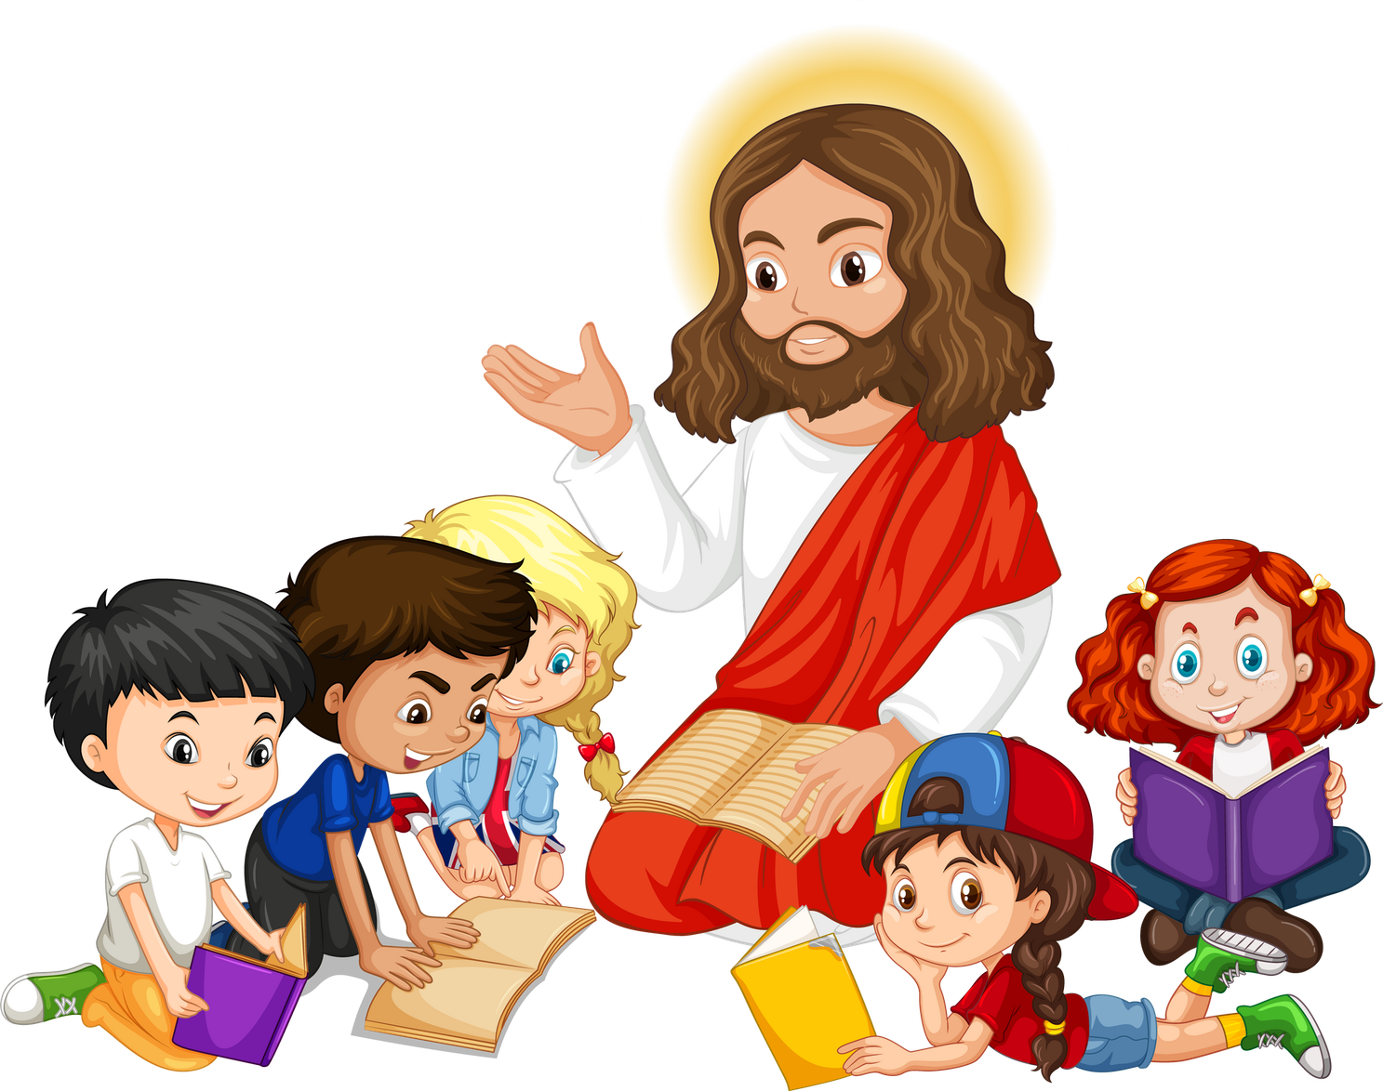
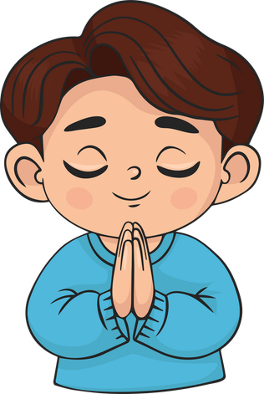

Live the Word Kids

Slide 2





"Twenty-Ninth Sunday in Ordinary Time"
October 18, 2026 | Cycle A Year 2

Slide 3
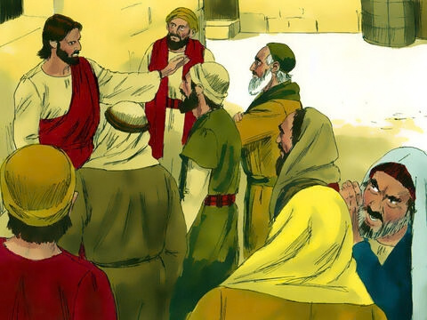

The Question about Paying Taxes
Matthew 22:15-21

Slide 4
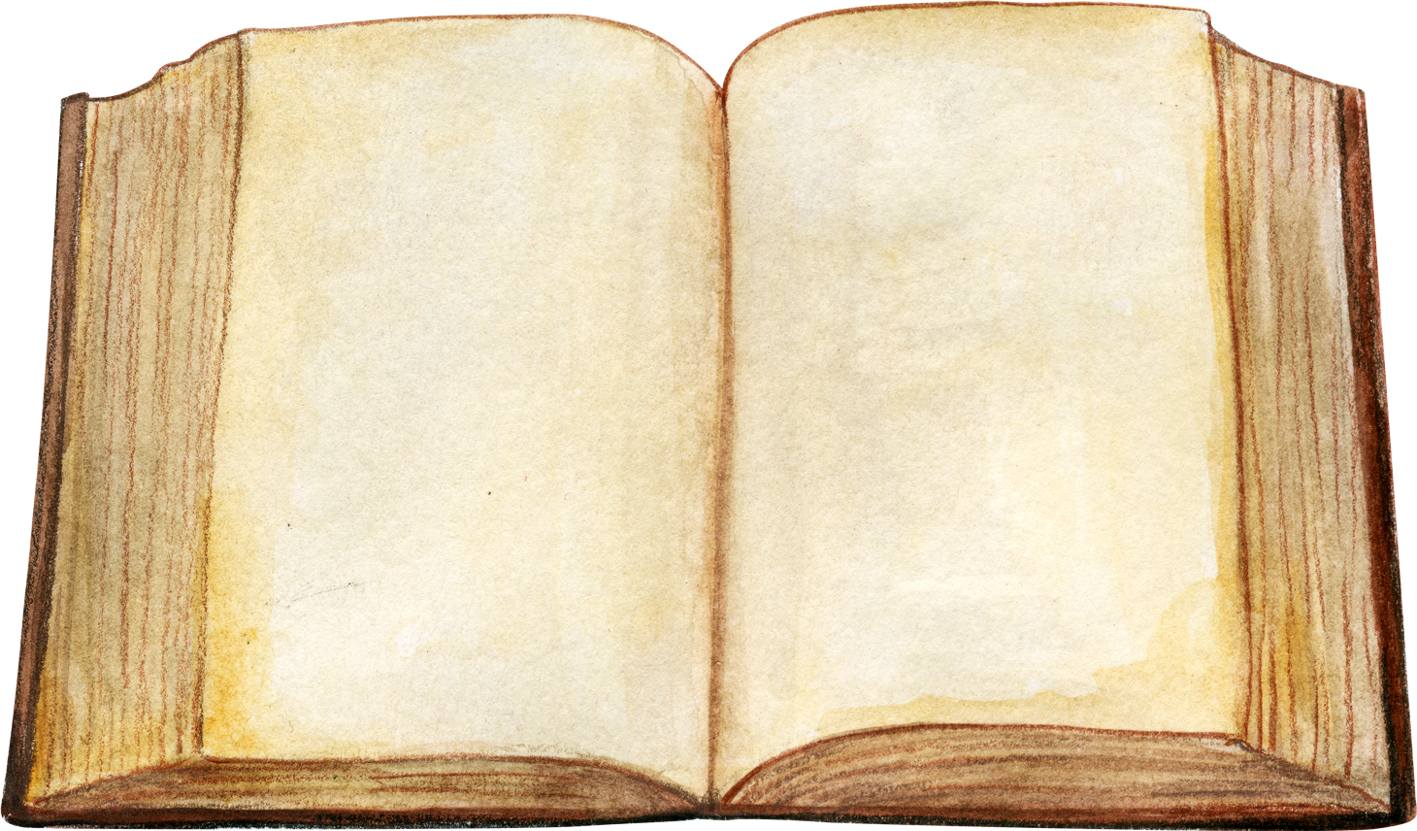
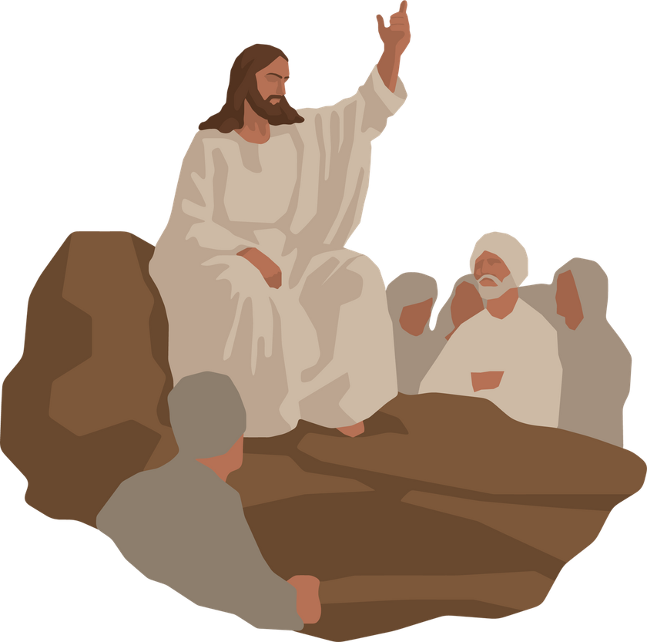
Leader:
A reading from the Holy Gospel according to Matthew.
All:
Glory to You, Oh Lord.

Slide 5
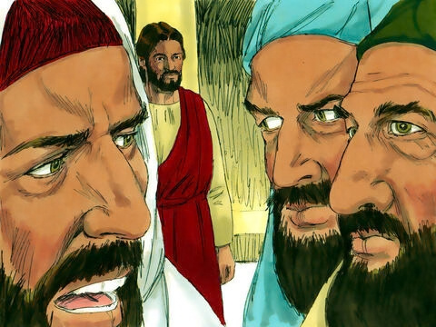
15
The Pharisees went off and made a plan to trap Jesus with questions.

Slide 6
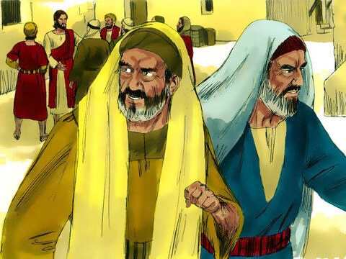
16
Then they sent to him some of their disciples and some members of Herod's party. “Teacher,” they said, “we know that you tell the truth. You teach the truth about God's will for people, without worrying about what others think, because you pay no attention to anyone's status.

Slide 7
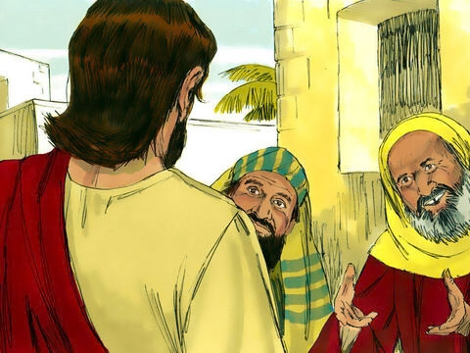
17
Tell us, then, what do you think? Is it against our Law to pay taxes to the Roman Emperor, or not?”

Slide 8
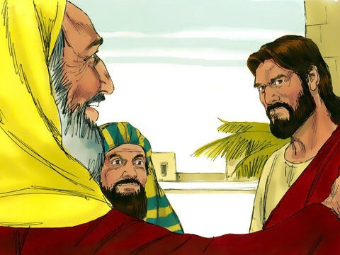
18
Jesus, however, was aware of their evil plan, and so he said, “You hypocrites! Why are you trying to trap me?

Slide 9
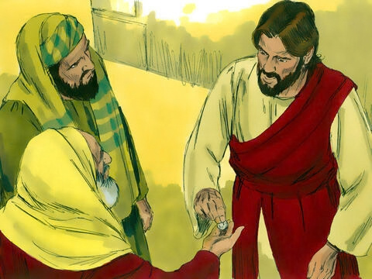
19
Show me the coin for paying the tax!”
They brought him the coin,

Slide 10
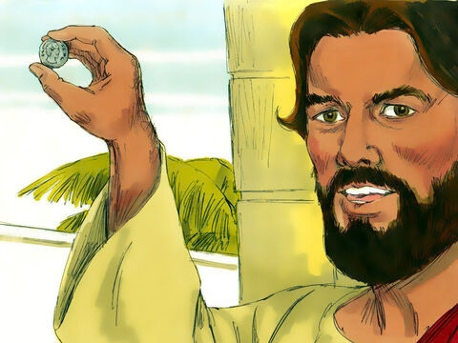
20
and he asked them, “Whose face and name are these?”

Slide 11
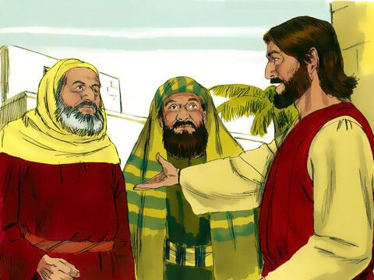
21
“The Emperor's,” they answered.

Slide 12
Leader:
The Gospel of the Lord
All:
Praise to you, Lord Jesus Christ.

Slide 13


Gospel Message

Slide 14
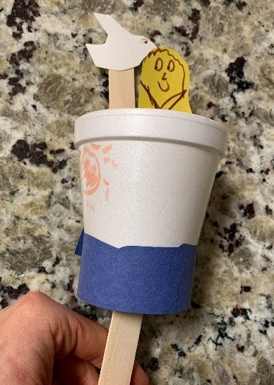
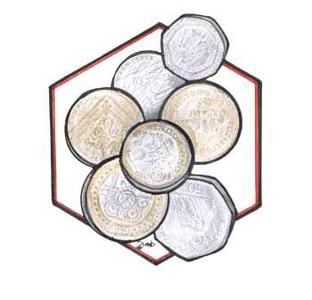
Activity:
The Coins that Belong to God
Materials Needed:
  Paper
  Real coins
  Pencil
  Scissors
  Glue
  Crayons or colored pencils

Slide 15
Instructions:
1. Draw a big hexagon on your paper.
2. Place a real coin under the paper. Gently rub the side of your pencil over the paper until the shape and design of the coin appear.
3. Repeat the coin rubbing several times to create a pile of coins.
4. Carefully cut around each coin rubbing.
5. Arrange the paper coins inside the hexagon. Overlap some coins to make them look like a pile, then glue them in place.

Slide 16


Dear God,
Thank You for teaching us through Your Word. Help us to listen to Your invitation and always choose to follow You. Teach us to give to God what belongs to God and to do what is right and good.
Help us to have thankful hearts, obey You, and share Your love with others.
In Jesus’s name,
Amen!
Closing Prayer

Slide 17
Live the Word Kids

