Slide 1



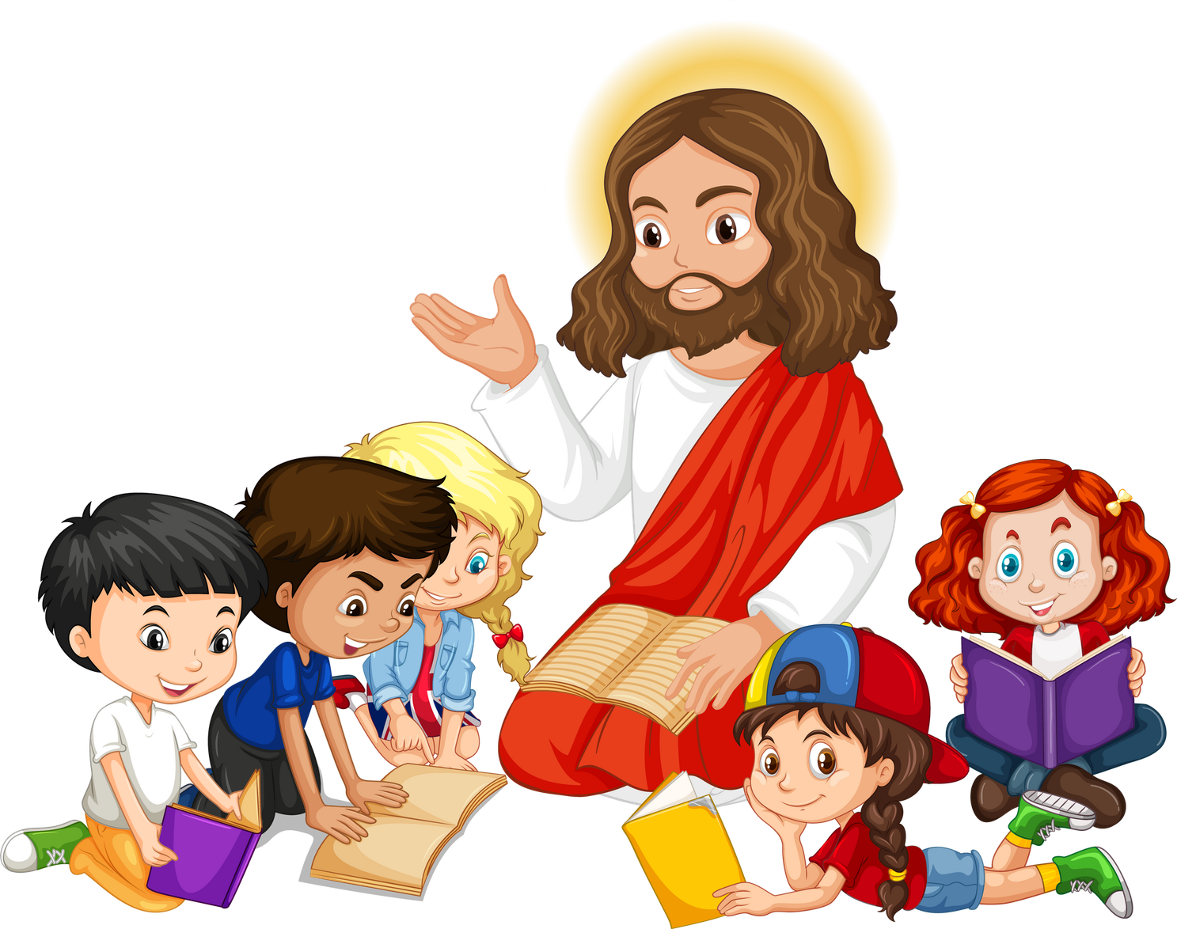


Live the Word Kids

Slide 2





"Twenty-Eight Sunday in Ordinary Time"
October 11, 2026 | Cycle A Year 2

Slide 3
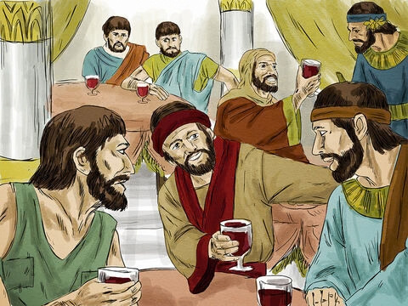

The Parable of the Wedding Feast
Matthew 22:1-14

Slide 4

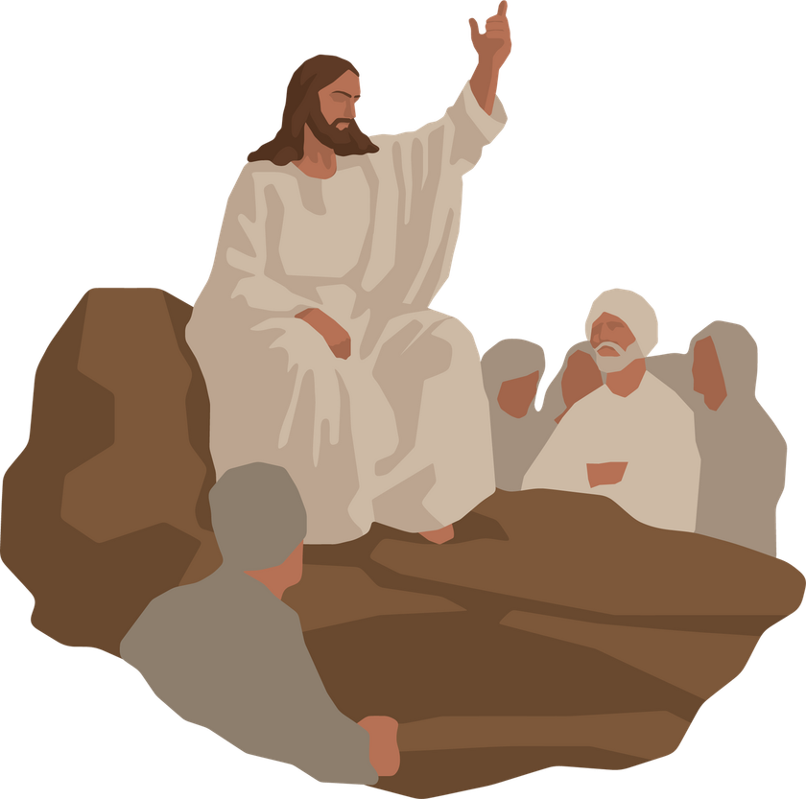
Leader:
A reading from the Holy Gospel according to Matthew.
All:
Glory to You, Oh Lord.

Slide 5
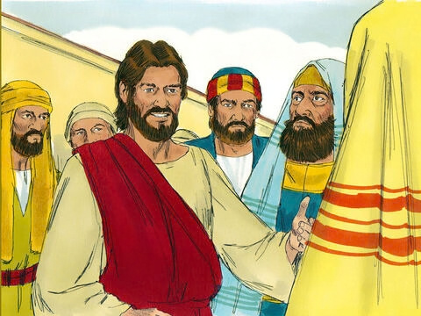
1
Jesus again used parables in talking to the people.

Slide 6
2
“The Kingdom of heaven is like this. Once there was a king who prepared a wedding feast for his son.

Slide 7
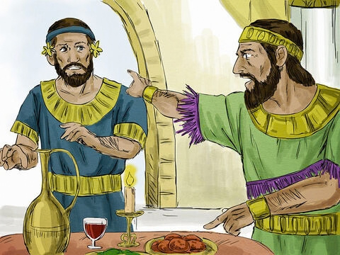
3
He sent his servants to tell the invited guests to come to the feast, but they did not want to come.

Slide 8
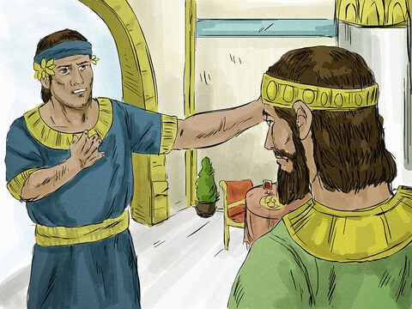
4
So he sent other servants with this message for the guests: ‘My feast is ready now; my steers and prize calves have been butchered, and everything is ready. Come to the wedding feast!’

Slide 9
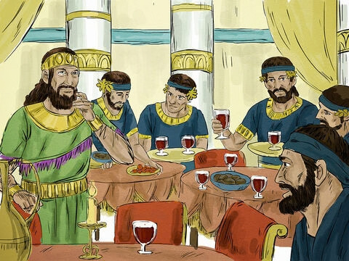
5
But the invited guests paid no attention and went about their business: one went to his farm, another to his store,

Slide 10
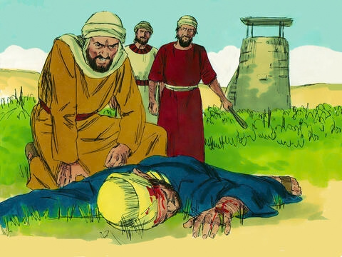
6
while others grabbed the servants, beat them, and killed them.

Slide 11
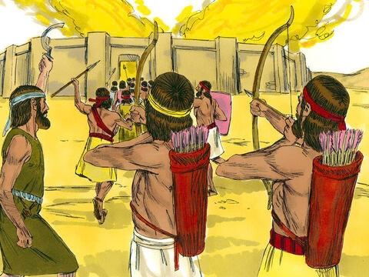
7
The king was very angry; so he sent his soldiers, who killed those murderers and burned down their city.

Slide 12
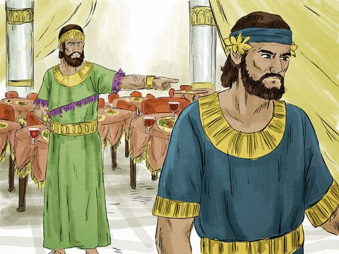
8
Then he called his servants and said to them, ‘My wedding feast is ready, but the people I invited did not deserve it.

Slide 13
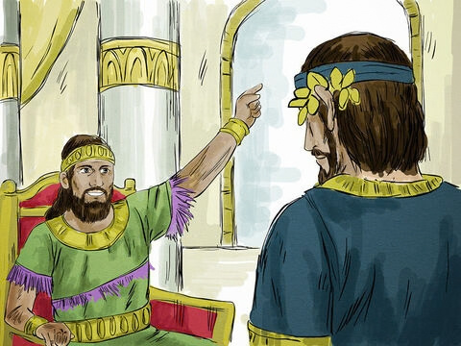
9
Now go to the main streets and invite to the feast as many people as you find.’

Slide 14
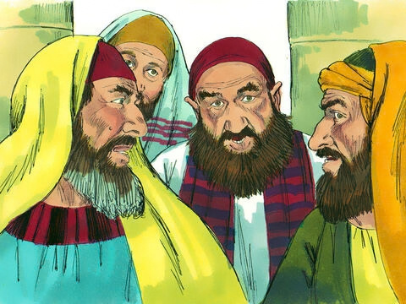
10
So the servants went out into the streets and gathered all the people they could find, good and bad alike; and the wedding hall was filled with people.

Slide 15
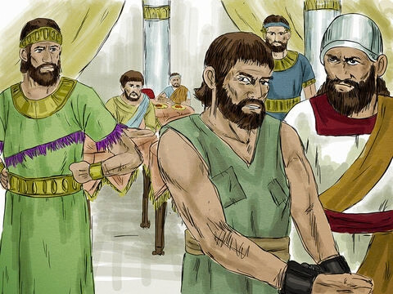
11
“The king went in to look at the guests and saw a man who was not wearing wedding clothes

Slide 16
12
‘Friend, how did you get in here without wedding clothes?’ the king asked him. But the man said nothing.

Slide 17
13
Then the king told the servants, ‘Tie him up hand and foot, and throw him outside in the dark. There he will cry and gnash his teeth.’”

Slide 18
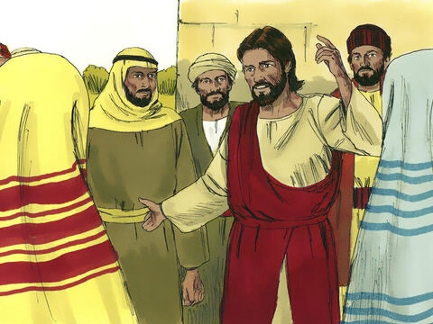
14
And Jesus concluded, “Many are invited, but few are chosen.”

Slide 19
Leader:
The Gospel of the Lord
All:
Praise to you, Lord Jesus Christ.

Slide 20


Gospel Message

Slide 21
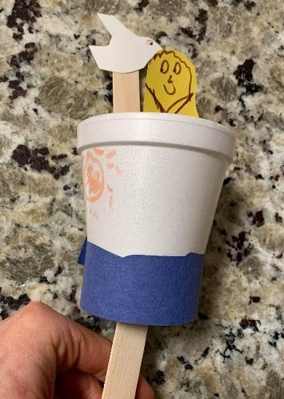
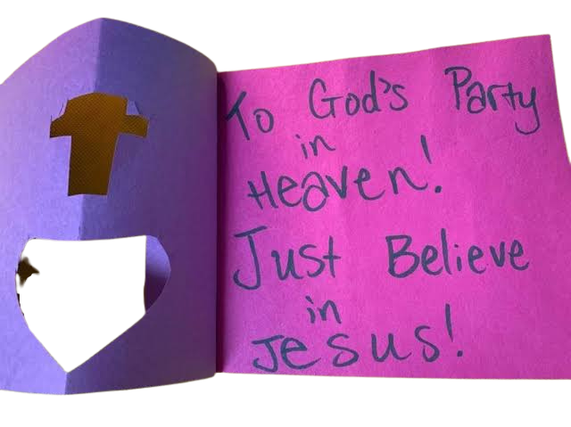
Activity:
You are Invited!
Materials Needed:
  Colored paper
  Scissors
  Glue
  Pencil, crayons/markers
  Optional: glitter, stickers, or decorations

Slide 22
Instructions:
1. Fold a piece of colored paper in half like a card.
2. Cut out a small cross from a paper and glue it on the front of the card.
3. Add hearts, stars, flowers, or other decorations to make your invitation beautiful.
4. Inside the card, write:
“Come to God’s Party in Heaven! Just Believe in Jesus!”

Slide 23


Dear God,
Thank You for inviting us to be part of Your Kingdom.
Help us to always say “Yes” to You.
Teach us to love You, follow You, and be kind to others.
Help us to have a heart that is always ready for You.
Thank You for loving us, Jesus.
In Jesus’s name,
Amen!
Closing Prayer

Slide 24
Live the Word Kids

