Slide 1




Live the Word Kids

Slide 2

Solemnity of the Most Holy Trinity
May 31, 2026 | Cycle A Year 2

Slide 3
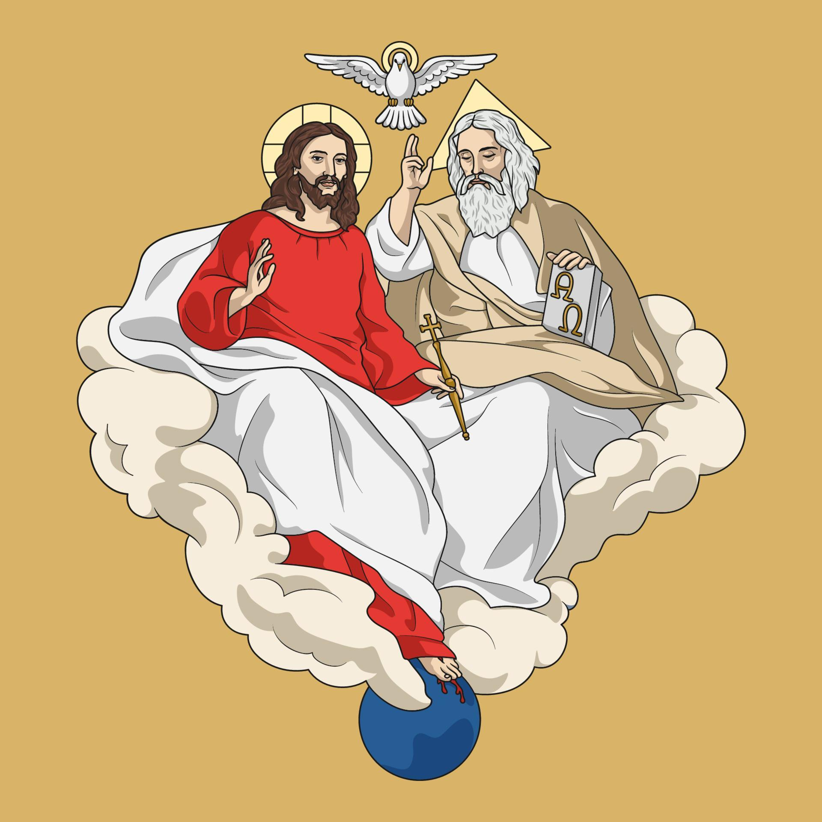
God’s Love and the Gift of Salvation
John 3:16-18

Slide 4


Leader:
A reading from the Holy Gospel according to John.
All:
Glory to You, Oh Lord.

Slide 5

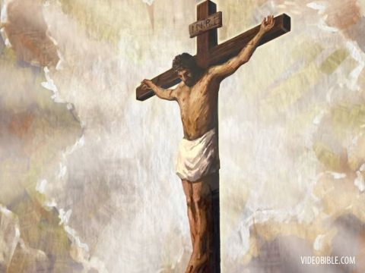
16
For God loved the world so much that he gave his only Son, so that everyone who believes in him may not die but have eternal life.

Slide 6
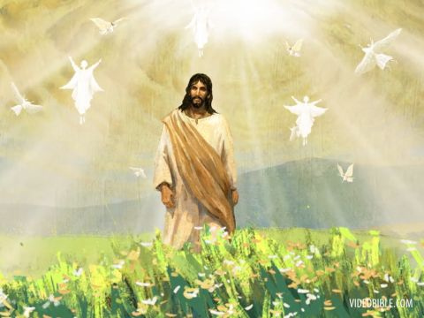
17
For God did not send his Son into the world to be its judge, but to be its savior.

Slide 7
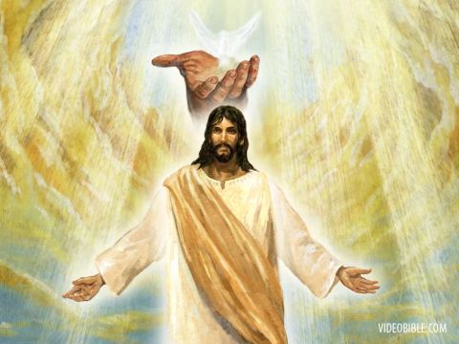
18
Those who believe in the Son are not judged; but those who do not believe have already been judged, because they have not believed in God's only Son.

Slide 8
Gospel Message

Slide 9
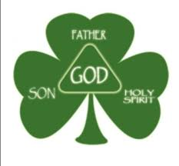
Activity:
Holy Trinity Shamrock
Materials Needed:
  Green Paper
  Pencil
  Scissors

Slide 10
Instructions:
Cut a shamrock shape from green construction paper. Make sure it has three leaves and a stem.
Write the words “Father” at the top leaf, “Son” at the left leaf, “Holy Spirit” at the right, and “God” at the center.

Slide 11
Closing Prayer
Dear Holy Trinity
Father, Son, and Holy Spirit,
thank You for loving us and giving us Jesus. Help us to believe in Him, follow His ways, and share Your love with others every day.
Amen.

Slide 12
Live the Word Kids

