Slide 1




Live the Word Kids

Slide 2

5th Sunday of Easter
May 3, 2026 | Cycle A Year 2

Slide 3
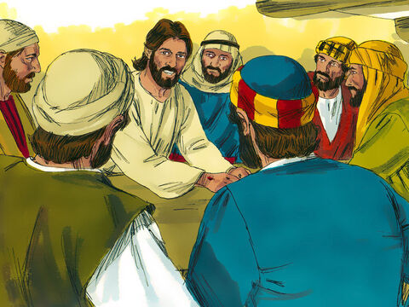
Jesus the Way to the Father
John 14:1-12

Slide 4


Leader:
A reading from the Holy Gospel according to John.
All:
Glory to You, Oh Lord.

Slide 5

1
“Do not be worried and upset,” Jesus told them. “Believe in God and believe also in me.

Slide 6
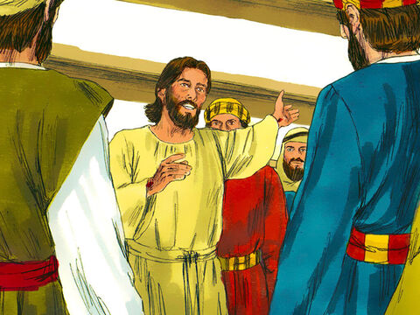
2
There are many rooms in my Father's house, and I am going to prepare a place for you. I would not tell you this if it were not so.

Slide 7
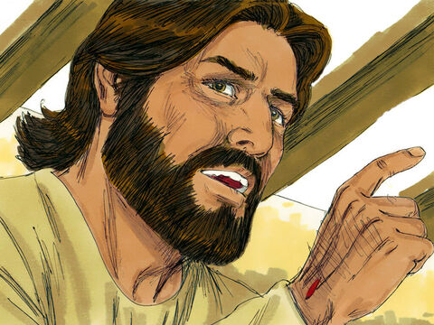
3
And after I go and prepare a place for you, I will come back and take you to myself, so that you will be where I am.

Slide 8
4
You know the way that leads to the place where I am going.”

Slide 9
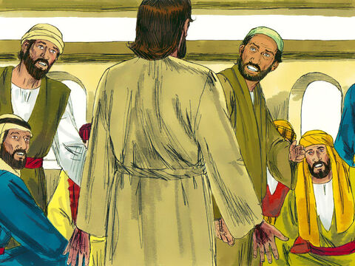
5
Thomas said to him, “Lord, we do not know where you are going; so how can we know the way to get there?”

Slide 10
6
Jesus answered him, “I am the way, the truth, and the life; no one goes to the Father except by me.

Slide 11
7
Now that you have known me,” he said to them, “you will know my Father also, and from now on you do know him and you have seen him.”

Slide 12
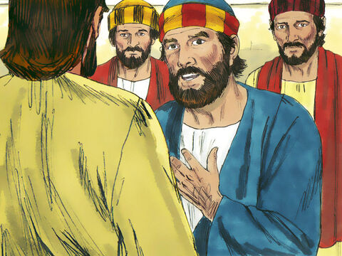
8
Philip said to him, “Lord, show us the Father; that is all we need.”

Slide 13
9
Jesus answered, “For a long time I have been with you all; yet you do not know me, Philip? Whoever has seen me has seen the Father. Why, then, do you say, ‘Show us the Father’?

Slide 14
10
Do you not believe, Philip, that I am in the Father and the Father is in me? The words that I have spoken to you,” Jesus said to his disciples, “do not come from me. The Father, who remains in me, does his own work.

Slide 15
11
Believe me when I say that I am in the Father and the Father is in me. If not, believe because of the things I do.

Slide 16
12
I am telling you the truth: those who believe in me will do what I do—yes, they will do even greater things, because I am going to the Father.

Slide 17
Gospel Message

Slide 18
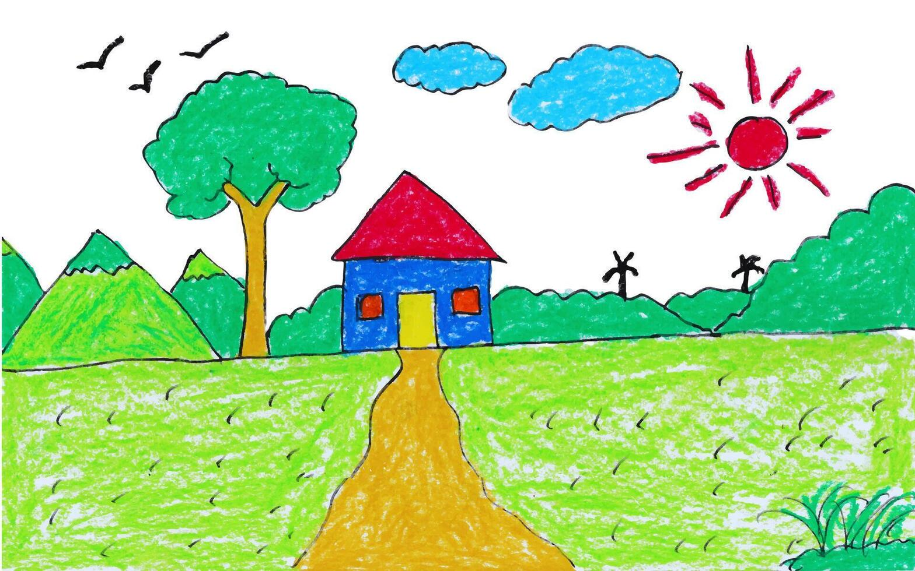
Activity:
“Jesus is the Way” Craft
Materials Needed:
  Colored Paper
  Bond Paper
  Markers and Coloring materials
  Tape/Glue

Slide 19
Instructions:
Draw a house on one side of the paper.
Cut out small footprints or stepping stones from the colored paper.
Write words like “faith,” “love,” “trust,” on each step.
Label the path: “Jesus is the Way”

Slide 20
Dear Jesus,
Thank You for loving us and taking care of us every day. Thank You for reminding us not to be afraid or worried. Help us to trust You with all our hearts. Thank You for being the Way, the Truth, and the Life. Guide us to follow You and to do what is right. Thank You for preparing a special place for us with You. Help us to remember that You are always with us.
In Your name we pray,
Amen.
Closing Prayer

Slide 21
Live the Word Kids

