Slide 1




Live the Word Kids

Slide 2

Pentecost Sunday
May 24, 2026 | Cycle A Year 2

Slide 3
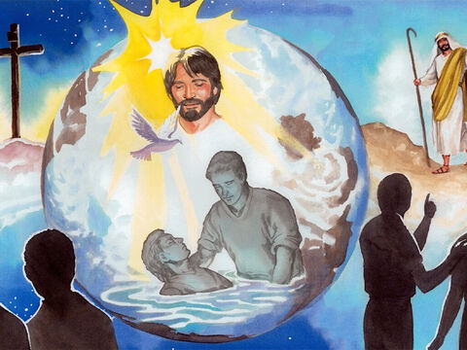
Jesus Appears to His Disciples
John 20:19-23

Slide 4


Leader:
A reading from the Holy Gospel according to John.
All:
Glory to You, Oh Lord.

Slide 5

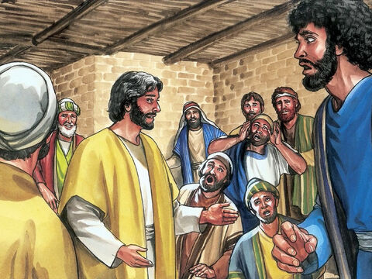
19
It was late that Sunday evening, and the disciples were gathered together behind locked doors, because they were afraid of the Jewish authorities. Then Jesus came and stood among them. “Peace be with you,” he said.

Slide 6
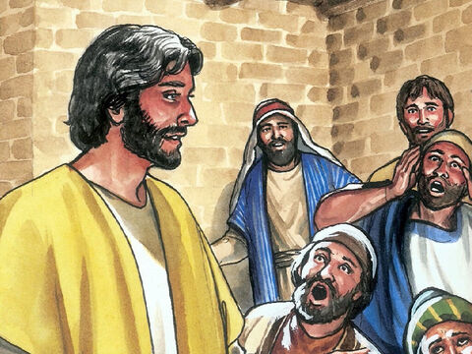
20
After saying this, he showed them his hands and his side. The disciples were filled with joy at seeing the Lord.

Slide 7
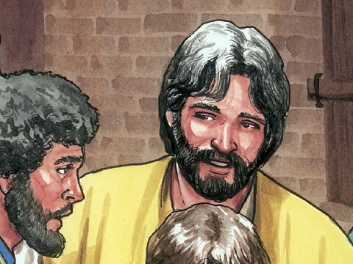
21
Jesus said to them again, “Peace be with you. As the Father sent me, so I send you.”

Slide 8
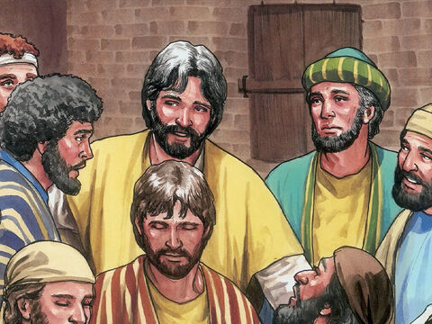
22
Then he breathed on them and said, “Receive the Holy Spirit.

Slide 9
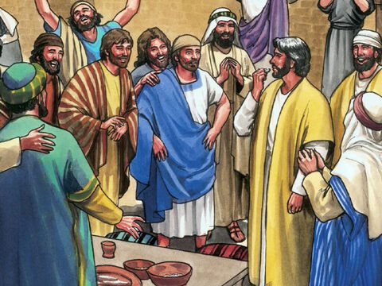
23
If you forgive people's sins, they are forgiven; if you do not forgive them, they are not forgiven.”

Slide 10
Gospel Message

Slide 11
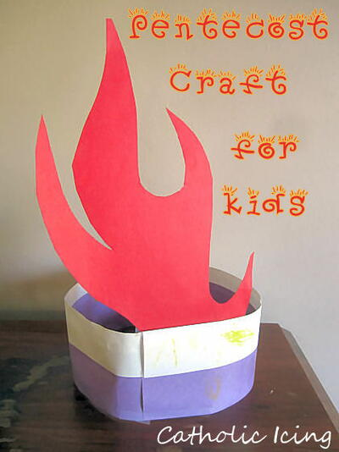
Activity:
Tongues of Fire Craft
Materials Needed:
  Coloring materials
  Bond Paper
  Pencil
  Scissors
  Glue

Slide 12
Instructions:
Make the base, fold the paper and make it round to form a crown like shape.
Draw a flame shape, cut it out, then color it.
Glue the flame inside the base.

Slide 13
Dear God,
Thank You for being with us today. Thank You for the gift of the Holy Spirit, who gives us peace, courage, and love. Help us to be kind to others, to forgive like Jesus taught us, and to share Your peace wherever we go. Fill our hearts with Your light, so we can follow You every day.
We love You, Lord.
Amen.
Closing Prayer

Slide 14
Live the Word Kids

