Slide 1




Live the Word Kids

Slide 2

The Ascension of the Lord
May 17, 2026 | Cycle A Year 2

Slide 3
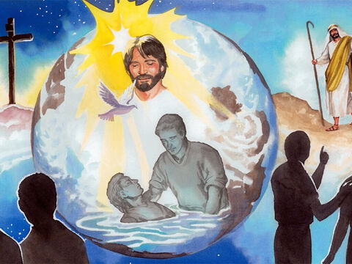
Jesus Appears to His Disciples
Matthew 28:16-20

Slide 4


Leader:
A reading from the Holy Gospel according to Mathew.
All:
Glory to You, Oh Lord.

Slide 5

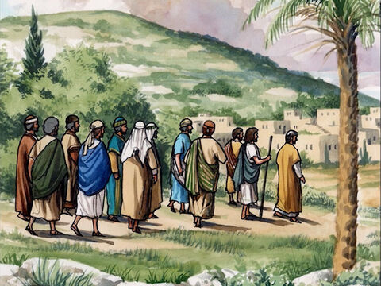
16
The eleven disciples went to the hill in Galilee where Jesus had told them to go.

Slide 6
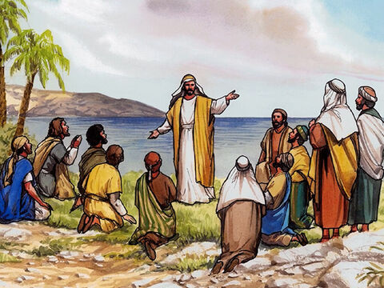
17
When they saw him, they worshiped him, even though some of them doubted.

Slide 7
18
Jesus drew near and said to them, “I have been given all authority in heaven and on earth.

Slide 8
19
Go, then, to all peoples everywhere and make them my disciples: baptize them in the name of the Father, the Son, and the Holy Spirit,

Slide 9
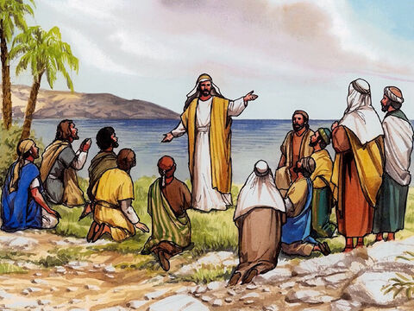
20
and teach them to obey everything I have commanded you. And I will be with you always, to the end of the age.”

Slide 10
Gospel Message

Slide 11
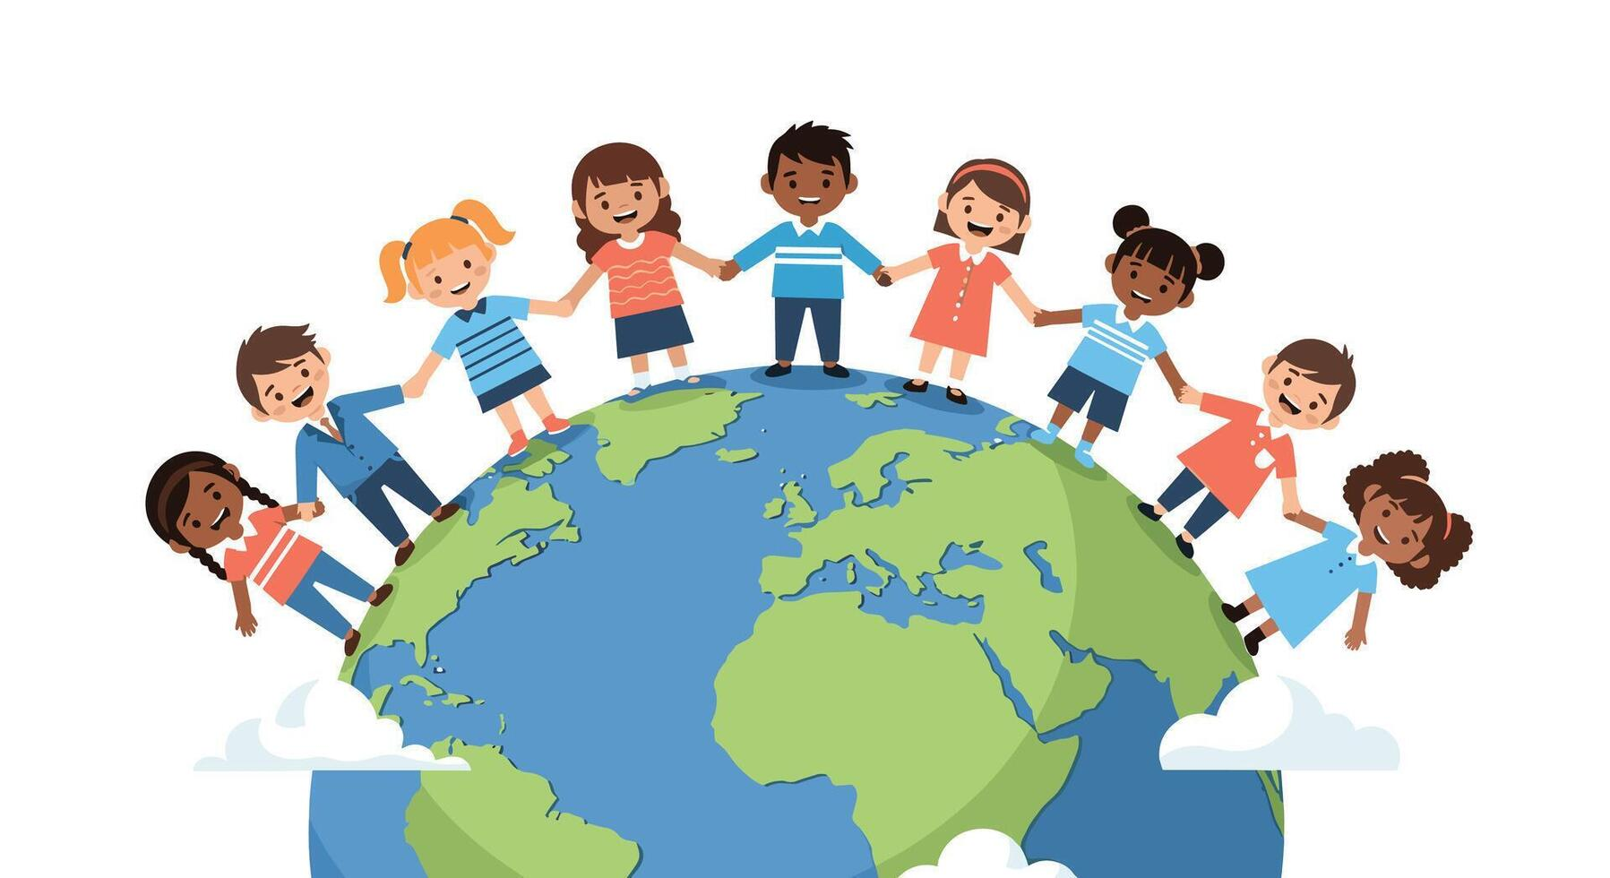
Activity:
“Go and Make Disciples” World Craft
Materials Needed:
  Coloring materials
  Bond Paper
  Pencil

Slide 12
Instructions:
Draw the World.
Add People from All Nations outside the World.
At the center write “Go and make disciples of all nations”.

Slide 13
Dear Jesus,
Thank You for loving us and for being with us always. Thank You for teaching us to go and share Your love with others. Help us to be kind, helpful, and brave, so we can show Your love to our family, friends, and everyone we meet.
Guide us every day, and remind us that we are never alone because You are always with us.
We love You, Lord.
Amen.
Closing Prayer

Slide 14
Live the Word Kids

