Slide 1




Live the Word Kids

Slide 2

6th Sunday of Easter
May 10, 2026 | Cycle A Year 2

Slide 3
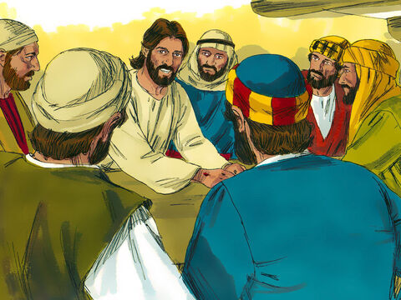
The Promise of the Holy Spirit
John 14:15-21

Slide 4


Leader:
A reading from the Holy Gospel according to John.
All:
Glory to You, Oh Lord.

Slide 5

15
“If you love me, you will obey my commandments.

Slide 6
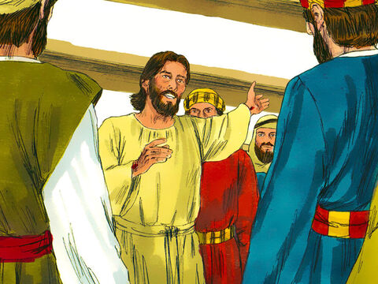
16
I will ask the Father, and he will give you another Helper, who will stay with you forever.

Slide 7
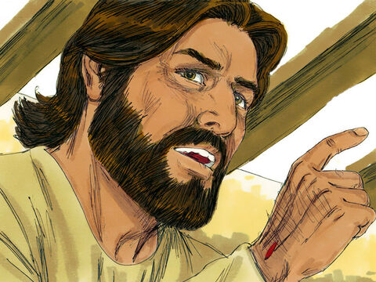
17
He is the Spirit, who reveals the truth about God. The world cannot receive him, because it cannot see him or know him. But you know him, because he remains with you and is in you.

Slide 8
18
“When I go, you will not be left all alone; I will come back to you.

Slide 9
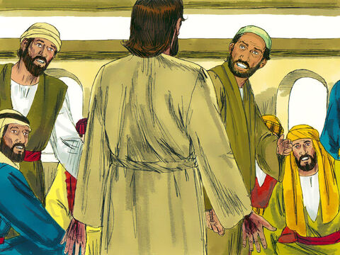
19
In a little while the world will see me no more, but you will see me; and because I live, you also will live.

Slide 10
20
When that day comes, you will know that I am in my Father and that you are in me, just as I am in you.

Slide 11
21
“Those who accept my commandments and obey them are the ones who love me. My Father will love those who love me; I too will love them and reveal myself to them.”

Slide 12
Gospel Message

Slide 13
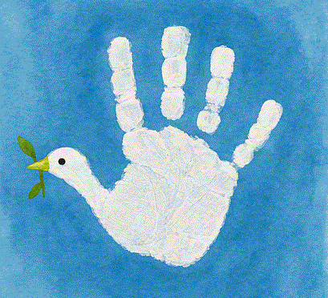
Activity:
Holy Spirit Helper Dove
Materials Needed:
  Coloring materials
  Bond Paper
  Pencil

Slide 14
Instructions:
Trace your hand to make a dove.
Draw a beak and eye for the dove on the thumb part.
Write: “The Holy Spirit helps me” in the middle of your hand.

Slide 15
Dear Jesus,
Thank You for loving us so much. Thank You for teaching us how to love others and obey You. Help us remember Your words and follow Your ways every day. Thank You for sending the Holy Spirit to guide us and help us. Remind us that we are never alone because You are always with us. Teach us to be kind, loving, and faithful, just like You. We love You, Lord.
In Jesus’ name we pray,
Amen.
Closing Prayer

Slide 16
Live the Word Kids

