Slide 1






Live the Word Kids

Slide 2
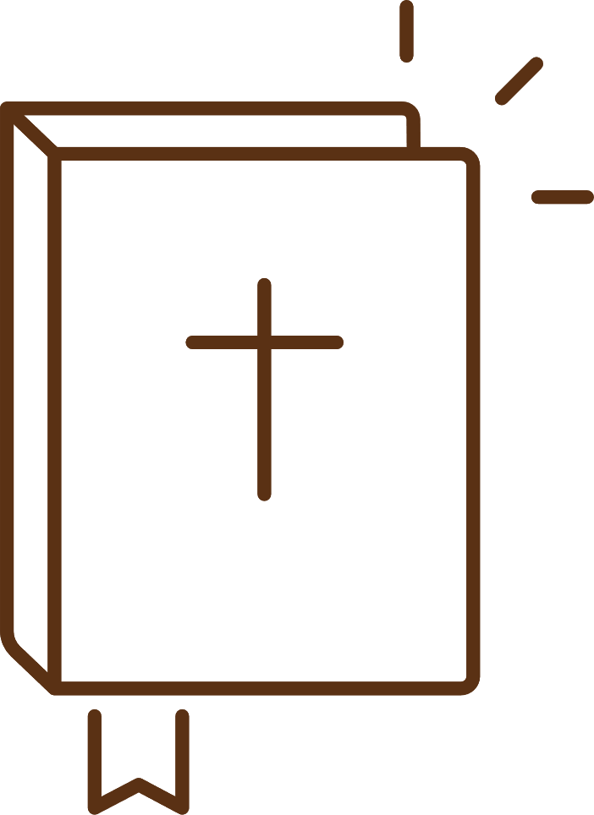
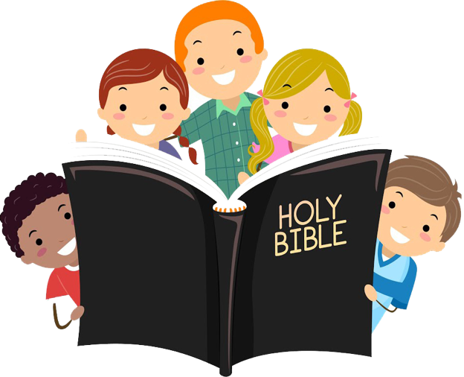



3rd Sunday of Lent
March 8, 2026 | Cycle A Year 2

Slide 3
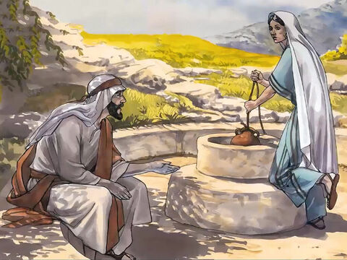

Jesus and the Samaritan Woman
John 4:5-15, 19b-26, 39a, 40-42

Slide 4


Leader:
A reading from the Holy Gospel according to John.
All:
Glory to You, Oh Lord.

Slide 5

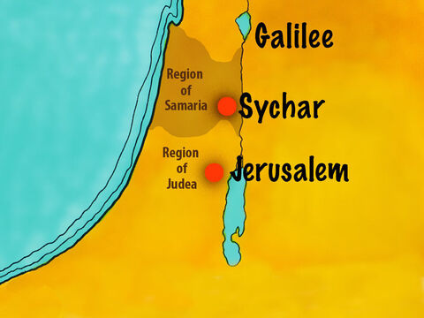
5
In Samaria he came to a town named Sychar, which was not far from the field that Jacob had given to his son Joseph.

Slide 6
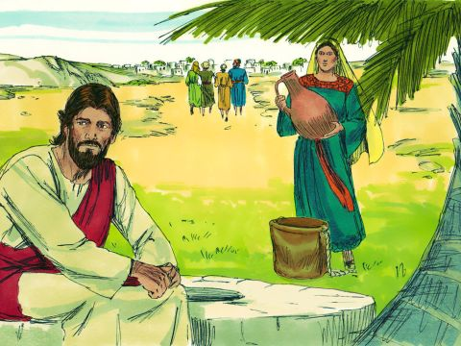
6
Jacob's well was there, and Jesus, tired out by the trip, sat down by the well. It was about noon.

Slide 7
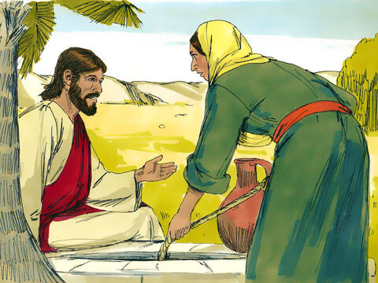
7
A Samaritan woman came to draw some water, and Jesus said to her, “Give me a drink of water.”

Slide 8
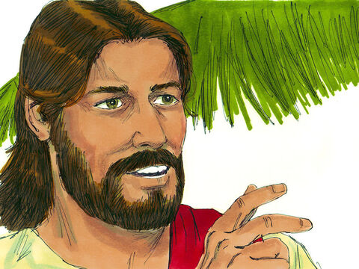
8
His disciples had gone into town to buy food.

Slide 9
9
The woman answered, “You are a Jew, and I am a Samaritan—so how can you ask me for a drink?”

Slide 10
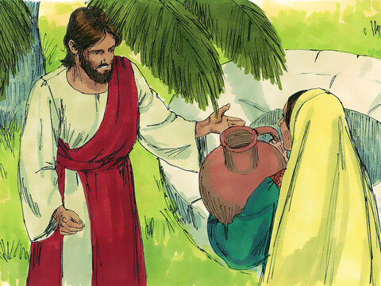
10
Jesus answered, “If you only knew what God gives and who it is that is asking you for a drink, you would ask him, and he would give you life-giving water.”

Slide 11
11
“Sir,” the woman said, “you don't have a bucket, and the well is deep. Where would you get that life-giving water?

Slide 12
12
It was our ancestor Jacob who gave us this well; he and his children and his flocks all drank from it. You don't claim to be greater than Jacob, do you?”

Slide 13
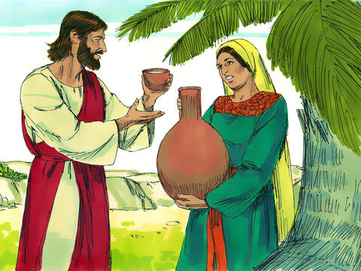
13
Jesus answered, “Those who drink this water will get thirsty again,

Slide 14
14
but those who drink the water that I will give them will never be thirsty again. The water that I will give them will become in them a spring which will provide them with life-giving water and give them eternal life.”

Slide 15
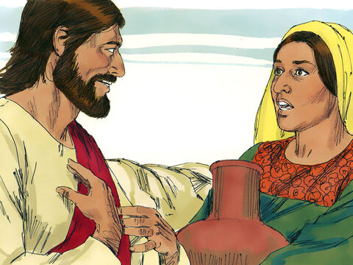
15
“Sir,” the woman said, “give me that water! Then I will never be thirsty again, nor will I have to come here to draw water.”

Slide 16
19b
the woman said.

Slide 17
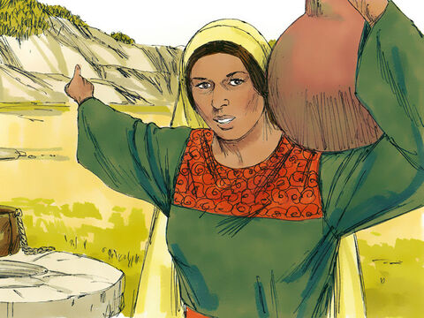
20
“My Samaritan ancestors worshiped God on this mountain, but you Jews say that Jerusalem is the place where we should worship God.”

Slide 18
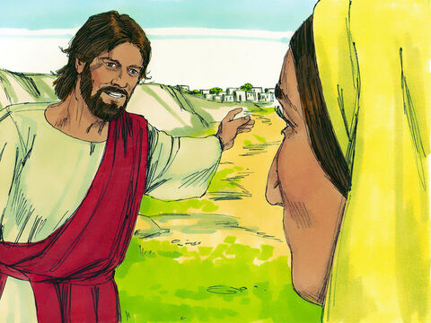
21
Jesus said to her, “Believe me, woman, the time will come when people will not worship the Father either on this mountain or in Jerusalem.

Slide 19
22
You Samaritans do not really know whom you worship; but we Jews know whom we worship, because it is from the Jews that salvation comes.

Slide 20
23
But the time is coming and is already here, when by the power of God's Spirit people will worship the Father as he really is, offering him the true worship that he wants.

Slide 21
24
God is Spirit, and only by the power of his Spirit can people worship him as he really is.”

Slide 22
25
The woman said to him, “I know that the Messiah will come, and when he comes, he will tell us everything.”

Slide 23
26
Jesus answered, “I am he, I who am talking with you.”

Slide 24
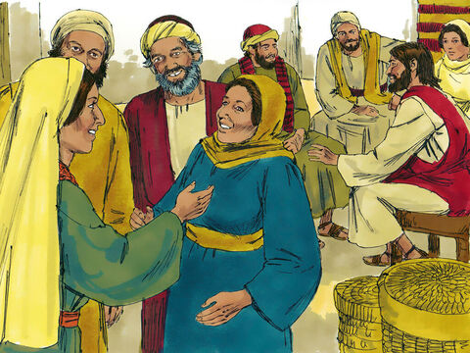
39a
Many of the Samaritans in that town believed in Jesus because the woman had said,

Slide 25
40
So when the Samaritans came to him, they begged him to stay with them, and Jesus stayed there two days.

Slide 26
41
Many more believed because of his message,

Slide 27
42
and they told the woman, “We believe now, not because of what you said, but because we ourselves have heard him, and we know that he really is the Savior of the world.”

Slide 28


Gospel Message

Slide 29
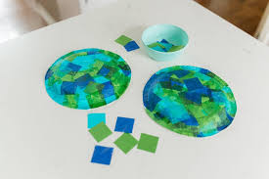
Activity:
Living Water Well Craft
Materials Needed:
  Paper plate
  Colored paper (Blue, Brown, Green)
  Glue
  Scissors
  Pen

Slide 30
Instructions:
Cut small square or rectangle to make a bricks in brown paper.
Cut circle in blue paper smaller than the plate then write “Jesus is the Living Water” inside the circle.
Assemble the well, the bricks should be the outline of the plate, the inner circle should be the water.

Slide 31


Dear Jesus,
Thank You for loving everyone.
Thank You for giving us living water
that makes our hearts happy.
Help us share Your love with others
every day.
In Jesus’s name,
Amen!
Closing Prayer

Slide 32
Live the Word Kids

