Slide 1


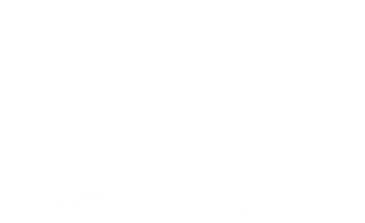



Live the Word Kids

Slide 2
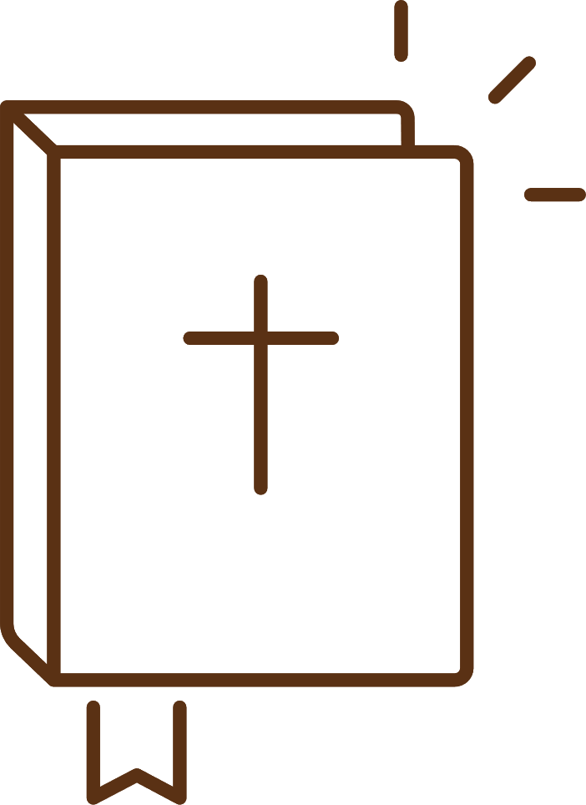


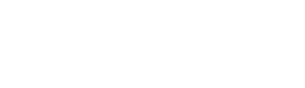

6th Sunday of Lent
March 29, 2026 | Cycle A Year 2

Slide 3
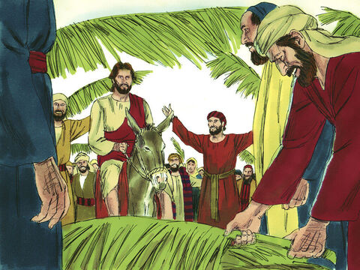
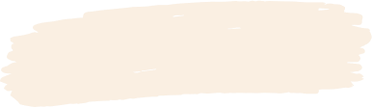
Jesus Rides into Jerusalem
Matthew 21: 1-11

Slide 4


Leader:
A reading from the Holy Gospel according to Matthew.
All:
Glory to You, Oh Lord.

Slide 5

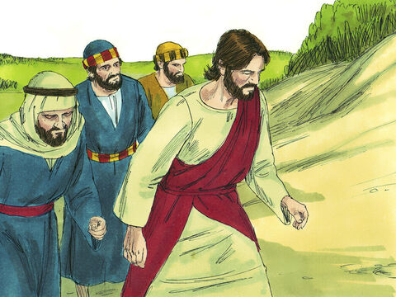
1
As Jesus and his disciples approached Jerusalem, they came to Bethphage at the Mount of Olives. There Jesus sent two of the disciples on ahead

Slide 6
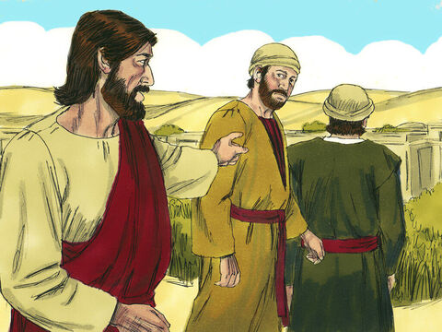
2
with these instructions: “Go to the village there ahead of you, and at once you will find a donkey tied up with her colt beside her. Untie them and bring them to me.

Slide 7
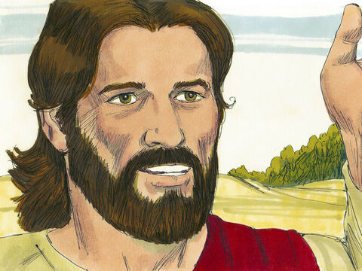
3
And if anyone says anything, tell him, ‘The Master needs them’; and then he will let them go at once.”

Slide 8
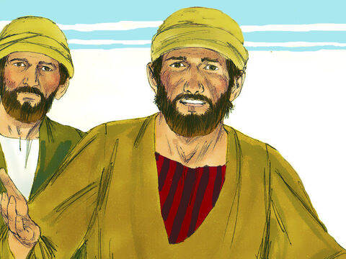
4
This happened in order to make come true what the prophet had said:

Slide 9
5
“Tell the city of Zion,
Look, your king is coming to you!
He is humble and rides on a donkey
and on a colt, the foal of a donkey.”

Slide 10
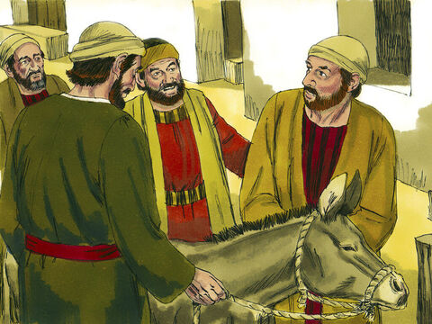
6
So the disciples went and did what Jesus had told them to do:

Slide 11
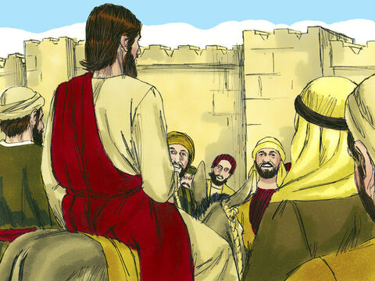
7
they brought the donkey and the colt, threw their cloaks over them, and Jesus got on.

Slide 12
8
A large crowd of people spread their cloaks on the road while others cut branches from the trees and spread them on the road.

Slide 13
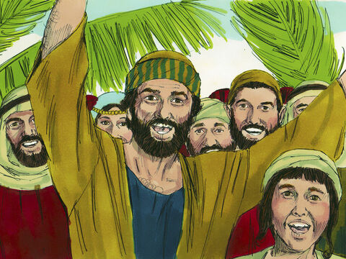
9
The crowds walking in front of Jesus and those walking behind began to shout, “Praise to David's Son! God bless him who comes in the name of the Lord! Praise be to God!”

Slide 14
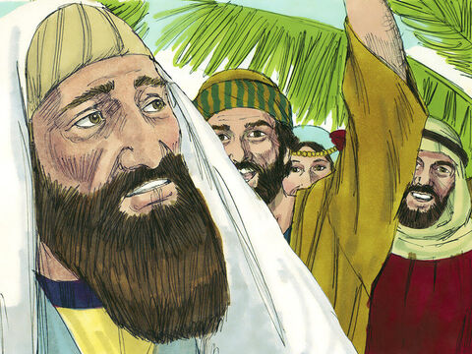
10
When Jesus entered Jerusalem, the whole city was thrown into an uproar. “Who is he?” the people asked.

Slide 15
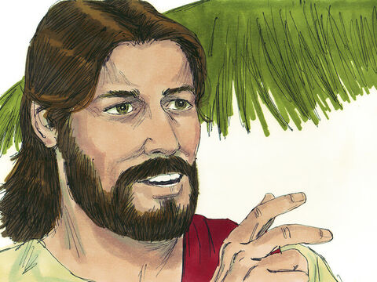
11
“This is the prophet Jesus, from Nazareth in Galilee,” the crowds answered.

Slide 16


Gospel Message

Slide 17
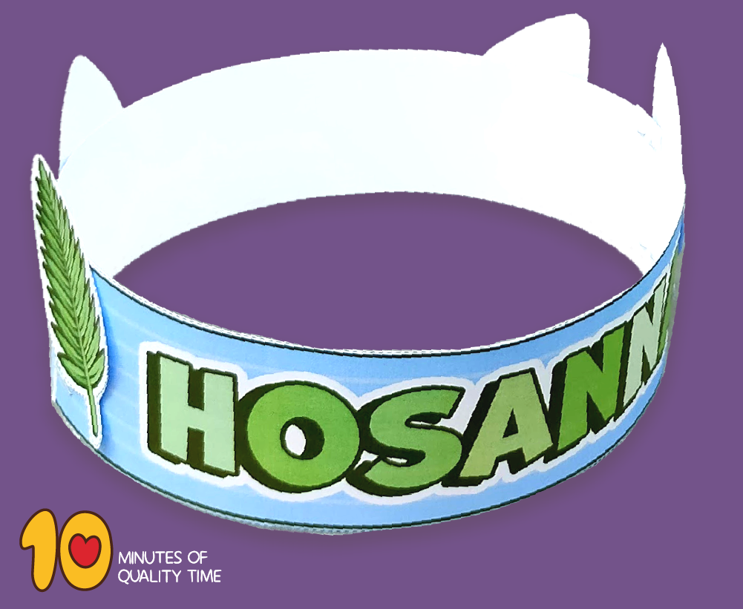
Activity:
Palm Leaf Crown
Materials Needed:
  Pencil
  Bond Paper
  Colored Paper
  Scissors
  Glue

Slide 18
Instructions:
Cut green construction paper to make a palm.
Cut a strip of paper long enough to fit around your head.
Glue the palm leaves to the strip of paper, spacing them evenly.
Write Hosanna.

Slide 19


Closing Prayer
Dear Jesus,
Thank You for coming to us with love and humility. Help us to welcome You in our hearts every day, just like the people welcomed You into Jerusalem.
In Jesus’s name,
Amen!

Slide 20
Live the Word Kids

