Slide 1






Live the Word Kids

Slide 2





5th Sunday of Lent
March 22, 2026 | Cycle A Year 2

Slide 3
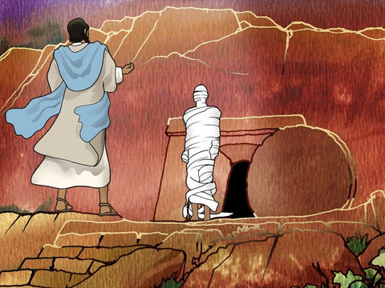

Jesus Raises Lazarus from the Dead
John 11: 3-7, 17, 20-27, 33b-45

Slide 4


Leader:
A reading from the Holy Gospel according to John.
All:
Glory to You, Oh Lord.

Slide 5

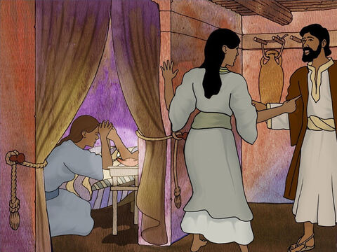
3
The sisters sent Jesus a message: “Lord, your dear friend is sick.”

Slide 6
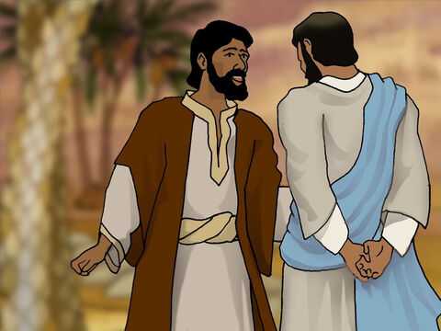
4
When Jesus heard it, he said, “The final result of this sickness will not be the death of Lazarus; this has happened in order to bring glory to God, and it will be the means by which the Son of God will receive glory.”

Slide 7
5
Jesus loved Martha and her sister and Lazarus.

Slide 8
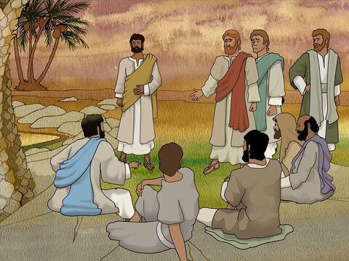
6
Yet when he received the news that Lazarus was sick, he stayed where he was for two more days.

Slide 9
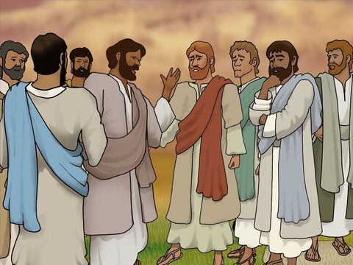
7
Then he said to the disciples, “Let us go back to Judea.”

Slide 10
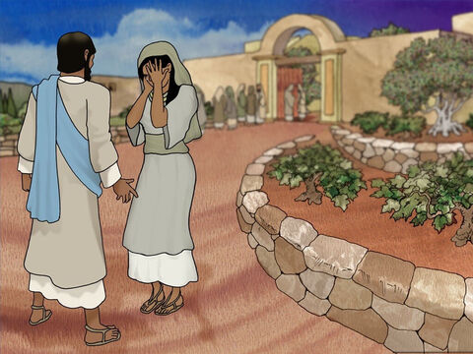
17
When Jesus arrived, he found that Lazarus had been buried four days before.

Slide 11
20
When Martha heard that Jesus was coming, she went out to meet him, but Mary stayed in the house.

Slide 12
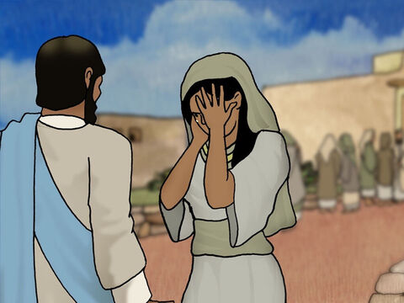
21
Martha said to Jesus, “If you had been here, Lord, my brother would not have died!

Slide 13
22
But I know that even now God will give you whatever you ask him for.”

Slide 14
23
“Your brother will rise to life,” Jesus told her.

Slide 15
24
“I know,” she replied, “that he will rise to life on the last day.”

Slide 16
25
Jesus said to her, “I am the resurrection and the life. Those who believe in me will live, even though they die;

Slide 17
26
and those who live and believe in me will never die. Do you believe this?”

Slide 18
27
“Yes, Lord!” she answered. “I do believe that you are the Messiah, the Son of God, who was to come into the world.”

Slide 19
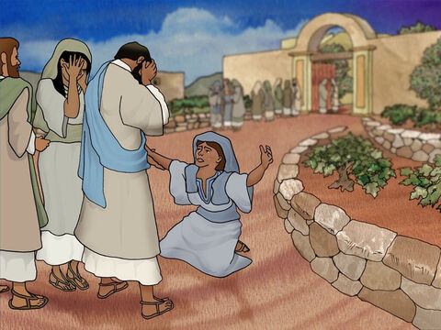
33b
His heart was touched, and he was deeply moved.

Slide 20
34
“Where have you buried him?” he asked them.
“Come and see, Lord,” they answered.

Slide 21
35
Jesus wept.

Slide 22
36
“See how much he loved him!” the people said.

Slide 23
37
But some of them said, “He gave sight to the blind man, didn't he? Could he not have kept Lazarus from dying?”

Slide 24
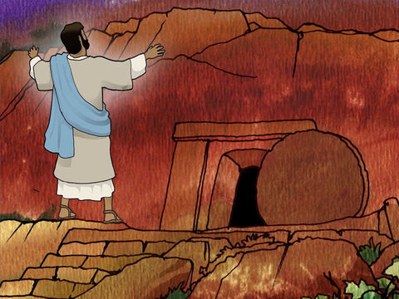
38
Deeply moved once more, Jesus went to the tomb, which was a cave with a stone placed at the entrance.

Slide 25
39
“Take the stone away!” Jesus ordered.
Martha, the dead man's sister, answered, “There will be a bad smell, Lord. He has been buried four days!”

Slide 26
40
Jesus said to her, “Didn't I tell you that you would see God's glory if you believed?”

Slide 27
41
“They took the stone away. Jesus looked up and said, “I thank you, Father, that you listen to me.

Slide 28
42
I know that you always listen to me, but I say this for the sake of the people here, so that they will believe that you sent me.”

Slide 29
43
After he had said this, he called out in a loud voice, “Lazarus, come out!”

Slide 30
44
He came out, his hands and feet wrapped in grave cloths, and with a cloth around his face. “Untie him,” Jesus told them, “and let him go.”

Slide 31
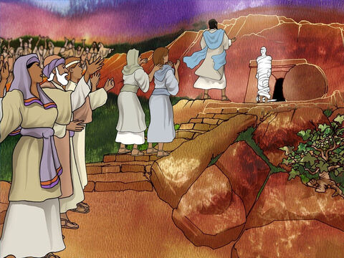
45
Many of the people who had come to visit Mary saw what Jesus did, and they believed in him.

Slide 32


Gospel Message

Slide 33
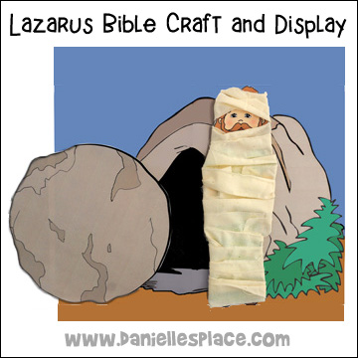
Activity:
Come out Lazarus Tomb Craft
Materials Needed:
  Pencil
  Paper
  Crayons

Slide 34
Instructions:
Draw big tomb at the center of the paper.
Draw Lazarus outside the tomb.
Draw big stone beside the opening of the tomb.
Write “Lazarus, Come Out” on top of the tomb.
Color the tomb and the stone.

Slide 35


Closing Prayer
Dear Jesus,
Thank You for loving us and giving us life and hope.
Help us believe in You and trust in Your power.
Teach us to love others as You love us.
In Jesus’s name,
Amen!

Slide 36
Live the Word Kids

