Slide 1






Live the Word Kids

Slide 2





4th Sunday of Lent
March 15, 2026 | Cycle A Year 2

Slide 3
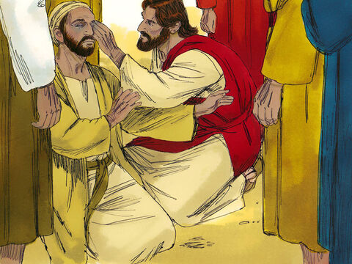
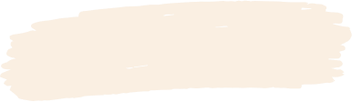
Jesus Heals a Man Born Blind
John 9:1, 6-9, 13-17, 34-38

Slide 4


Leader:
A reading from the Holy Gospel according to John.
All:
Glory to You, Oh Lord.

Slide 5

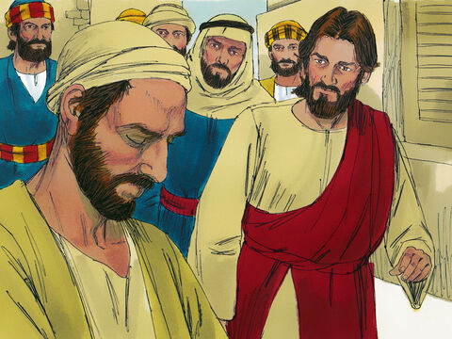
1
As Jesus was walking along, he saw a man who had been born blind.

Slide 6
6
Jesus spat on the ground and made some mud with the spittle; he rubbed the mud on the man's eyes

Slide 7
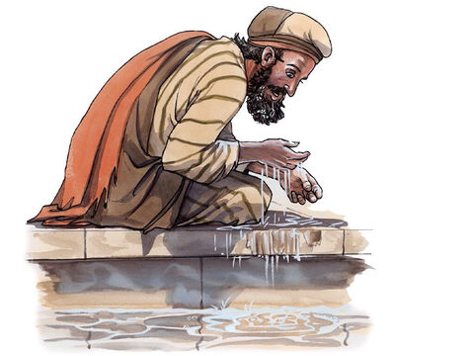
7
and told him, “Go and wash your face in the Pool of Siloam.” (This name means “Sent.”) So the man went, washed his face, and came back seeing.

Slide 8
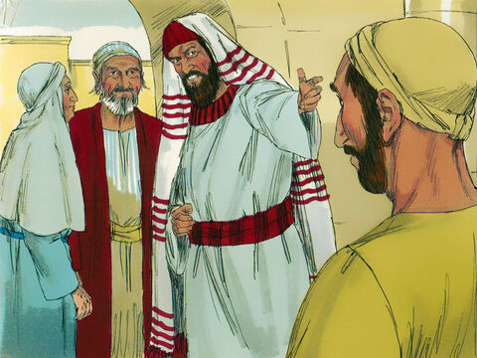
8
His neighbors, then, and the people who had seen him begging before this, asked, “Isn't this the man who used to sit and beg?”

Slide 9
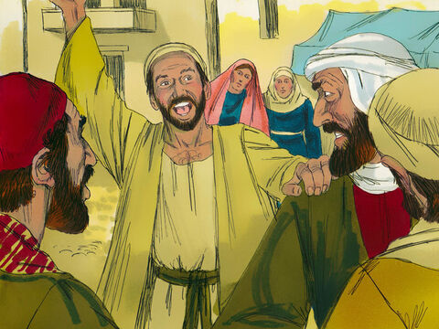
9
Some said, “He is the one,” but others said, “No he isn't; he just looks like him.”
So the man himself said, “I am the man.”

Slide 10
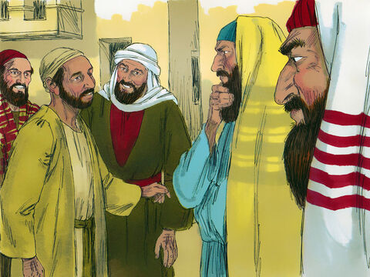
13
Then they took to the Pharisees the man who had been blind.

Slide 11
14
The day that Jesus made the mud and cured him of his blindness was a Sabbath.

Slide 12
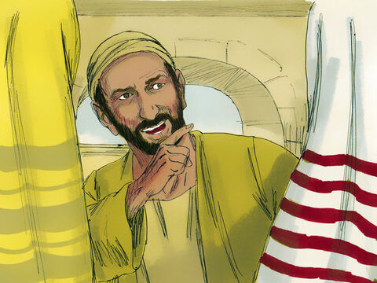
15
The Pharisees, then, asked the man again how he had received his sight. He told them, “He put some mud on my eyes; I washed my face, and now I can see.”

Slide 13
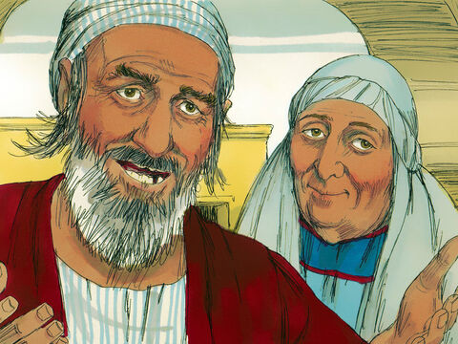
16
Some of the Pharisees said, “The man who did this cannot be from God, for he does not obey the Sabbath law.”
Others, however, said, “How could a man who is a sinner perform such miracles as these?” And there was a division among them.

Slide 14
17
So the Pharisees asked the man once more, “You say he cured you of your blindness—well, what do you say about him?”
“He is a prophet,” the man answered.

Slide 15
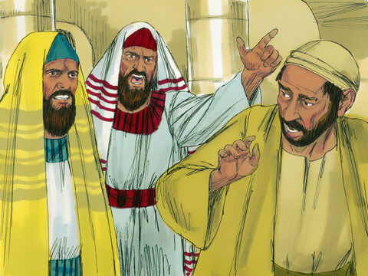
34
They answered, “You were born and brought up in sin—and you are trying to teach us?” And they expelled him from the synagogue.

Slide 16
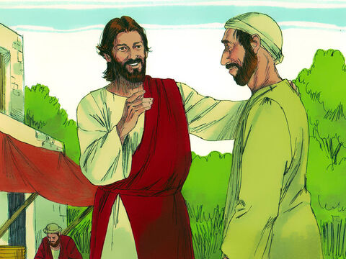
35
When Jesus heard what had happened, he found the man and asked him, “Do you believe in the Son of Man?”

Slide 17
36
The man answered, “Tell me who he is, sir, so that I can believe in him!”

Slide 18
37
Jesus said to him, “You have already seen him, and he is the one who is talking with you now.”

Slide 19
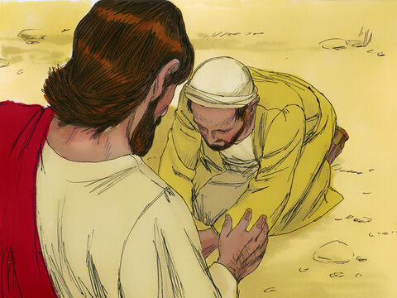
38
“I believe, Lord!” the man said, and knelt down before Jesus.

Slide 20

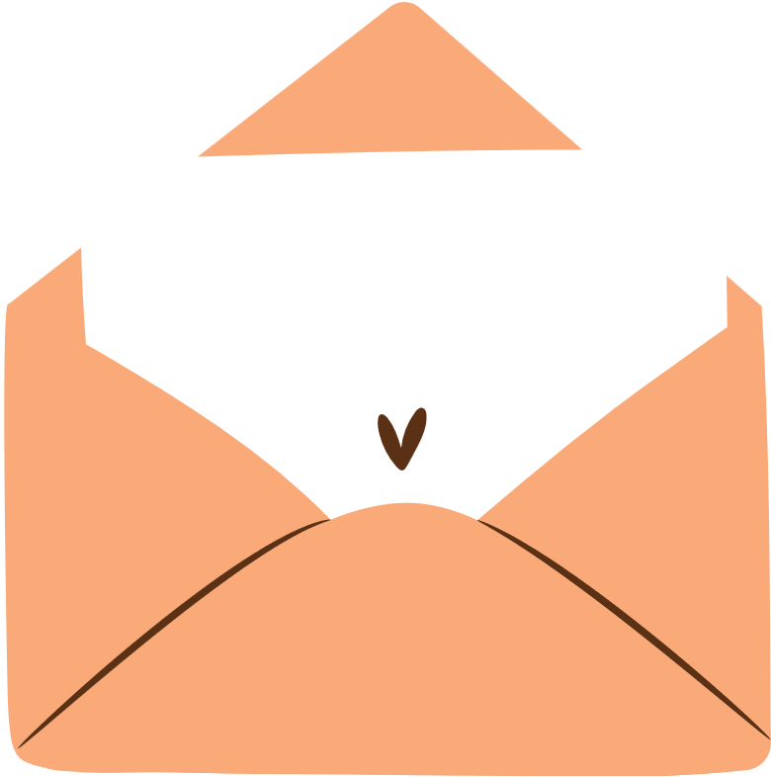
Gospel Message

Slide 21

Activity:
Jesus is the Light Sun Craft
Materials Needed:
  Pencil
  Paper
  Crayons

Slide 22
Instructions:
Draw big circle at the center of the paper.
Draw a happy face inside the circle.
Add sun rays outside the circle using the crayons.
Write “Jesus is my Light”.

Slide 23


Closing Prayer
Dear Jesus,
Thank You for being our Light.
Help us see what is good and kind.
Guide us to love others every day.
Let Your light shine in our hearts.
In Jesus’s name,
Amen!

Slide 24
Live the Word Kids

