Slide 1






Live the Word Kids

Slide 2





2nd Sunday of Lent
March 1, 2026 | Cycle A Year 2

Slide 3
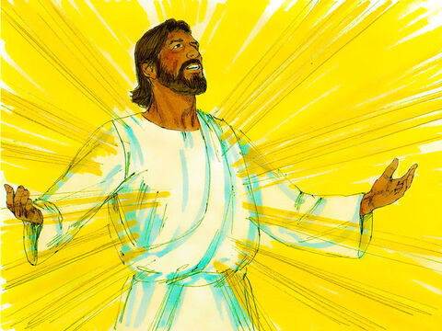

The Transfiguration of Jesus
Matthew17:1-9

Slide 4


Leader:
A reading from the Holy Gospel according to Matthew.
All:
Glory to You, Oh Lord.

Slide 5

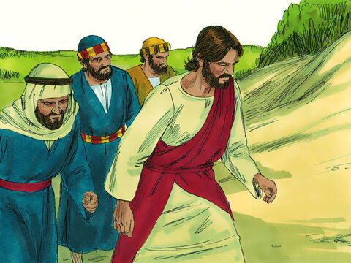
1
Six days later Jesus took with him Peter and the brothers James and John and led them up a high mountain where they were alone.

Slide 6
2
As they looked on, a change came over Jesus: his face was shining like the sun, and his clothes were dazzling white.

Slide 7
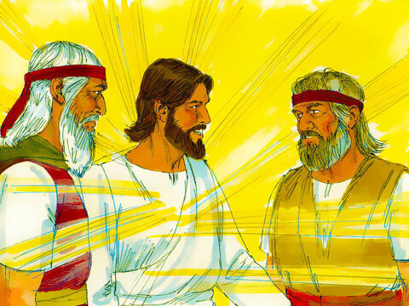
3
Then the three disciples saw Moses and Elijah talking with Jesus.

Slide 8
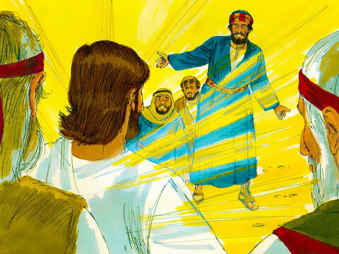
4
So Peter spoke up and said to Jesus, “Lord, how good it is that we are here! If you wish, I will make three tents here, one for you, one for Moses, and one for Elijah.”

Slide 9
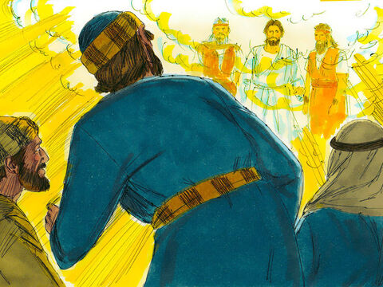
5
While he was talking, a shining cloud came over them, and a voice from the cloud said, “This is my own dear Son, with whom I am pleased—listen to him!”

Slide 10
6
When the disciples heard the voice, they were so terrified that they threw themselves face downward on the ground.

Slide 11
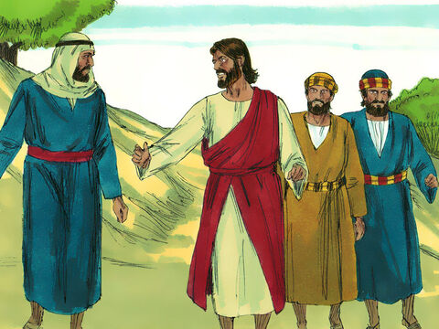
7
Jesus came to them and touched them. “Get up,” he said. “Don't be afraid!”

Slide 12
8
So they looked up and saw no one there but Jesus.

Slide 13
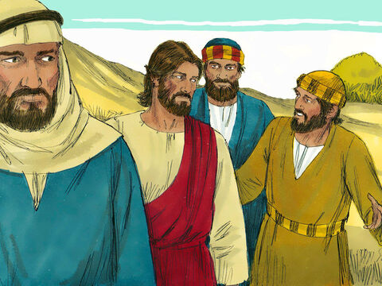
9
As they came down the mountain, Jesus ordered them, “Don't tell anyone about this vision you have seen until the Son of Man has been raised from death.”

Slide 14


Gospel Message

Slide 15
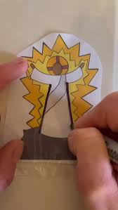
Activity:
Shining Jesus Craft
Materials Needed:
  Bond paper
  Pencil
  Crayons

Slide 16
Instructions:
Draw Jesus on the bond paper.
Color rays around Jesus to show His glory.
Write “This is my beloved Son. Listen to Him”

Slide 17


Dear Jesus,
Thank You for showing Your shining glory.
Help us to listen to You
and follow You every day.
Let Your light shine in our hearts.
In Jesus’s name,
Amen!
Closing Prayer

Slide 18
Live the Word Kids

