Slide 1




Live the Word Kids

Slide 2

"Fourteenth Sunday in Ordinary Time"
July 5, 2026 | Cycle A Year 2

Slide 3
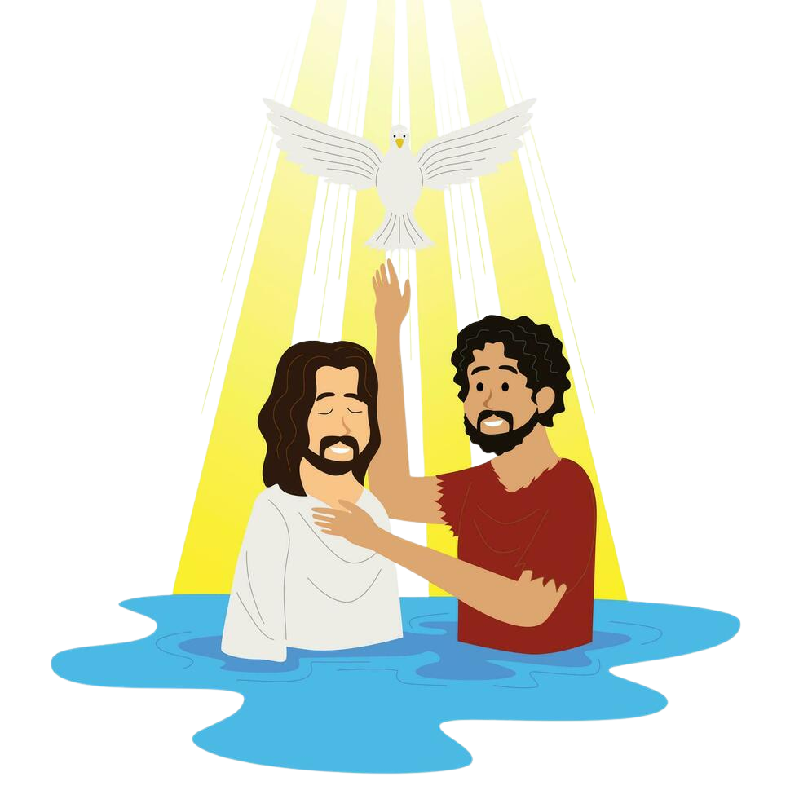
"My Yoke is Easy and My Burden Light"
Matthew 11:25-30

Slide 4

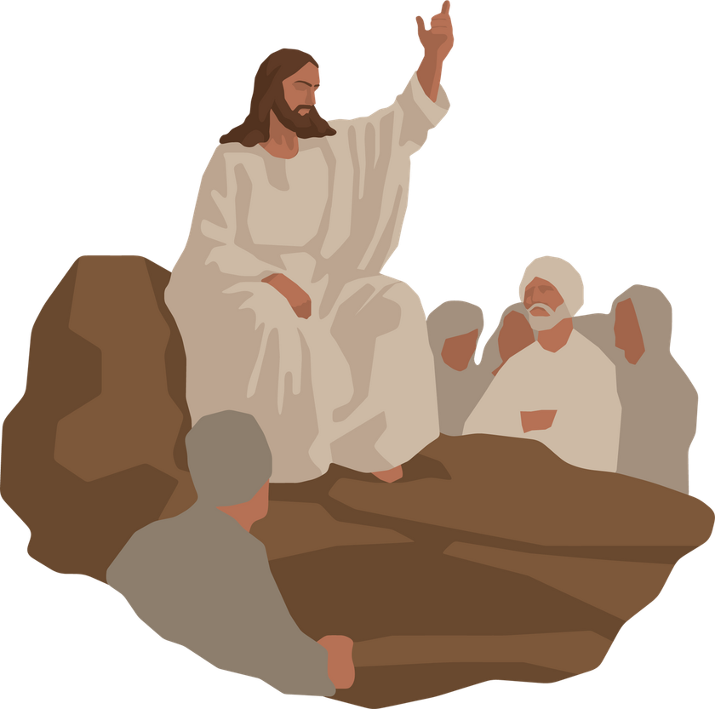
Leader:
A reading from the Holy Gospel according to Luke.
All:
Glory to You, Oh Lord.

Slide 5
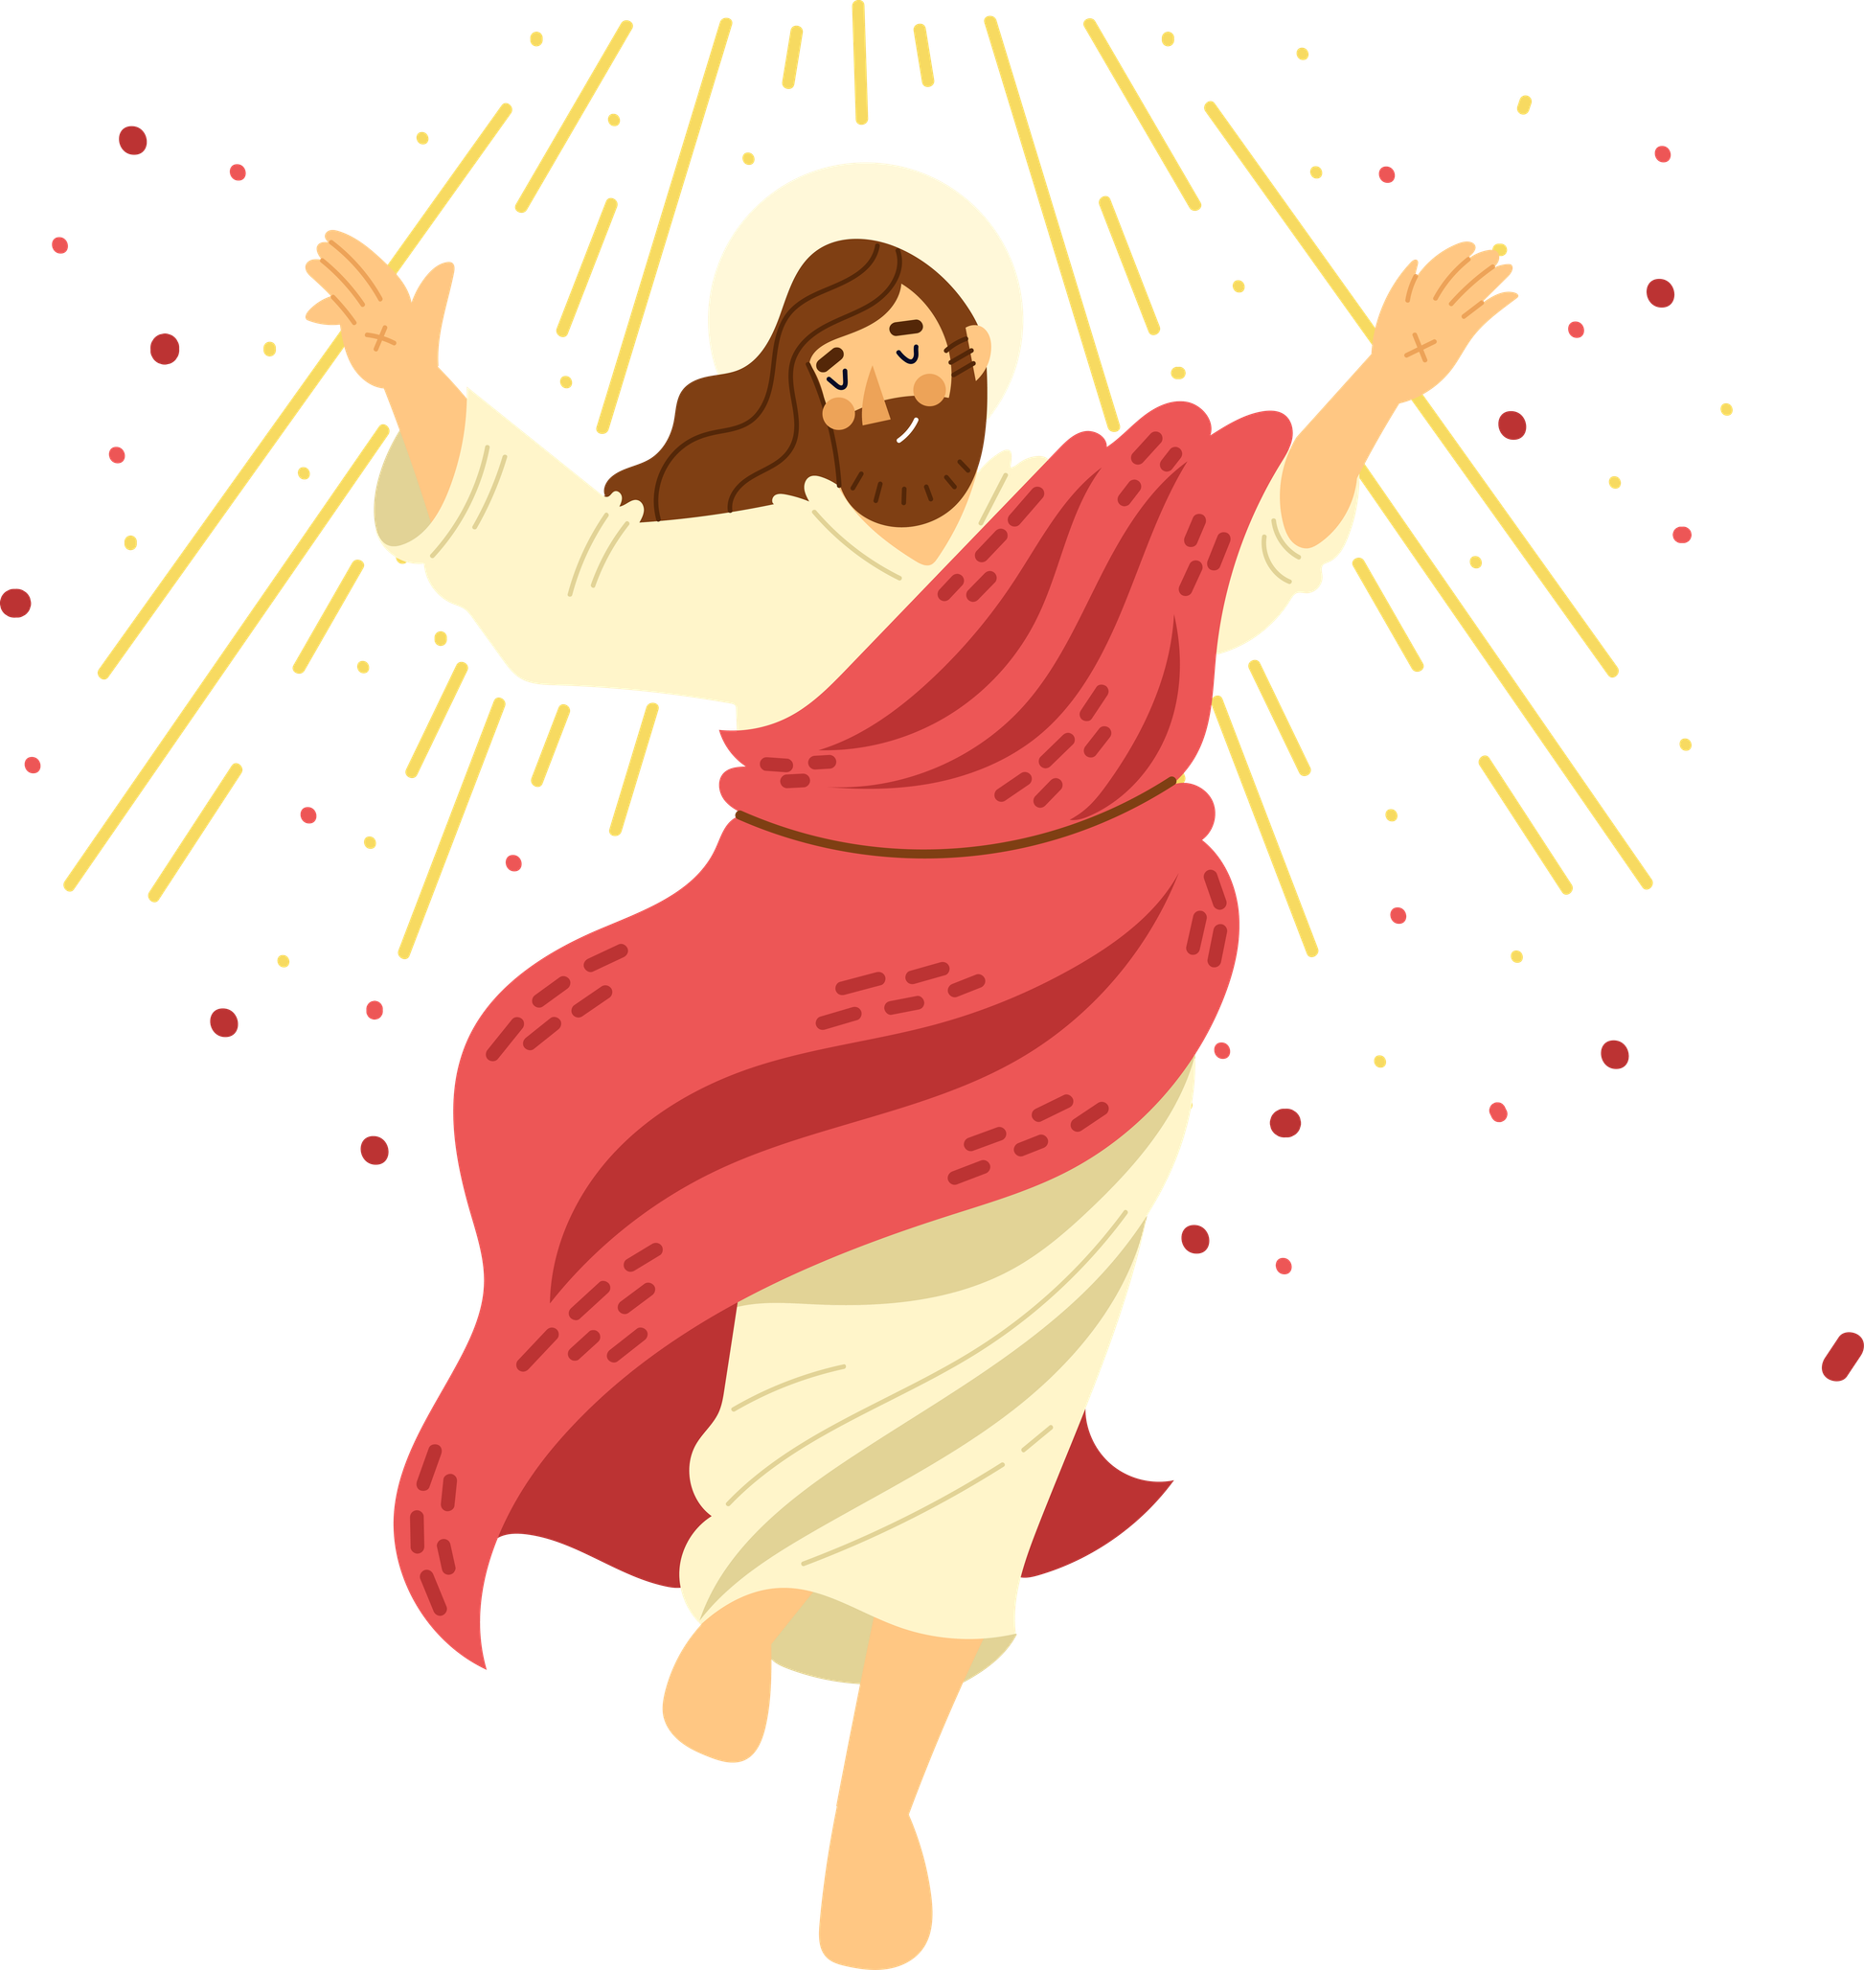
25
At that time Jesus said, “Father, Lord of heaven and earth! I thank you because you have shown to the unlearned what you have hidden from the wise and learned.

Slide 6
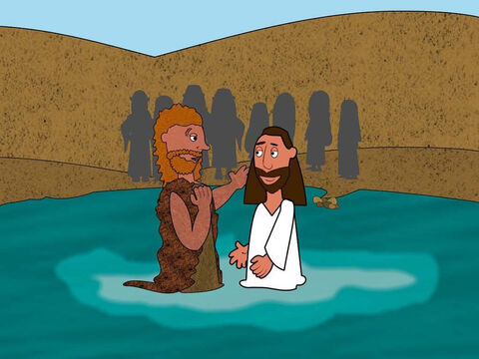
26
Yes, Father, this was how you were pleased to have it happen.

Slide 7
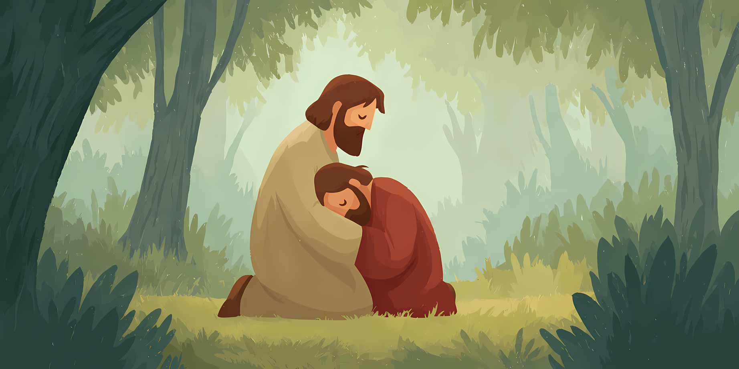
27
“My Father has given me all things. No one knows the Son except the Father, and no one knows the Father except the Son and those to whom the Son chooses to reveal him.

Slide 8
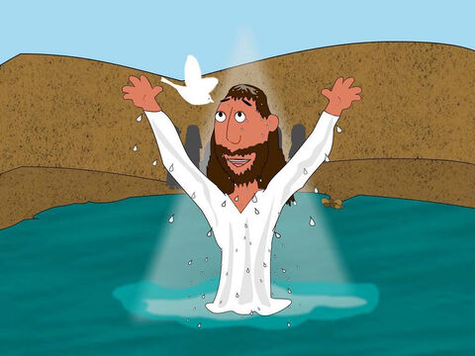
28
“Come to me, all of you who are tired from carrying heavy loads, and I will give you rest.

Slide 9
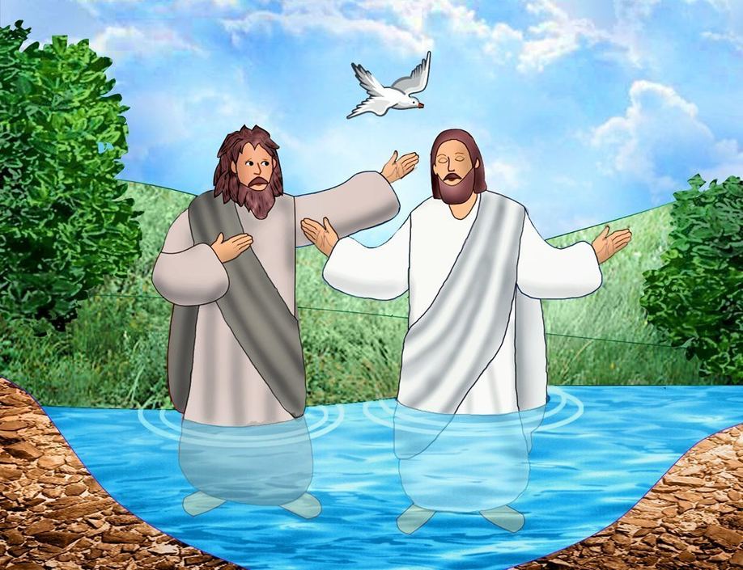
29
Take my yoke and put it on you, and learn from me, because I am gentle and humble in spirit; and you will find rest.

Slide 10
30
For the yoke I will give you is easy, and the load I will put on you is light.”

Slide 11
Leader:
The Gospel of the Lord
All:
Praise to you, Lord Jesus Christ.

Slide 12
Gospel Message

Slide 13
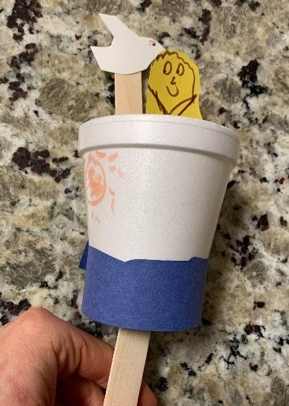
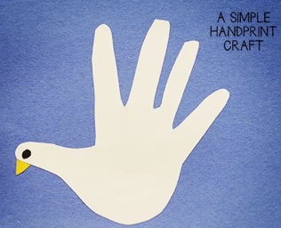
Activity:
“Promise To Holy Spirit”
Materials Needed:
  Colored Paper
  Bond Paper
  Scissors
  Glue
  Marker

Slide 14

Instructions:
•Trace your hand in a white bond paper and cut it out.
•Put a dot on the thumb part of your hand.
•Cut a small triangle in a yellow colored paper and glue it on the thumb part of your hand.

Slide 15
Dear God,
Heavenly Father, we thank you for the gentle words of your Son, Jesus, reminding us that we do not have to carry the weights of this world alone. May we walk out into the coming week lighter, freer, and deeply rooted in your love. In Jesus' name, we pray. Amen.
In Jesus’s name,
Amen!
Closing Prayer

Slide 16
Live the Word Kids

