Slide 1




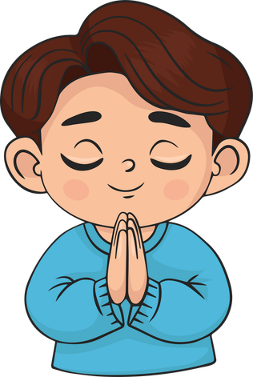
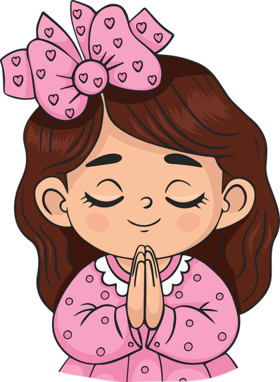
Live the Word Kids

Slide 2





Seventeenth Sunday in Ordinary Time
July 26, 2026 | Cycle A Year 2

Slide 3
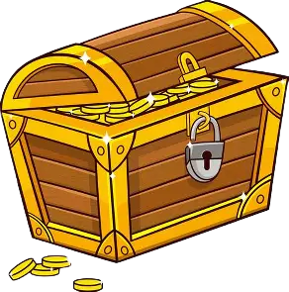

“Parables of the Hidden Treasure, the Pearl of Great Price, and the Net”
Matthew 13:44-52

Slide 4
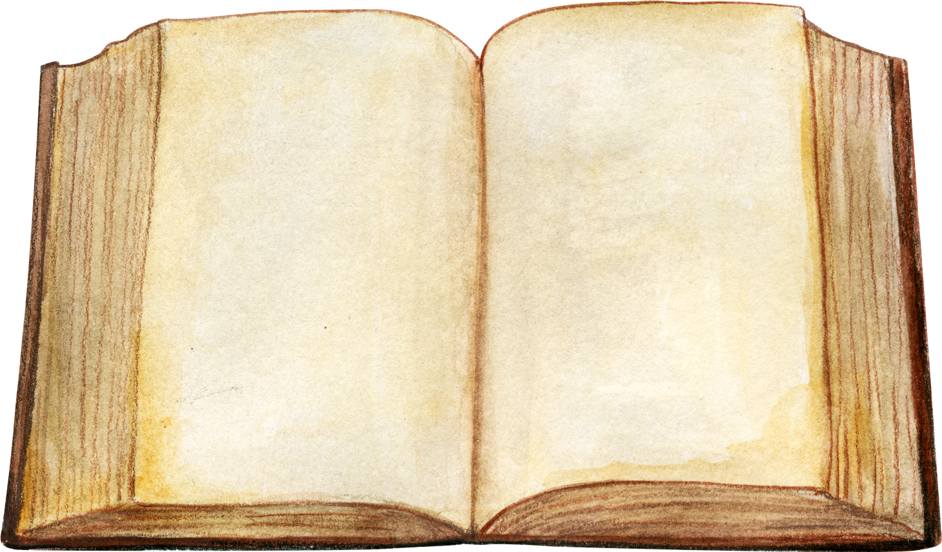

Leader:
A reading from the Holy Gospel according to Matthew.
All:
Glory to You, Oh Lord.

Slide 5
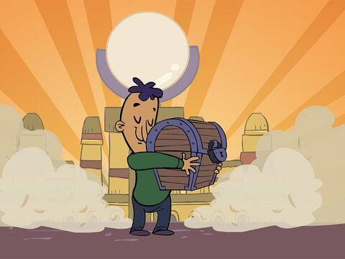
44
“The Kingdom of heaven is like this. A man happens to find a treasure hidden in a field. He covers it up again, and is so happy that he goes and sells everything he has, and then goes back and buys that field.

Slide 6
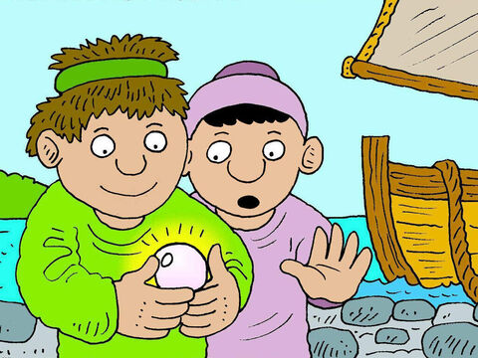
45
“Also, the Kingdom of heaven is like this. A man is looking for fine pearls,

Slide 7
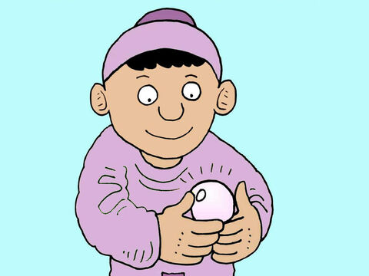
46
and when he finds one that is unusually fine, he goes and sells everything he has, and buys that pearl.

Slide 8
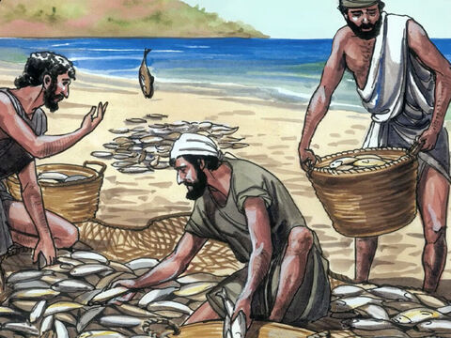
47
“Also, the Kingdom of heaven is like this. Some fishermen throw their net out in the lake and catch all kinds of fish.

Slide 9
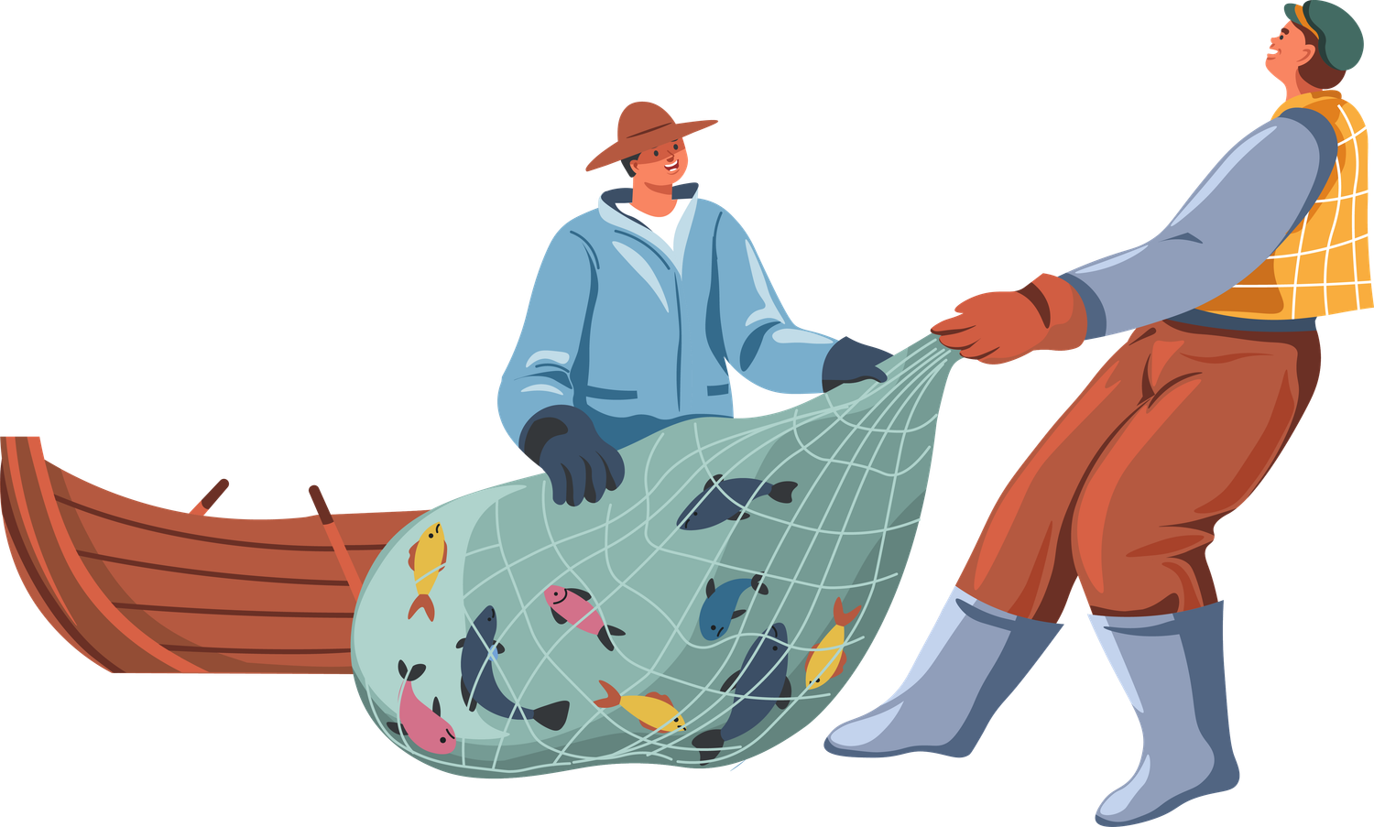
48
When the net is full, they pull it to shore and sit down to divide the fish: the good ones go into the buckets, the worthless ones are thrown away.

Slide 10
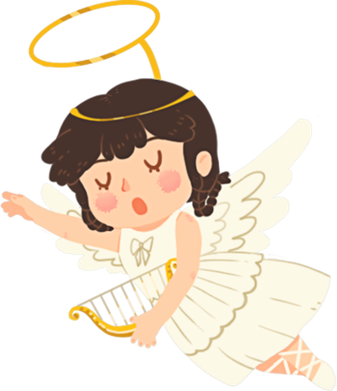
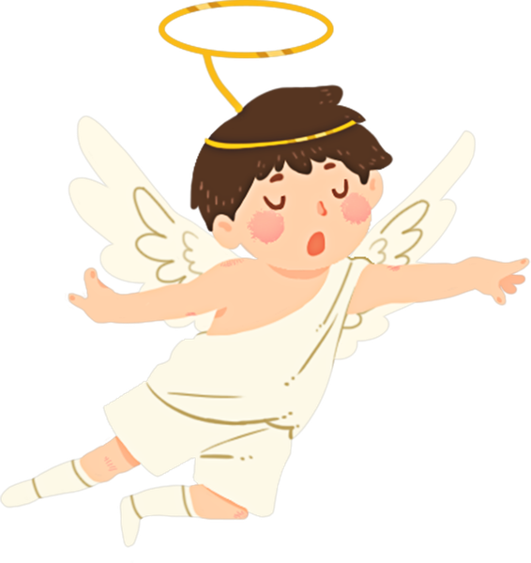
49
It will be like this at the end of the age: the angels will go out and gather up the evil people from among the good

Slide 11
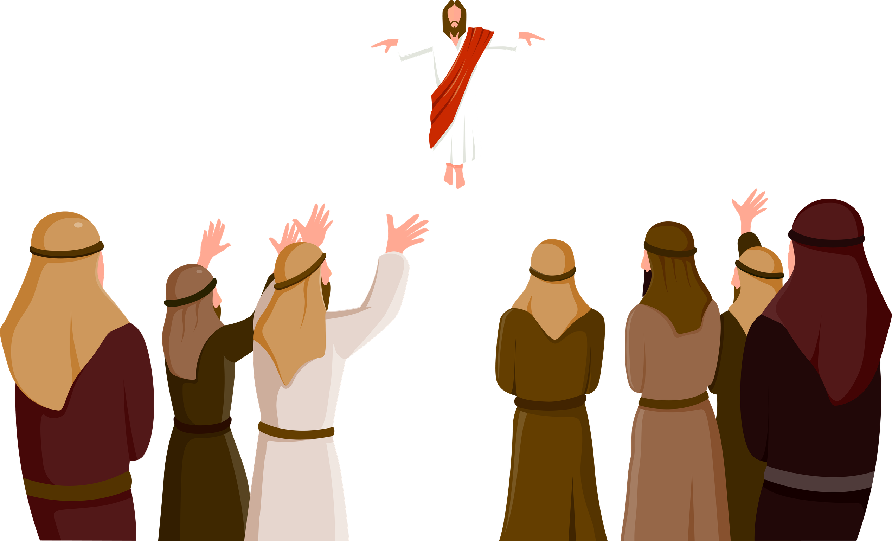
50
and will throw them into the fiery furnace, where they will cry and gnash their teeth.

Slide 12
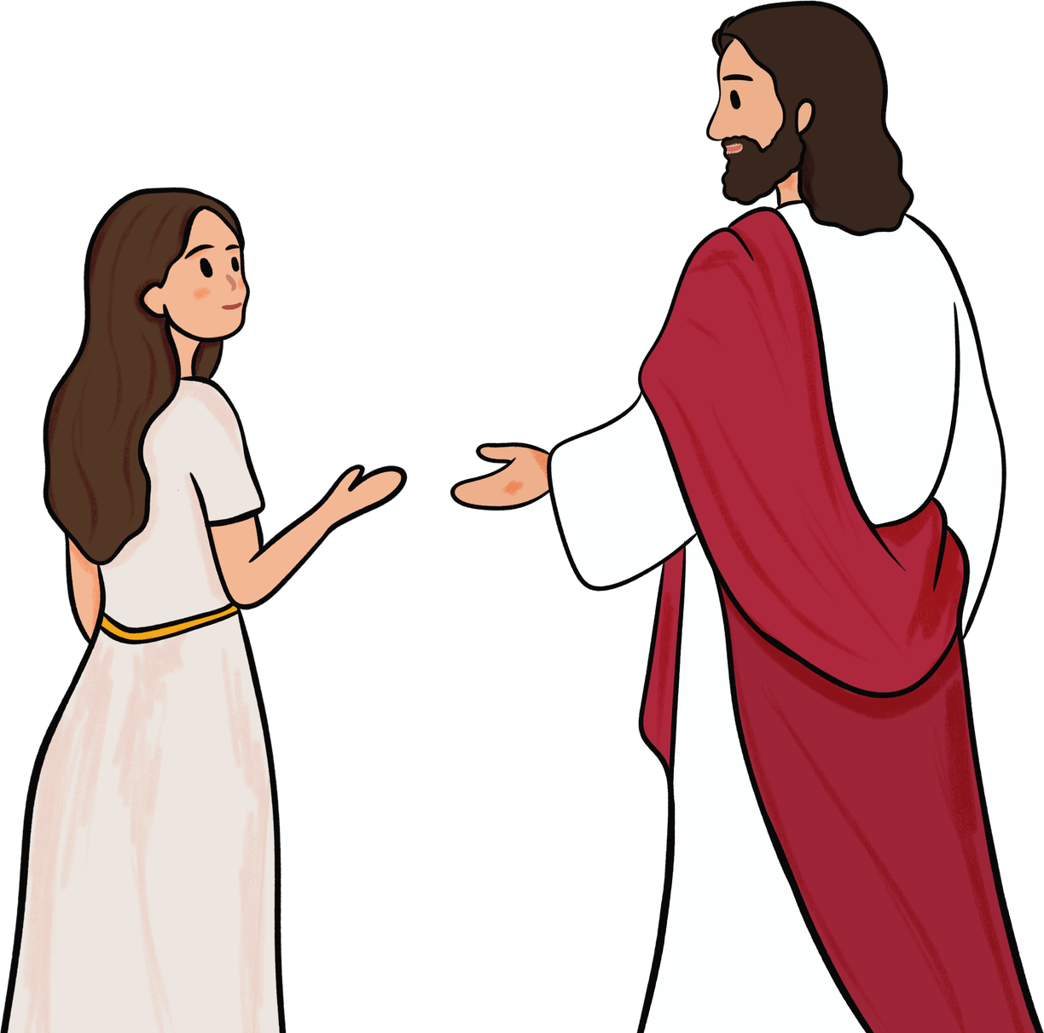
51
“Do you understand these things?” Jesus asked them.
“Yes,” they answered.

Slide 13

52
So he replied, “This means, then, that every teacher of the Law who becomes a disciple in the Kingdom of heaven is like a homeowner who takes new and old things out of his storage room.”

Slide 14
Leader:
The Gospel of the Lord
All:
Praise to you, Lord Jesus Christ.

Slide 15


Gospel Message

Slide 16

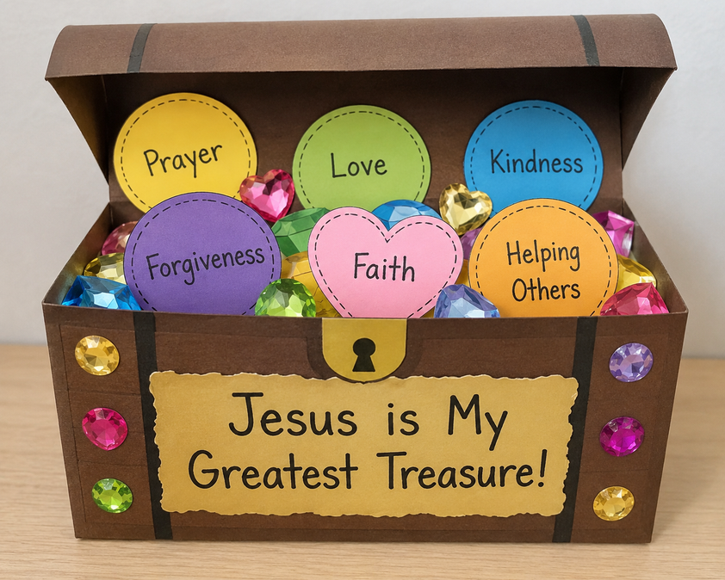
Activity:
“Treasure Chest Craft”
Materials Needed:
  Brown construction paper
  Colored paper
  Stickers or gem stickers
  Glue
  Scissors

Slide 17
Activity:
“Treasure Chest Craft”
4. Write on the chest:
"Jesus is My Greatest Treasure!"
1.Fold or assemble a paper treasure chest.
2.Fill it with paper coins, hearts, or gems.
3.On each "treasure," write things that help us grow closer to God:
  Prayer
  Love
  Kindness
  Forgiveness
  Faith
  Helping Others

Slide 18


Dear God,
Thank You for always trusting us in all things. Thank you for teaching us how to be honest and do things with a genuine heart. Lord, may we always serve you with our whole heart and always choose to do what is right.
In Jesus' name we pray.
Amen.
Closing Prayer

Slide 19
Live the Word Kids

