Slide 1




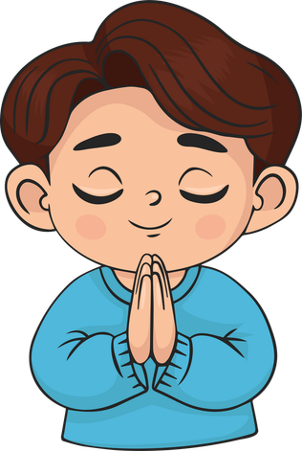

Live the Word Kids

Slide 2





Sixteenth Sunday in Ordinary Time
July 19, 2026 | Cycle A Year 2

Slide 3
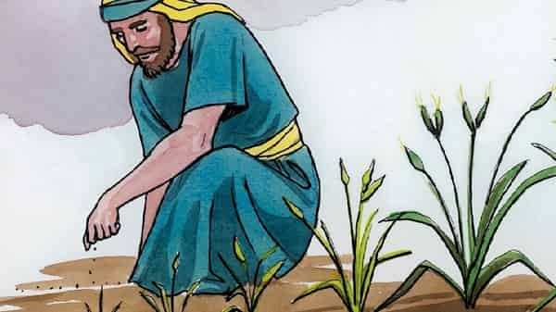

Parable of the Weeds or the Parable of the Mustard Seed and the Yeast
Matthew 13:24–43

Slide 4
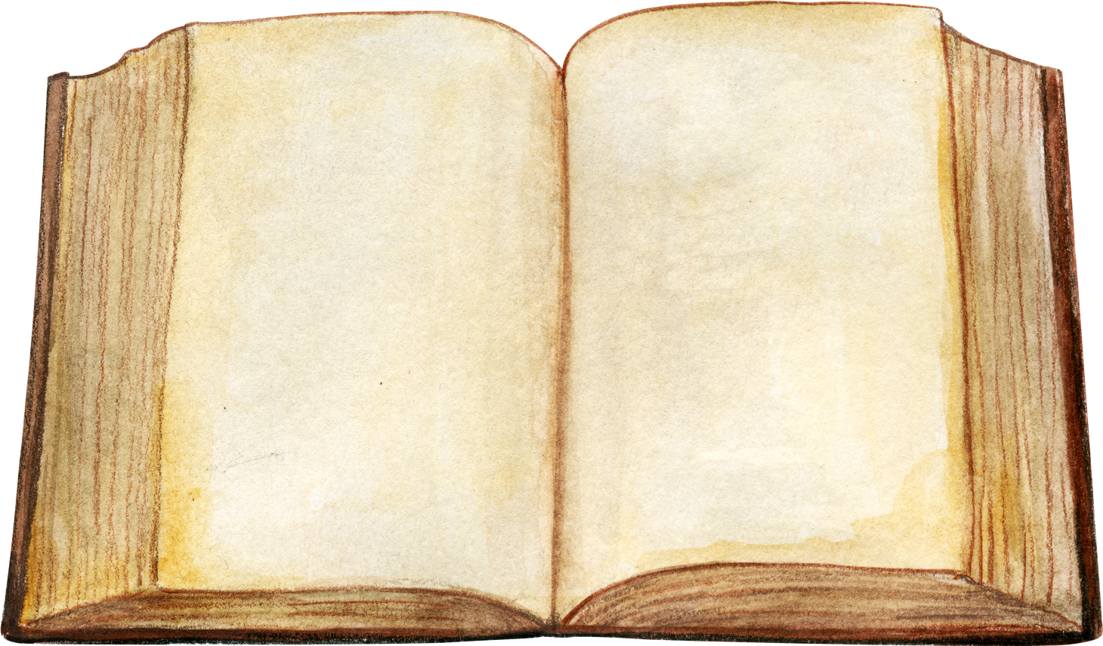

Leader:
A reading from the Holy Gospel according to Matthew.
All:
Glory to You, Oh Lord.

Slide 5
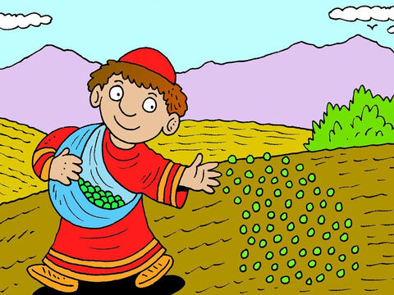
24
Jesus told them another parable: “The Kingdom of heaven is like this. A man sowed good seed in his field.

Slide 6
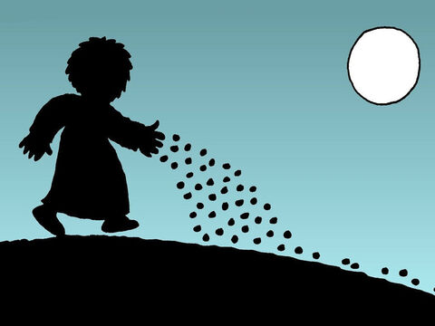
25
One night, when everyone was asleep, an enemy came and sowed weeds among the wheat and went away.

Slide 7
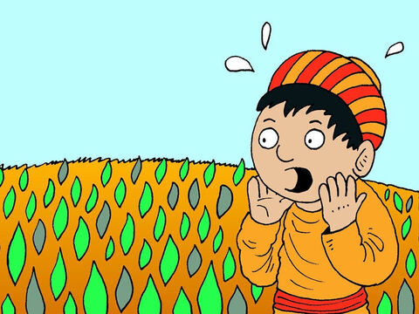
26
When the plants grew and the heads of grain began to form, then the weeds showed up.

Slide 8
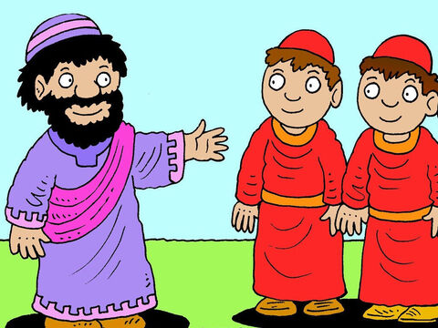
27
The man's servants came to him and said, ‘Sir, it was good seed you sowed in your field; where did the weeds come from?’

Slide 9
28
‘It was some enemy who did this,’ he answered. ‘Do you want us to go and pull up the weeds?’ they asked him.

Slide 10
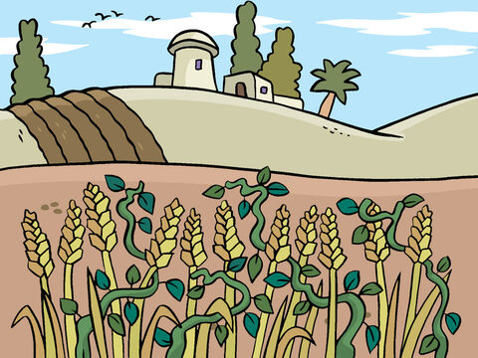
29
‘No,’ he answered, ‘because as you gather the weeds you might pull up some of the wheat along with them.

Slide 11
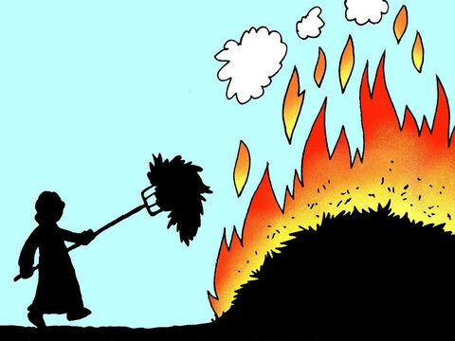
30
Let the wheat and the weeds both grow together until harvest. Then I will tell the harvest workers to pull up the weeds first, tie them in bundles and burn them, and then to gather in the wheat and put it in my barn.’”

Slide 12
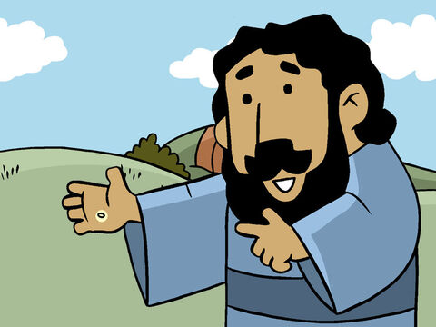
31
Jesus told them another parable: “The Kingdom of heaven is like this. A man takes a mustard seed and sows it in his field.

Slide 13
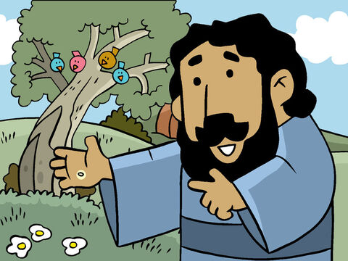
32
It is the smallest of all seeds, but when it grows up, it is the biggest of all plants. It becomes a tree, so that birds come and make their nests in its branches.”

Slide 14
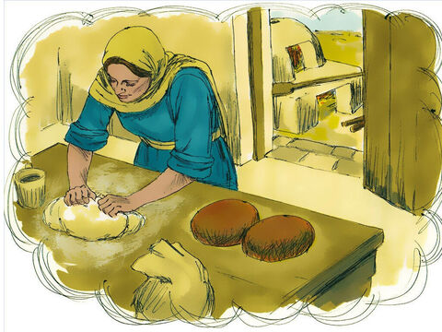
33
Jesus told them still another parable: “The Kingdom of heaven is like this. A woman takes some yeast and mixes it with a bushel of flour until the whole batch of dough rises.”

Slide 15
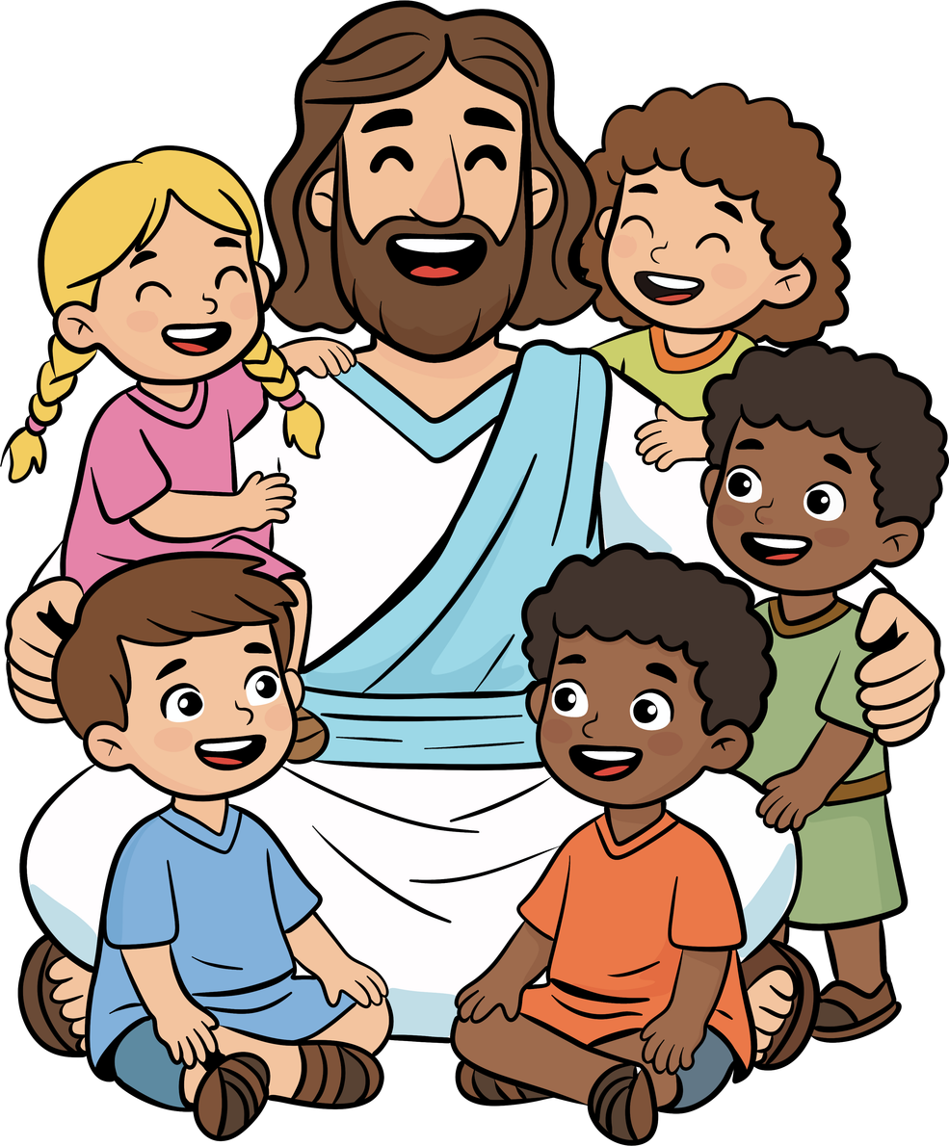
34
Jesus used parables to tell all these things to the crowds; he would not say a thing to them without using a parable.

Slide 16
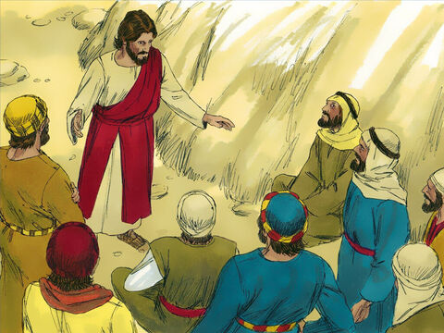
35
He did this to make come true what the prophet had said,
“I will use parables when I speak to them;
I will tell them things unknown since the creation of the world.”

Slide 17
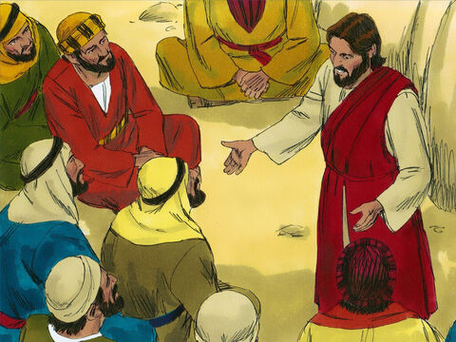
36
When Jesus had left the crowd and gone indoors, his disciples came to him and said, “Tell us what the parable about the weeds in the field means.”

Slide 18
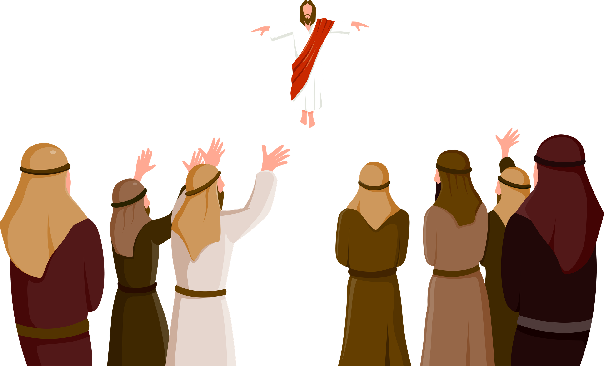
37
Jesus answered, “The man who sowed the good seed is the Son of Man;

Slide 19
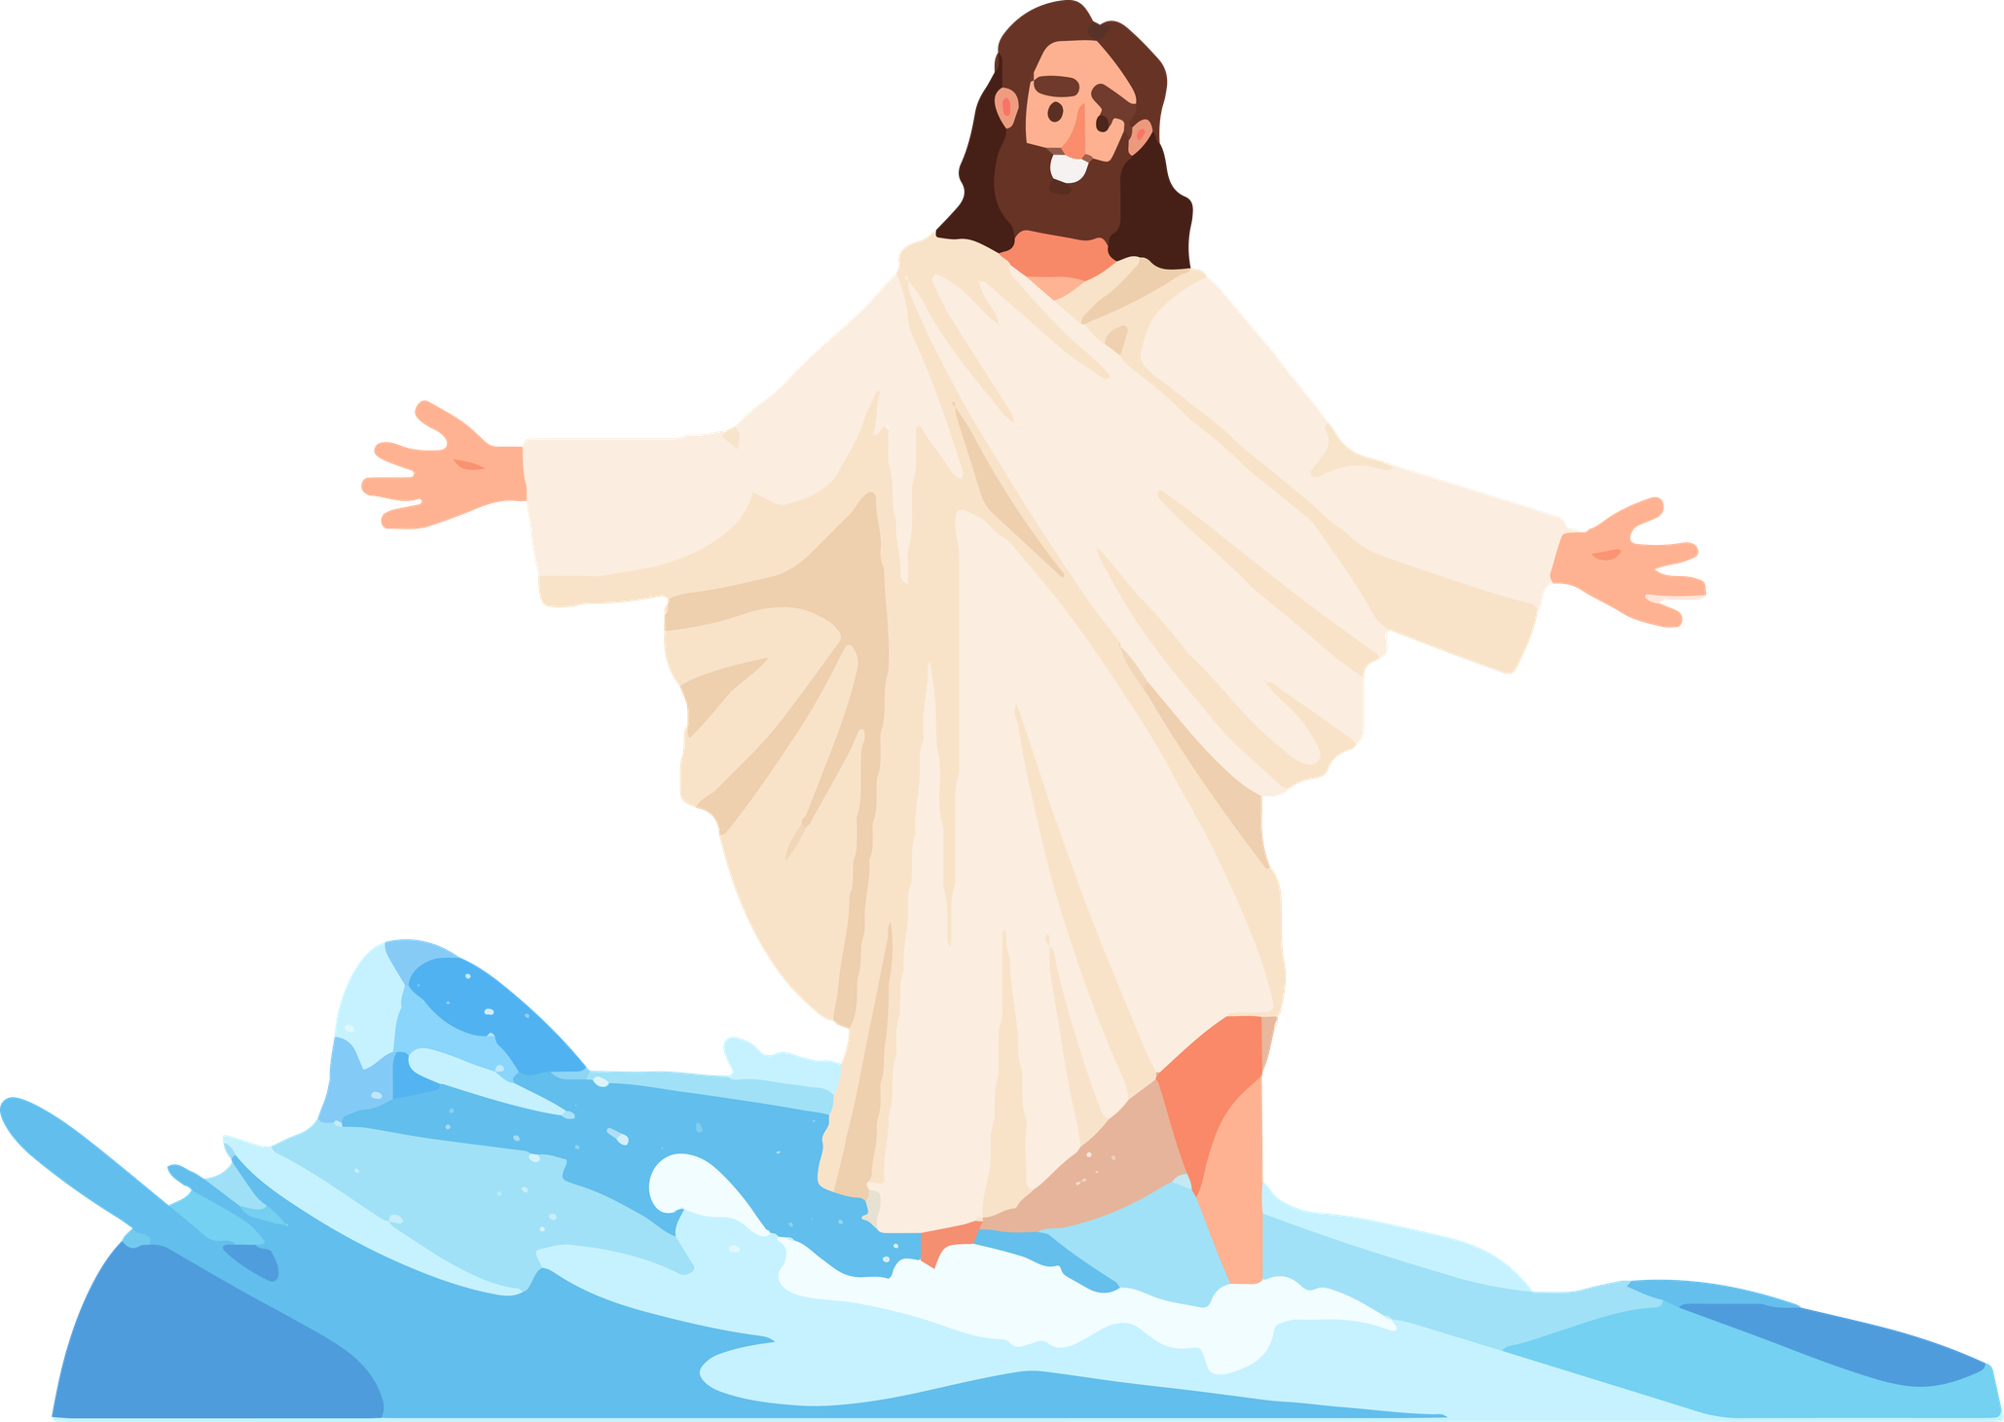
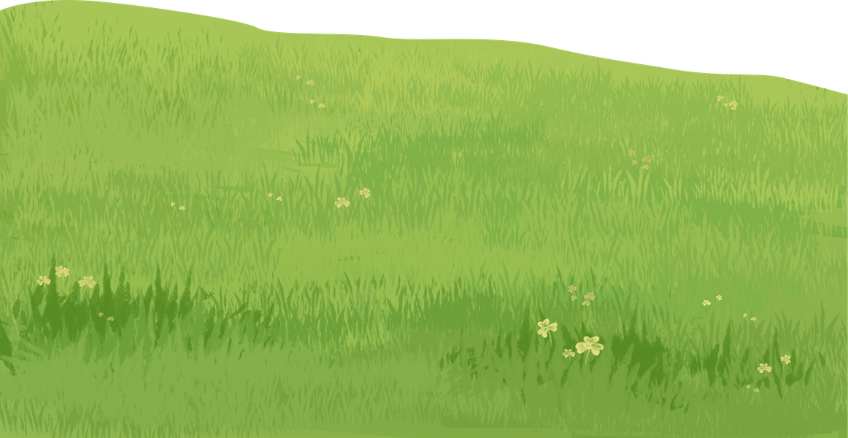
38
the field is the world; the good seed is the people who belong to the Kingdom; the weeds are the people who belong to the Evil One;

Slide 20
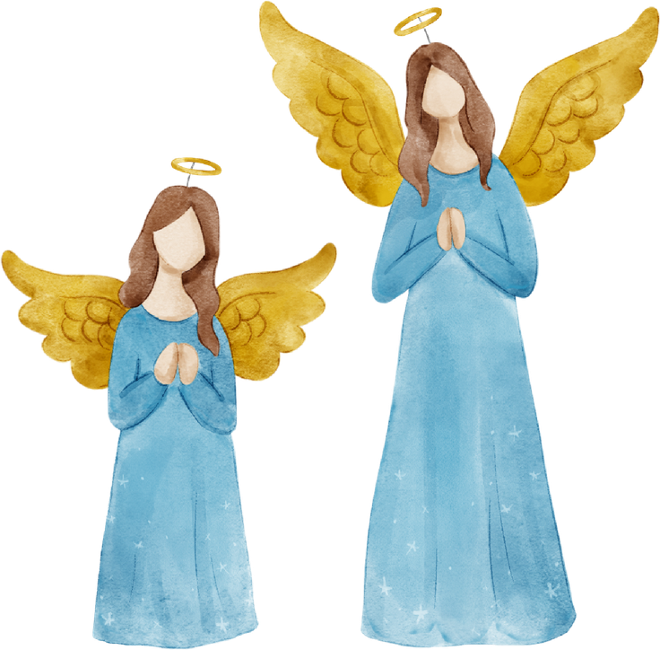
39
and the enemy who sowed the weeds is the Devil. The harvest is the end of the age, and the harvest workers are angels.

Slide 21
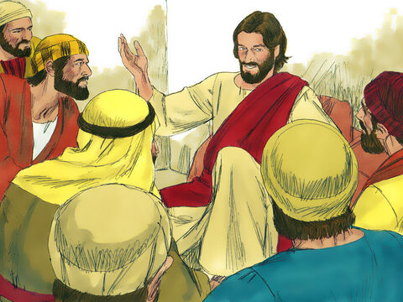
40
Just as the weeds are gathered up and burned in the fire, so the same thing will happen at the end of the age:

Slide 22
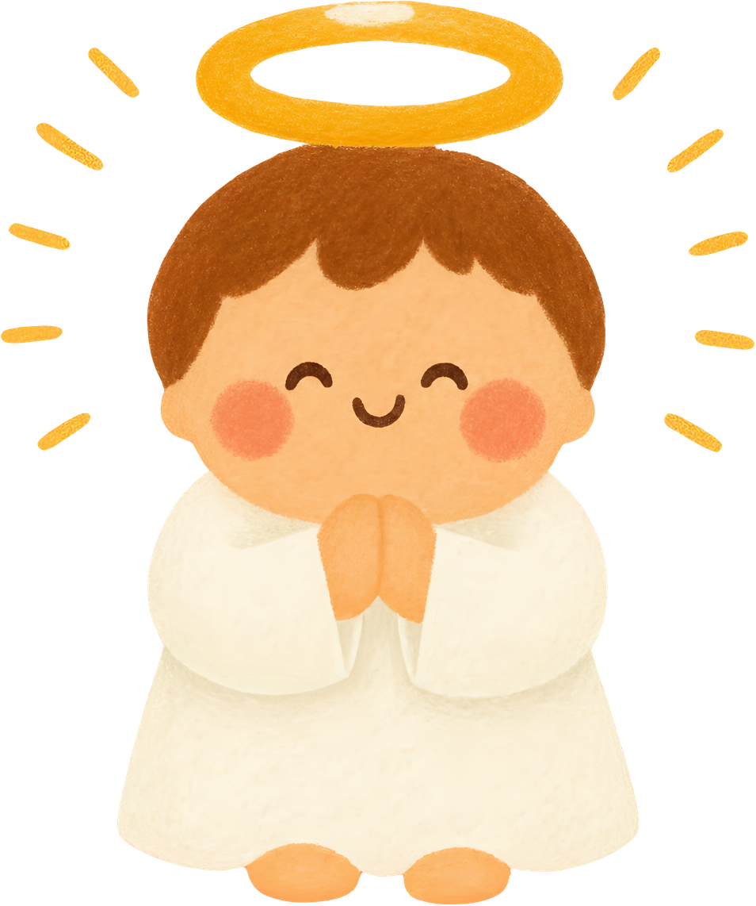
41
the Son of Man will send out his angels to gather up out of his Kingdom all those who cause people to sin and all others who do evil things,

Slide 23
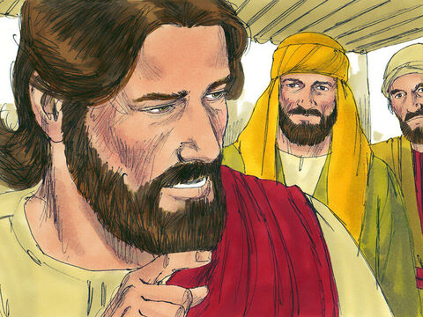
42
and they will throw them into the fiery furnace, where they will cry and gnash their teeth.

Slide 24
43
Then God's people will shine like the sun in their Father's Kingdom. Listen, then, if you have ears!

Slide 25
Leader:
The Gospel of the Lord
All:
Praise to you, Lord Jesus Christ.

Slide 26


Gospel Message

Slide 27

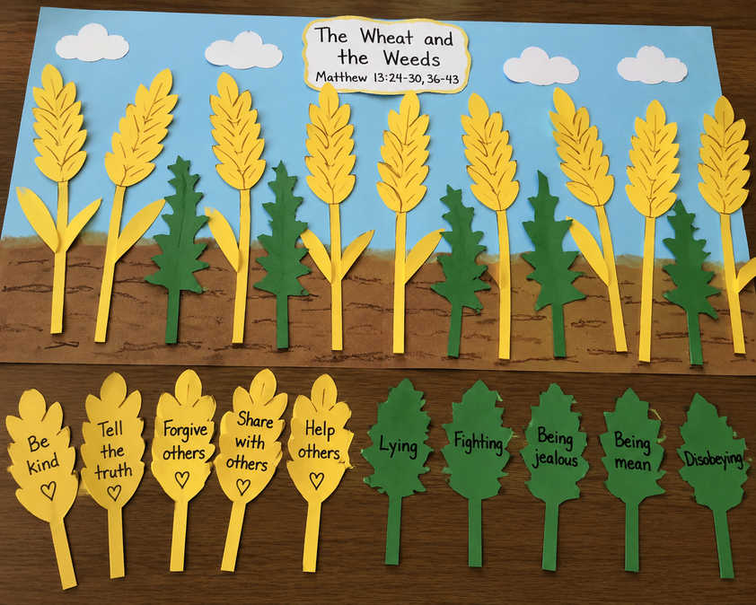
Activity:
“Wheat and Weeds Sorting Craft”
Materials Needed:
•Brown and yellow construction paper
•Green paper
•Scissors
•Glue
•Pen/Marker

Slide 28
Activity:
“Wheat and Weeds Sorting Craft”
•On the back of each weed, write behaviors to avoid (lying, fighting, jealousy).
•Draw or cut out several wheat stalks (yellow) and weeds (green).
•Glue them onto a field.
•On the back of each wheat, write ways to live like Jesus (kindness, honesty, forgiveness, sharing).

Slide 29


Dear God,
Thank You for loving and caring for us every day. Help us grow like the good wheat and choose what is right. May our faith grow like the mustard seed, and fill our hearts with love, kindness, and forgiveness. Help us obey You and share Your love with others each day.
Amen.
Closing Prayer

Slide 30
Live the Word Kids

