Slide 1




Live the Word Kids

Slide 2

“ Fifteenth Sunday in Ordinary Time”
July 12, 2026 | Cycle A Year 2

Slide 3
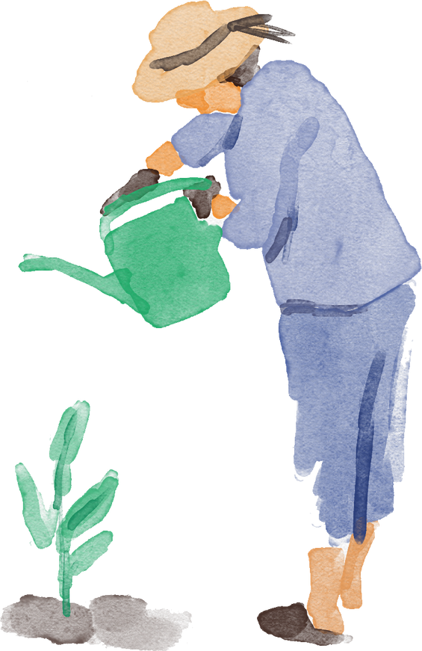
“ The Parable of the Sower”
Matthew 13:1-9

Slide 4

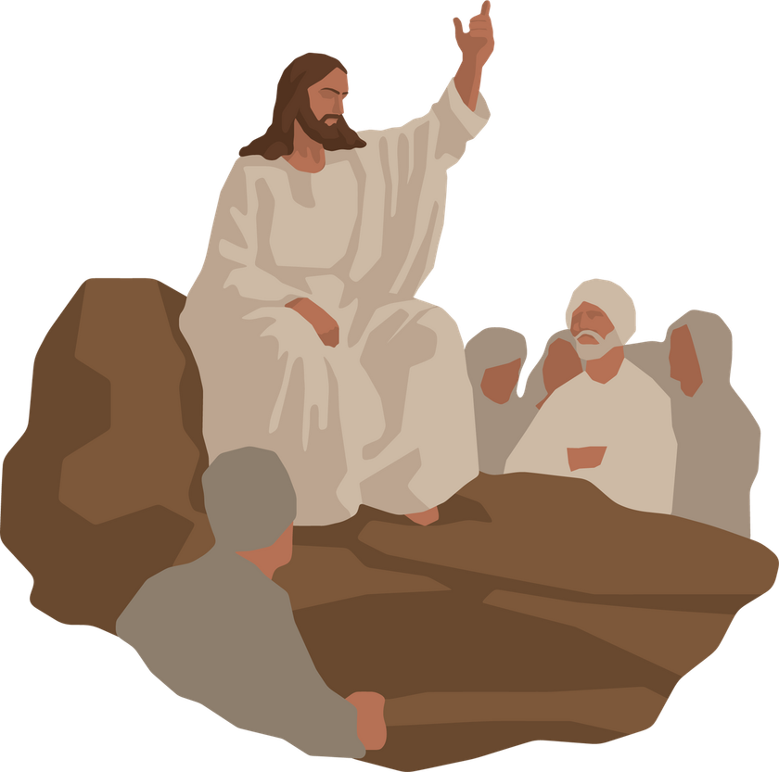
Leader:
A reading from the Holy Gospel according to Luke.
All:
Glory to You, Oh Lord.

Slide 5
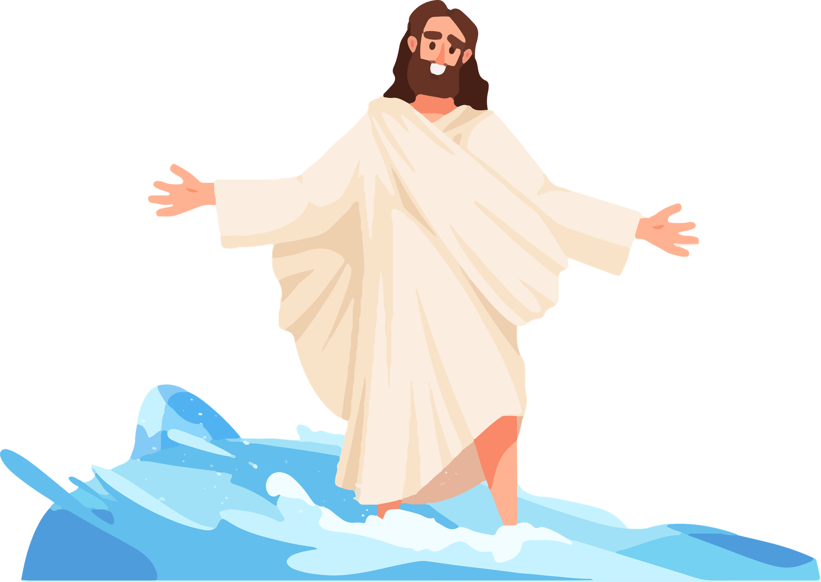
1
That same day Jesus left the house and went to the lakeside, where he sat down to teach.

Slide 6
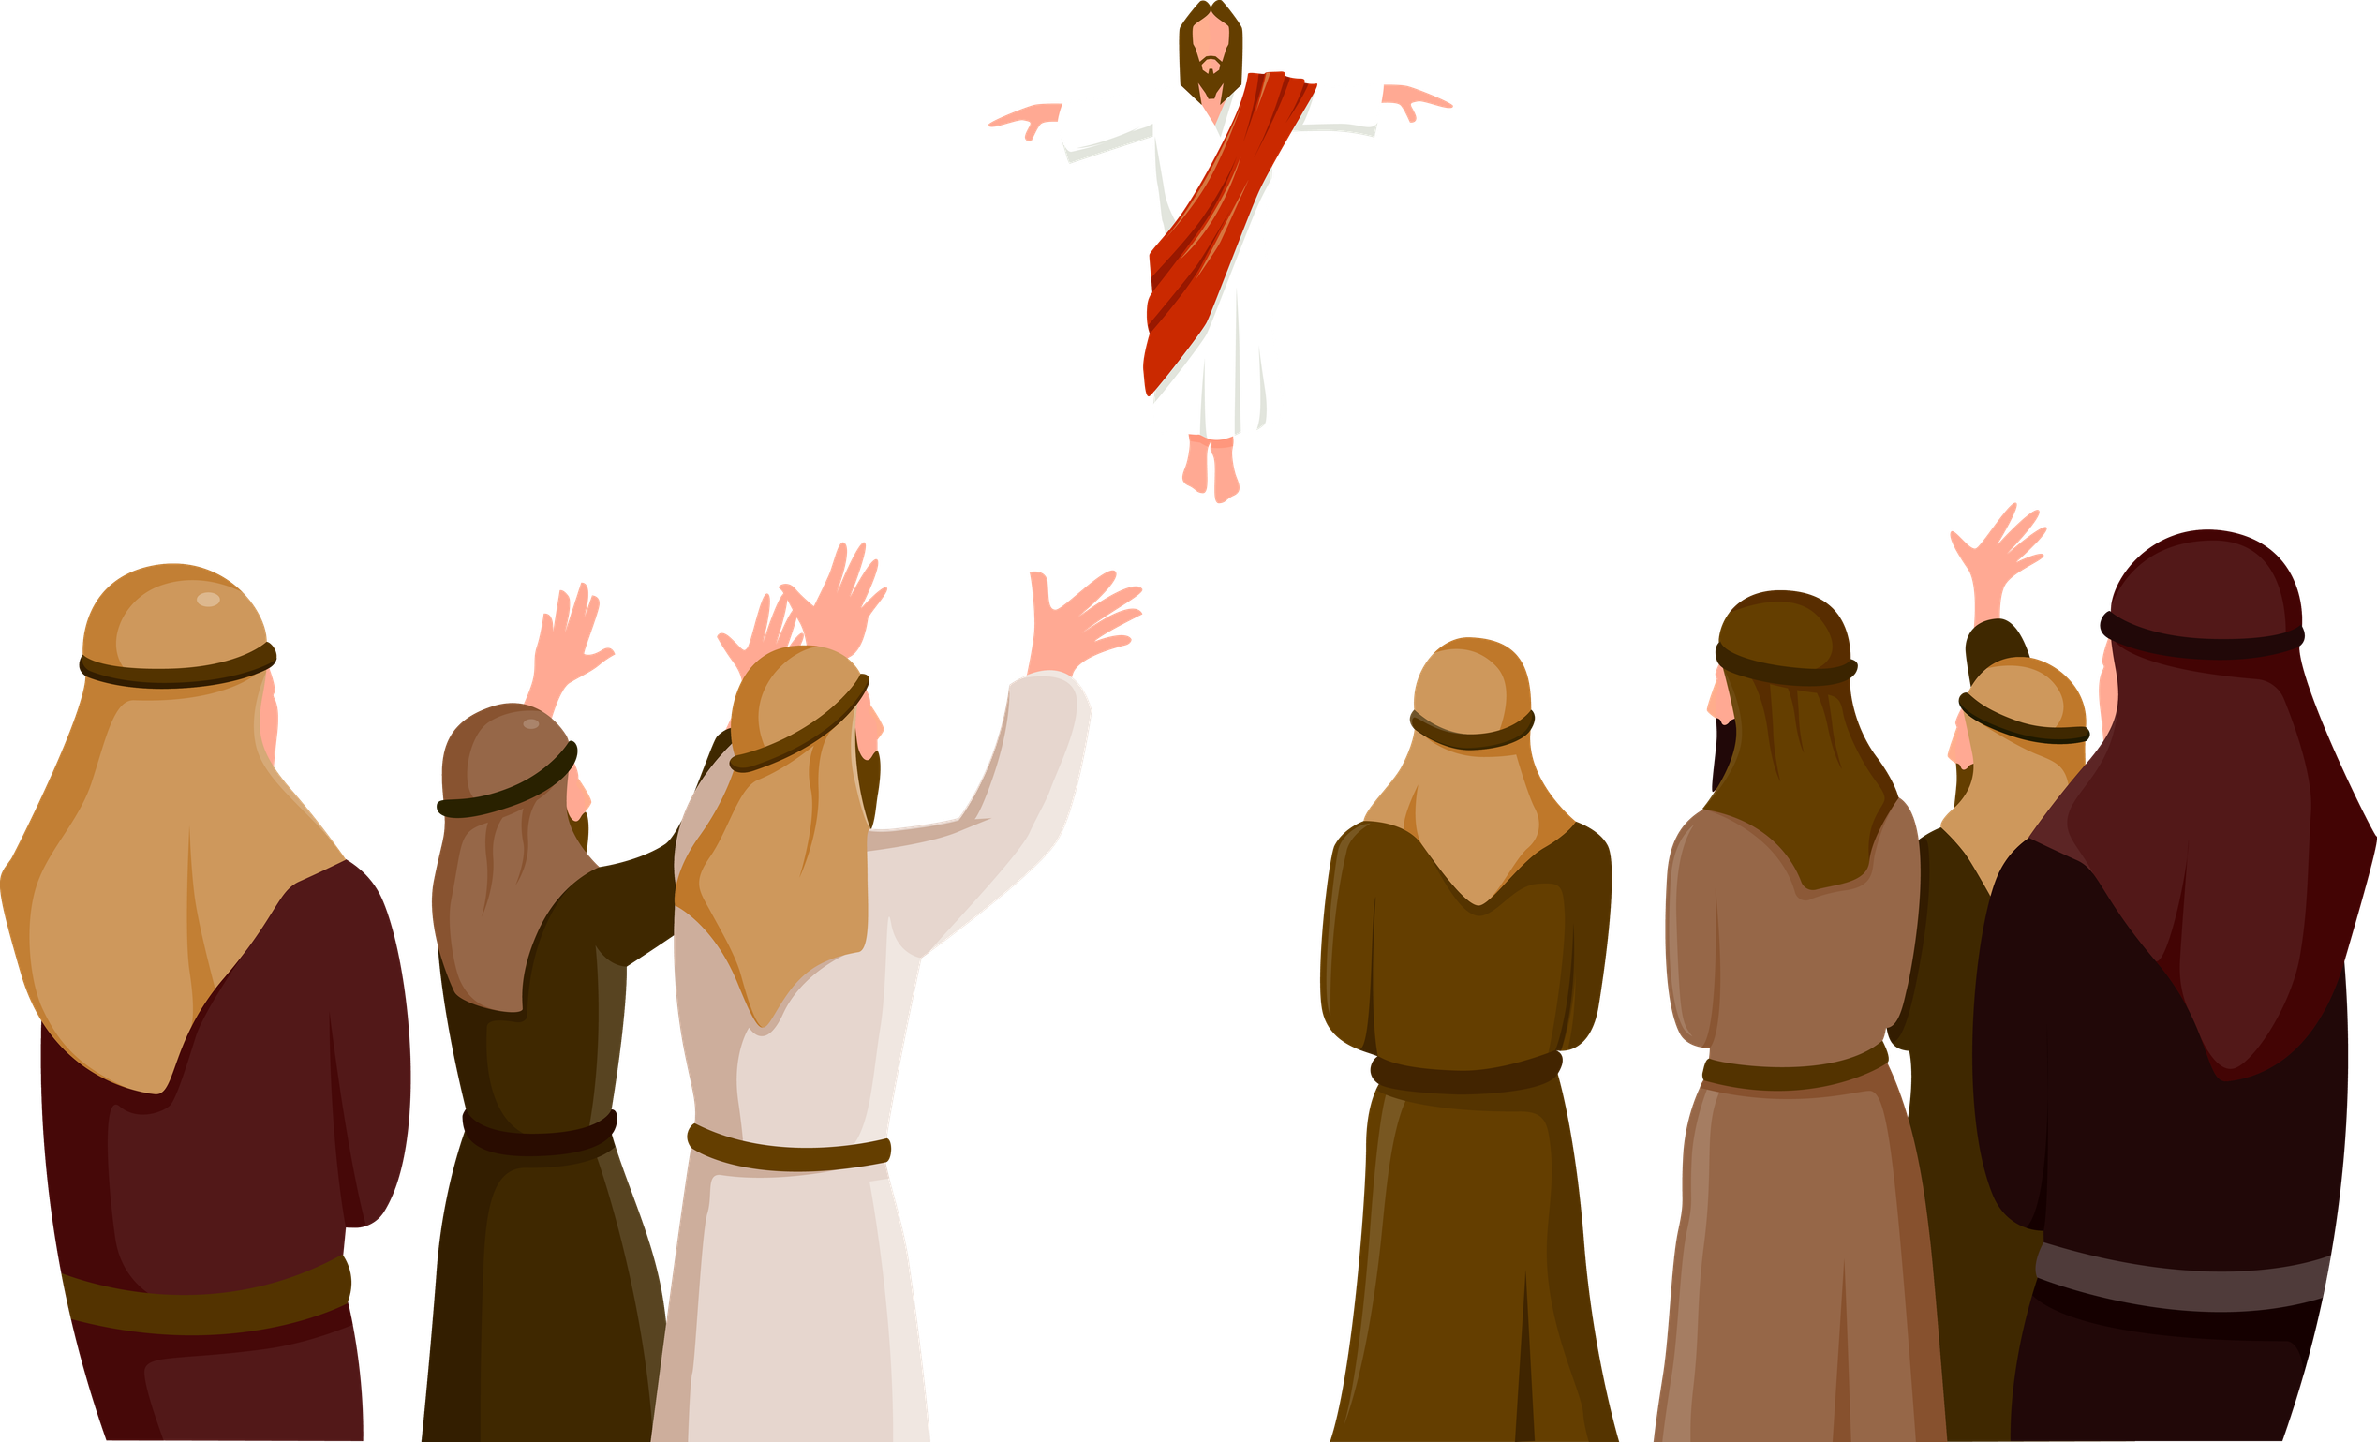
2
The crowd that gathered around him was so large that he got into a boat and sat in it, while the crowd stood on the shore.

Slide 7
3
He used parables to tell them many things.
“Once there was a man who went out to sow grain.

Slide 8
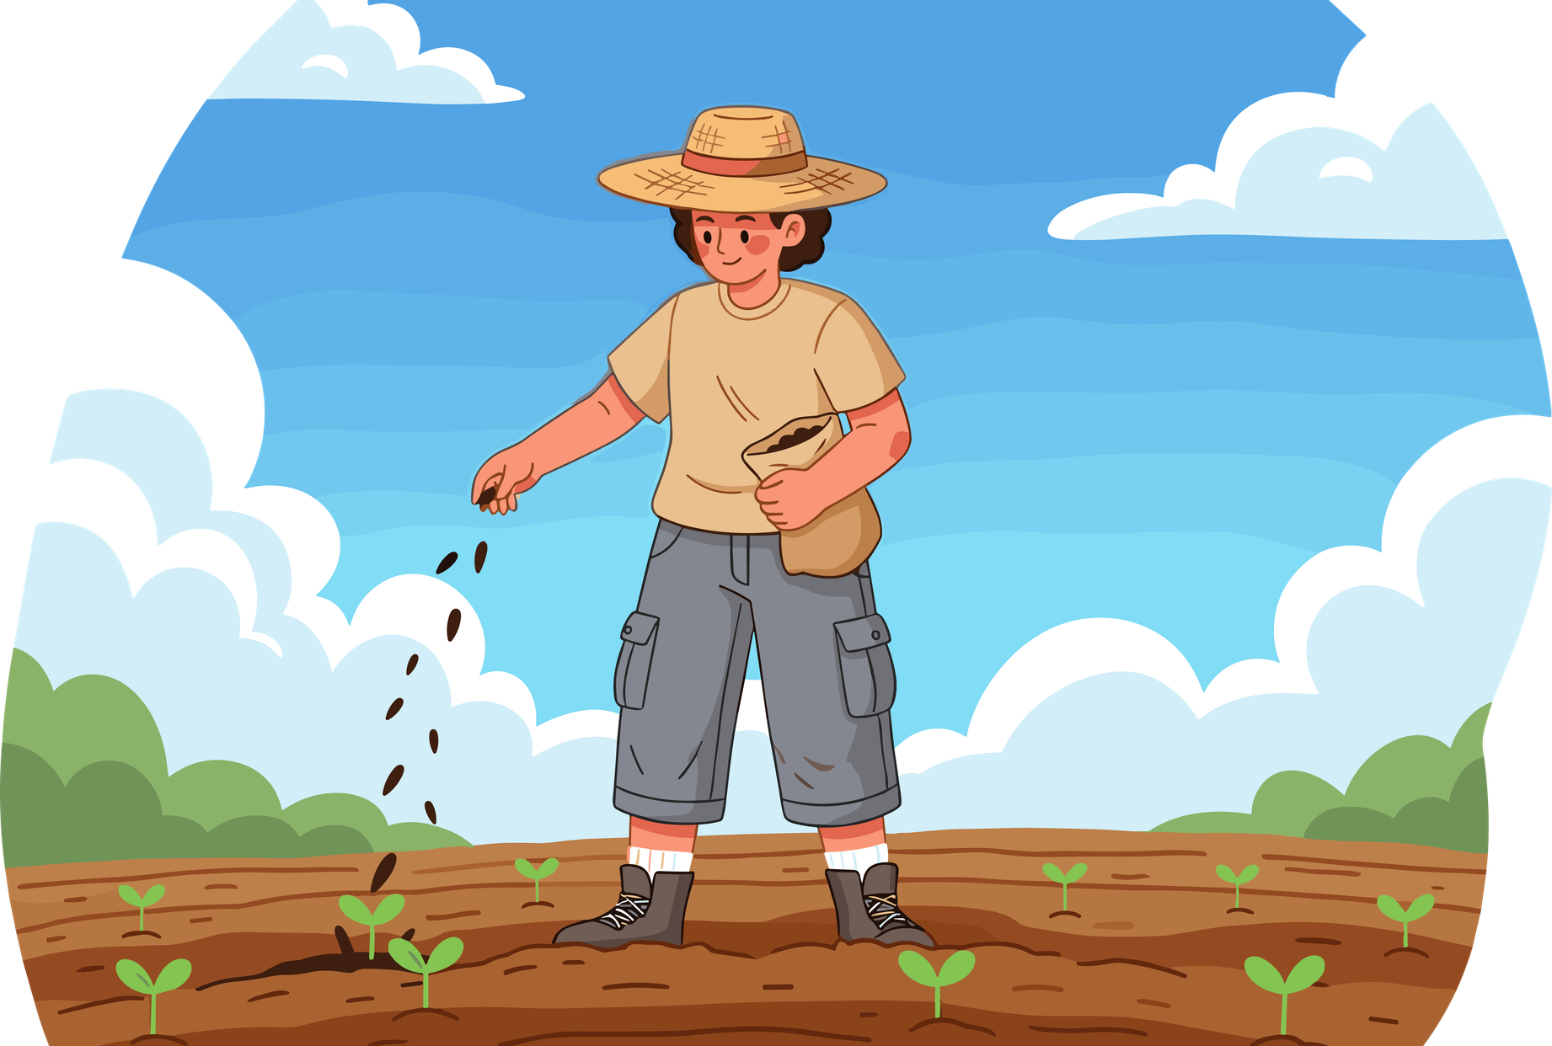
4
As he scattered the seed in the field, some of it fell along the path, and the birds came and ate it up.

Slide 9
5
Some of it fell on rocky ground, where there was little soil. The seeds soon sprouted, because the soil wasn't deep.

Slide 10
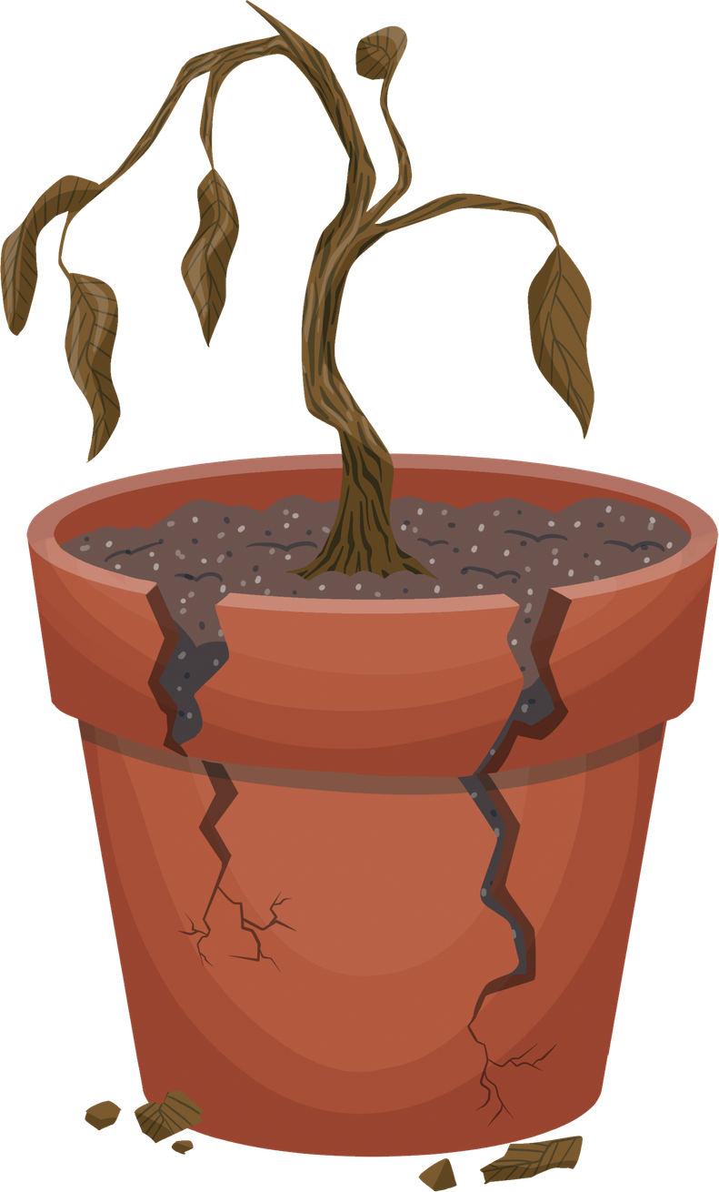
6
But when the sun came up, it burned the young plants; and because the roots had not grown deep enough, the plants soon dried up.

Slide 11
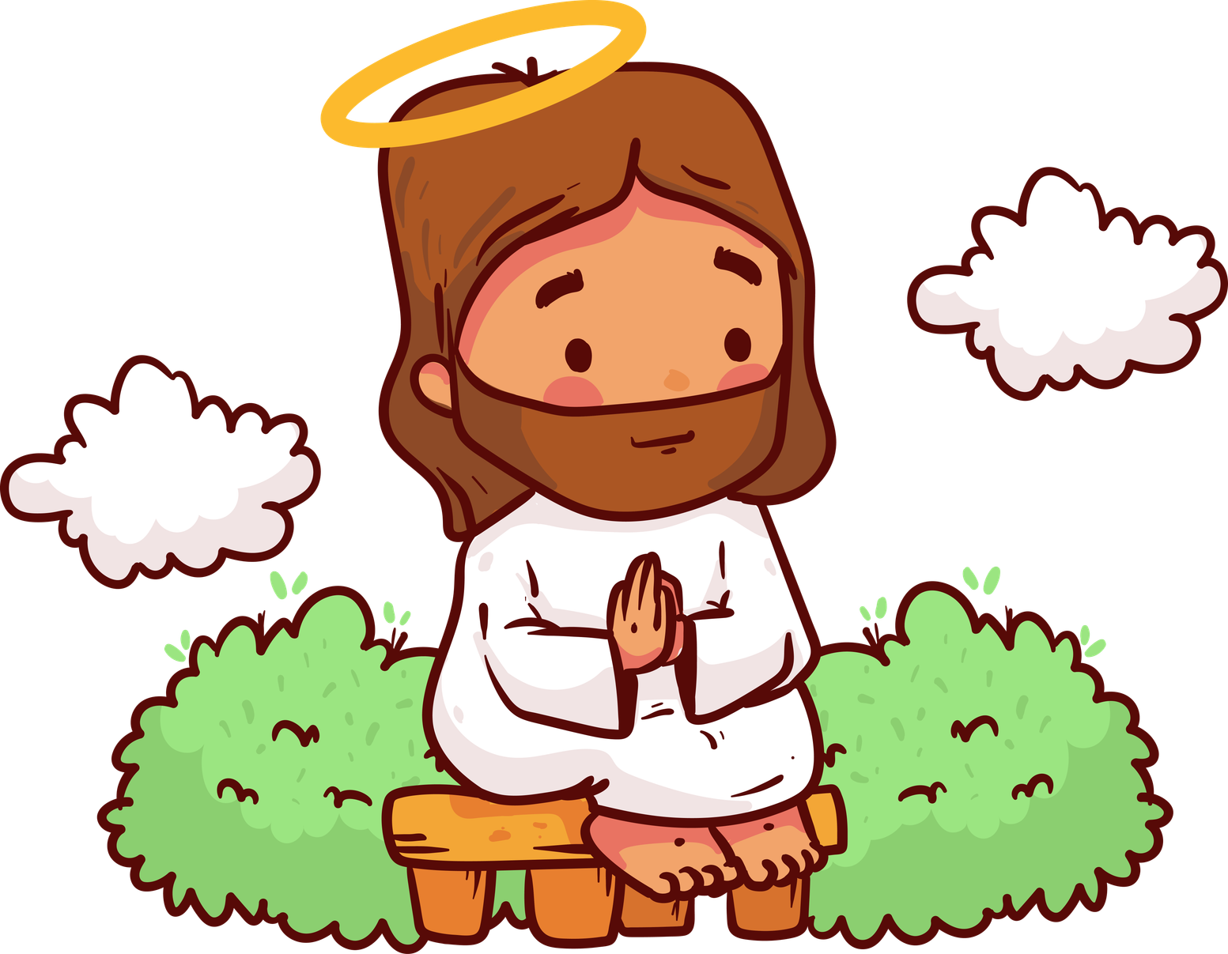
7
Some of the seed fell among thorn bushes, which grew up and choked the plants.

Slide 12

8
But some seeds fell in good soil, and the plants bore grain: some had one hundred grains, others sixty, and others thirty.”

Slide 13
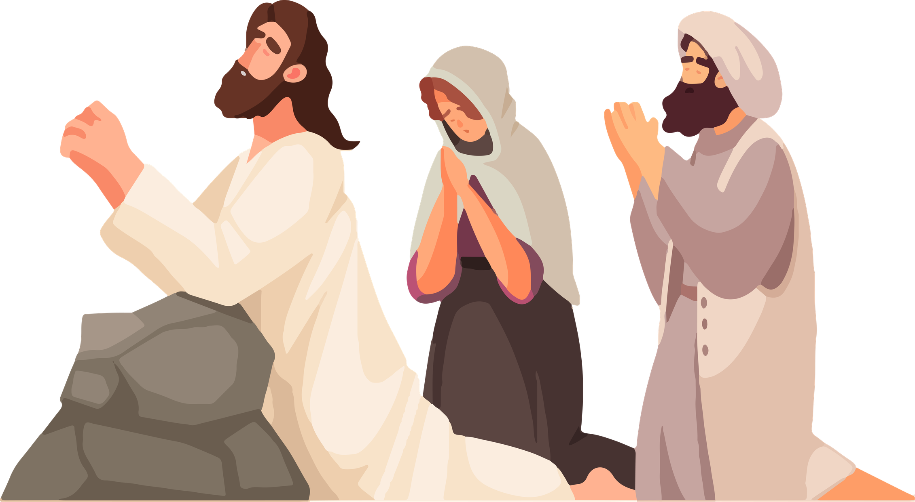
9
And Jesus concluded, “Listen, then, if you have ears!”

Slide 14
Leader:
The Gospel of the Lord
All:
Praise to you, Lord Jesus Christ.

Slide 15
Gospel Message

Slide 16
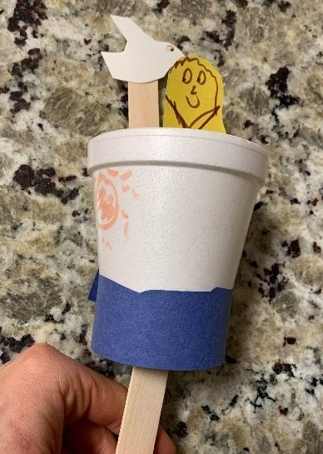
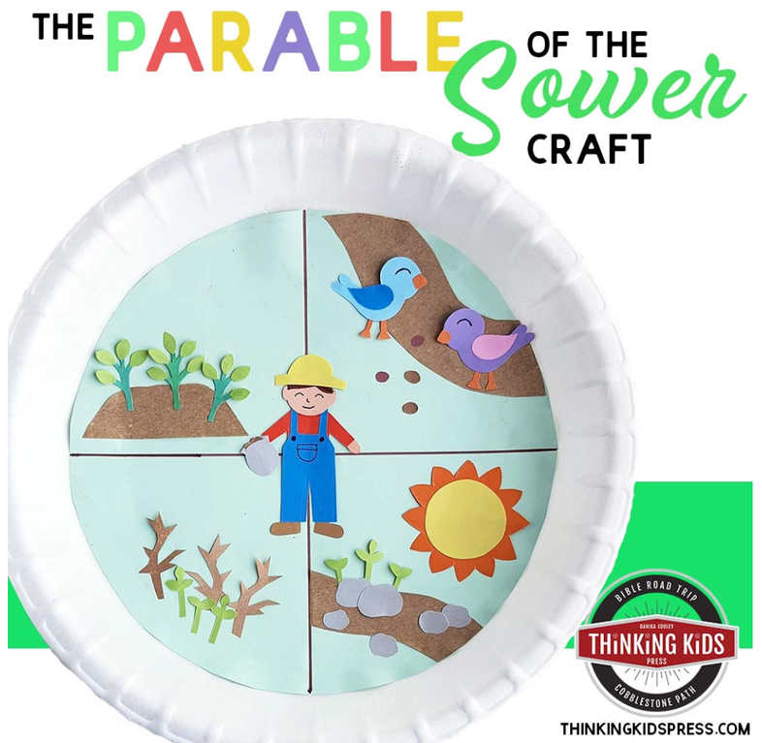
Activity:
“The Parable of the Sower Craft”
Materials Needed:
  Glue stick
  2 paper plates per
  1 paper fastener
  Crayons, markers, or colored pencils
  Safety scissors
  Pebbles, soil, leaves

Slide 17
  Push the metal pin right through the center hole of both plates and open the tabs on the back. Now, spin your wheel!
Instructions:
  Look at the plate with 4 spaces. Color them: the path, the rocks, the thorns, and the good soil.
  Glue your pebbles on the rocky soil, twigs on the thorny soil, and seeds on the path!
  Put the plate with the "cut-out window" right on top of your colored soil plate.

Slide 18
Dear God,
Heavenly Father, Lord, make our hearts like the good soil. Soften our hearts so we can listen to your word, understand it, and share your love and kindness with everyone we meet. May our lives produce a wonderful, joyful harvest for your kingdom.
In Jesus’s name,
Amen!
Closing Prayer

Slide 19
Live the Word Kids

