Slide 1






Live the Word Kids

Slide 2





3rd Sunday in Ordinary Time
January 25, 2026 | Cycle A Year 2

Slide 3
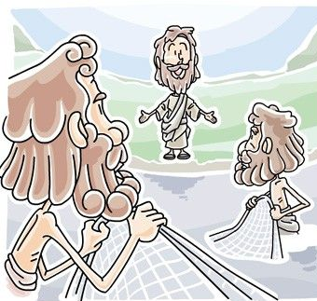

Jesus Calls Four Fishermen
Matthew 4:12-23

Slide 4


Leader:
A reading from the Holy Gospel according to Matthew.
All:
Glory to You, Oh Lord.

Slide 5

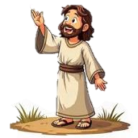
12
When Jesus heard that John had been put in prison, he went away to Galilee.

Slide 6
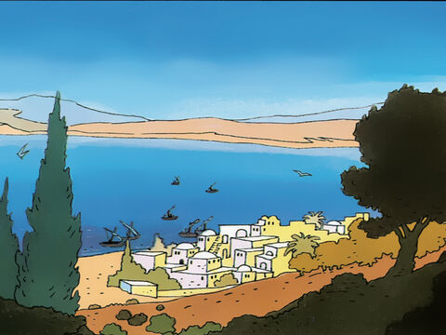
13
He did not stay in Nazareth, but went to live in Capernaum, a town by Lake Galilee, in the territory of Zebulun and Naphtali.

Slide 7
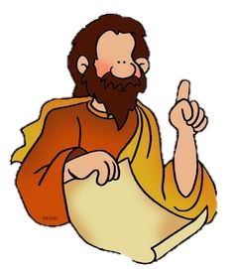
14
This was done to make come true what the prophet Isaiah had said,

Slide 8
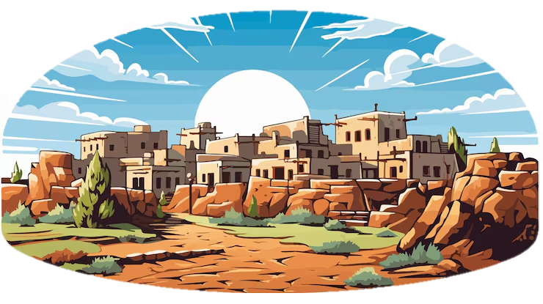
15
“Land of Zebulun and land of Naphtali,
on the road to the sea, on the other side of the Jordan,
Galilee, land of the Gentiles!

Slide 9
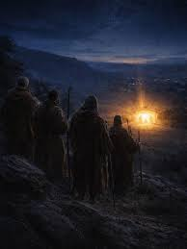
16
The people who live in darkness will see a great light.
On those who live in the dark land of death the light will shine.”

Slide 10
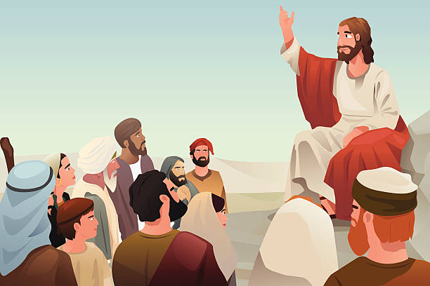
17
From that time Jesus began to preach his message: “Turn away from your sins, because the Kingdom of heaven is near!”

Slide 11
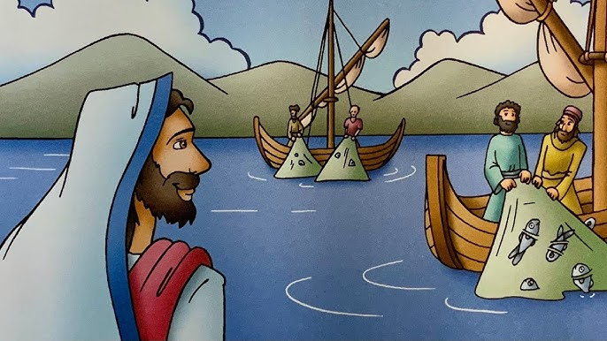
18
As Jesus walked along the shore of Lake Galilee, he saw two brothers who were fishermen, Simon (called Peter) and his brother Andrew, catching fish in the lake with a net.

Slide 12
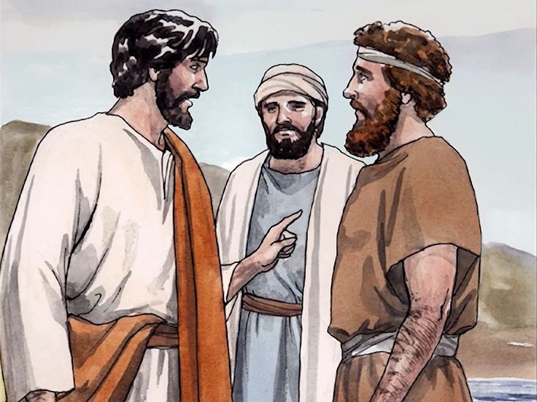
19
Jesus said to them, “Come with me, and I will teach you to catch people.”

Slide 13
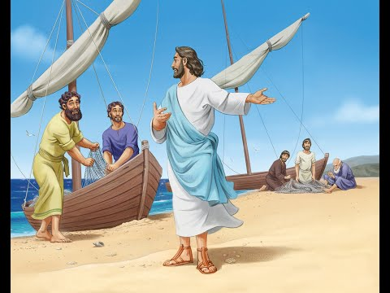
20
At once they left their nets and went with him.

Slide 14
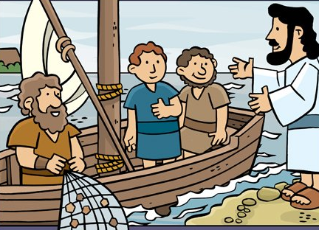
21
He went on and saw two other brothers, James and John, the sons of Zebedee. They were in their boat with their father Zebedee, getting their nets ready. Jesus called them,

Slide 15
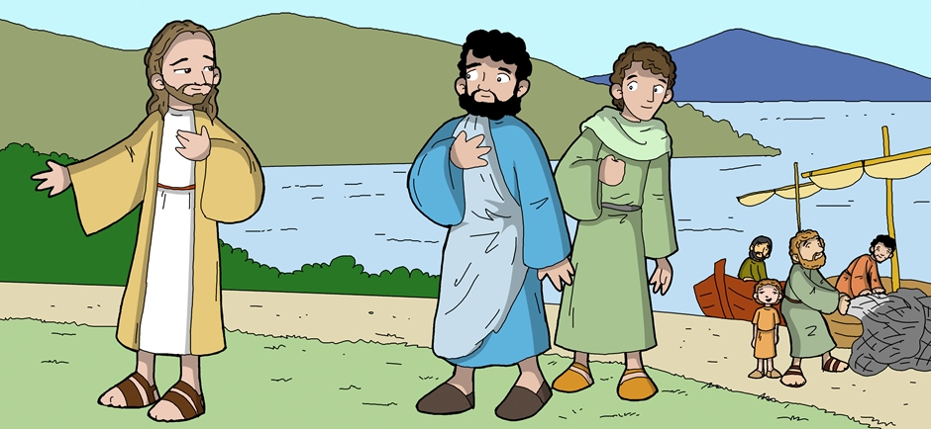
22
and at once they left the boat and their father, and went with him.

Slide 16
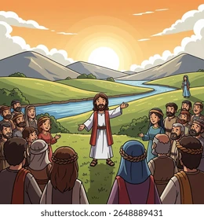
23
Jesus went all over Galilee, teaching in the synagogues, preaching the Good News about the Kingdom, and healing people who had all kinds of disease and sickness.

Slide 17


Gospel Message

Slide 18
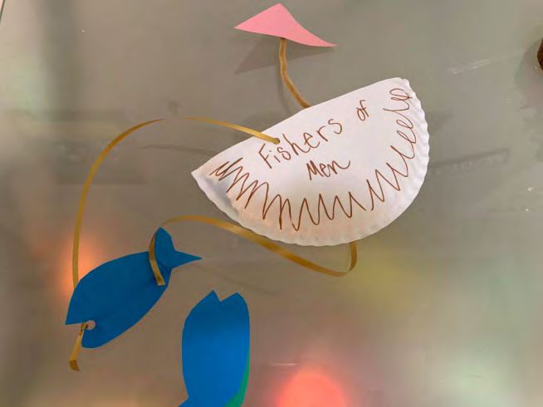
Activity:
“Fishers of Men Boat”
Materials Needed:
  Paper or Notecards
  Scissors
  String or Pipe cleaners
  Markers or decorating materials
  Hole punch or tape

Slide 19
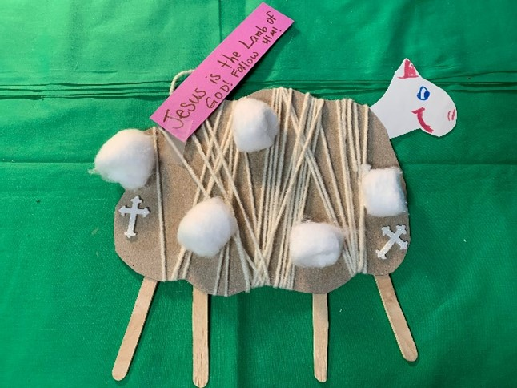
Instructions:
1. Cut cardboard or cardstock in the shape of a sheep body.
2. Add popsicle sticks or clothespins to the sheep to represent legs.
3. Add verses or captions to recall Jesus as the Lamb of God.
4. Attach cotton balls or string to represent wool around the sheep.
5. Add a head and face, along with any other desired elements. Hang or display in honor of God’s lamb!

Slide 20


Dear God,
Thank you for the love of Jesus
Help us to follow Him and know what that means.
Help us share His love with one another.
Thank you that we can be disciples, too.
Thank you for your love.
In Jesus’s name,
Amen!
Closing Prayer

Slide 21
Live the Word Kids

