Slide 1






Live the Word Kids

Slide 2





2nd Sunday in Ordinary Time
January 18, 2026 | Cycle A Year 2

Slide 3
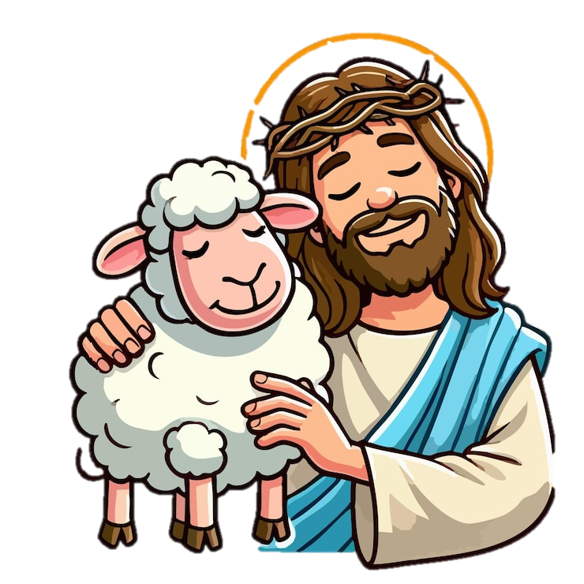

The Lamb of God
John 1:29-34

Slide 4


Leader:
A reading from the Holy Gospel according to John.
All:
Glory to You, Oh Lord.

Slide 5
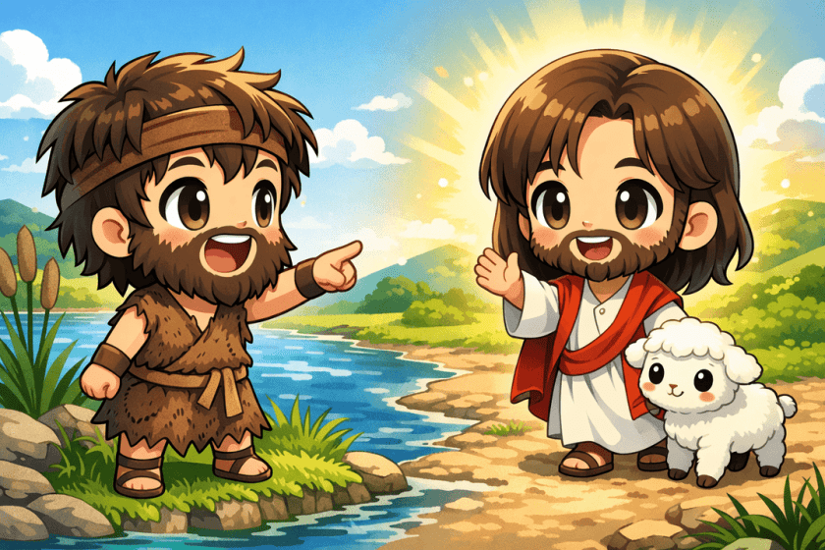
29
The next day John saw Jesus coming to him, and said, “There is the Lamb of God, who takes away the sin of the world!

Slide 6
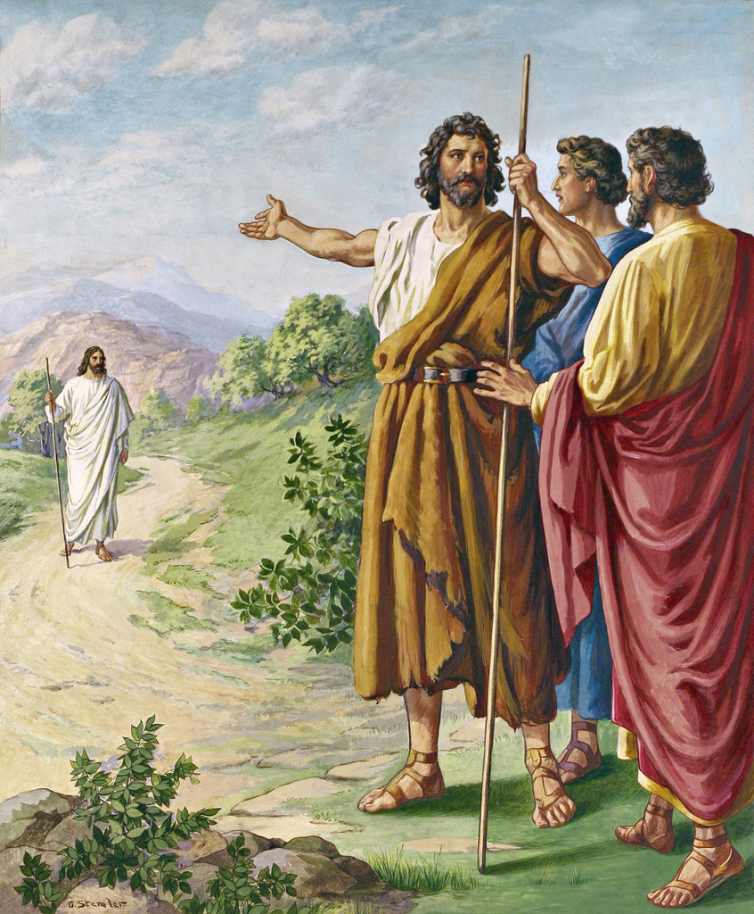
30
This is the one I was talking about when I said, ‘A man is coming after me, but he is greater than I am, because he existed before I was born.’

Slide 7
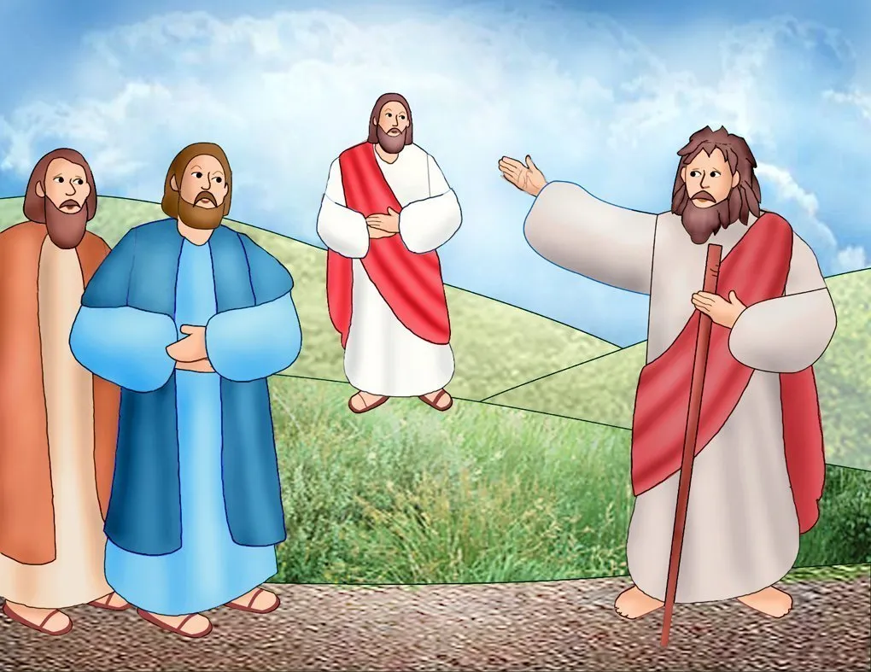
31
I did not know who he would be, but I came baptizing with water in order to make him known to the people of Israel.”

Slide 8
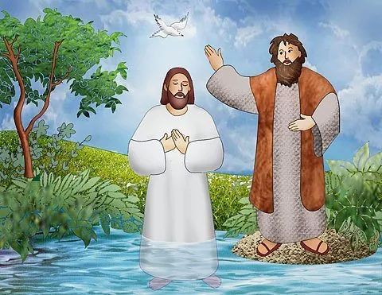
32
And John gave this testimony: “I saw the Spirit come down like a dove from heaven and stay on him.

Slide 9
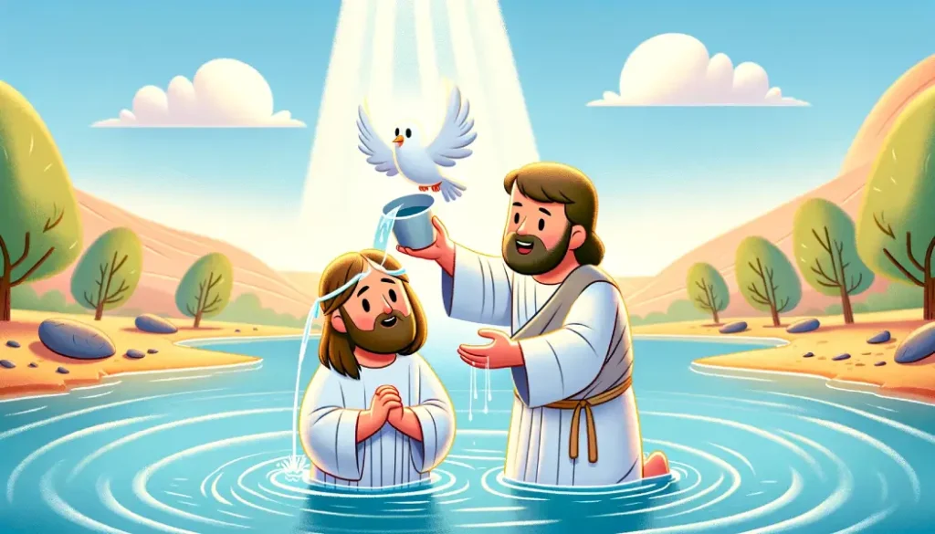
33
I still did not know that he was the one, but God, who sent me to baptize with water, had said to me, ‘You will see the Spirit come down and stay on a man; he is the one who baptizes with the Holy Spirit.’

Slide 10
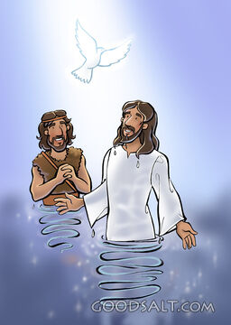
34
I have seen it,” said John, “and I tell you that he is the Son of God.”

Slide 11


Gospel Message

Slide 12
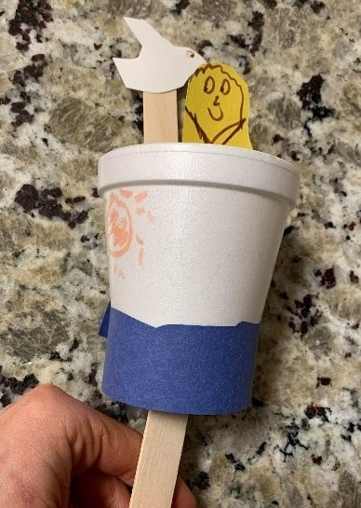
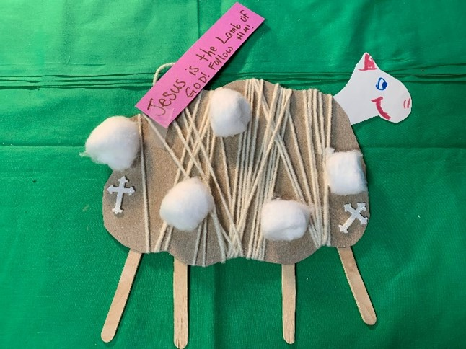
Activity:
“Lamb of God” decor
Materials Needed:
  Markers/crayons
  Construction paper or card stock
  Decorations (stickers, glitter, etc.)
  Scissors
  Tape or glue
  Popsicle sticks or clothespins
  Cotton balls
  Yarn or string

Slide 13
Instructions:
1. Cut cardboard or cardstock in the shape of a sheep body.
2. Add popsicle sticks or clothespins to the sheep to represent legs.
3. Add verses or captions to recall Jesus as the Lamb of God.
4. Attach cotton balls or string to represent wool around the sheep.
5. Add a head and face, along with any other desired elements. Hang or display in honor of God’s lamb!

Slide 14


Closing Prayer
Dear God,
Thank You for showing us who You are.Help us listen, believe, and follow You.May we point others to You like John the Baptist did.
In Jesus’s name,
Amen!

Slide 15
Live the Word Kids

