Slide 1






Live the Word Kids

Slide 2





Feast of the Baptism of the Lord
January 11, 2026 | Cycle A Year 2

Slide 3
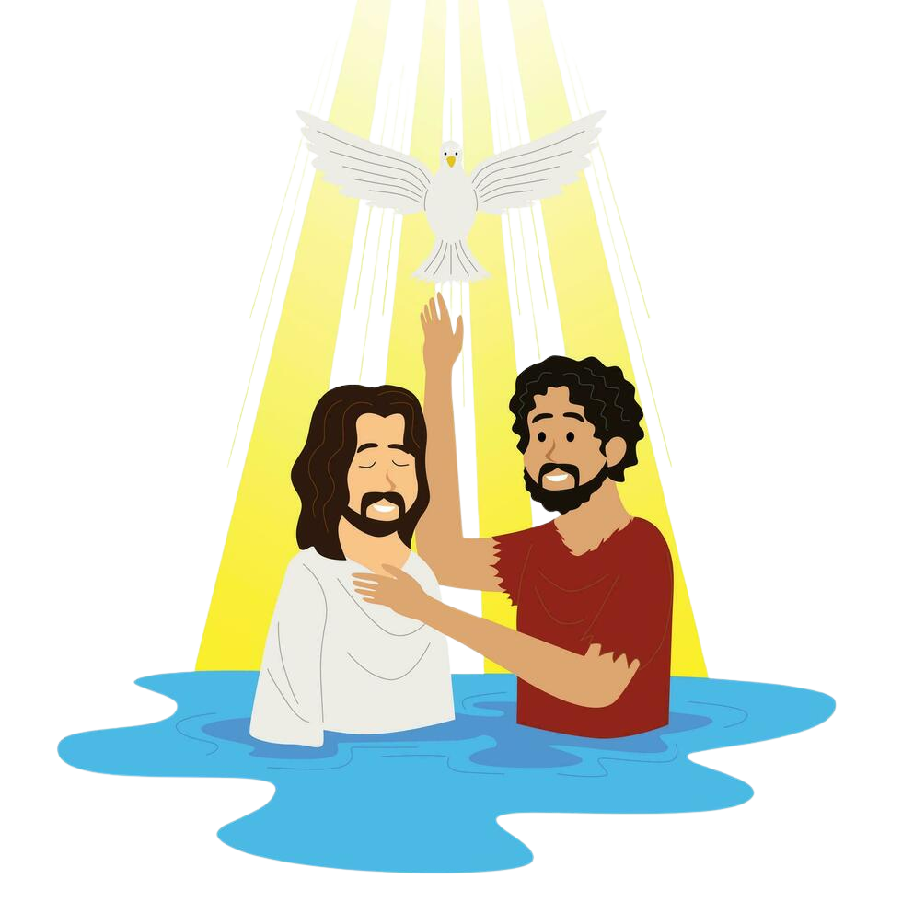

The Baptism of Jesus
Matthew 3:13-17

Slide 4


Leader:
A reading from the Holy Gospel according to Luke.
All:
Glory to You, Oh Lord.

Slide 5
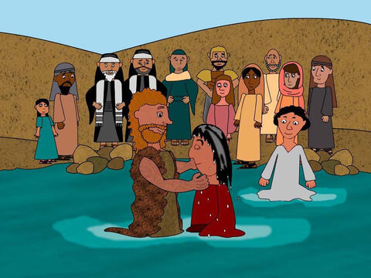
13
At that time Jesus arrived from Galilee and came to John at the Jordan to be baptized by him.

Slide 6
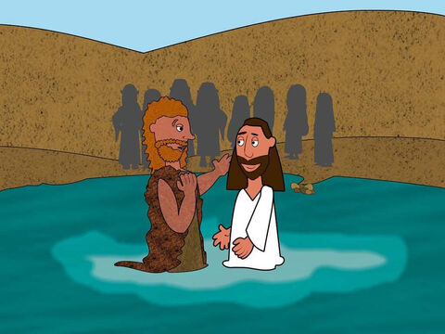
14
But John tried to make him change his mind. “I ought to be baptized by you,” John said, “and yet you have come to me!”

Slide 7
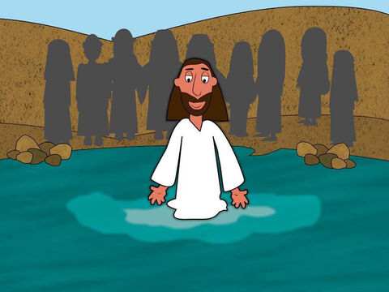
15
But Jesus answered him, “Let it be so for now. For in this way we shall do all that God requires.” So John agreed.

Slide 8
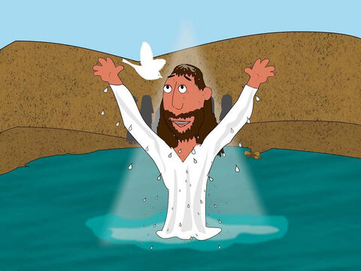
16
As soon as Jesus was baptized, he came up out of the water. Then heaven was opened to him, and he saw the Spirit of God coming down like a dove and lighting on him.

Slide 9
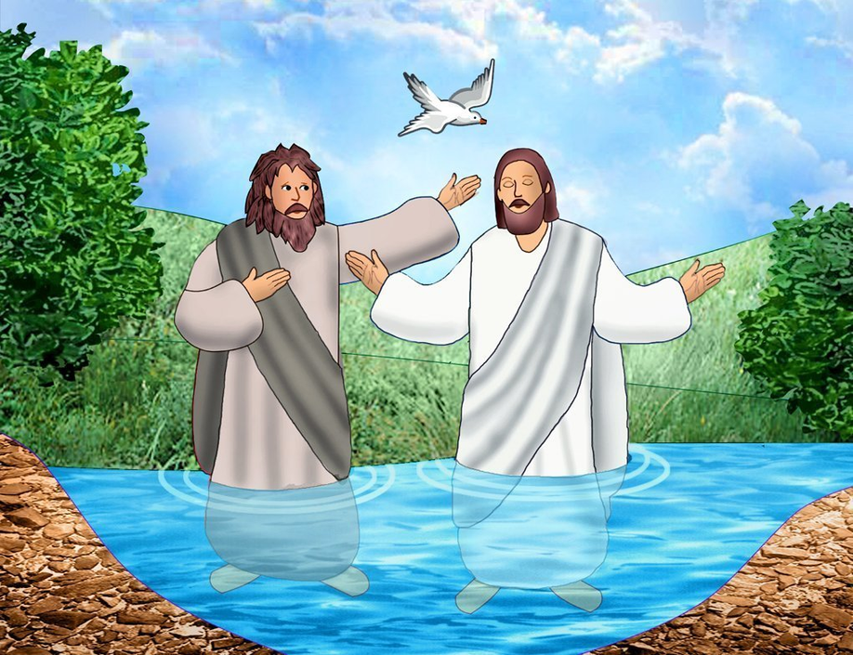
17
Then a voice said from heaven, “This is my own dear Son, with whom I am pleased.”

Slide 10


Gospel Message

Slide 11
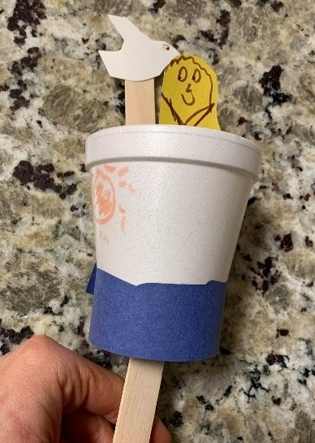
Activity:
“Jesus is Baptized” Craft
Materials Needed:
  Paper or Styrofoam cups
  Tape or glue
  Scissors
  Decorative materials
  Construction paper
  Popsicle sticks or clothespins

Slide 12
Instructions:
6. Make another stick with a dove figure, or attach the dove separately.
7. Watch the dove and “Jesus” go down into the cup (water) and come from above.
1. Decorate your cup with “river waves” or a sunshine scene.
2. Add verse caption, if desired.
3. Carefully stick popsicle stick through the bottom of the cup.
4. Color a Jesus figure (pre-printed or hand-drawn) and cut out.
5. Attach the “Jesus” onto the popsicle stick.

Slide 13


Dear God,
Thank you for baptism
Thank you for washing our sins and making us clean
Help us remember that, and live in your presence
Thank you for your son Jesus
Thank you for your love
We love you, God!
In Jesus’s name,
Amen!
Closing Prayer

Slide 14
Live the Word Kids

