Slide 1






Live the Word Kids

Slide 2





5th Sunday in Ordinary Time
February 8, 2026 | Cycle A Year 2

Slide 3
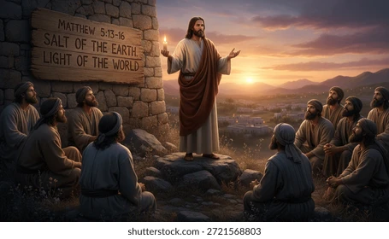

Salt and Light
Matthew 5:13-16

Slide 4


Leader:
A reading from the Holy Gospel according to Matthew.
All:
Glory to You, Oh Lord.

Slide 5

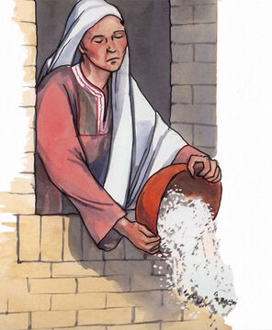
13
“You are like salt for the whole human race. But if salt loses its saltiness, there is no way to make it salty again. It has become worthless, so it is thrown out and people trample on it.

Slide 6
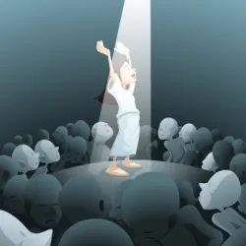
14
“You are like light for the whole world. A city built on a hill cannot be hid.

Slide 7

15
No one lights a lamp and puts it under a bowl; instead it is put on the lampstand, where it gives light for everyone in the house.

Slide 8

16
In the same way your light must shine before people, so that they will see the good things you do and praise your Father in heaven.

Slide 9


Gospel Message

Slide 10
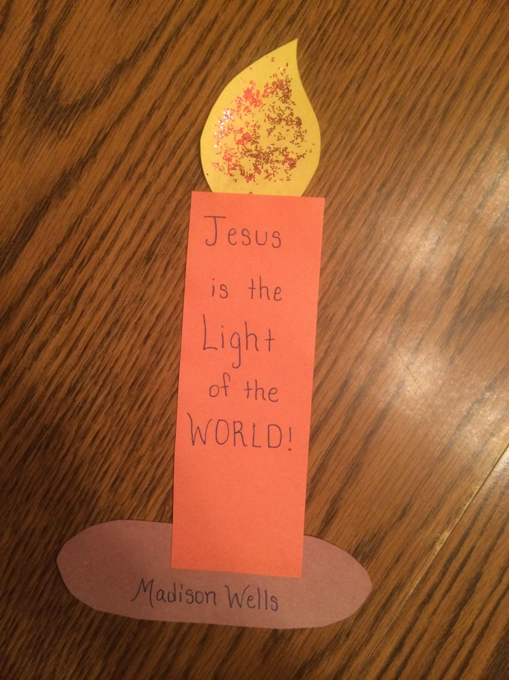
Activity:
“Jesus Is the Light of the World” Candle Craft
Materials Needed:
  Colored paper (orange/red for candle, yellow for flame, brown for base)
  Scissors
  Glue
  Markers or Crayons
  Glitter (optional)

Slide 11
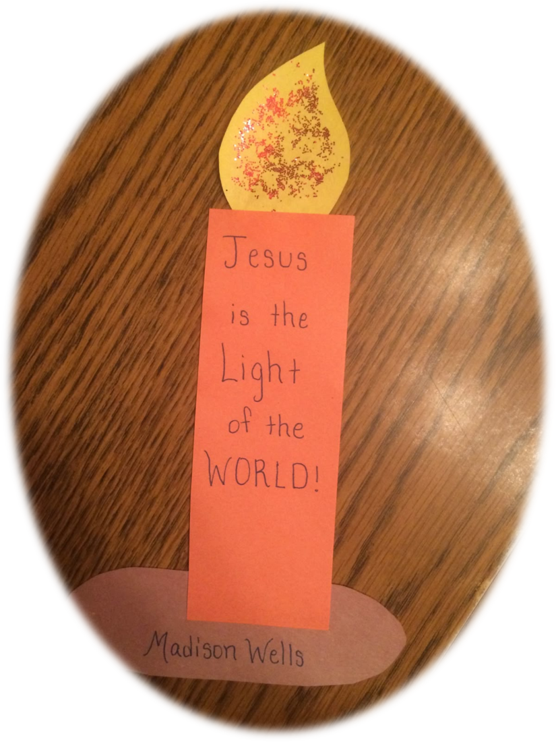
Instructions:
6. Cut an oval shape from brown paper. And write your name on it.
7. Glue it to the bottom of the candle.
Cut a long rectangle from orange or red paper. This will be the candle.
2. Write the message: “Jesus is the Light of the World”
3. Cut a flame shape from yellow paper.
4. Add glitter or draw dots and lines to make it look bright and glowing.
5. Glue the flame to the top of the candle rectangle.

Slide 12


Dear God,
Thank You for teaching us to be the salt and light of the world. Help us to share Your love with everyone we meet. Let our words and actions shine bright so others can see Your goodness. Teach us to be kind, caring, and brave in showing Your love every day.
In Jesus’s name,
Amen!
Closing Prayer

Slide 13
Live the Word Kids

