Slide 1






Live the Word Kids

Slide 2





1st Sunday of Lent
February 22, 2026 | Cycle A Year 2

Slide 3
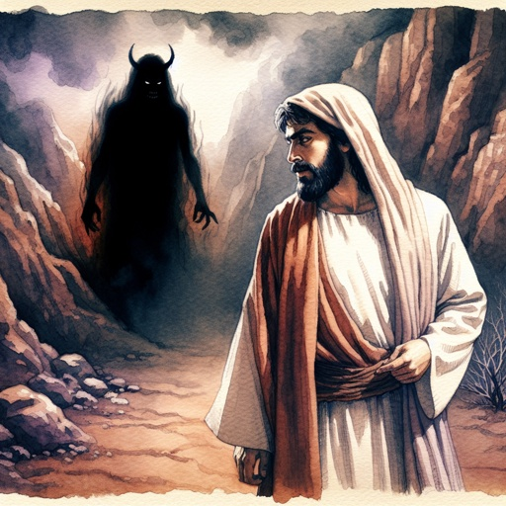
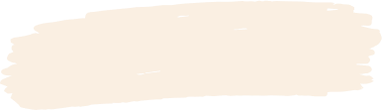
The Temptation of Jesus
Matthew 4:1-11

Slide 4


Leader:
A reading from the Holy Gospel according to Matthew.
All:
Glory to You, Oh Lord.

Slide 5

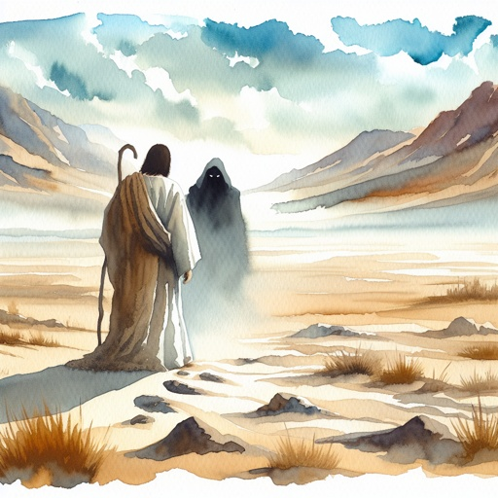
1
Then the Spirit led Jesus into the desert to be tempted by the Devil.

Slide 6
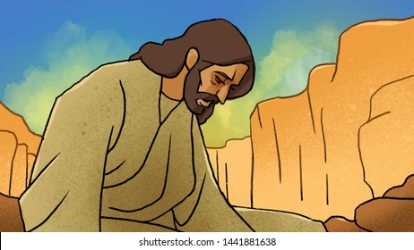
2
After spending forty days and nights without food, Jesus was hungry.

Slide 7
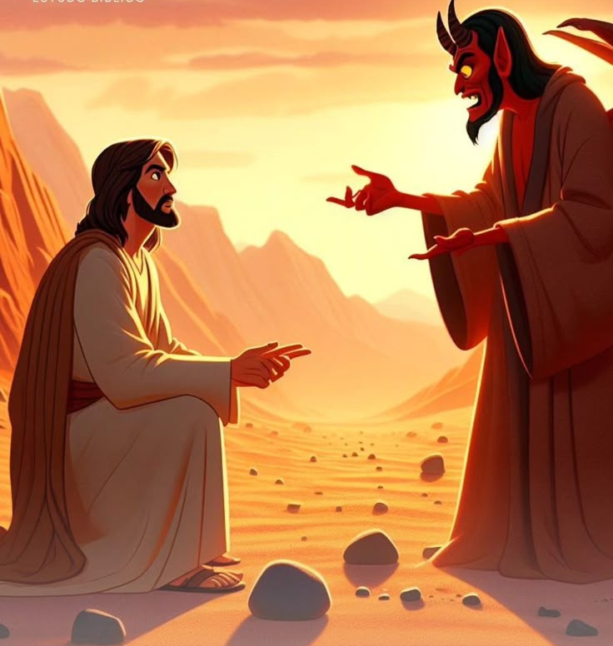
3
Then the Devil came to him and said, “If you are God's Son, order these stones to turn into bread.”

Slide 8
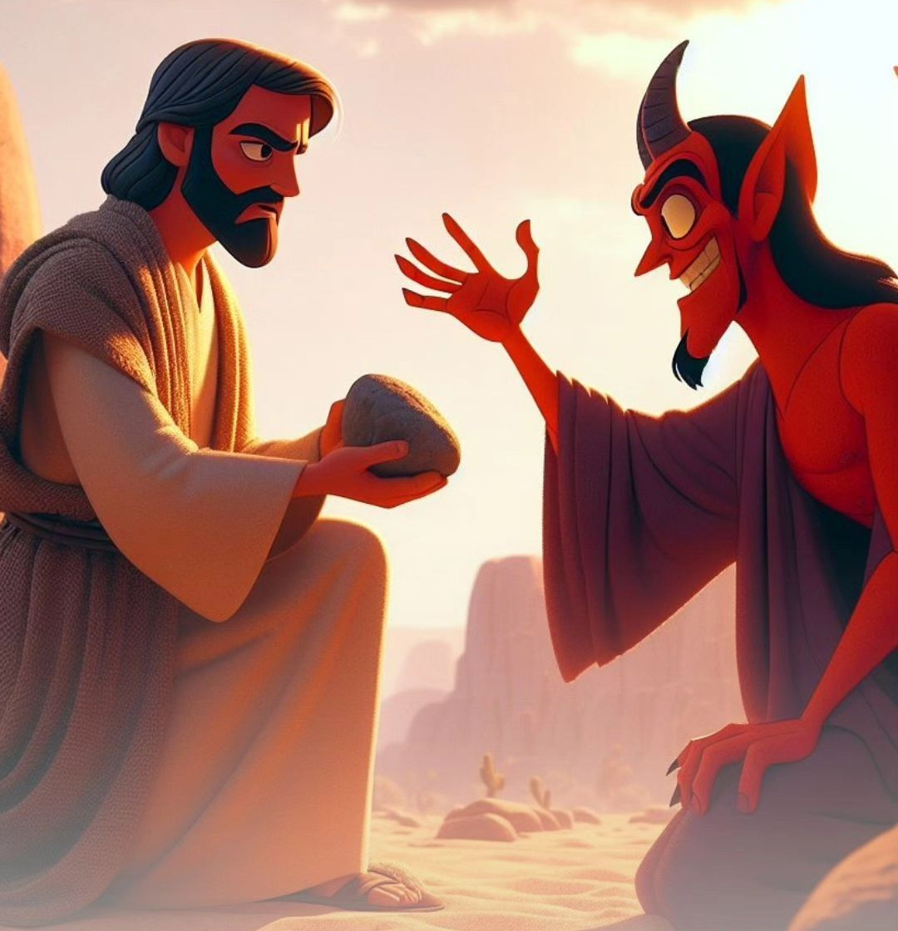
4
But Jesus answered, “The scripture says, ‘Human beings cannot live on bread alone, but need every word that God speaks.’”

Slide 9
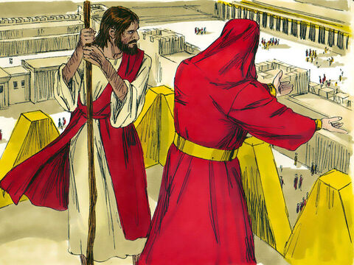
5
Then the Devil took Jesus to Jerusalem, the Holy City, set him on the highest point of the Temple,

Slide 10
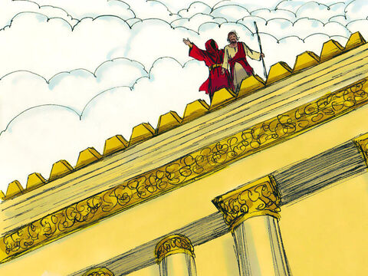
6
and said to him, “If you are God's Son, throw yourself down, for the scripture says,
‘God will give orders to his angels about you; they will hold you up with their hands, so that not even your feet will be hurt on the stones.’”

Slide 11
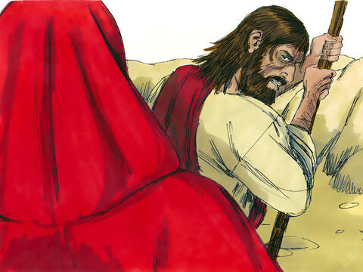
7
Jesus answered, “But the scripture also says, ‘Do not put the Lord your God to the test.’”

Slide 12
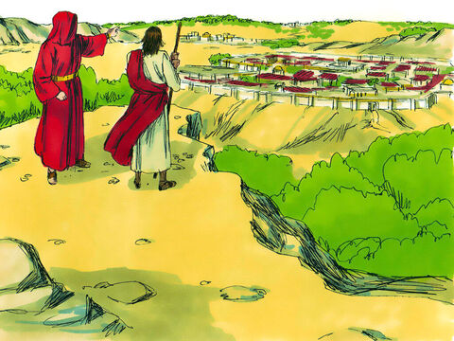
8
Then the Devil took Jesus to a very high mountain and showed him all the kingdoms of the world in all their greatness.

Slide 13
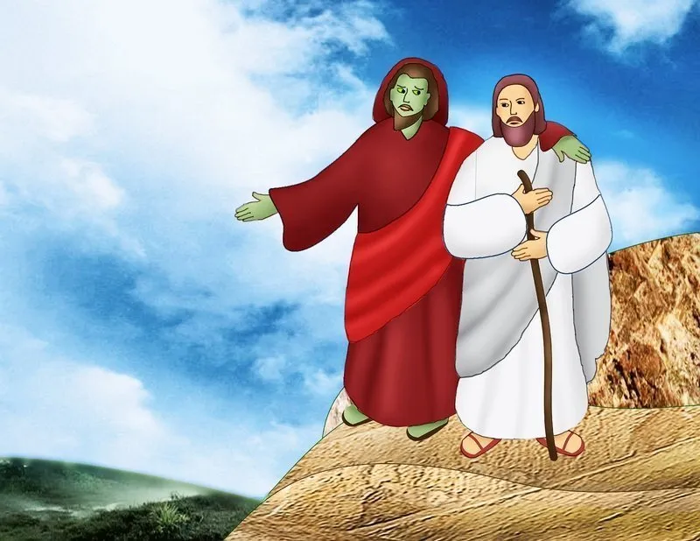
9
“All this I will give you,” the Devil said, “if you kneel down and worship me.”

Slide 14
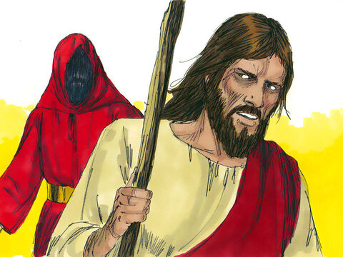
10
Then Jesus answered, “Go away, Satan! The scripture says, ‘Worship the Lord your God and serve only him!’”

Slide 15
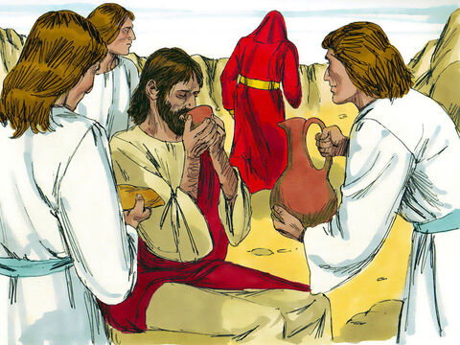
11
Then the Devil left Jesus; and angels came and helped him.

Slide 16


Gospel Message

Slide 17
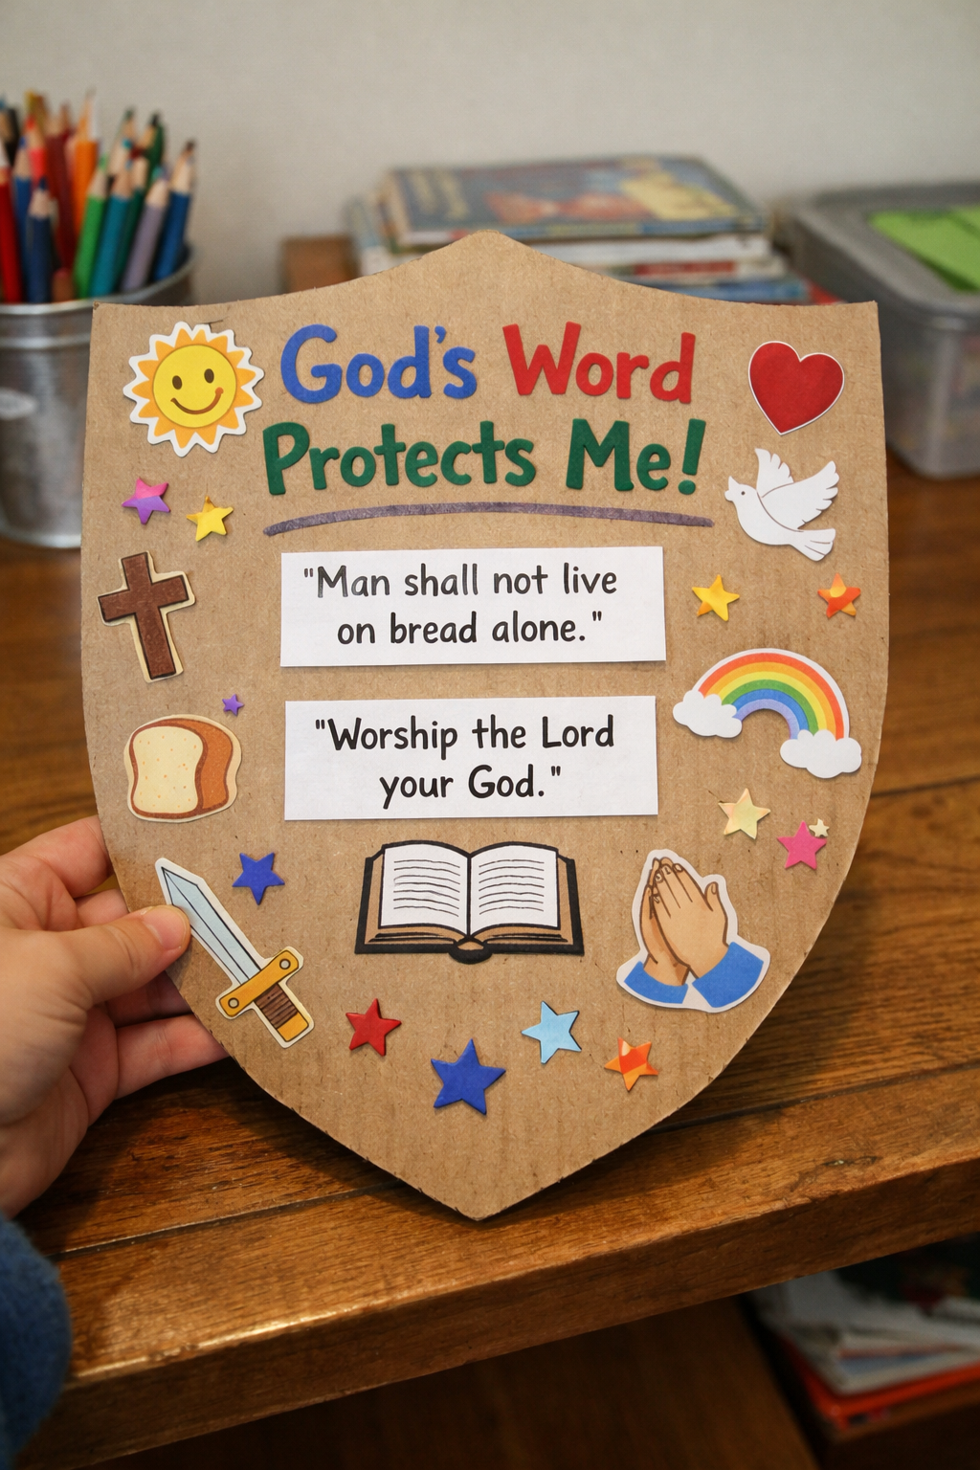
Activity:
Resist Temptation Shield Craft
Materials Needed:
  Card board or Cartolina
  Scissors
  Markers or Crayons

Slide 18
Instructions:
Cut the cardboard into a shield shape.
Write on top: “God’s Word Protects Me!”
Write simple verses Jesus said:
“Man shall not live on bread alone.”
“Worship the Lord your God.”
4. Decorate your shield.

Slide 19


Dear God,
Thank You for showing us how to be strong when we are tempted. Sometimes we want to do things that are not right. Help us choose what is good and pleasing to You. When we feel like lying, fighting, or disobeying, remind us of Your Word. Make our hearts brave like Yours in the desert. Help us say “NO” to wrong choices and “YES” to God’s way.
In Jesus’s name,
Amen!
Closing Prayer

Slide 20
Live the Word Kids

