Slide 1






Live the Word Kids

Slide 2





6th Sunday in Ordinary Time
February 15, 2026 | Cycle A Year 2

Slide 3
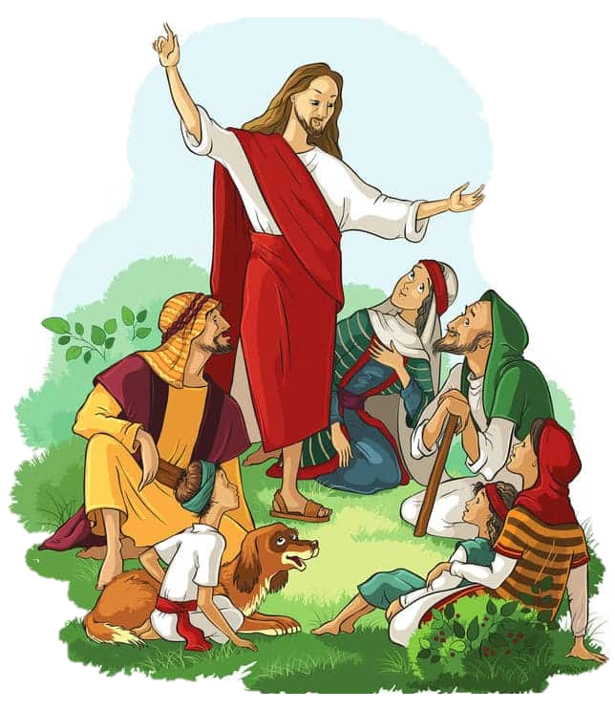

Teaching about the Law
Matthew 5:17-37

Slide 4


Leader:
A reading from the Holy Gospel according to Matthew.
All:
Glory to You, Oh Lord.

Slide 5

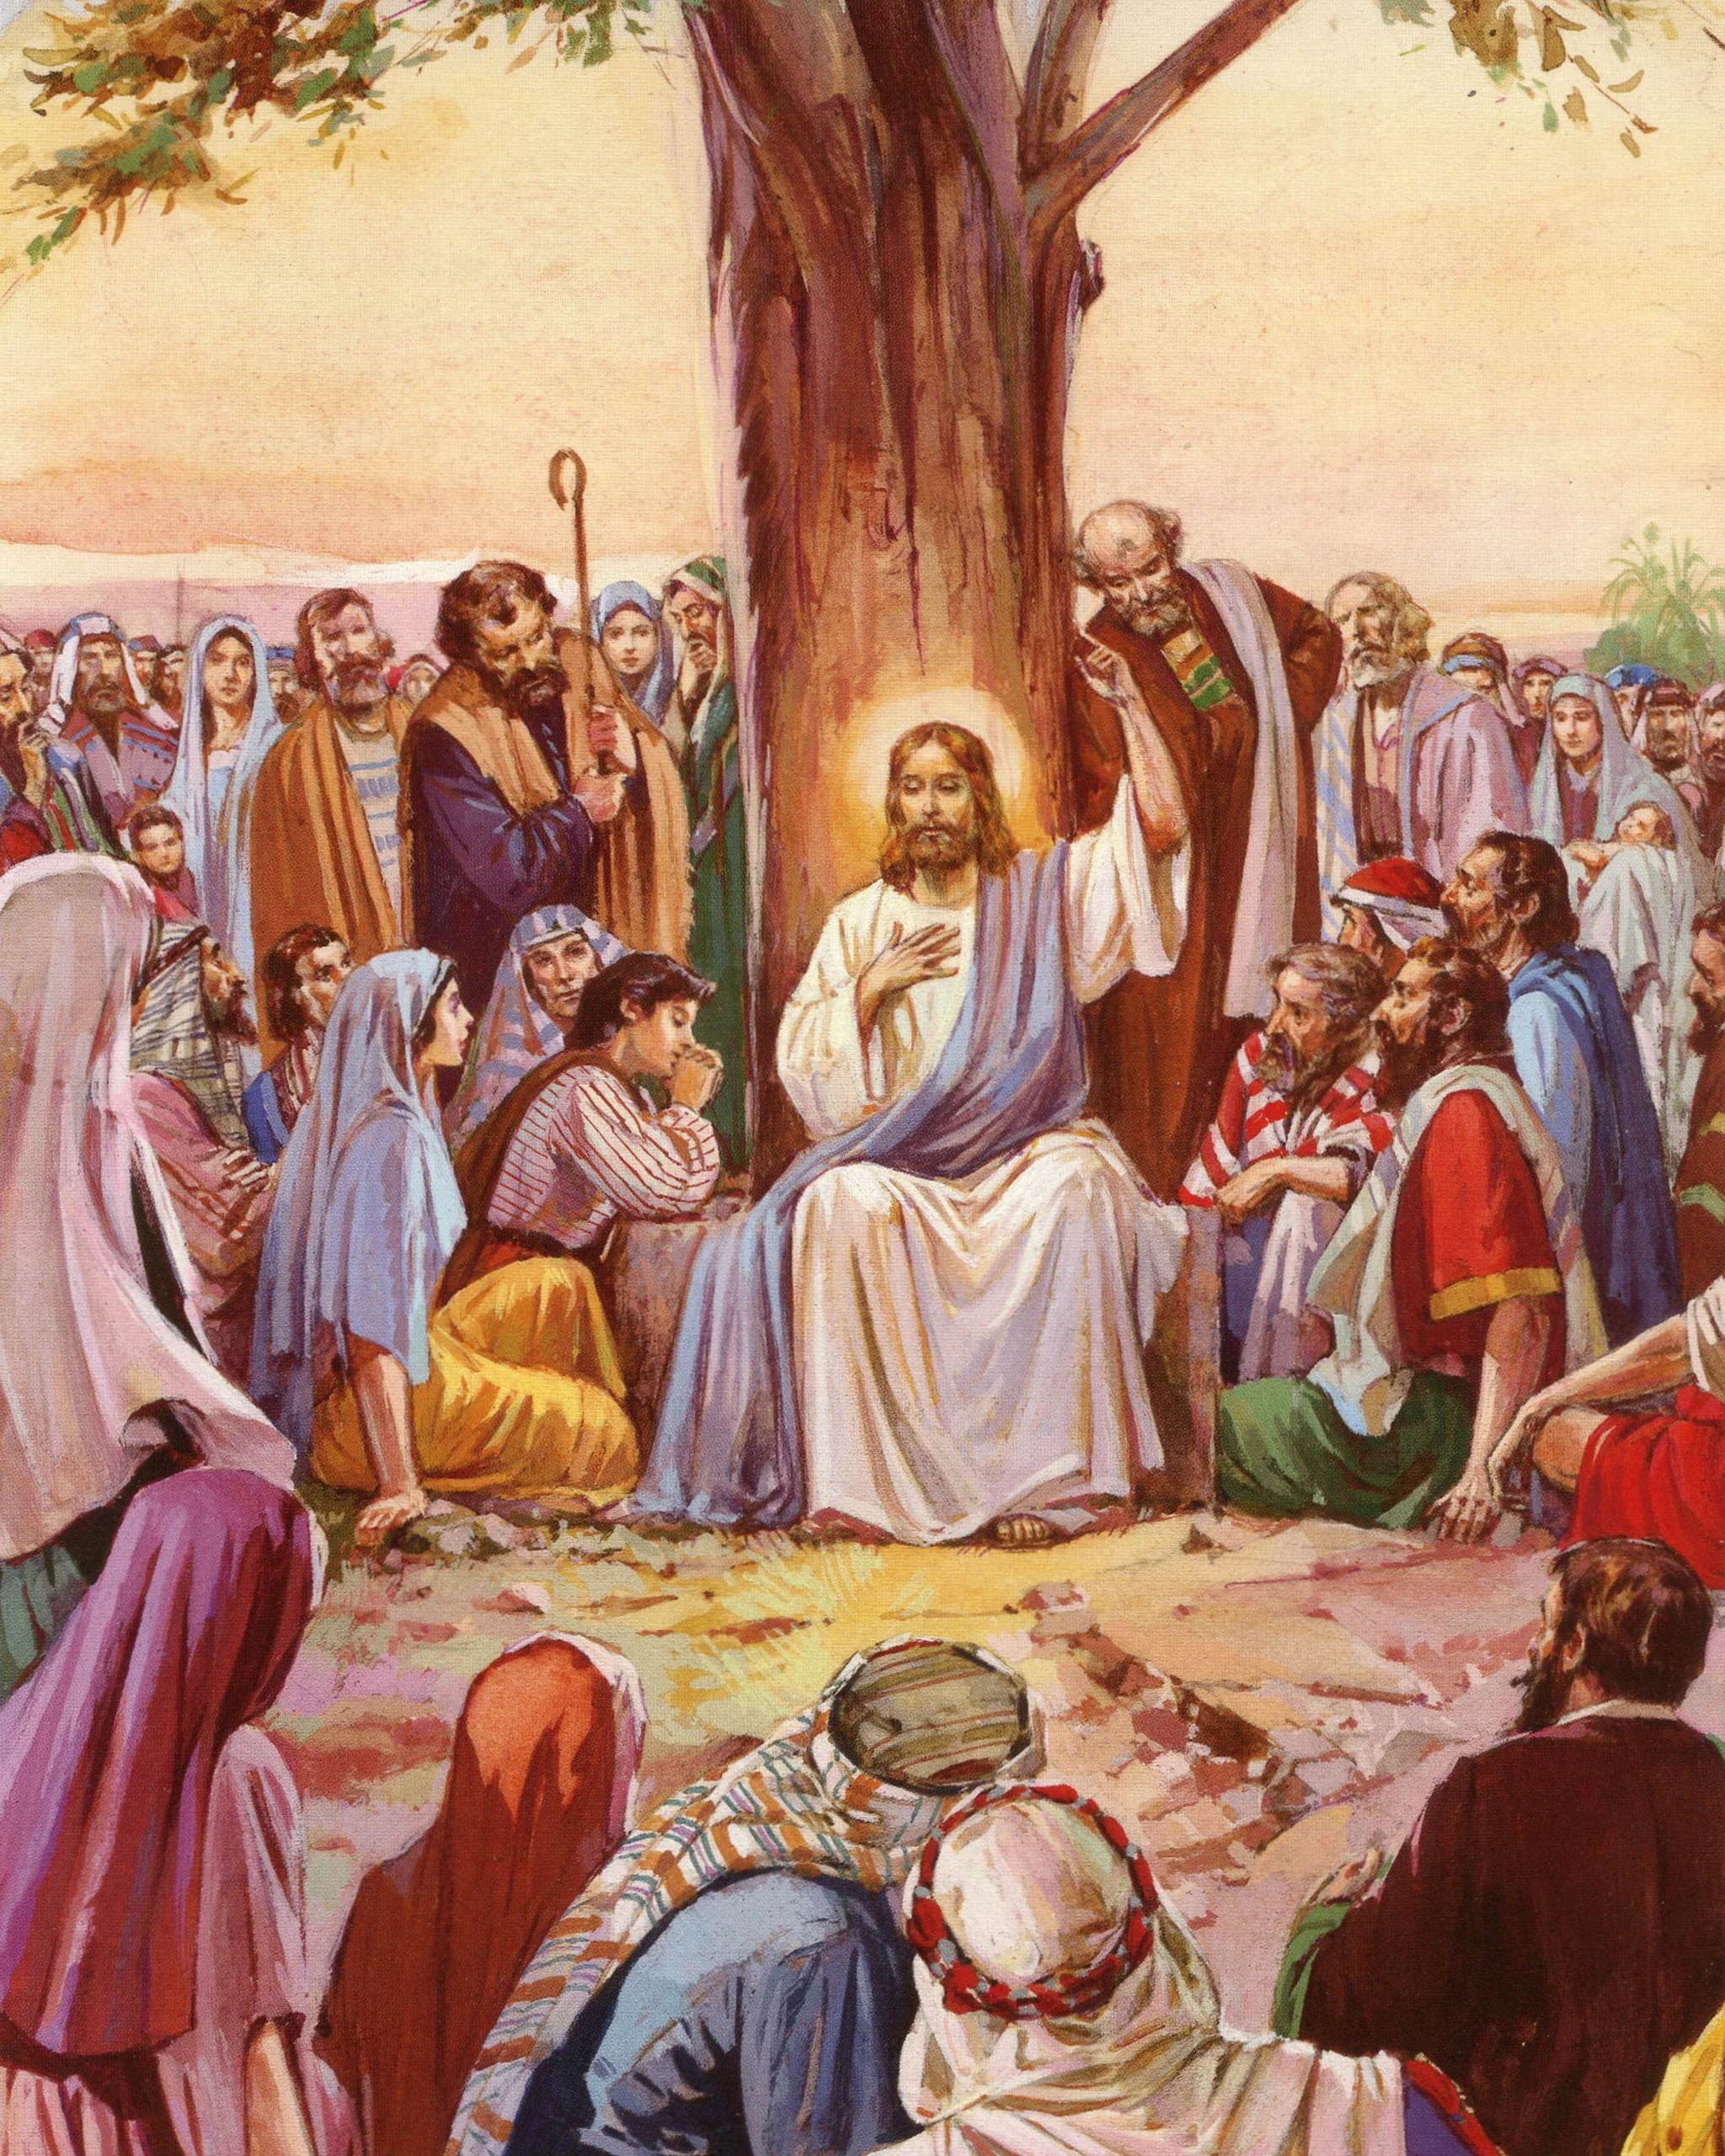
17
“Do not think that I have come to do away with the Law of Moses and the teachings of the prophets. I have not come to do away with them, but to make their teachings come true.

Slide 6
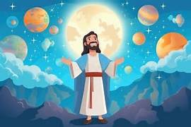
18
Remember that as long as heaven and earth last, not the least point nor the smallest detail of the Law will be done away with—not until the end of all things.

Slide 7
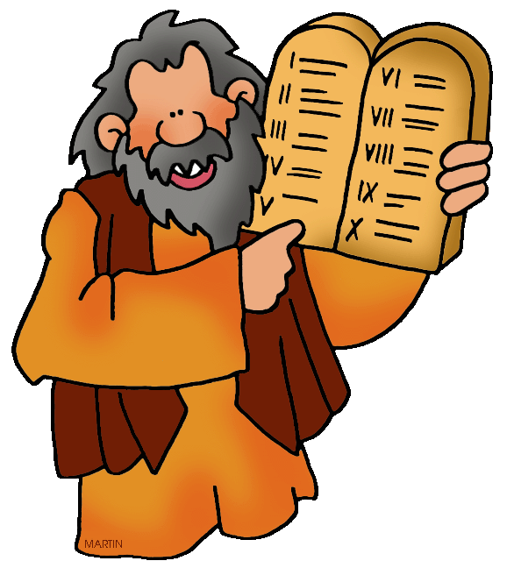
19
So then, whoever disobeys even the least important of the commandments and teaches others to do the same, will be least in the Kingdom of heaven. On the other hand, whoever obeys the Law and teaches others to do the same, will be great in the Kingdom of heaven.

Slide 8
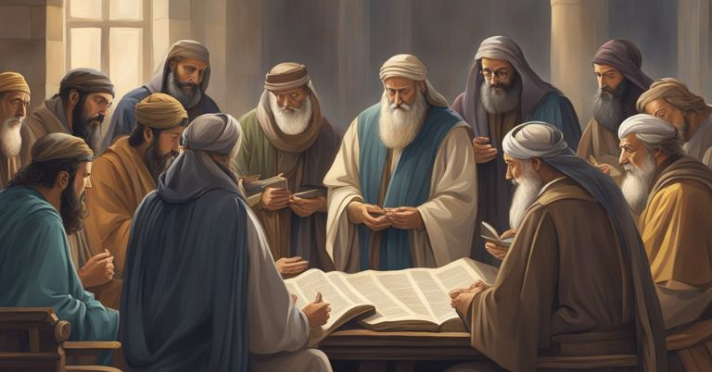
20
I tell you, then, that you will be able to enter the Kingdom of heaven only if you are more faithful than the teachers of the Law and the Pharisees in doing what God requires.

Slide 9
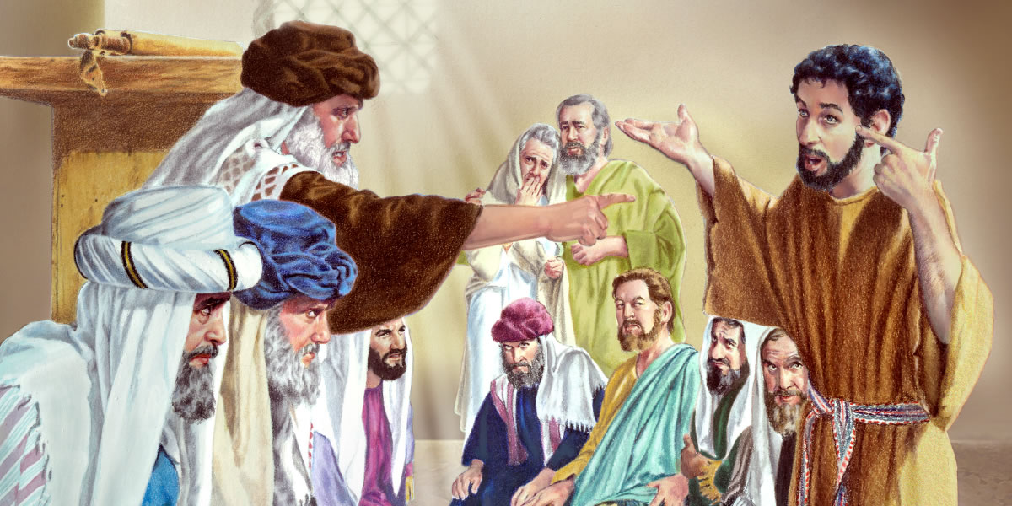
21
“You have heard that people were told in the past, ‘Do not commit murder; anyone who does will be brought to trial.’

Slide 10
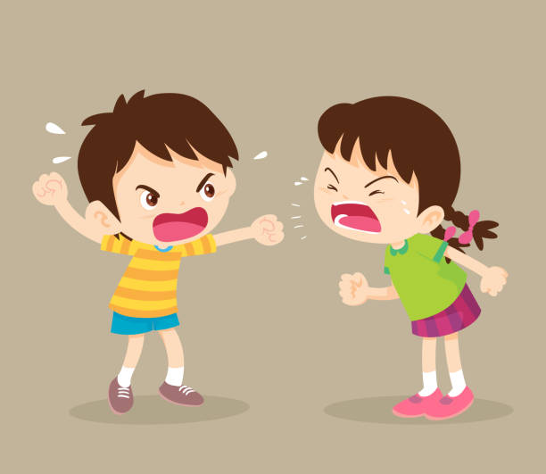
22
But now I tell you: if you are angry with your brother you will be brought to trial, if you call your brother ‘You good-for-nothing!’ you will be brought before the Council, and if you call your brother a worthless fool you will be in danger of going to the fire of hell.

Slide 11
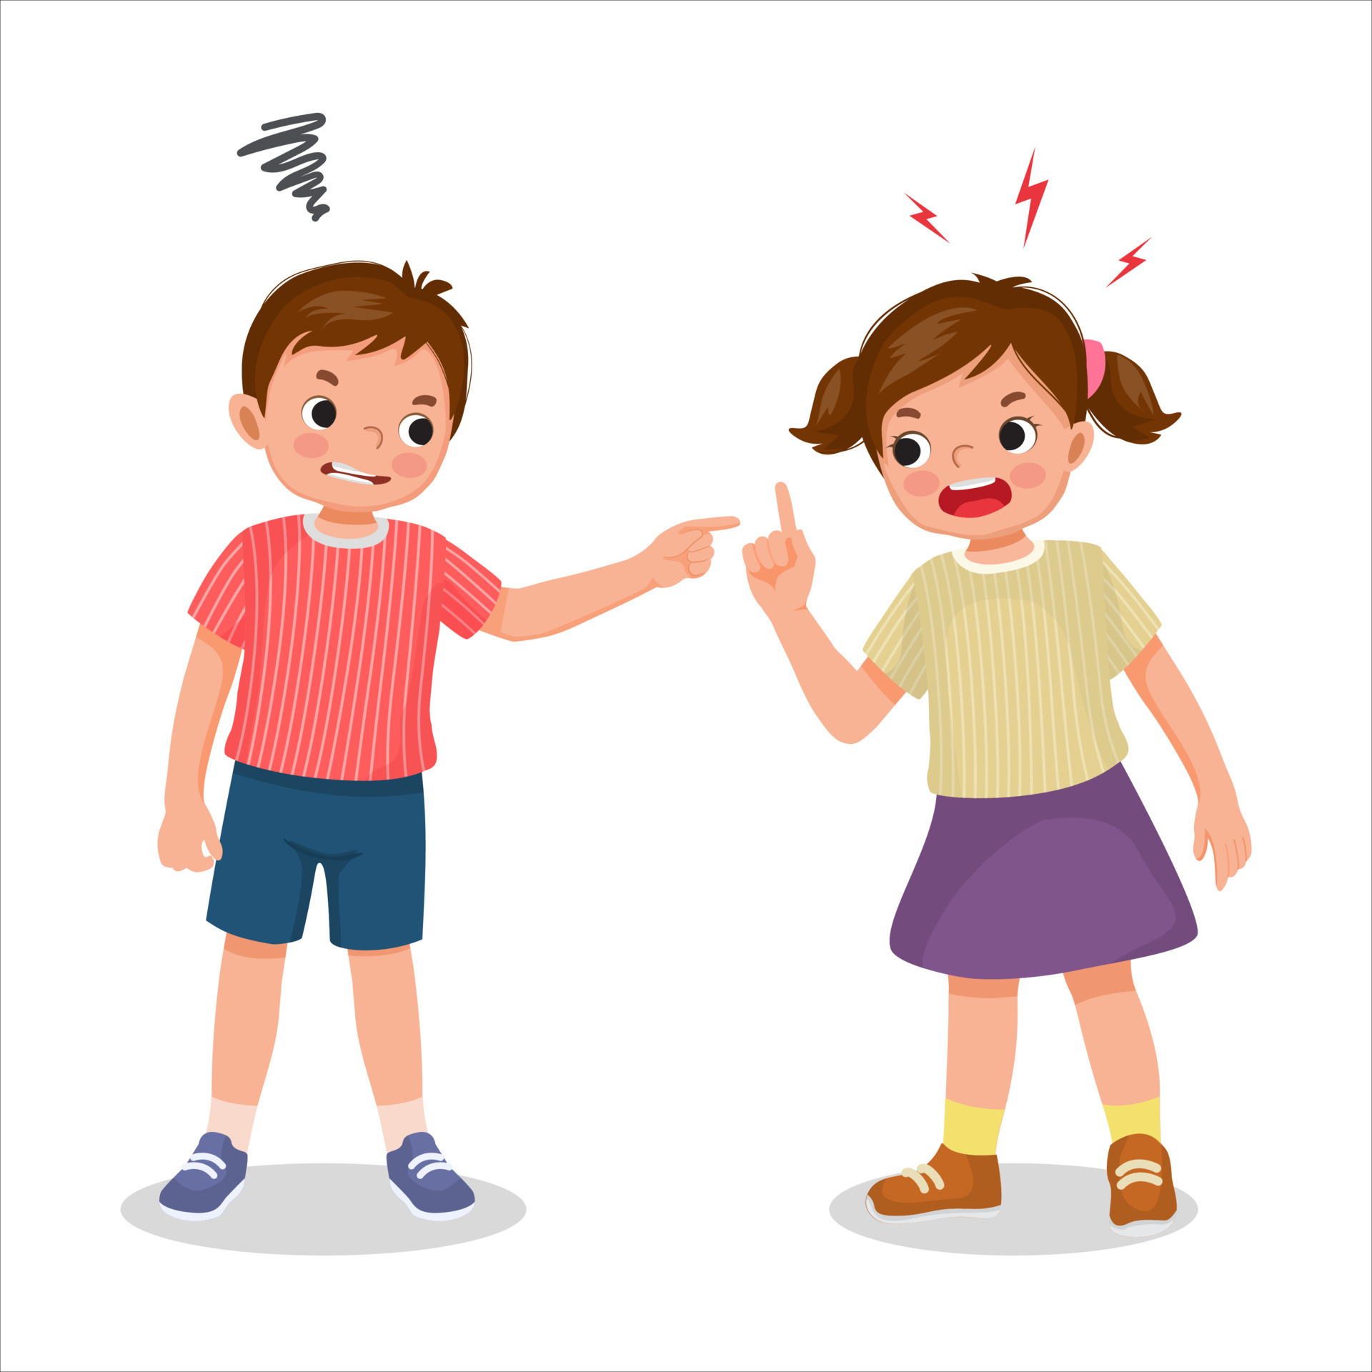
23
So if you are about to offer your gift to God at the altar and there you remember that your brother has something against you,

Slide 12
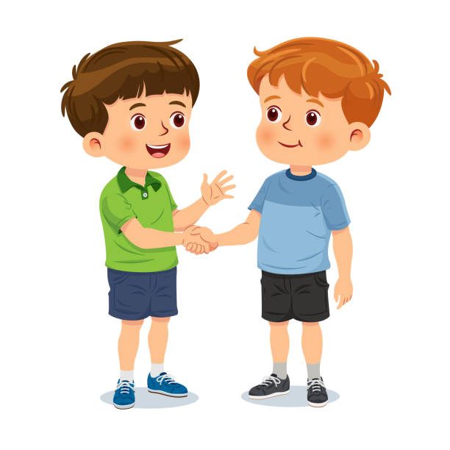
24
leave your gift there in front of the altar, go at once and make peace with your brother, and then come back and offer your gift to God.

Slide 13
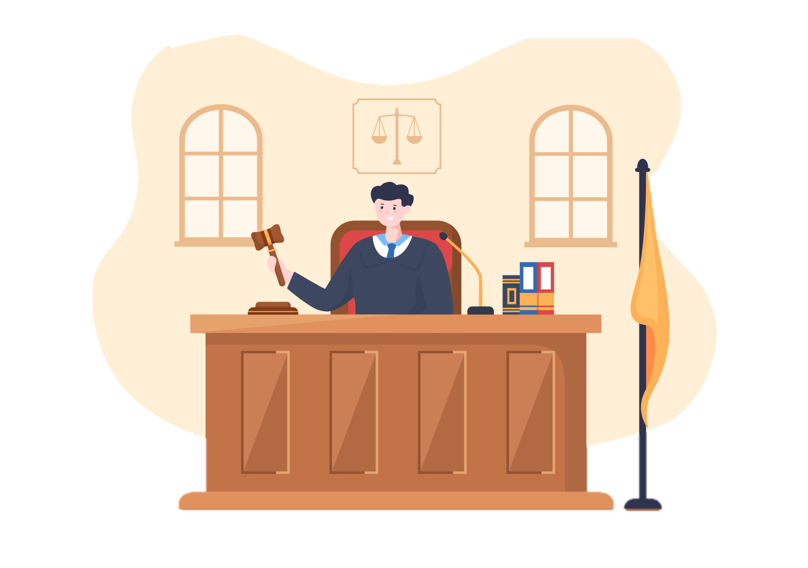
25
“If someone brings a lawsuit against you and takes you to court, settle the dispute while there is time, before you get to court. Once you are there, you will be turned over to the judge, who will hand you over to the police, and you will be put in jail.

Slide 14
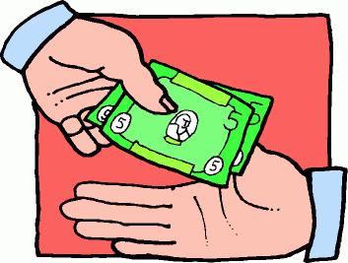
26
There you will stay, I tell you, until you pay the last penny of your fine.

Slide 15
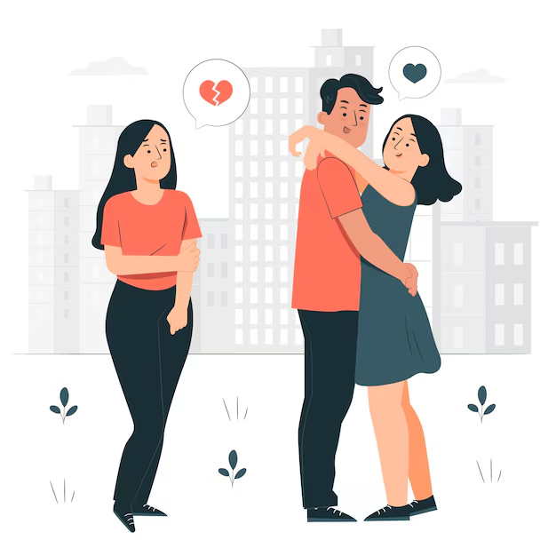
27
“You have heard that it was said, ‘Do not commit adultery.’

Slide 16
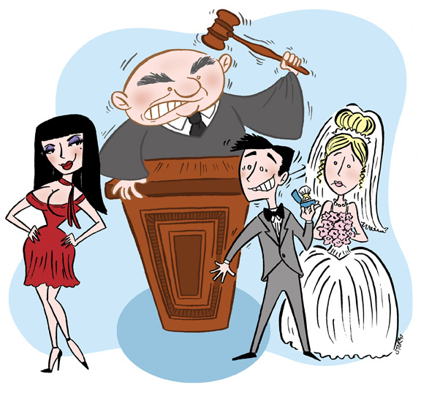
28
But now I tell you: anyone who looks at a woman and wants to possess her is guilty of committing adultery with her in his heart.

Slide 17
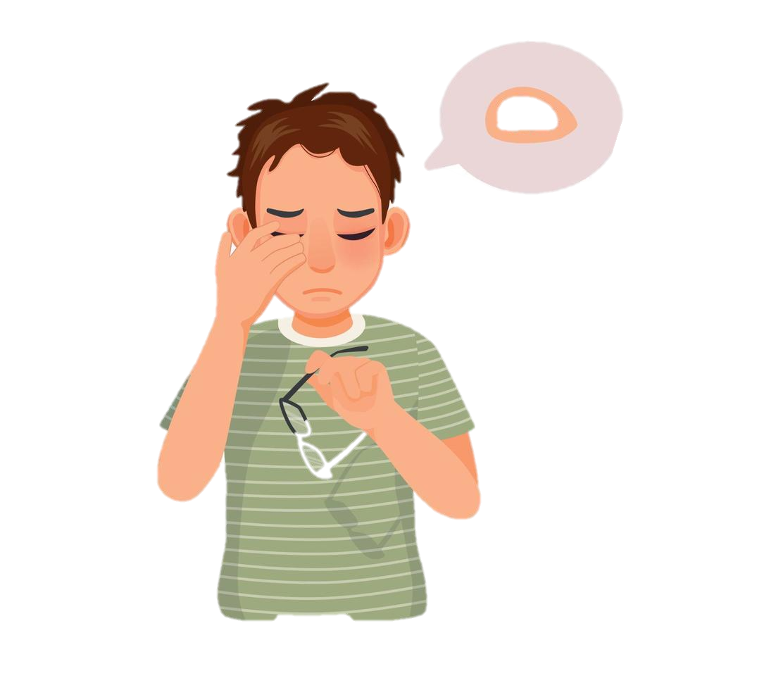
29
So if your right eye causes you to sin, take it out and throw it away! It is much better for you to lose a part of your body than to have your whole body thrown into hell.

Slide 18
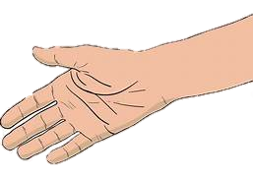
30
If your right hand causes you to sin, cut it off and throw it away! It is much better for you to lose one of your limbs than to have your whole body go off to hell.

Slide 19
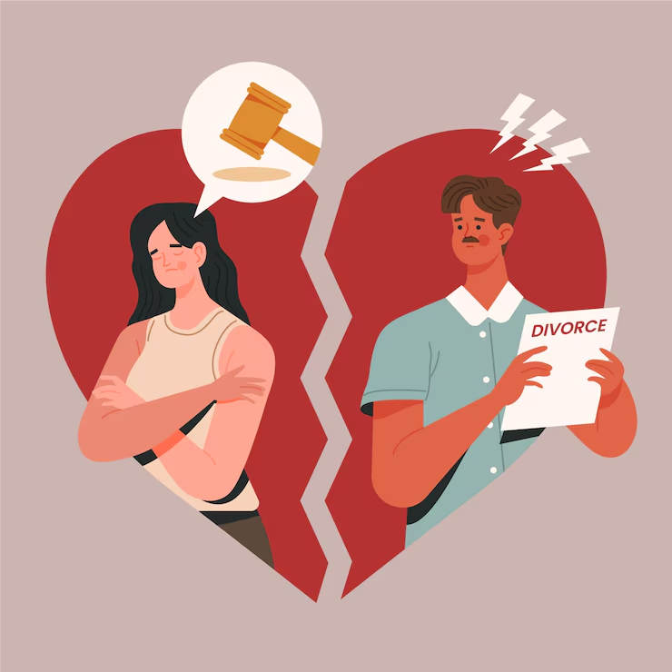
31
“It was also said, ‘Anyone who divorces his wife must give her a written notice of divorce.’

Slide 20
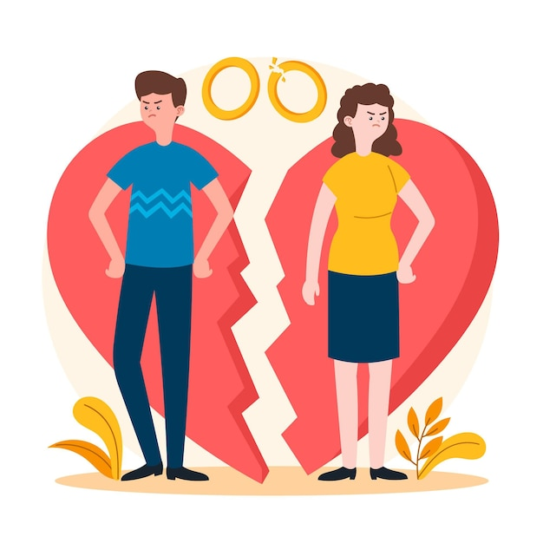
32
But now I tell you: if a man divorces his wife for any cause other than her unfaithfulness, then he is guilty of making her commit adultery if she marries again; and the man who marries her commits adultery also.

Slide 21
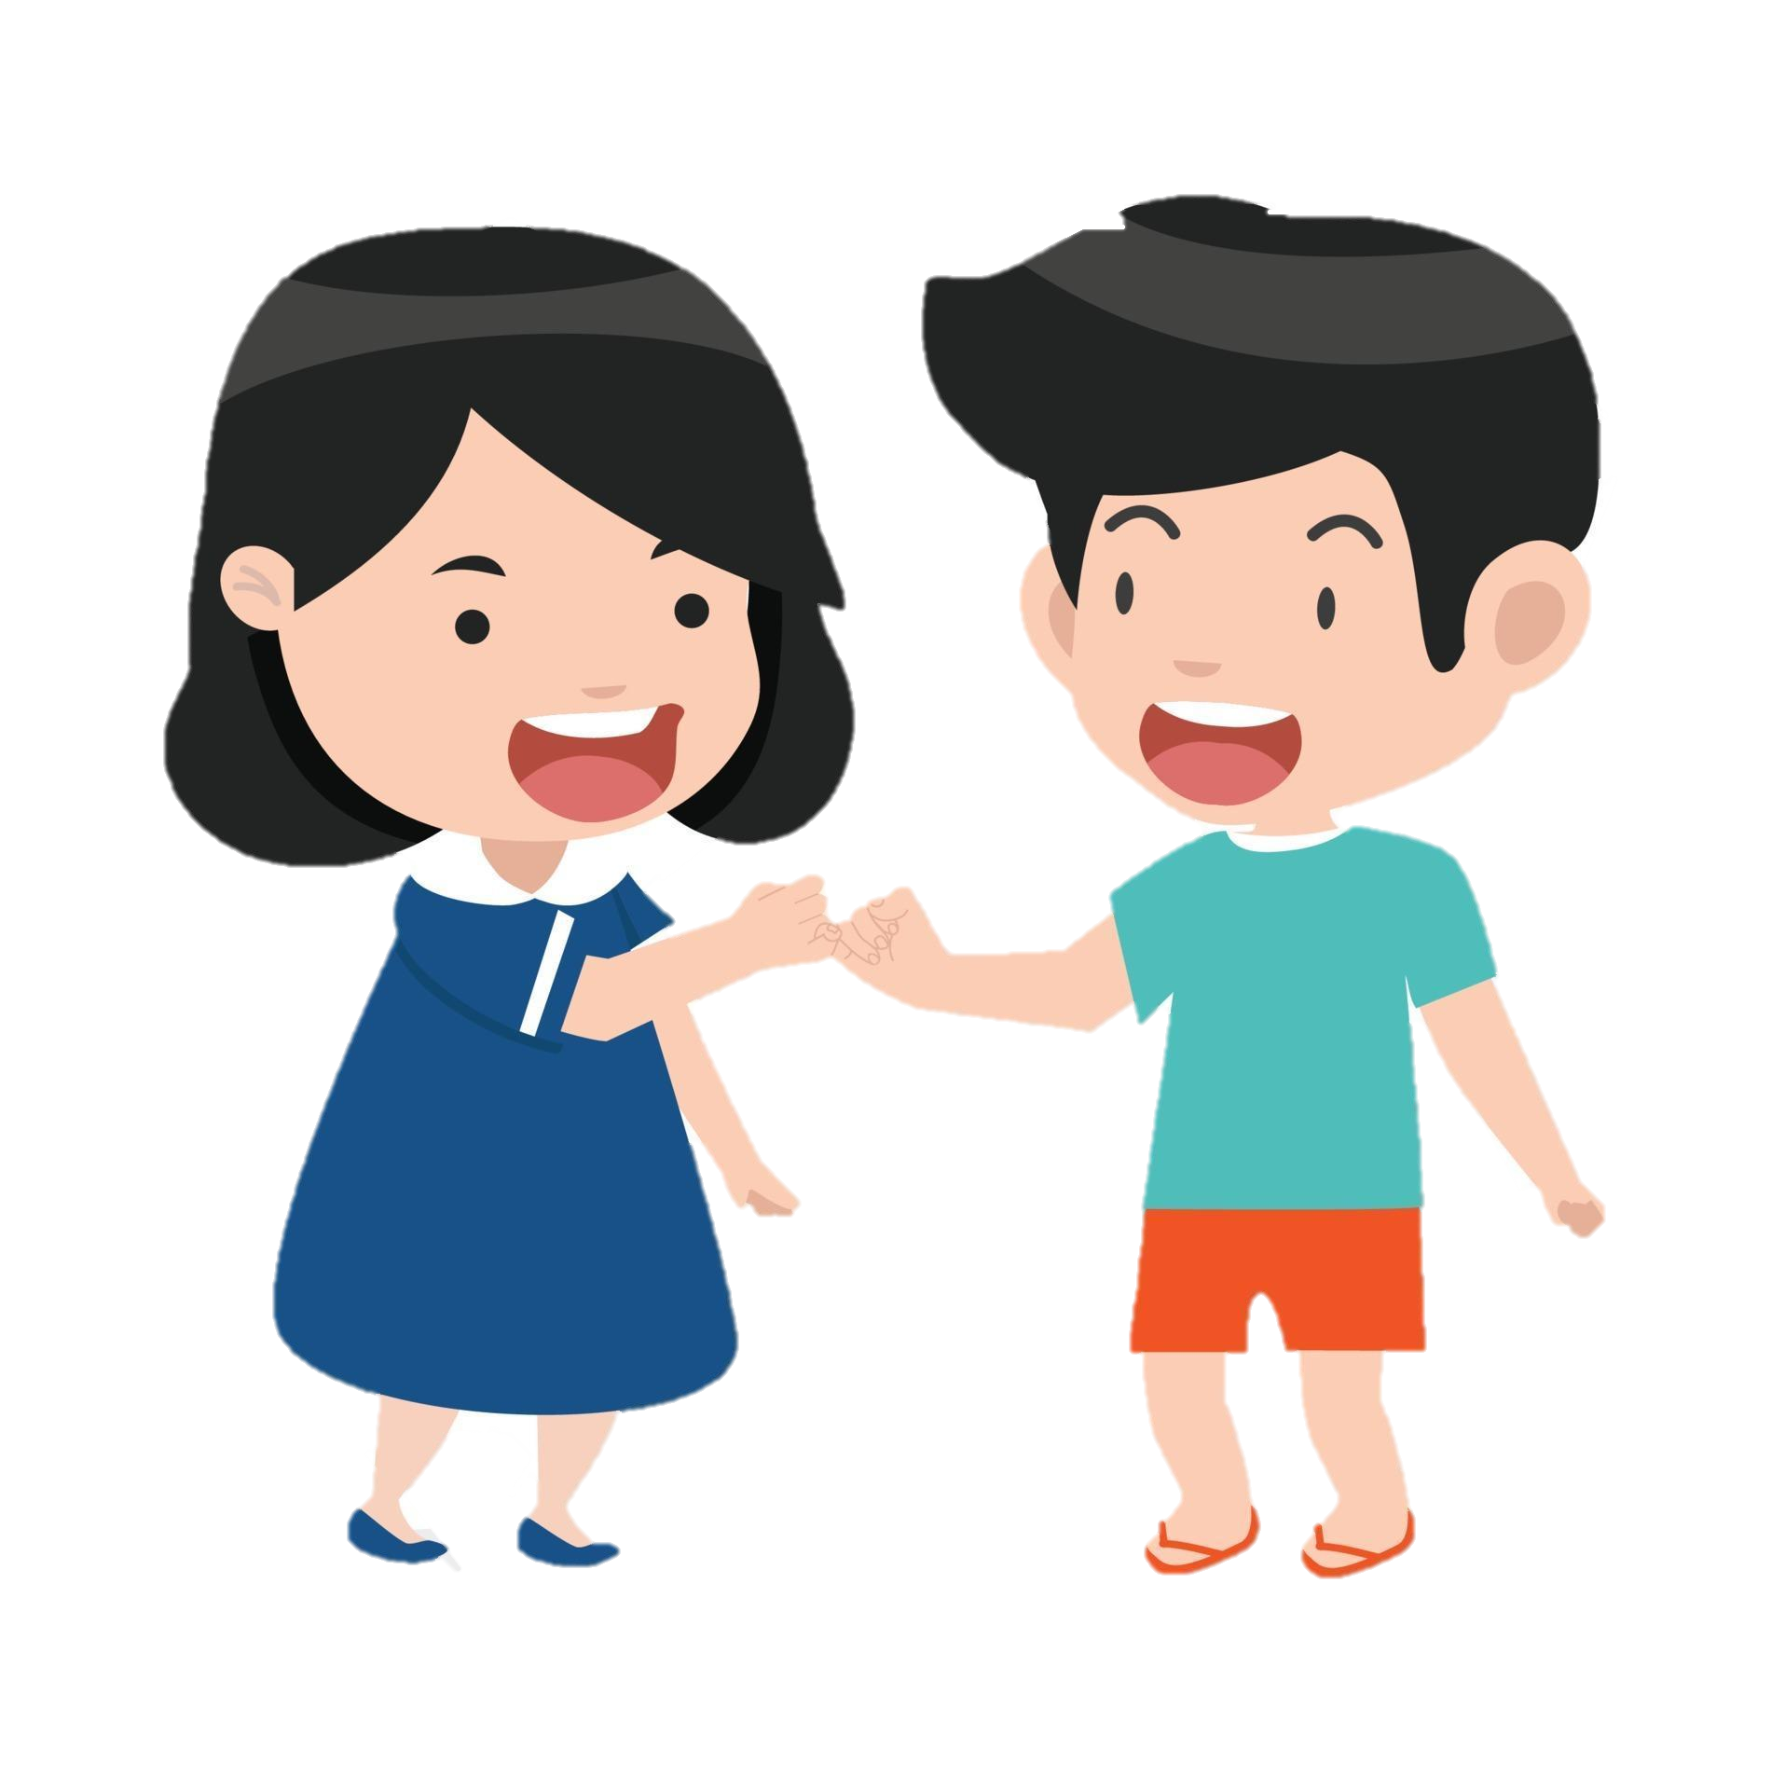
33
“You have also heard that people were told in the past, ‘Do not break your promise, but do what you have vowed to the Lord to do.’

Slide 22

34
But now I tell you: do not use any vow when you make a promise. Do not swear by heaven, for it is God's throne;

Slide 23
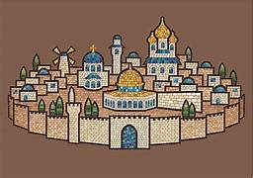
35
nor by earth, for it is the resting place for his feet; nor by Jerusalem, for it is the city of the great King.

Slide 24
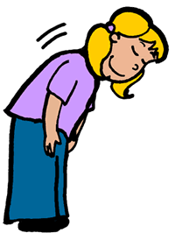
36
Do not even swear by your head, because you cannot make a single hair white or black.

Slide 25
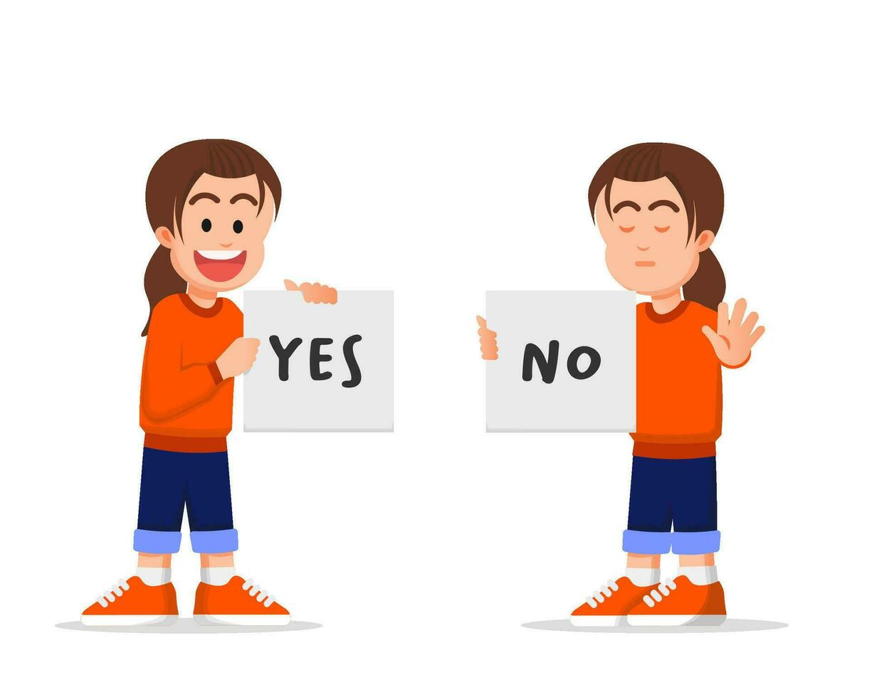
37
Just say ‘Yes’ or ‘No’—anything else you say comes from the Evil One.

Slide 26


Gospel Message

Slide 27

Activity:
“Jesus’ Teachings Scroll” Craft
Materials Needed:
  Paper
  Popsicle sticks
  Glue
  Markers or Crayons

Slide 28
Instructions:
Make the scroll
Roll the top and bottom of the paper on popsicle sticks. Tape or glue.
2. Write the title
At the top:
“Jesus teaches us to love and do what is right.”
3. Draw 3 good actions
Example:
Share • Say Sorry • Tell the Truth
4. Color and decorate
Add hearts or smiley faces.

Slide 29


Dear God,
Thank You for teaching us how to live with love in our hearts. Help us not only follow rules, but choose what is good and kind inside. Teach us to forgive when we are hurt, to say sorry when we make mistakes, and to always tell the truth. When we feel angry, help us choose peace. When it is hard to do what is right, give us courage and strength. May our words be kind and our promises be true. Help us follow You every day with happy and loving hearts.
In Jesus’s name,
Amen!
Closing Prayer

Slide 30
Live the Word Kids

