Slide 1






Live the Word Kids

Slide 2





4th Sunday in Ordinary Time
February 1, 2026 | Cycle A Year 2

Slide 3
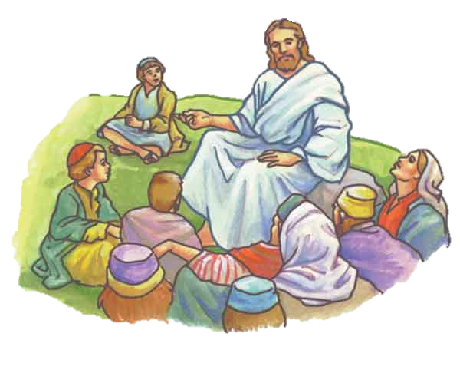

The Sermon on the Mount
Matthew 5:1-12a

Slide 4


Leader:
A reading from the Holy Gospel according to Matthew.
All:
Glory to You, Oh Lord.

Slide 5

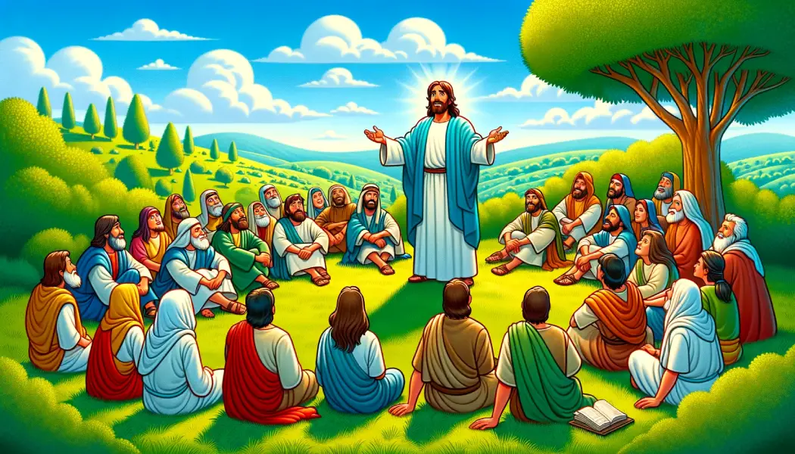
1
Jesus saw the crowds and went up a hill, where he sat down. His disciples gathered around him,

Slide 6
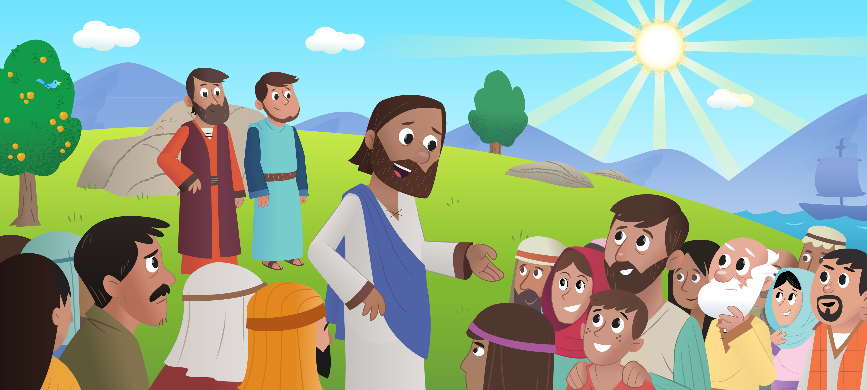
2
and he began to teach them:

Slide 7
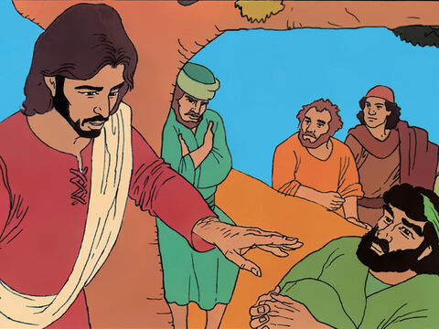
3
“Happy are those who know they are spiritually poor;
the Kingdom of heaven belongs to them!

Slide 8
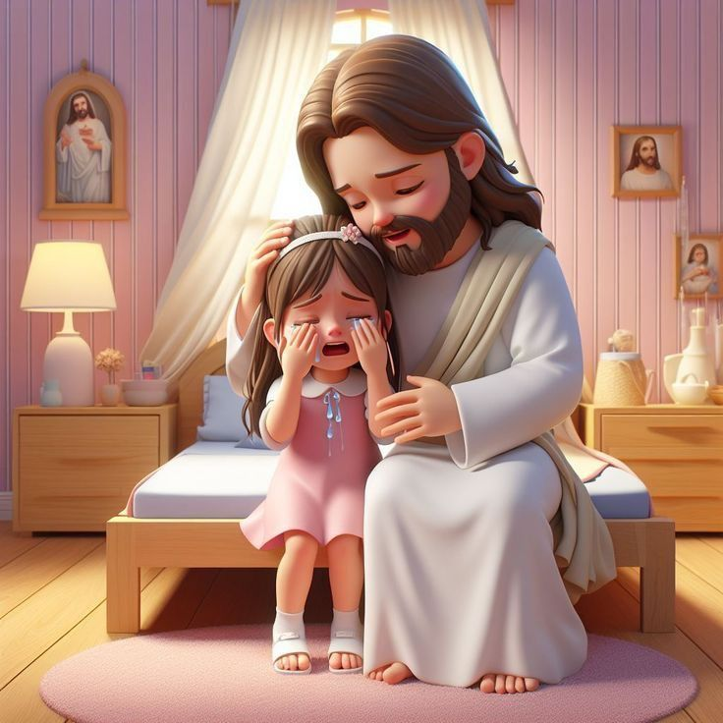
4
Happy are those who mourn;
God will comfort them!

Slide 9
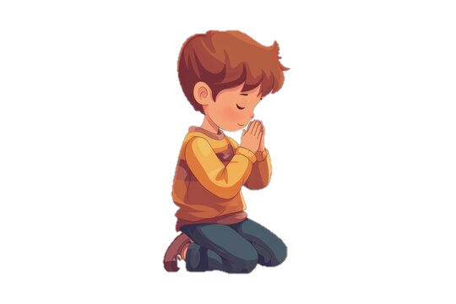
5
“Happy are those who are humble;
they will receive what God has promised!

Slide 10
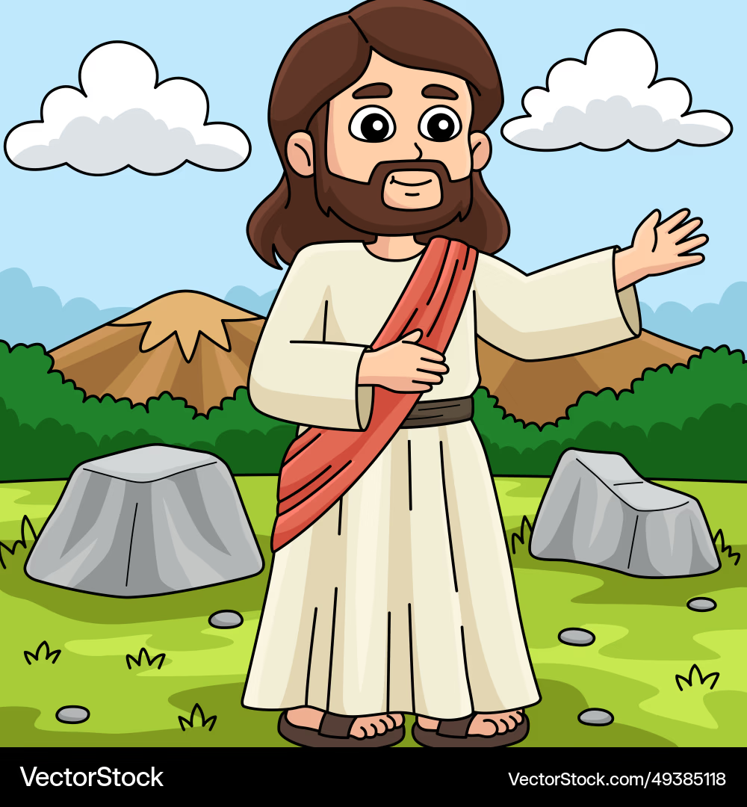
6
“Happy are those whose greatest desire is to do what God requires
God will satisfy them fully!

Slide 11
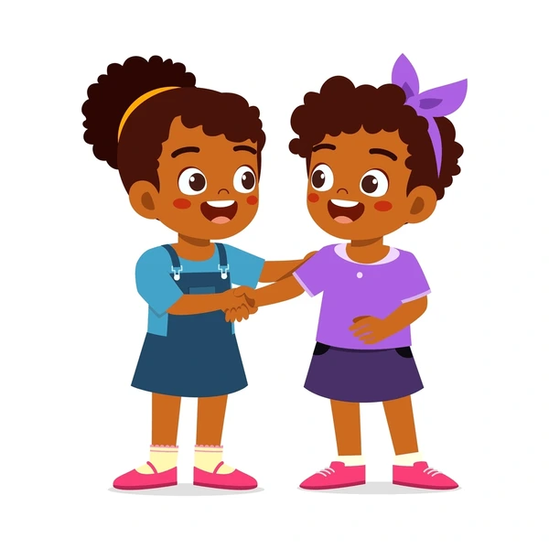
7
“Happy are those who are merciful to others;
God will be merciful to them!

Slide 12

8
“Happy are the pure in heart;
they will see God!

Slide 13
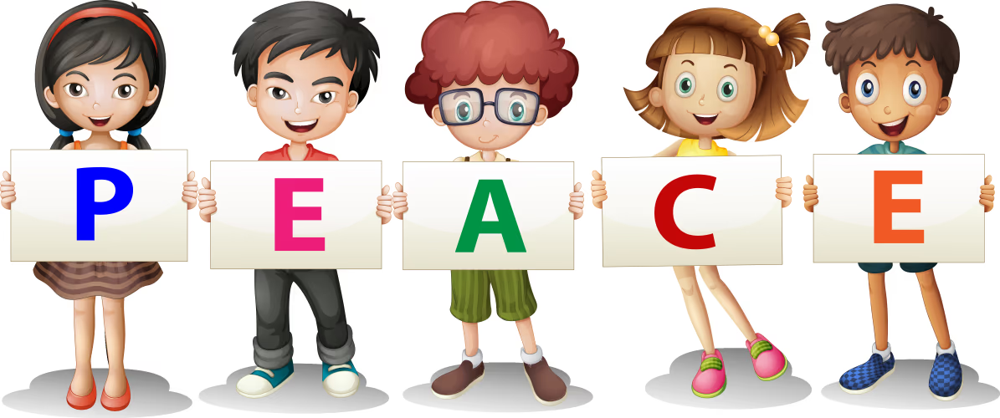
9
“Happy are those who work for peace;
God will call them his children!

Slide 14
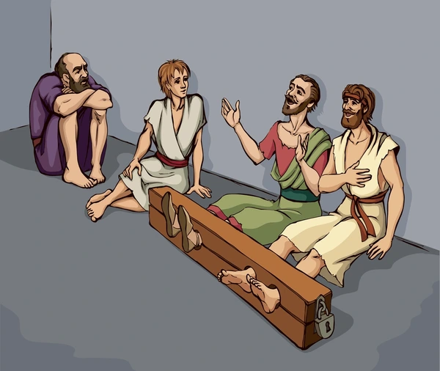
10
“Happy are those who are persecuted because they do what God requires;
the Kingdom of heaven belongs to them!

Slide 15
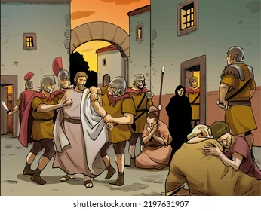
11
“Happy are you when people insult you and persecute you and tell all kinds of evil lies against you because you are my followers.

Slide 16
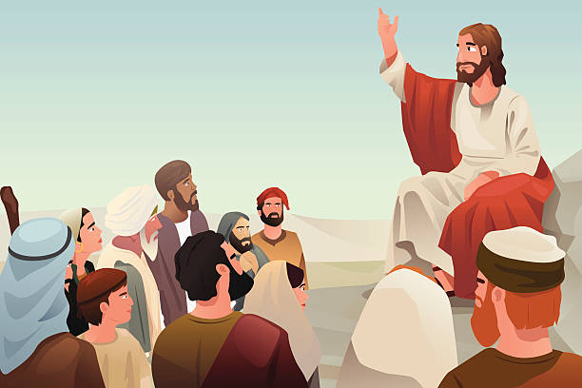
12
Be happy and glad, for a great reward is kept for you in heaven. This is how the prophets who lived before you were persecuted.

Slide 17


Gospel Message

Slide 18
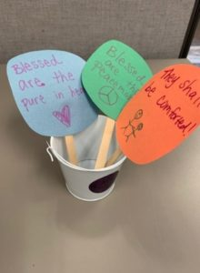
Activity:
“Beatitude Garden”
Materials Needed:
  Paper or Notecards
  Scissors
  Paper bags or baskets
  Markers or decorating materials
  Glue or tape
  Popsicle sticks

Slide 19
Instructions:
4. Decorate a basket, bucket, or bag to hold the beatitudes; or merely cut slits into a large sheet of construction paper.
5. Place the “flowers” into the container. Use as a reminder of the words of Jesus!
Cut the paper into geometric shapes or flower shapes.
2. Decorate the paper with the words of the beatitudes, adding a picture for reminder reference. If space allows, write the starting line on one side of the paper, and the conclusion on the other side.
3. Glue or tape the papers onto popsicle sticks.

Slide 20


Dear God,
Thank You for teaching us how to love and be kind. Help us to be gentle, to share with others, to forgive, and to do what is right. Help us to have a happy heart that follows You every day. We want to be a blessing to others, just like You.
In Jesus’s name,
Amen!
Closing Prayer

Slide 21
Live the Word Kids

