Slide 1




Live the Word Kids

Slide 2

Nineteenth Sunday in Ordinary Time
August 9, 2026 | Cycle A Year 2

Slide 3
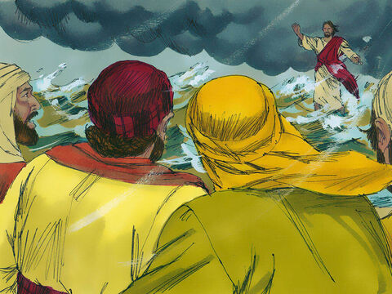
Jesus Walks on the Water
Matthew 14:22-33

Slide 4


Leader:
A reading from the Holy Gospel according to Matthew.
All:
Glory to You, Oh Lord.

Slide 5
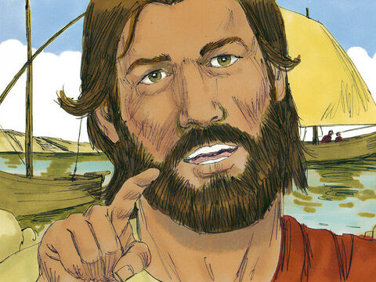
22
Then Jesus made the disciples get into the boat and go on ahead to the other side of the lake, while he sent the people away.

Slide 6
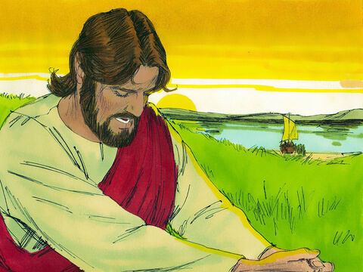
23
After sending the people away, he went up a hill by himself to pray. When evening came, Jesus was there alone;

Slide 7
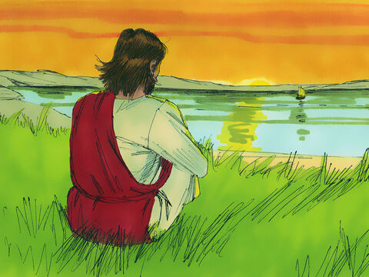
24
and by this time the boat was far out in the lake, tossed about by the waves, because the wind was blowing against it.

Slide 8
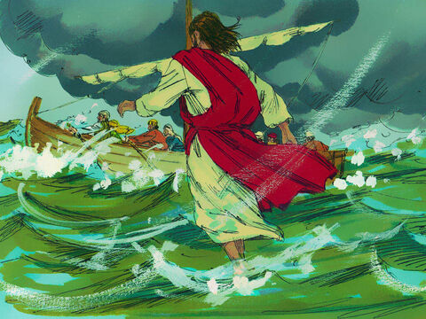
25
Between three and six o'clock in the morning Jesus came to the disciples, walking on the water.

Slide 9
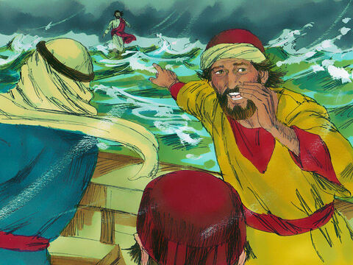
26
When they saw him walking on the water, they were terrified. “It's a ghost!” they said, and screamed with fear.

Slide 10
27
Jesus spoke to them at once. “Courage!” he said. “It is I. Don't be afraid!”

Slide 11
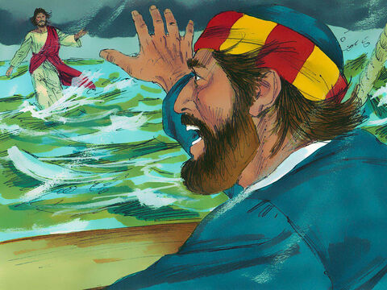
28
Then Peter spoke up. “Lord, if it is really you, order me to come out on the water to you.”

Slide 12
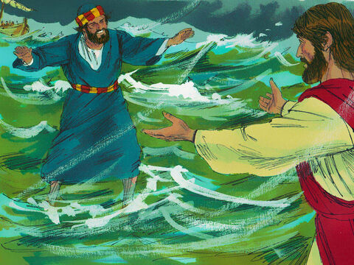
29
“Come!” answered Jesus. So Peter got out of the boat and started walking on the water to Jesus

Slide 13
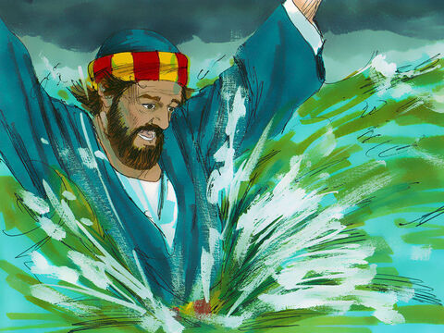
30
But when he noticed the strong wind, he was afraid and started to sink down in the water. “Save me, Lord!” he cried.

Slide 14
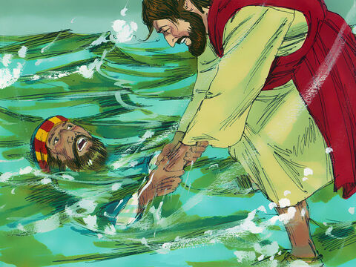
31
At once Jesus reached out and grabbed hold of him and said, “What little faith you have! Why did you doubt?”

Slide 15
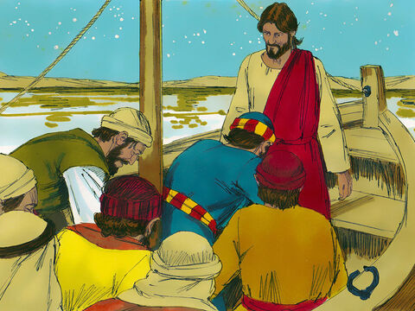
32
They both got into the boat, and the wind died down.

Slide 16
33
Then the disciples in the boat worshiped Jesus. “Truly you are the Son of God!” they exclaimed.

Slide 17
Leader:
The Gospel of the Lord
All:
Praise to you, Lord Jesus Christ.

Slide 18
Gospel Message

Slide 19


Activity:
“Keep Your Eyes on Jesus”
Materials Needed:
  Colored paper (Blue and Brown)
  Glue
  Scissors
  Crayons

Slide 20
Activity:
“Keep Your Eyes on Jesus”
1.Draw and cut a boat shape (brown paper).
2.Glue the boat onto the blue paper.
3.Draw a picture of Jesus standing on the water.
4. Draw Peter stepping out of the boat toward Jesus.
5. Draw waves around them.

Slide 21
Dear Jesus,
Thank You for always being with us, even when life feels scary. Help us to keep our eyes on You and trust You every day. Give us courage, peace, and faith, knowing that You will never leave us. Thank You for loving us and taking care of us.
In Your name we pray,
Amen.
Closing Prayer

Slide 22
Live the Word Kids

