Slide 1


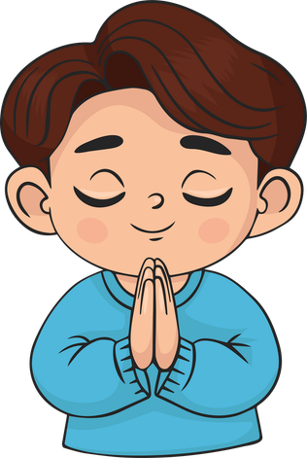
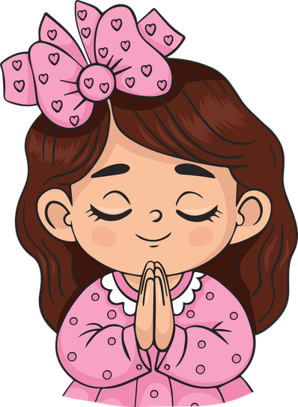
Live the Word Kids

Slide 2

Twenty-Second Sunday in Ordinary Time
August 30, 2026 | Cycle A Year 2

Slide 3
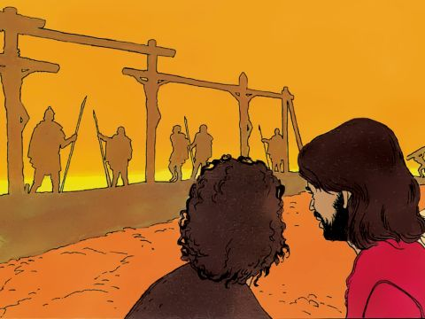
Jesus Speaks about His Suffering and Death
Matthew 16:21-27

Slide 4
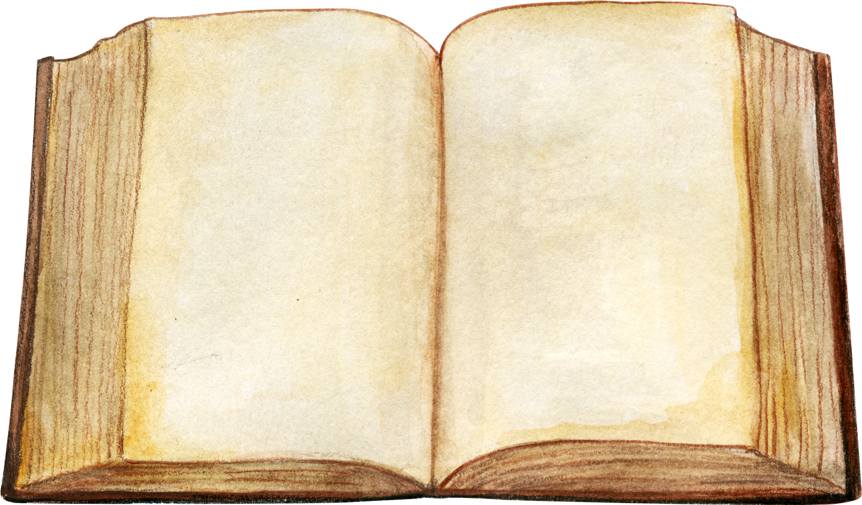

Leader:
A reading from the Holy Gospel according to Matthew.
All:
Glory to You, Oh Lord.

Slide 5
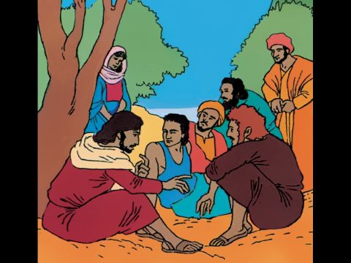
21
From that time on Jesus began to say plainly to his disciples, “I must go to Jerusalem and suffer much from the elders, the chief priests, and the teachers of the Law. I will be put to death, but three days later I will be raised to life.”

Slide 6
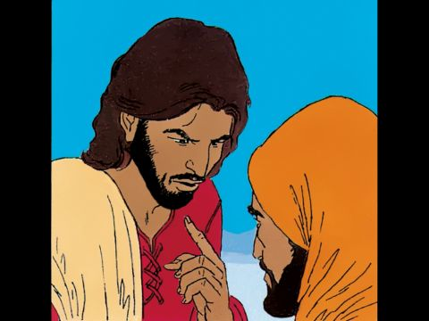
22
Peter took him aside and began to rebuke him. “God forbid it, Lord!” he said. “That must never happen to you!”

Slide 7
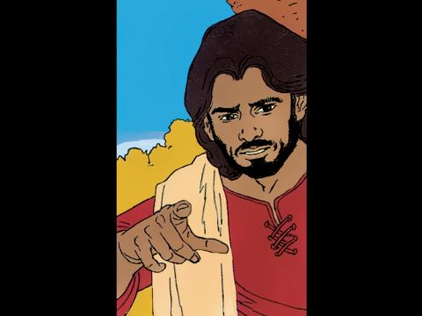
23
Jesus turned around and said to Peter, “Get away from me, Satan! You are an obstacle in my way, because these thoughts of yours don't come from God, but from human nature.”

Slide 8
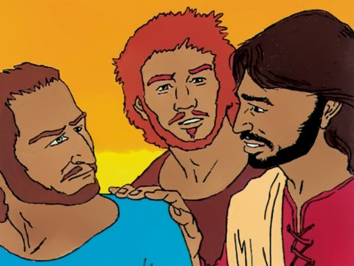
24
Then Jesus said to his disciples, “If any of you want to come with me, you must forget yourself, carry your cross, and follow me.

Slide 9
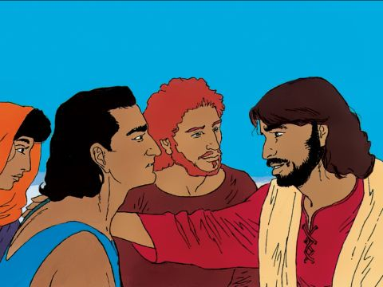
25
For if you want to save your own life, you will lose it; but if you lose your life for my sake, you will find it.

Slide 10
26
Will you gain anything if you win the whole world but lose your life? Of course not! There is nothing you can give to regain your life.

Slide 11
27
For the Son of Man is about to come in the glory of his Father with his angels, and then he will reward each one according to his deeds.

Slide 12
Leader:
The Gospel of the Lord
All:
Praise to you, Lord Jesus Christ.

Slide 13
Gospel Message

Slide 14


Activity:
“Carry Your Cross” Paper Cross
Materials Needed:
  Bond paper
  Crayons
  Scissors

Slide 15
Activity:
“Carry Your Cross”
Paper Cross
1.Cut out a large cross from the bond paper.
2.Write at the top: “I Will follow Jesus”
3. Color and decorate your cross .

Slide 16
Dear Jesus,
thank You for loving us so much. Help us to follow You every day with joyful hearts. Give us courage to choose what is right, to love others, and to trust You in everything we do. Thank You for always being with us.
In Jesus' name,
Amen.
Closing Prayer

Slide 17
Live the Word Kids

