Slide 1


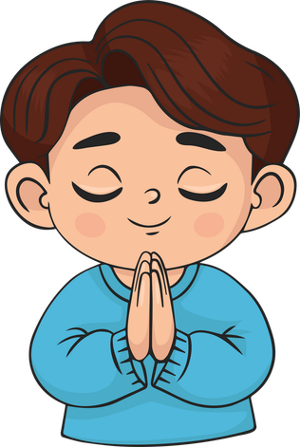

Live the Word Kids

Slide 2

Twenty-First Sunday in Ordinary Time
August 23, 2026 | Cycle A Year 2

Slide 3
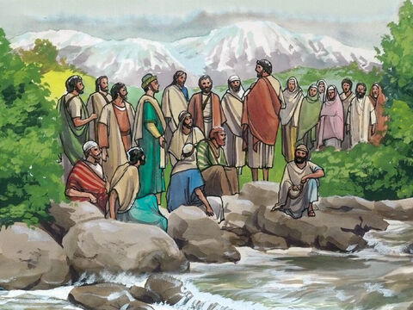
Peter’s Declaration About Jesus
Matthew 16:13-20

Slide 4
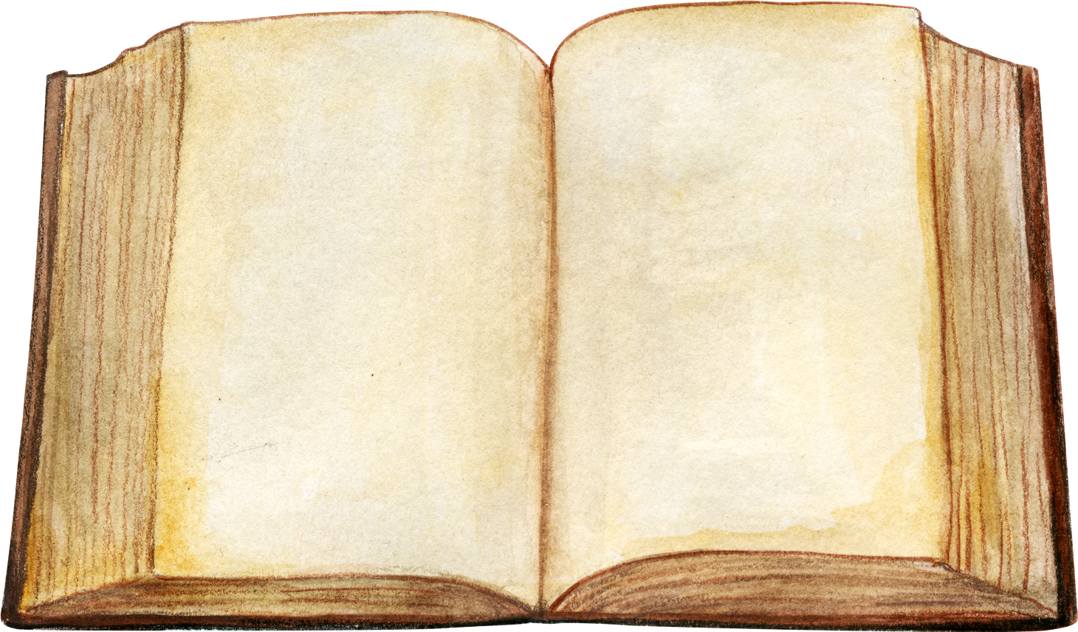

Leader:
A reading from the Holy Gospel according to Matthew.
All:
Glory to You, Oh Lord.

Slide 5
13
Jesus went to the territory near the town of Caesarea Philippi, where he asked his disciples, “Who do people say the Son of Man is?”

Slide 6
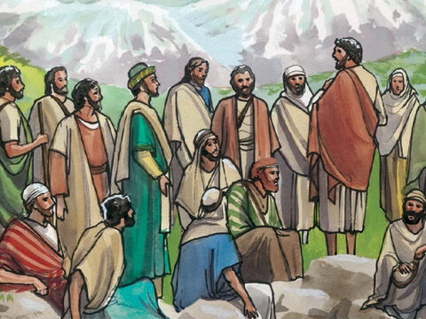
14
“Some say John the Baptist,” they answered. “Others say Elijah, while others say Jeremiah or some other prophet.”

Slide 7
15
“What about you?” he asked them. “Who do you say I am?”

Slide 8
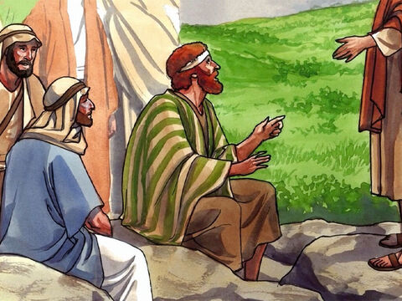
16
Simon Peter answered, “You are the Messiah, the Son of the living God.”

Slide 9
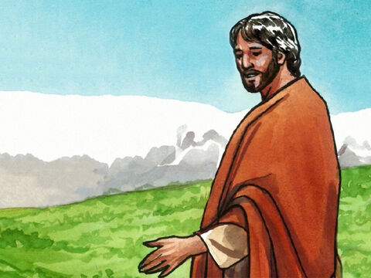
17
“Good for you, Simon son of John!” answered Jesus. “For this truth did not come to you from any human being, but it was given to you directly by my Father in heaven.

Slide 10
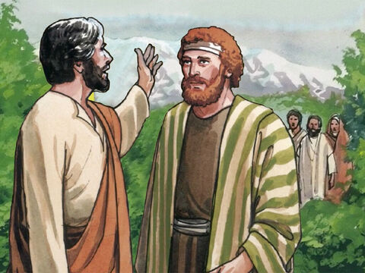
18
And so I tell you, Peter: you are a rock, and on this rock foundation I will build my church, and not even death will ever be able to overcome it.

Slide 11
19
I will give you the keys of the Kingdom of heaven; what you prohibit on earth will be prohibited in heaven, and what you permit on earth will be permitted in heaven.”

Slide 12
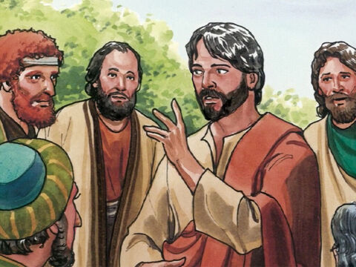
20
Then Jesus ordered his disciples not to tell anyone that he was the Messiah.

Slide 13
Leader:
The Gospel of the Lord
All:
Praise to you, Lord Jesus Christ.

Slide 14
Gospel Message

Slide 15

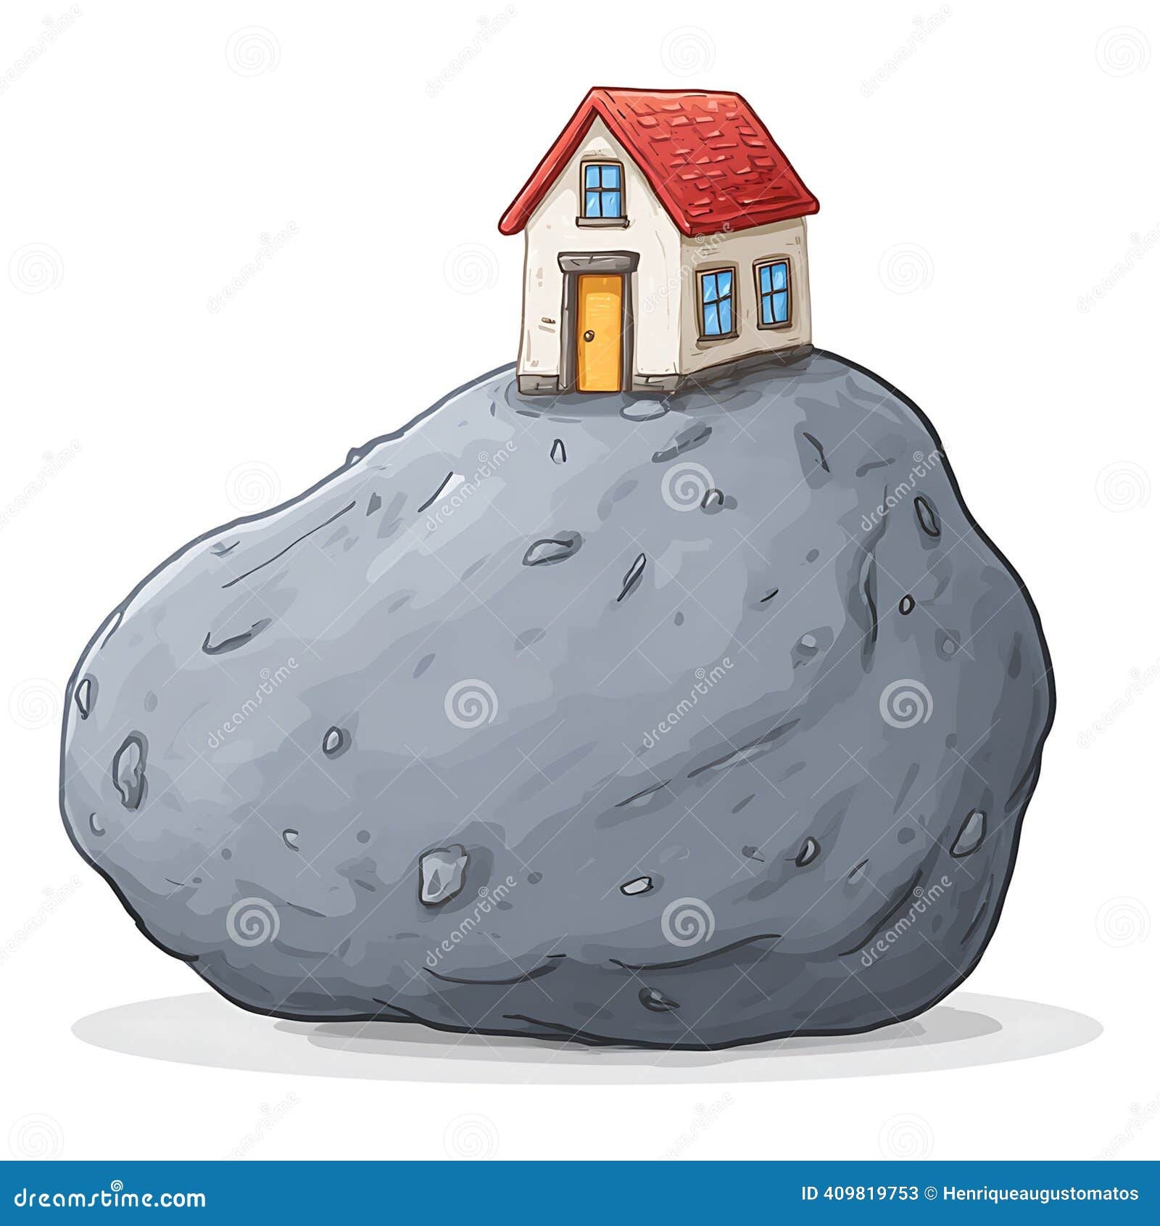
Activity:
“The Rock of Faith”
Materials Needed:
  Gray colored paper
  Bond paper
  Crayons
  Scissors
  Glue

Slide 16
Activity:
“The Rock of Faith”
1.Cut out a large stone from construction paper.
2.Write on the Rock: “Jesus the Mesiah”
3. Glue the Rock on the bond paper.
4. Draw a house standing on a rock.

Slide 17
Dear Jesus,
Thank You for loving us and for showing us that You are the Son of God. Help us to have faith like Peter and to tell others about You with courage. Build our lives on Your truth and help us trust You every day.
In Jesus' name,
Amen.
Closing Prayer

Slide 18
Live the Word Kids

