Slide 1




Live the Word Kids

Slide 2

Eighteenth Sunday in Ordinary Time
August 2, 2026 | Cycle A Year 2

Slide 3
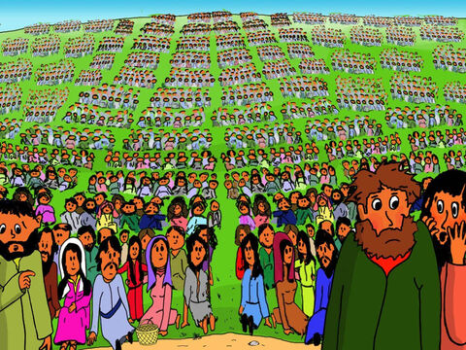
Jesus Feeds Five Thousand
Matthew 14:13-21

Slide 4


Leader:
A reading from the Holy Gospel according to Matthew.
All:
Glory to You, Oh Lord.

Slide 5
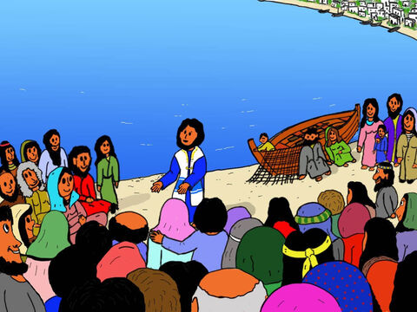
13
When Jesus heard the news about John, he left there in a boat and went to a lonely place by himself. The people heard about it, and so they left their towns and followed him by land.

Slide 6
14
Jesus got out of the boat, and when he saw the large crowd, his heart was filled with pity for them, and he healed their sick.

Slide 7
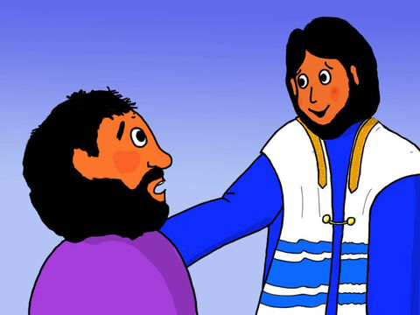
15
That evening his disciples came to him and said, “It is already very late, and this is a lonely place. Send the people away and let them go to the villages to buy food for themselves.”

Slide 8
16
“They don't have to leave,” answered Jesus. “You yourselves give them something to eat!”

Slide 9
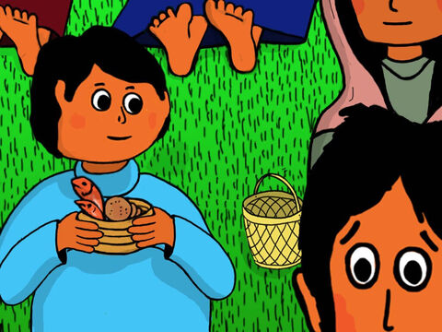
17
“All we have here are five loaves and two fish,” they replied.

Slide 10
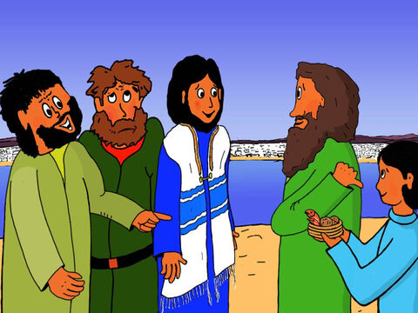
18
“Then bring them here to me,” Jesus said.

Slide 11
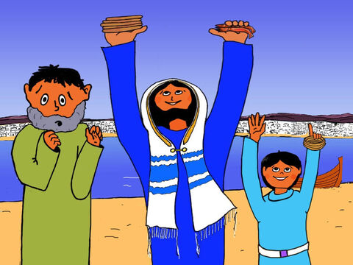
19
He ordered the people to sit down on the grass; then he took the five loaves and the two fish, looked up to heaven, and gave thanks to God. He broke the loaves and gave them to the disciples, and the disciples gave them to the people.

Slide 12
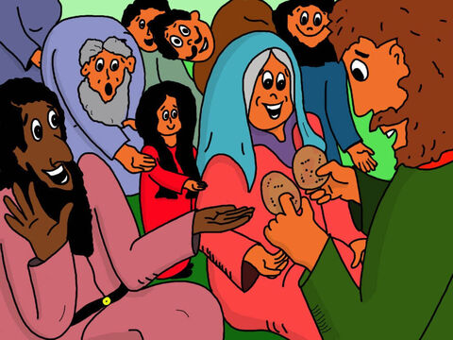
20
Everyone ate and had enough. Then the disciples took up twelve baskets full of what was left over.

Slide 13
21
The number of men who ate was about five thousand, not counting the women and children.

Slide 14
Leader:
The Gospel of the Lord
All:
Praise to you, Lord Jesus Christ.

Slide 15
Gospel Message

Slide 16


Activity:
“Jesus Provides” Basket Craft
Materials Needed:
  Paper Plate
  Colored paper (Yellow and Gray)
  Glue
  Scissors
  Crayons

Slide 17
Activity:
“Jesus Provides” Basket Craft
1.Cut out a basket shape to look like a basket.
2.Cut out 5 small bread (Yellow Paper) and 2 fish (Gray Paper).
3.Glue the bread and fish into the basket
4. Color the basket according to your liking.

Slide 18
Dear Jesus,
thank You for loving us and providing everything we need. Help us to trust You, share with others, and remember that You can do amazing things. Bless our families and keep us safe. In Jesus' name,
Amen.
Closing Prayer

Slide 19
Live the Word Kids

