Slide 1



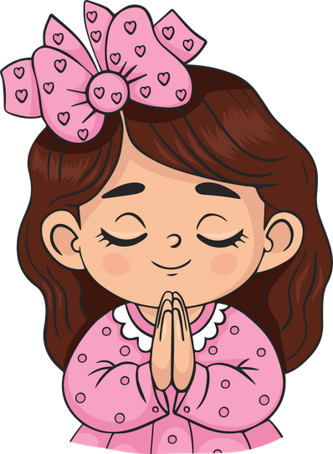
Live the Word Kids

Slide 2

Twentieth Sunday in Ordinary Time
August 16, 2026 | Cycle A Year 2

Slide 3
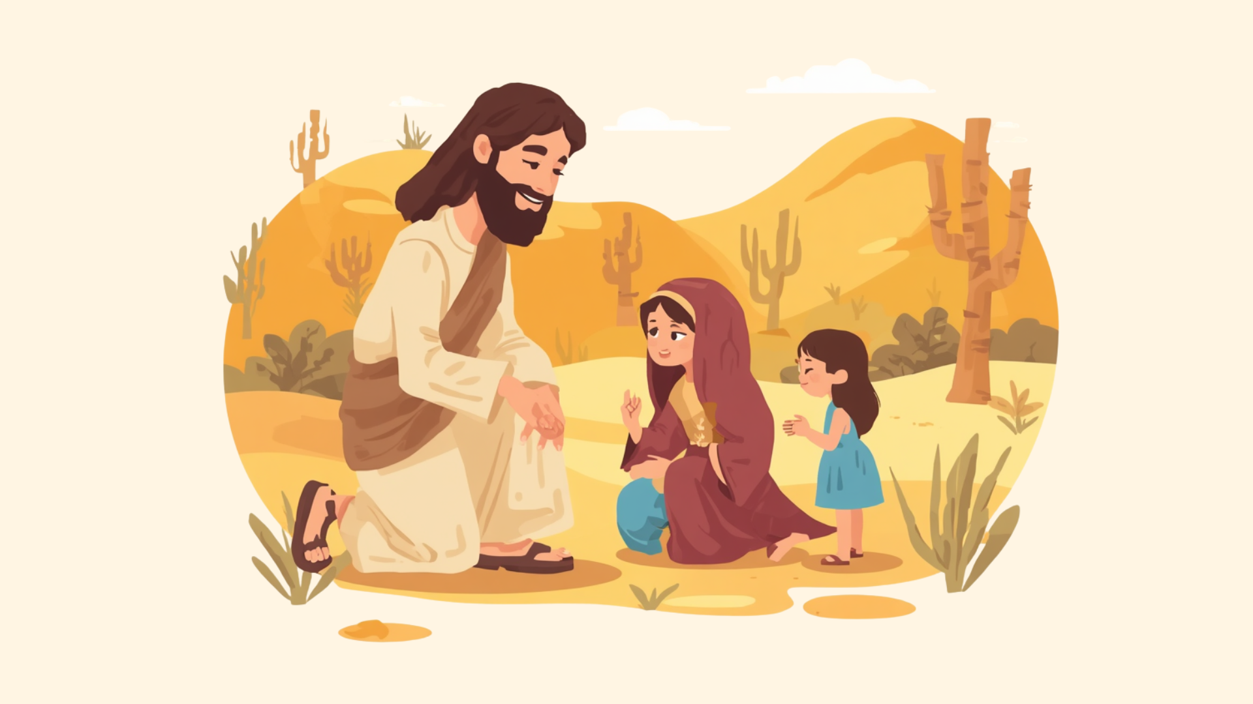
A Woman’s Faith
Matthew 15:21-28

Slide 4
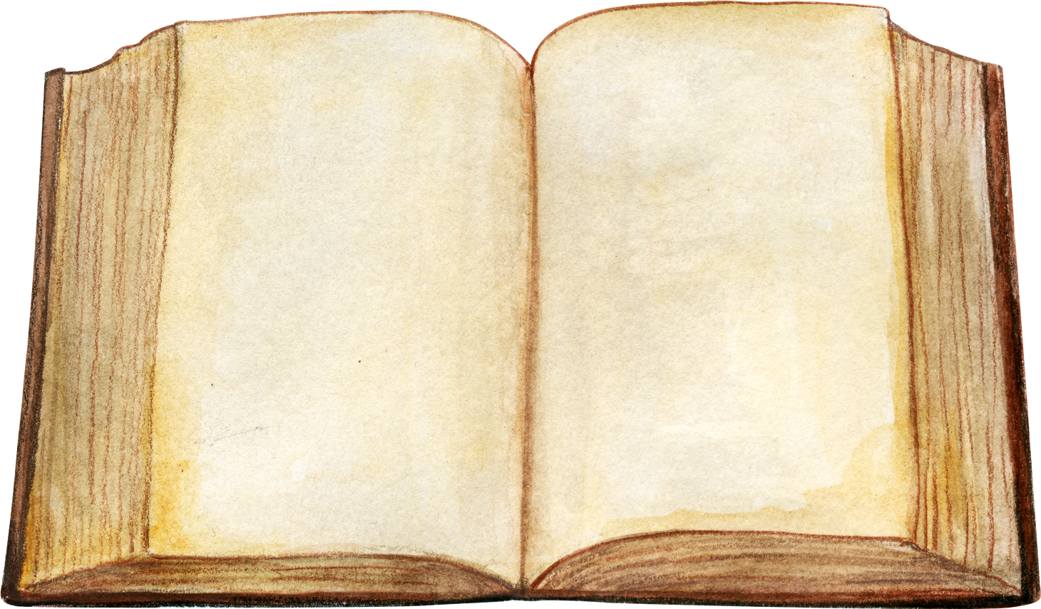

Leader:
A reading from the Holy Gospel according to Matthew.
All:
Glory to You, Oh Lord.

Slide 5
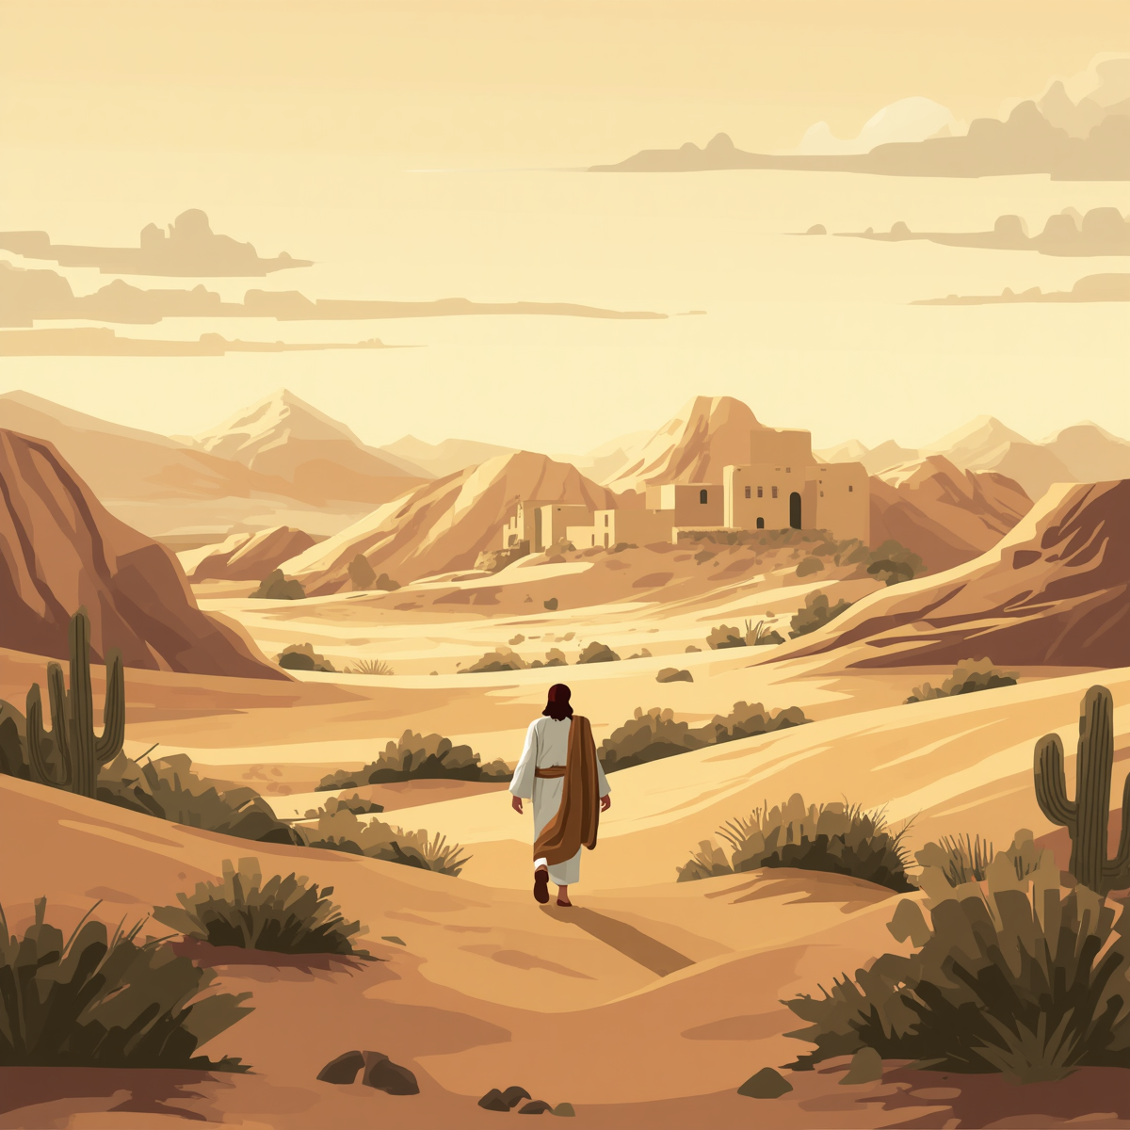
21
Jesus left that place and went off to the territory near the cities of Tyre and Sidon.

Slide 6
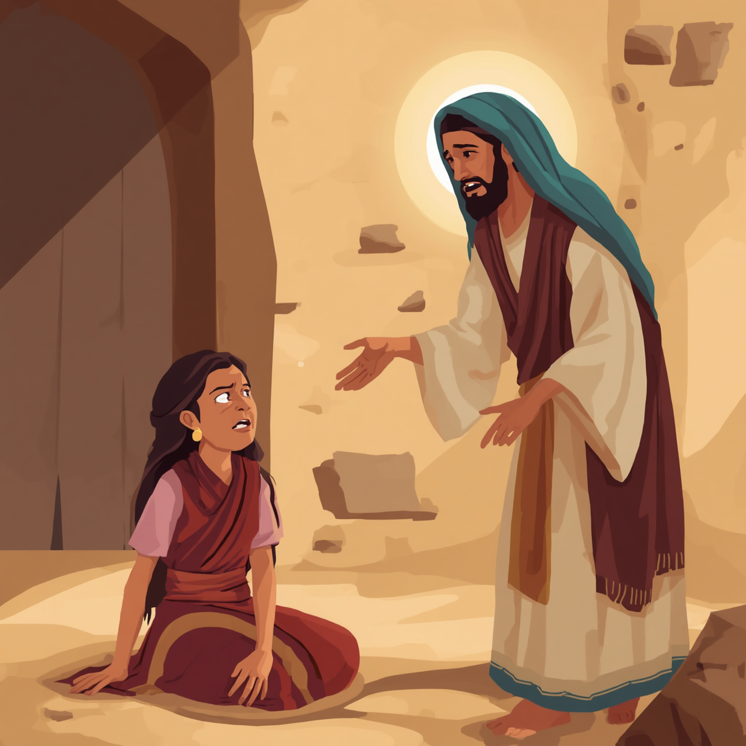
22
A Canaanite woman who lived in that region came to him. “Son of David!” she cried out. “Have mercy on me, sir! My daughter has a demon and is in a terrible condition.”

Slide 7
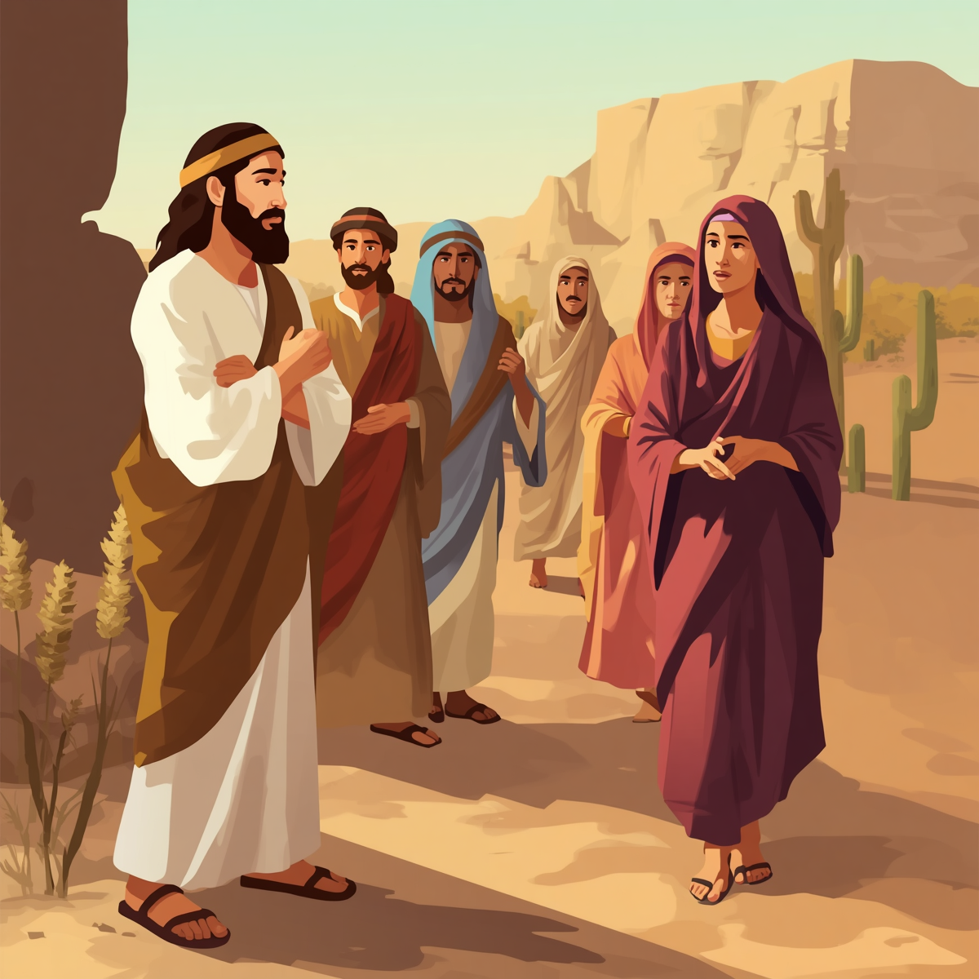
23
But Jesus did not say a word to her. His disciples came to him and begged him, “Send her away! She is following us and making all this noise!”

Slide 8
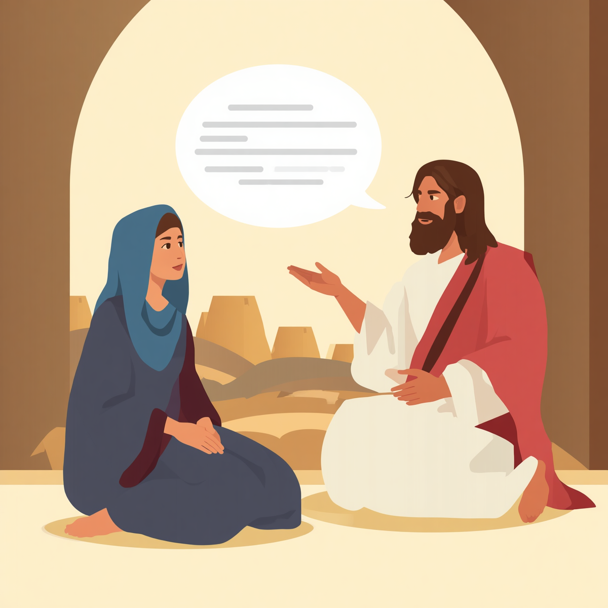
24
Then Jesus replied, “I have been sent only to the lost sheep of the people of Israel.”

Slide 9
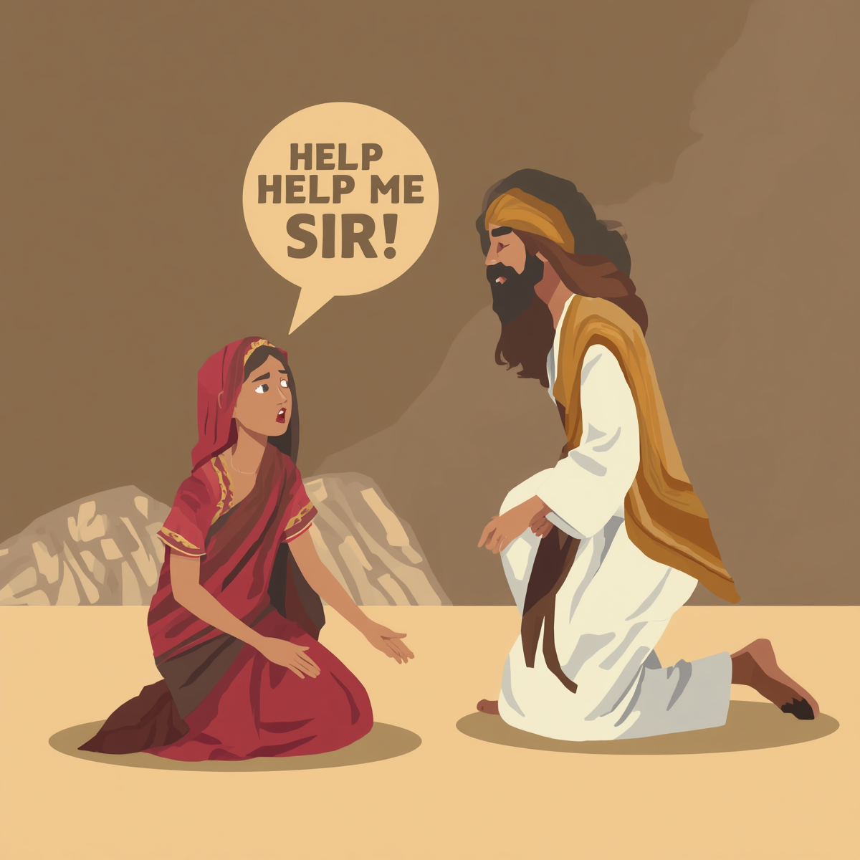
25
At this the woman came and fell at his feet. “Help me, sir!” she said.

Slide 10
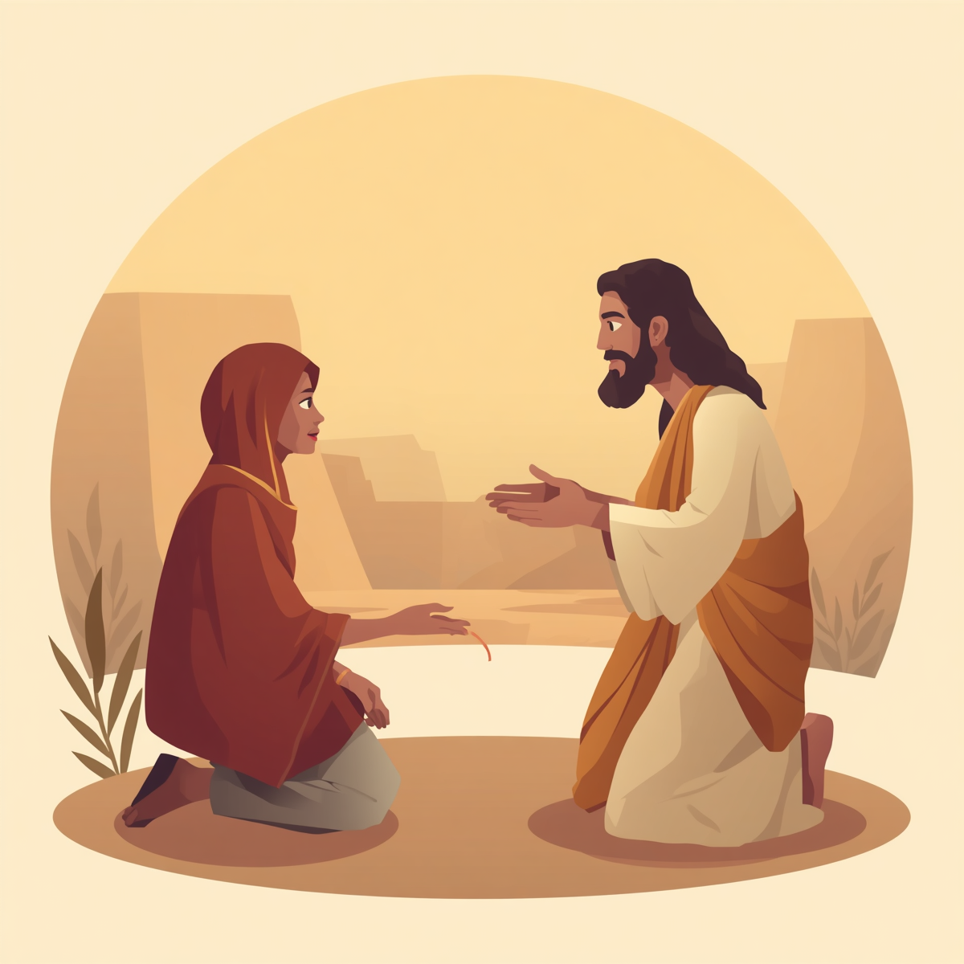
26
Jesus answered, “It isn't right to take the children's food and throw it to the dogs.”

Slide 11
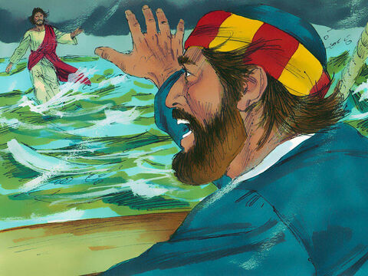
28
Then Peter spoke up. “Lord, if it is really you, order me to come out on the water to you.”

Slide 12
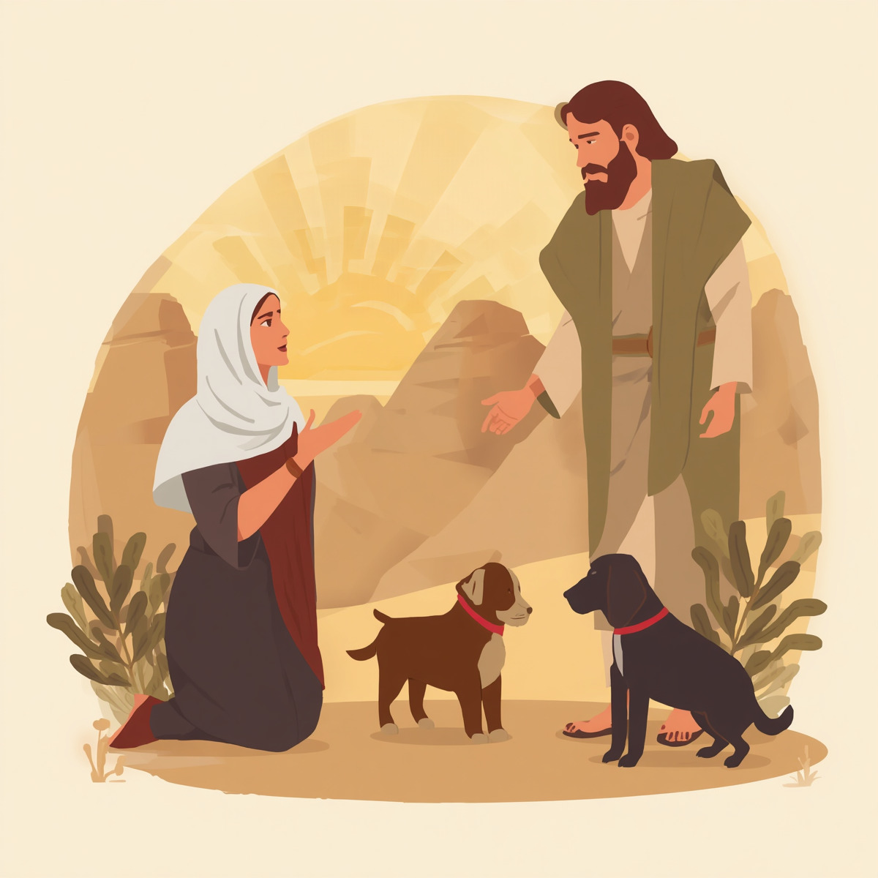
27
“That's true, sir,” she answered, “but even the dogs eat the leftovers that fall from their masters' table.”

Slide 13
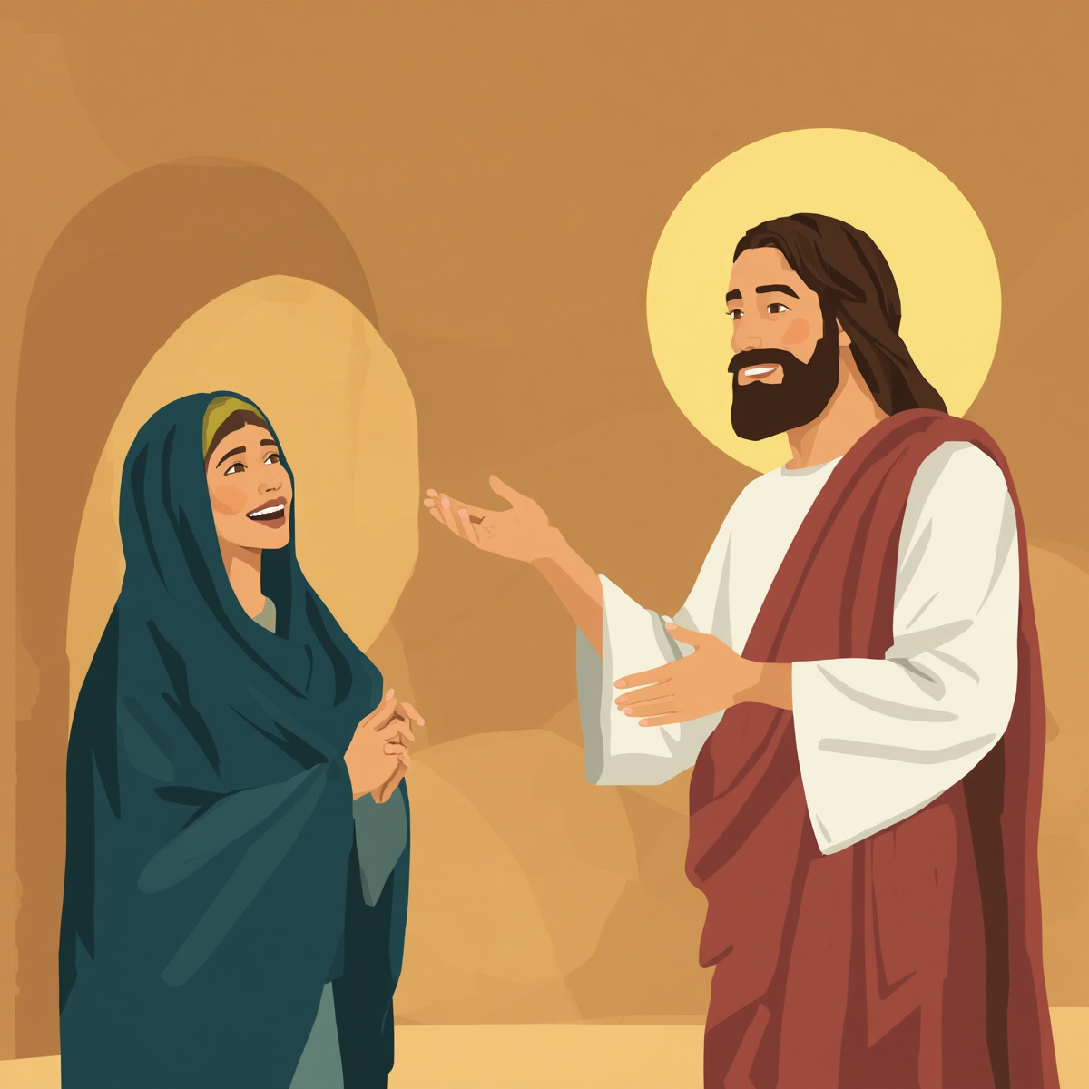
28
So Jesus answered her, “You are a woman of great faith! What you want will be done for you.” And at that very moment her daughter was healed.

Slide 14
Leader:
The Gospel of the Lord
All:
Praise to you, Lord Jesus Christ.

Slide 15
Gospel Message

Slide 16


Activity:
“Faith Heart”
Materials Needed:
  Red colored paper
  Scissors

Slide 17
Activity:
“Faith Heart”
1.Cut out a large heart from construction paper.
2.Write in the middle: “Jesus, I Trust You”.

Slide 18
Dear Jesus,
Thank You for loving us and listening to our prayers. Help us to have strong faith like the Canaanite woman. Teach us to trust You every day, even when we have to wait. Thank You for always caring for us. We love You.
Amen.
Closing Prayer

Slide 19
Live the Word Kids

