Slide 1






Live the Word
Kids

Slide 2





26th Sunday in Ordinary Time
September 28, 2025 | Cycle C Year I

Slide 3

The Rich Man and Lazarus
Luke 16:19-31

Slide 4



Leader: A reading from
the Holy Gospel
according to Luke.
All: Glory to You, Oh Lord.

Slide 5


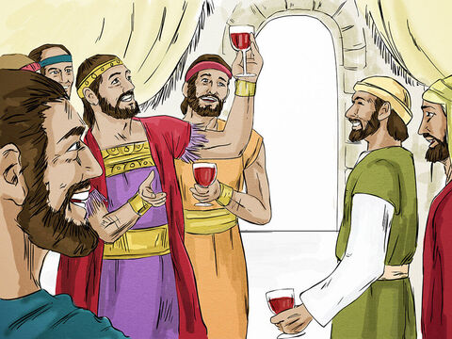
19
“There was once a rich man who dressed in the most expensive clothes and lived in great luxury every day.

Slide 6
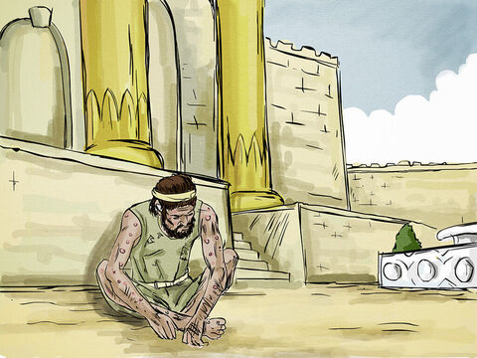
20
There was also a poor man named Lazarus, covered with sores, who used to be brought to the rich man's door,

Slide 7
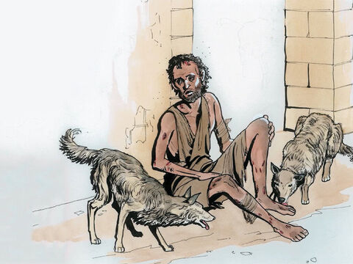
21
hoping to eat the bits of food that fell from the rich man's table. Even the dogs would come and lick his sores.

Slide 8
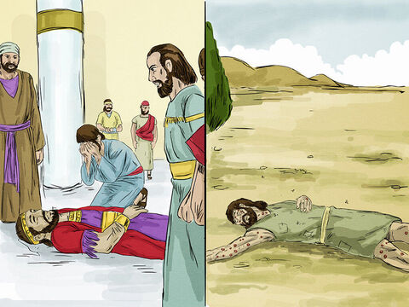
22
The poor man died and was carried by the angels to sit beside Abraham at the feast in heaven. The rich man died and was buried,

Slide 9
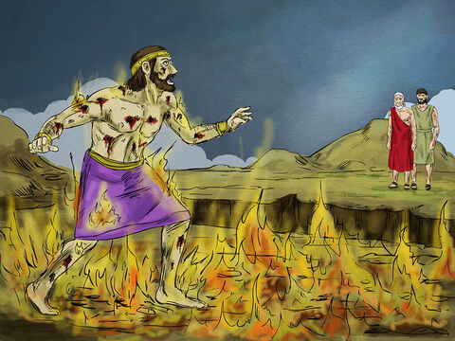
23
and in Hades, where he was in great pain, he looked up and saw Abraham, far away, with Lazarus at his side.

Slide 10
24
So he called out, ‘Father Abraham! Take pity on me, and send Lazarus to dip his finger in some water and cool off my tongue, because I am in great pain in this fire!’

Slide 11
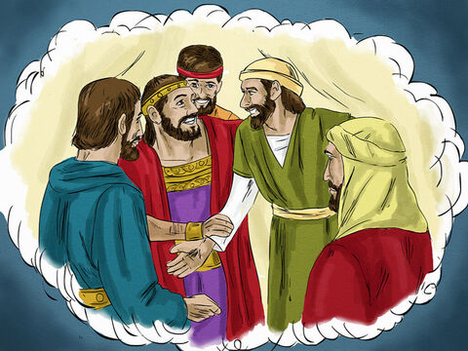
25
But Abraham said, ‘Remember, my son, that in your lifetime you were given all the good things, while Lazarus got all the bad things. But now he is enjoying himself here, while you are in pain.

Slide 12
26
Besides all that, there is a deep pit lying between us, so that those who want to cross over from here to you cannot do so, nor can anyone cross over to us from where you are.’

Slide 13
27
  The rich man said, ‘Then I beg you, father Abraham, send Lazarus to my father's house,

Slide 14
28
where I have five brothers. Let him go and warn them so that they, at least, will not come to this place of pain.’

Slide 15
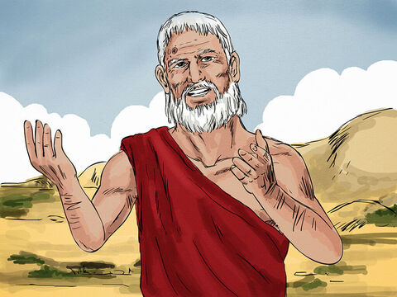
29
  Abraham said, ‘Your brothers have Moses and the prophets to warn them; your brothers should listen to what they say.’

Slide 16
30
The rich man answered, ‘That is not enough, father Abraham! But if someone were to rise from death and go to them, then they would turn from their sins.’

Slide 17
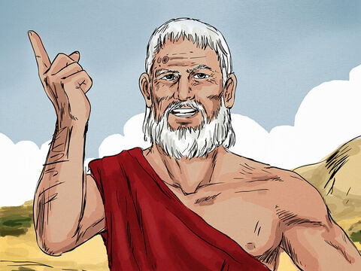
31
  But Abraham said, ‘If they will not listen to Moses and the prophets, they will not be convinced even if someone were to rise from death.’”

Slide 18
Leader: The Gospel of the Lord
All: Praise to You,
Lord Jesus Christ

Slide 19


Gospel Message

Slide 20


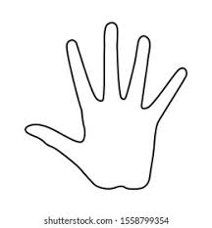
Activity: “Helping Hands”
Materials Needed:
•Bond Paper
•Pencil
•Coloring Materials

Slide 21
Instructions:
  Trace hand on a piece of paper.
  On each handprint, write one way you can help others (e.g., share food, give toys, pray for the sick, visit the lonely, say kind words).
  Color the background

Slide 22



Closing Prayer
Dear Jesus,
Thank You for giving us loving hands and hearts.
Help us to see people in need and share with them.
Make us kind and generous, just like You.
Amen.

Slide 23
Live the Word
Kids

