Slide 1


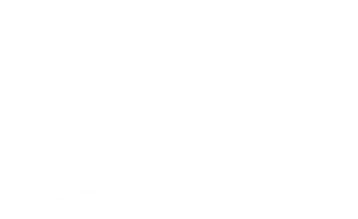

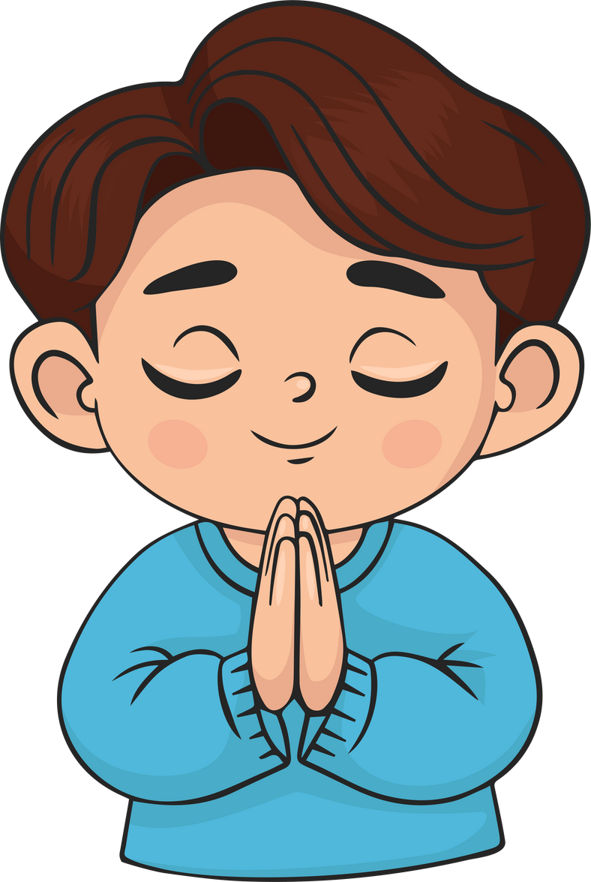
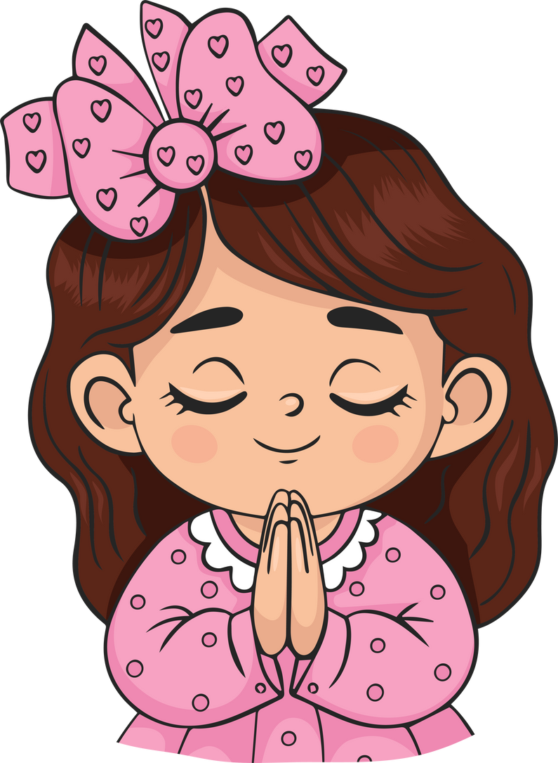
Live the Word
Kids

Slide 2
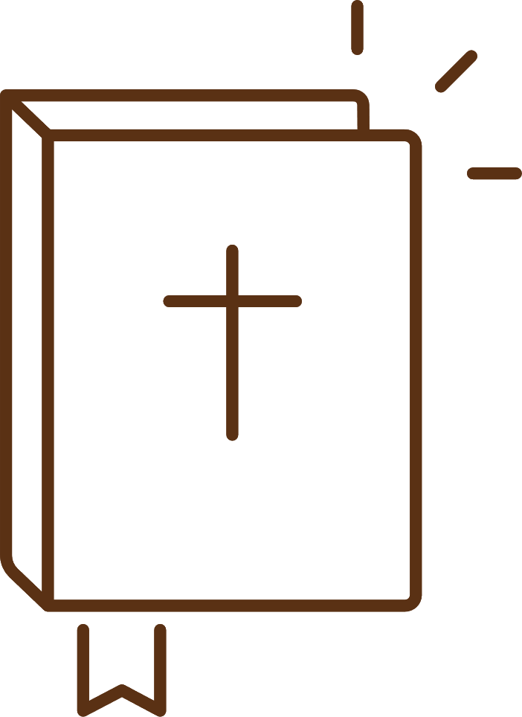
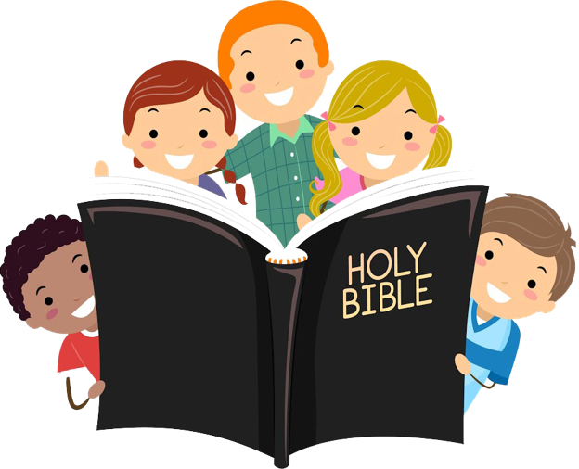

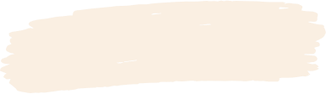

27th Sunday in Ordinary Time
October 5, 2025 | Cycle C Year I

Slide 3

The Parable of the Mustard Seed
Luke 17:5-10

Slide 4



Leader: A reading from
the Holy Gospel
according to Luke.
All: Glory to You, Oh Lord.

Slide 5

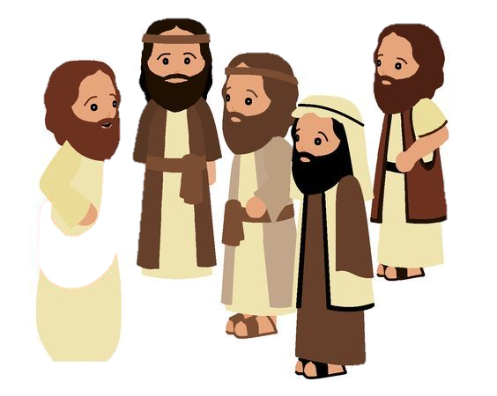
5
The apostles said to the Lord, “Make our faith greater.”

Slide 6
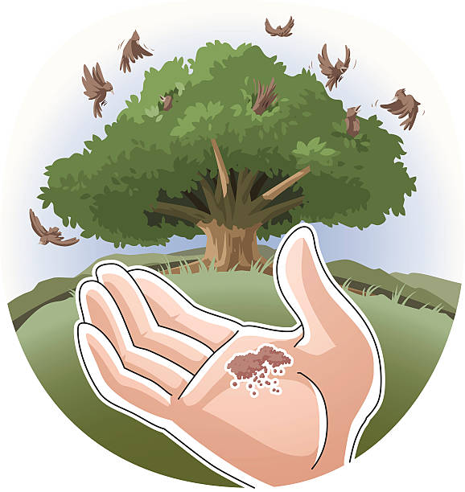
6
The Lord answered, “If you had faith as big as a mustard seed, you could say to this mulberry tree, ‘Pull yourself up by the roots and plant yourself in the sea!’ and it would obey you.

Slide 7
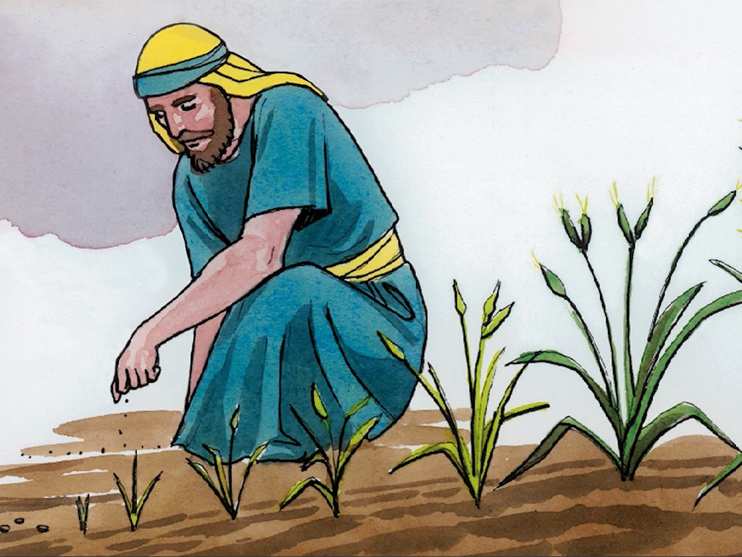
7
“Suppose one of you has a servant who is plowing or looking after the sheep. When he comes in from the field, do you tell him to hurry along and eat his meal?

Slide 8
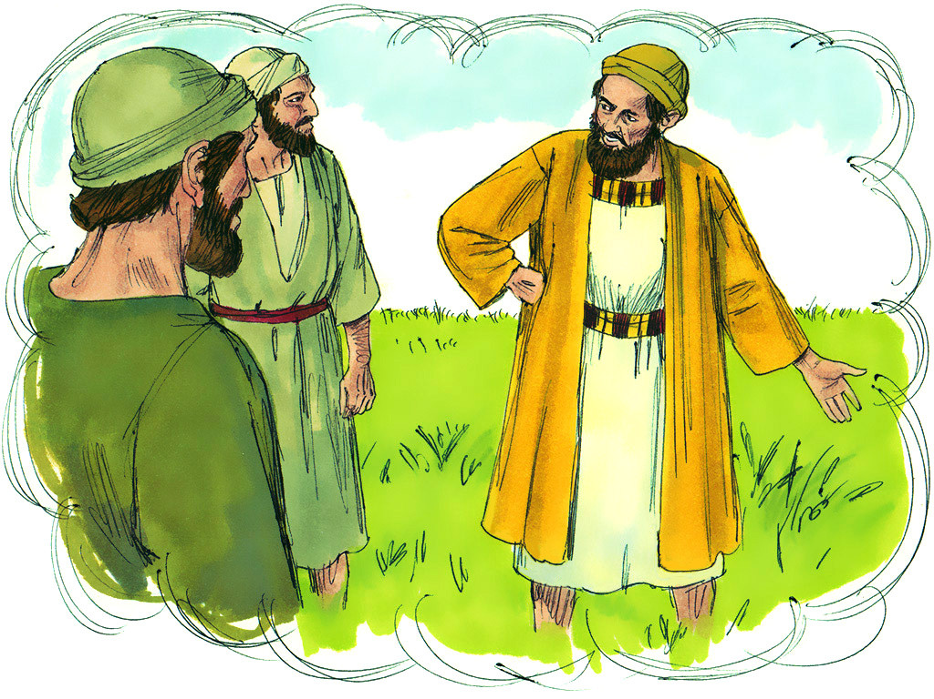
8
Of course not! Instead, you say to him, ‘Get my supper ready, then put on your apron and wait on me while I eat and drink; after that you may have your meal.’

Slide 9
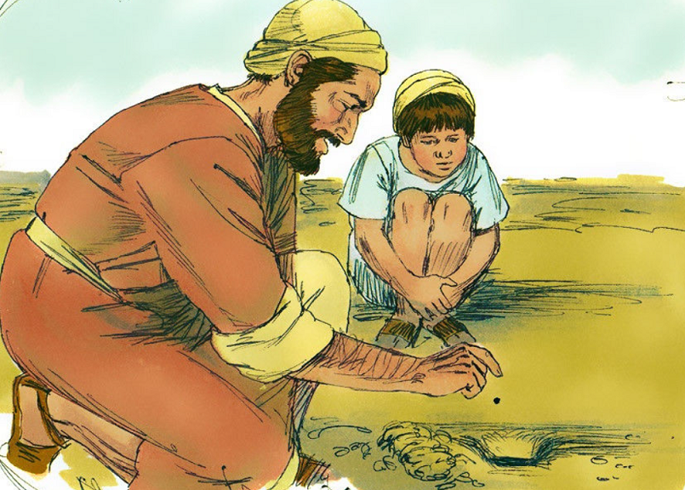
9
The servant does not deserve thanks for obeying orders, does he?

Slide 10
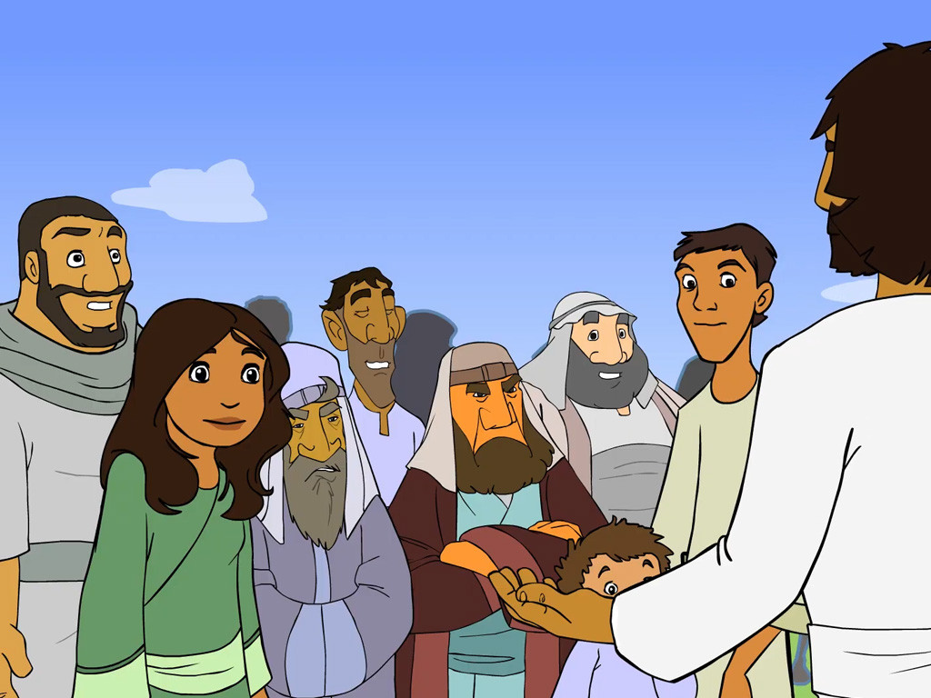
10
It is the same with you; when you have done all you have been told to do, say, ‘We are ordinary servants; we have only done our duty.’”

Slide 11
Leader: The Gospel of the Lord
All: Praise to You,
Lord Jesus Christ

Slide 12


Gospel Message

Slide 13



Activity: “Handprint Mustard Seed”
Materials Needed:
•Bond Paper
•Colored Paper
•Glue
•Scissors
•Pencil/Coloring pens

Slide 14
Instructions:
  Draw or paint a tree trunk in the middle of the paper.
  Put paint on your hand and press your hand down to make leaves, or cut out hand shapes from colored paper.
  Glue the hand leaves around the trunk.
  At the base, glue a few real or drawn
  seeds and write “Kingdom Starts Small.”

Slide 15


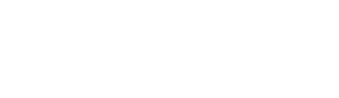
Closing Prayer
Dear Jesus, thank You for showing us that even a little faith is powerful. Help me to grow my faith every day through prayer and good choices. Teach me to serve others with love and not expect rewards. Remind me
that small acts of kindness matter to You. I want to be Your faithful child, trusting and obeying You always.
Amen.

Slide 16
Live the Word
Kids

