Slide 1






Live the Word Kids

Slide 2
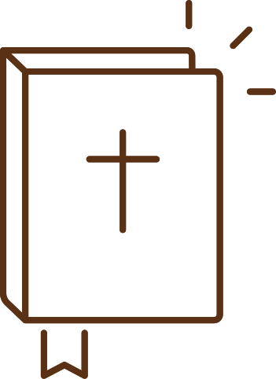
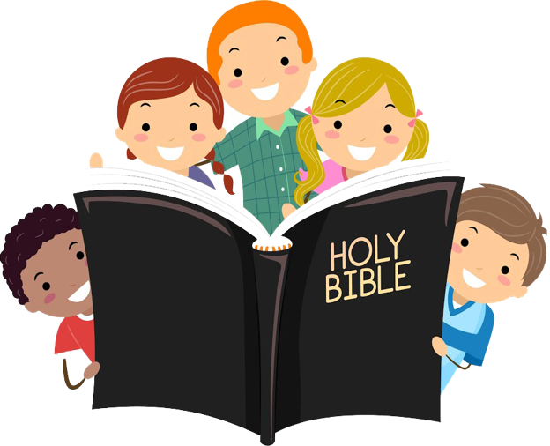



30th Sunday in Ordinary Time
October 26, 2025 | Cycle C Year I

Slide 3
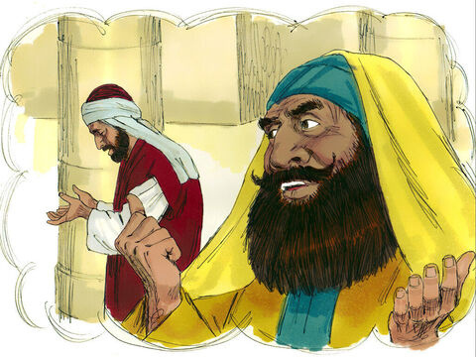
The Parable of the Pharisee and the Tax Collector
Luke 18:9-14

Slide 4


Leader: A reading from
the Holy Gospel
according to Luke.
All: Glory to You, Oh Lord.

Slide 5


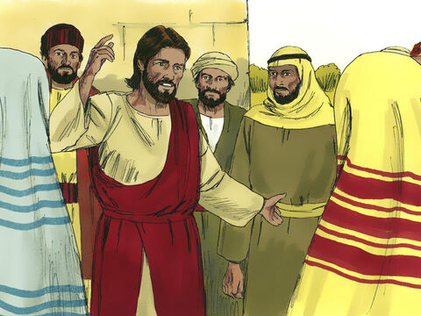
9
Jesus also told this parable to people who were sure of their own goodness and despised everybody else.

Slide 6
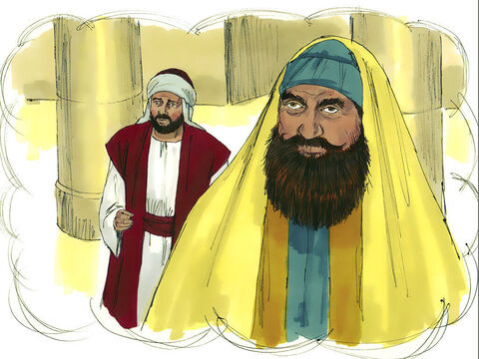
10
“Once there were two men who went up to the Temple to pray: one was a Pharisee, the other a tax collector.

Slide 7
11
The Pharisee stood apart by himself and prayed,'I thank you, God, that I am not greedy, dishonest, or an adulterer, like everybody else. I thank you that I am not like that tax collector over there.

Slide 8
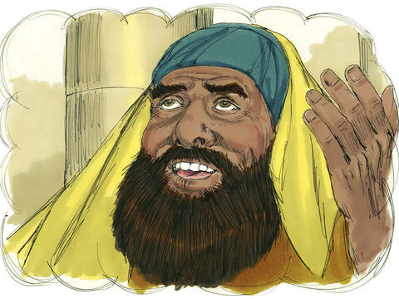
12
I fast two days a week, and I give you one tenth of all my income.’

Slide 9
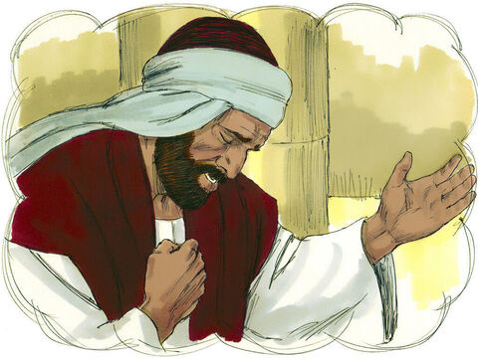
13
But the tax collector stood at a distance and would not even raise his face to heaven, but beat on his breast and said, ‘God, have pity on me, a sinner!’

Slide 10
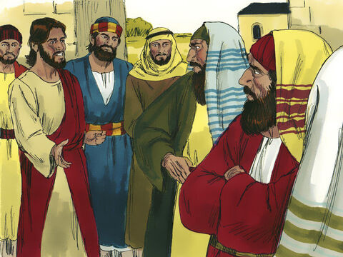
14
I tell you,” said Jesus, “the tax collector, and not the Pharisee, was in the right with God when he went home. For those who make themselves great will be humbled, and those who humble themselves will be made great.”

Slide 11
Leader: The Gospel of the Lord
All: Praise to You,
Lord Jesus Christ

Slide 12
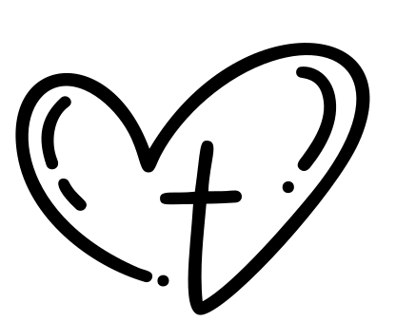
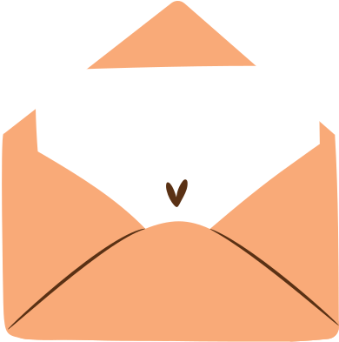
Gospel Message

Slide 13




Activity: My Humble Heart
Materials Needed:
  2 sheets of colored paper (red and white)
  Scissors
  Glue
  Markers or crayons
God, have
mercy on me.

Slide 14
Instructions:
1. Cut a big red heart and a smaller white heart.
2. On the white heart, write: “The Tax Collector said, ‘God, have mercy on me.’”
3. Glue the white heart inside the red heart.
4. Decorate and write at the bottom: “God loves a humble heart – Luke 18:14.”
God, have
mercy on me.

Slide 15



Dear God,
Thank You for teaching us that You love humble hearts. Help us to pray like the tax collector — honest and kind, not proud or boastful. Teach us to listen and follow You with gentle hearts each day. Forgive us when we think we’re better than others and remind us to stay humble. Fill our hearts with love, kindness, and truth in all that we do. We love You, Lord, and we want to please You in our prayers and actions. Amen.
Amen.
Closing Prayer

Slide 16
Live the Word Kids

