Slide 1






Live the Word Kids

Slide 2





29th Sunday in Ordinary Time
October 19, 2025 | Cycle C Year I

Slide 3
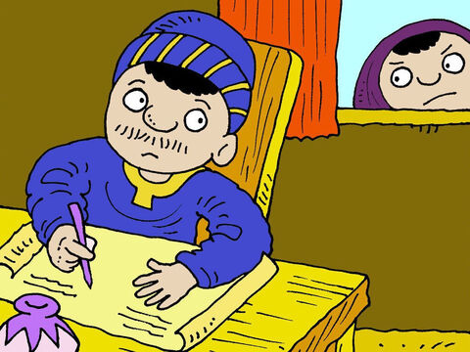
The Parable of the Widow and the Judge
Luke 18:1-8

Slide 4


Leader: A reading from
the Holy Gospel
according to Luke.
All: Glory to You, Oh Lord.

Slide 5


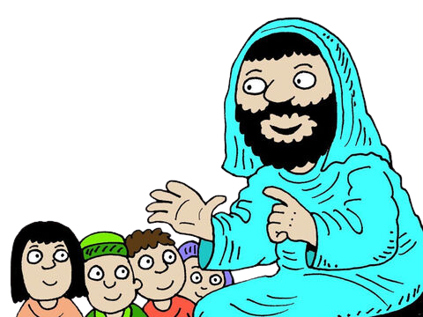
1
Then Jesus told his disciples a parable to teach them that they should always pray and never become discouraged.

Slide 6
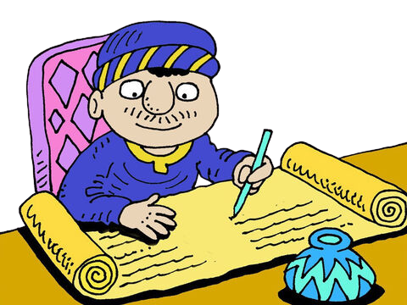
2
“In a certain town there was a judge who neither feared God nor respected people.

Slide 7
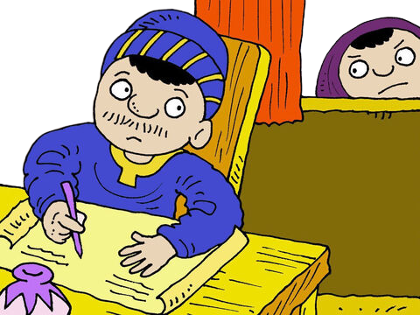
3
And there was a widow in that same town who kept coming to him and pleading for her rights, saying, ‘Help me against my opponent!’

Slide 8
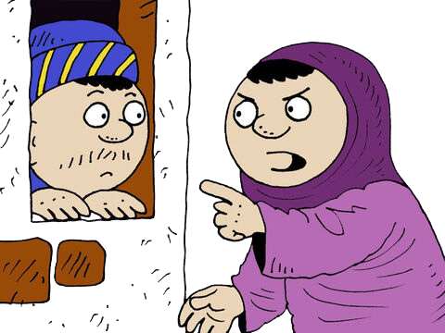
4
For a long time the judge refused to act, but at last he said to himself, ‘Even though I don't fear God or respect people,

Slide 9
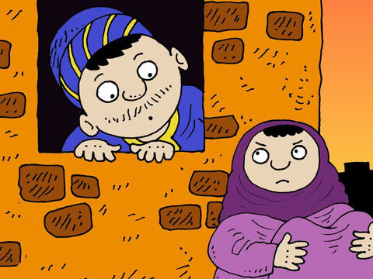
5
yet because of all the trouble this widow is giving me, I will see to it that she gets her rights. If I don't, she will keep on coming and finally wear me out!’”

Slide 10
6
And the Lord continued, “Listen to what that corrupt judge said.

Slide 11
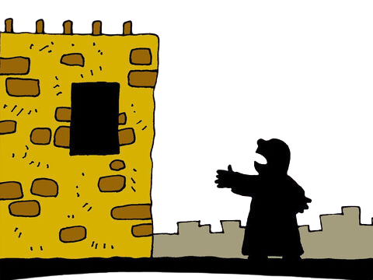
7
Now, will God not judge in favor of his own people who cry to him day and night for help? Will he be slow to help them?

Slide 12
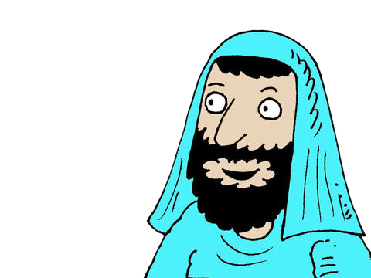
8
I tell you, he will judge in their favor and do it quickly. But will the Son of Man find faith on earth when he comes?”

Slide 13
Leader: The Gospel of the Lord
All: Praise to You,
Lord Jesus Christ

Slide 14


Gospel Message

Slide 15







Activity: “A Cup of Clean Heart”
Materials Needed:
  Tissue roll
  Yellow and orange paper (for flame)
  White paper (to wrap around roll)
  Glue, crayons, and scissors
I will pray and not give up

Slide 16
Instructions:
1. Wrap the tissue roll in white paper to look like a candle.
2. Cut a flame shape from yellow and orange paper, glue on top.
3. Write on the candle: “I will pray and not give up.”
4. Decorate with stars, hearts, or crosses.
I will pray and not give up

Slide 17



Closing Prayer
Dear Lord,
Thank You for teaching us to always pray and never give up, just like the widow in the story. Help us to trust You even when answers take time. Give us strong hearts and patient faith to keep talking to You every day. Remind us that You always hear our prayers and love us deeply.
Amen.

Slide 18
Live the Word Kids

