Slide 1




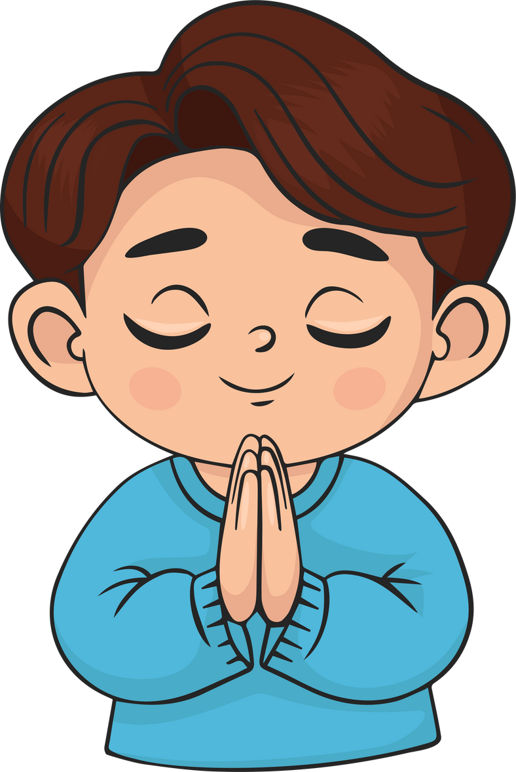
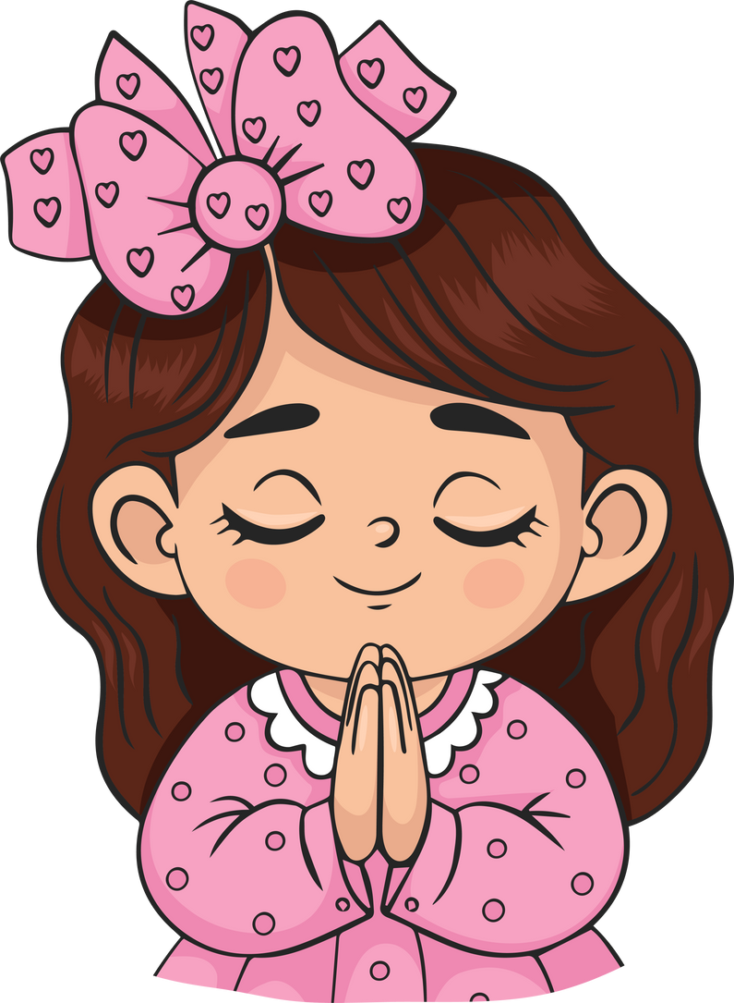
Live the Word
Kids

Slide 2





28th Sunday in Ordinary Time
October 12, 2025 | Cycle C Year I

Slide 3

Jesus Heals Ten Men
Luke 17:11-19

Slide 4



Leader: A reading from
the Holy Gospel
according to Luke.
All: Glory to You, Oh Lord.

Slide 5

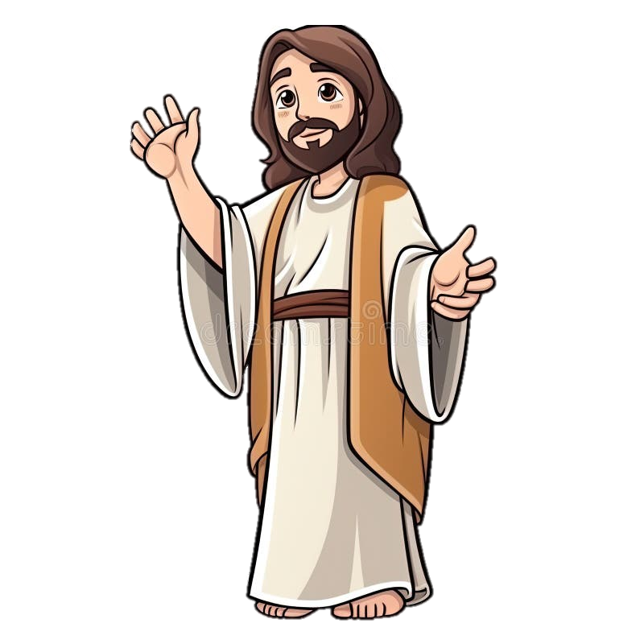
11
As Jesus made his way to Jerusalem, he went along the border between Samaria and Galilee.

Slide 6
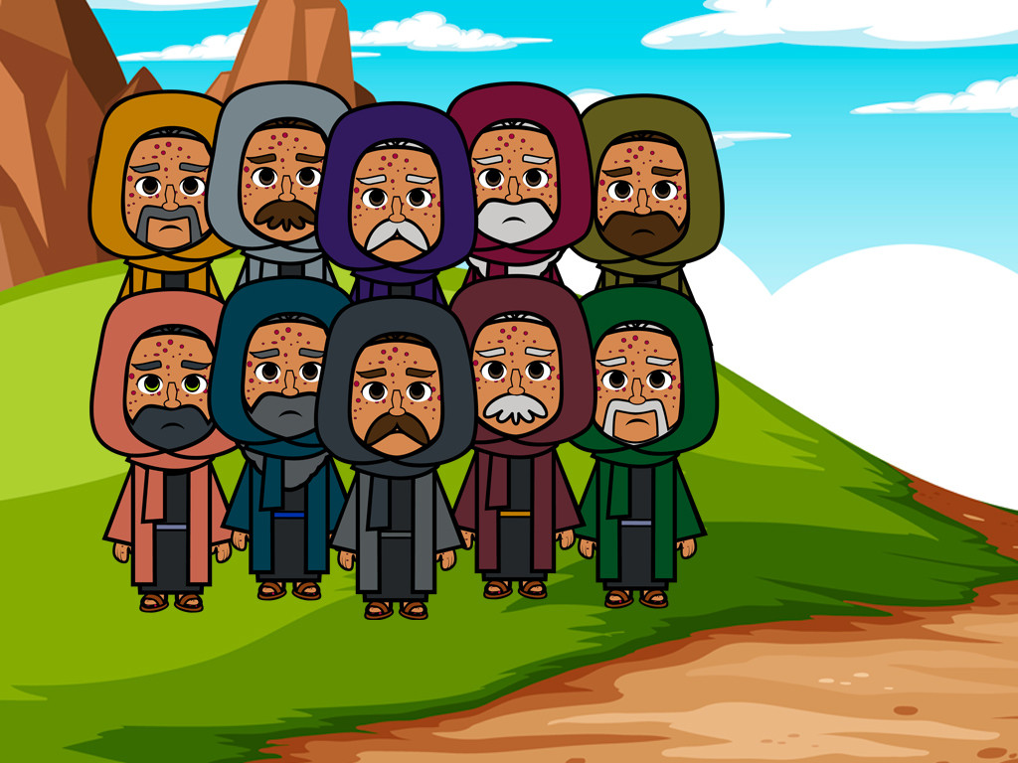
12
He was going into a village when he was met by ten men suffering from a dreaded skin disease. They stood at a distance

Slide 7
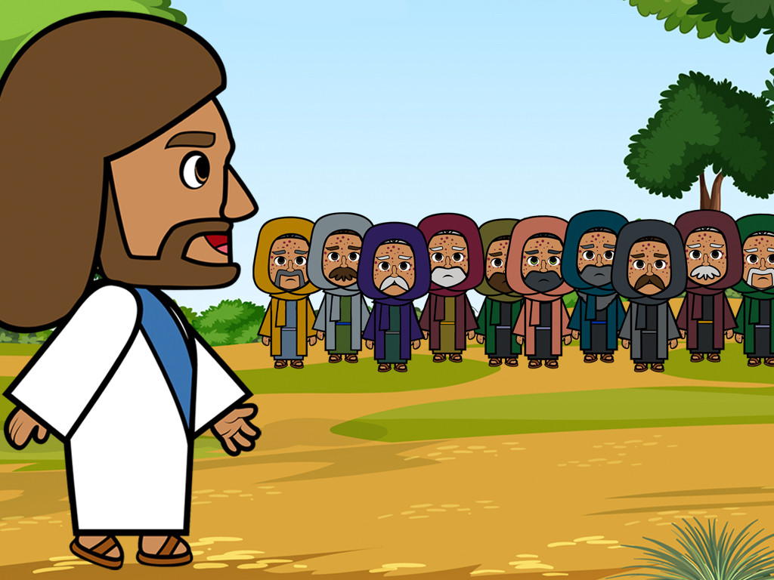
13
and shouted, “Jesus! Master! Have pity on us!”

Slide 8
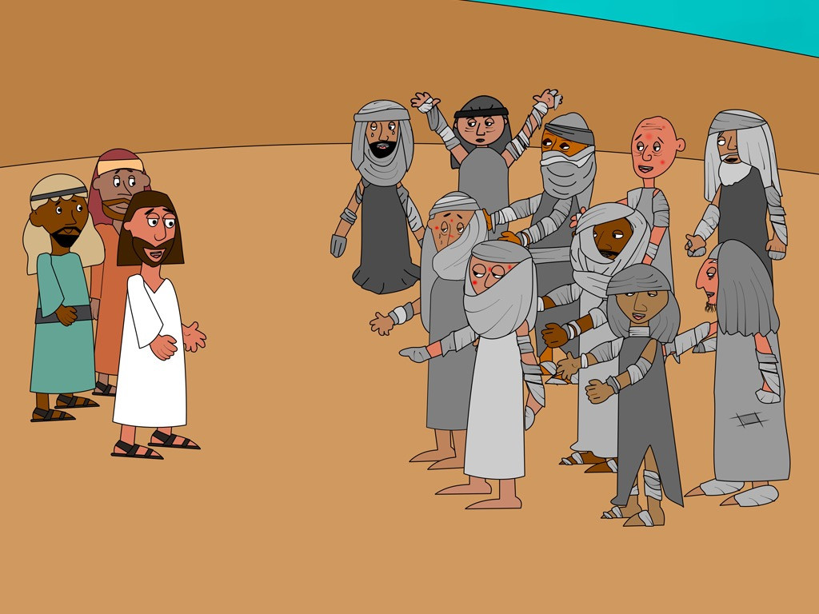
14
Jesus saw them and said to them, “Go and let the priests examine you.”
On the way they were made clean.

Slide 9
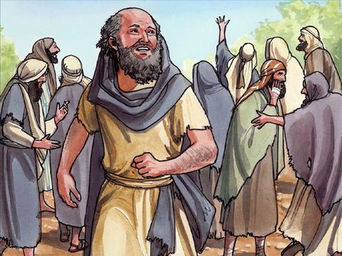
15
When one of them saw that he was healed, he came back, praising God in a loud voice.

Slide 10
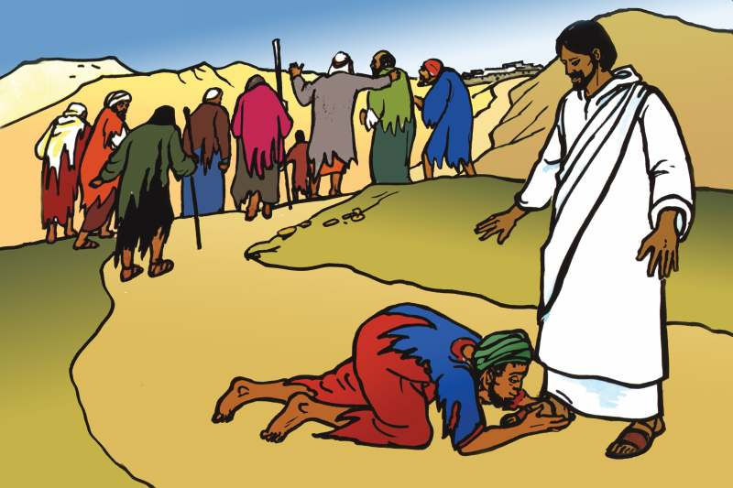
16
He threw himself to the ground at Jesus' feet and thanked him. The man was a Samaritan.

Slide 11
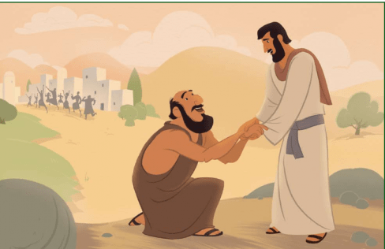
17
Jesus spoke up, “There were ten who were healed; where are the other nine?

Slide 12
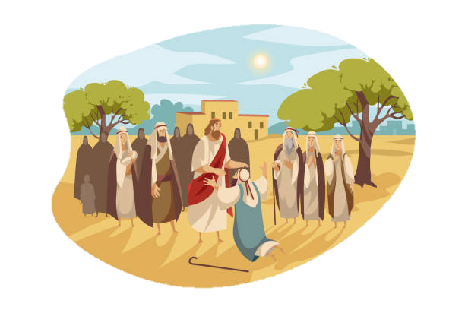
18
Why is this foreigner the only one who came back to give thanks to God?”

Slide 13
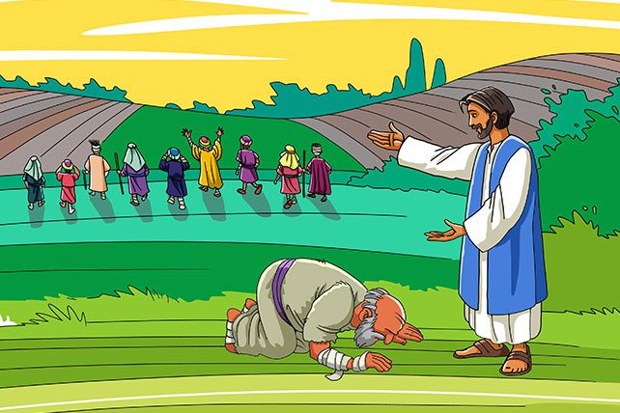
19
And Jesus said to him, “Get up and go; your faith has made you well.”

Slide 14
Leader: The Gospel of the Lord
All: Praise to You,
Lord Jesus Christ

Slide 15


Gospel Message

Slide 16


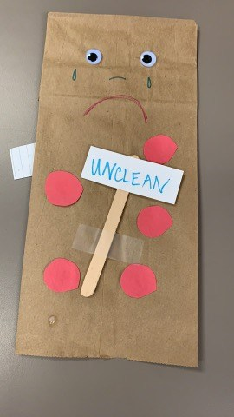
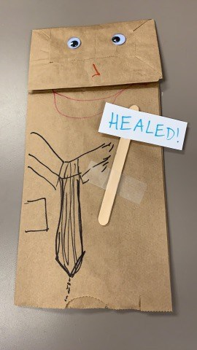
Activity: “Leper Paper Bag Puppet”
Materials Needed:
•Construction Paper
•Glue
•Scissors
•Googly eyes
•Pens/ Decorative material

Slide 17
Instructions:
  1. Decorate the paper bags as with faces, making one side happy and another sad.
  2. Add googly eyes and “clothes,” if desired.
  3. On the “leprous” side, glue cut out spots.
  4. Add signs on each side, for extra flair, making one read “unclean” and another “healed”.
  5. Flip your puppet back and forth to share the story!

Slide 18



Closing Prayer
Dear Jesus, thank you for being good and for healing us when we need it. Thank you for healing those ten men from their sickness, just like You help us when we are sick. Thank you for the man who came back to say "Thank You" and to praise God with a loud voice. Help us remember to thank You every day for all the good things You do for us, and to praise You with happy hearts. Amen.

Slide 19
Live the Word
Kids

