Slide 1






Live the Word
Kids

Slide 2





1st Sunday of Advent
November 30, 2025 | Cycle A Year 2

Slide 3

Signs of Christ’s Return
Matthew 24:37-44

Slide 4



Leader: A reading from
the Holy Gospel
according to Matthew
All: Glory to You, Oh Lord.

Slide 5

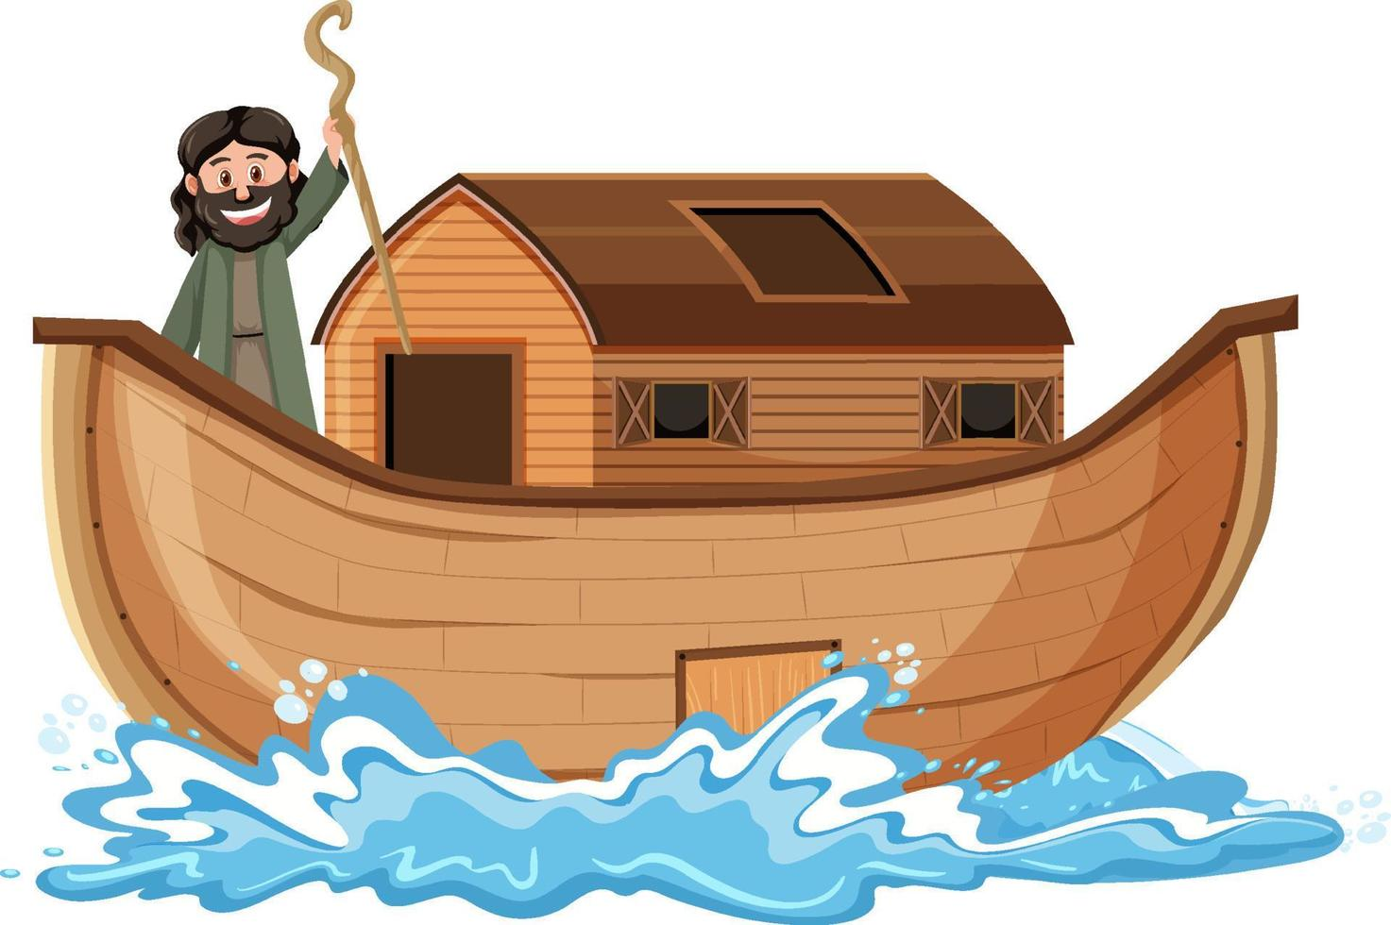
37
The coming of the Son of Man will be like what happened in the time of Noah.

Slide 6
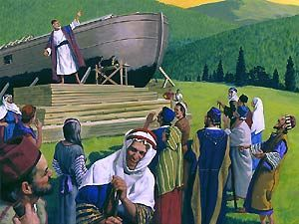
38
In the days before the flood people ate and drank, men and women married, up to the very day Noah went into the boat;

Slide 7
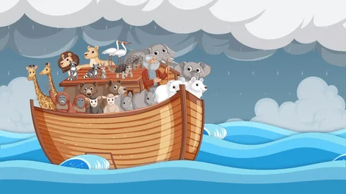
39
yet they did not realize what was happening until the flood came and swept them all away. That is how it will be when the Son of Man comes.

Slide 8

40
At that time two men will be working in a field: one will be taken away, the other will be left behind.

Slide 9
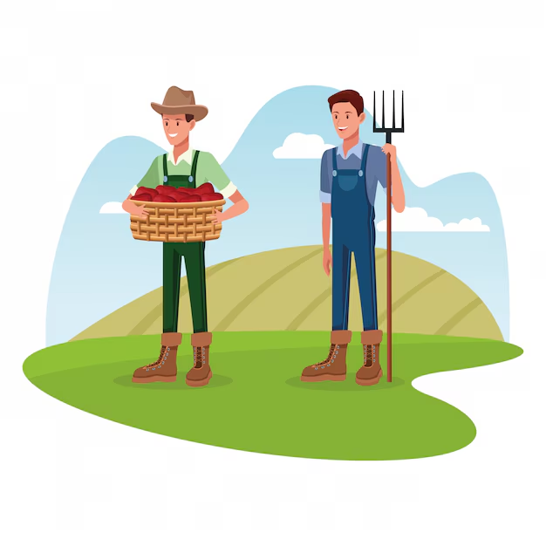
41
Two women will be at a mill grinding meal: one will be taken away, the other will be left behind.

Slide 10
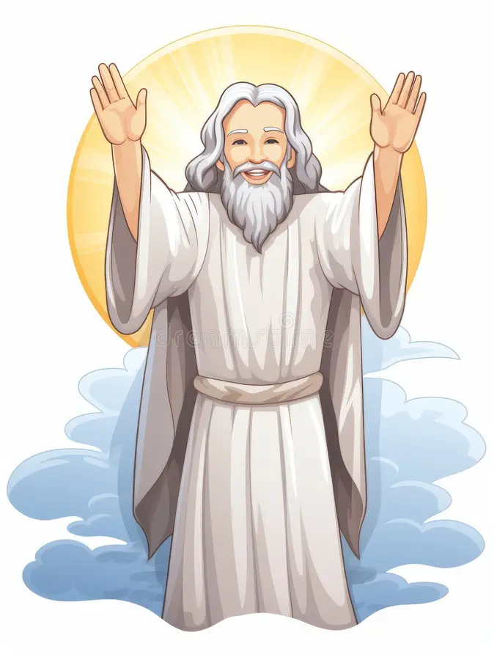
42
Watch out, then, because you do not know what day your Lord will come.

Slide 11
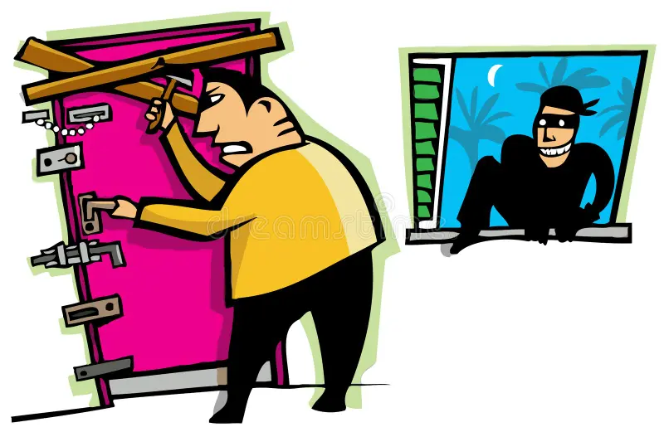
43
If the owner of a house knew the time when the thief would come, you can be sure that he would stay awake and not let the thief break into his house.

Slide 12
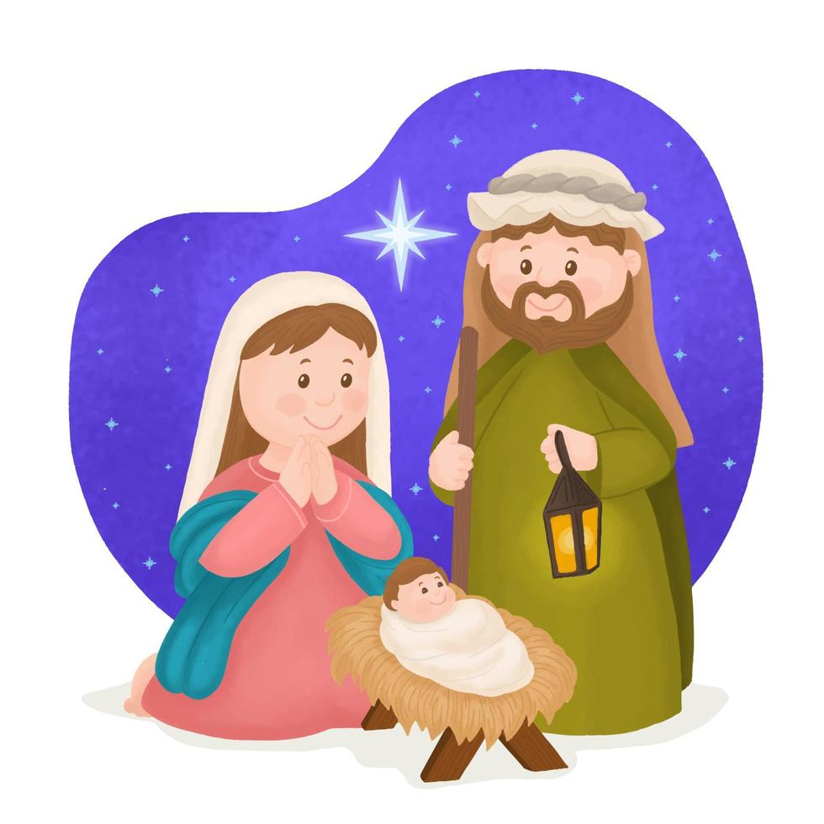
44
So then, you also must always be ready, because the Son of Man will come at an hour when you are not expecting him.

Slide 13
Leader: The Gospel of the Lord
All: Praise to You,
Lord Jesus Christ

Slide 14


Gospel Message

Slide 15


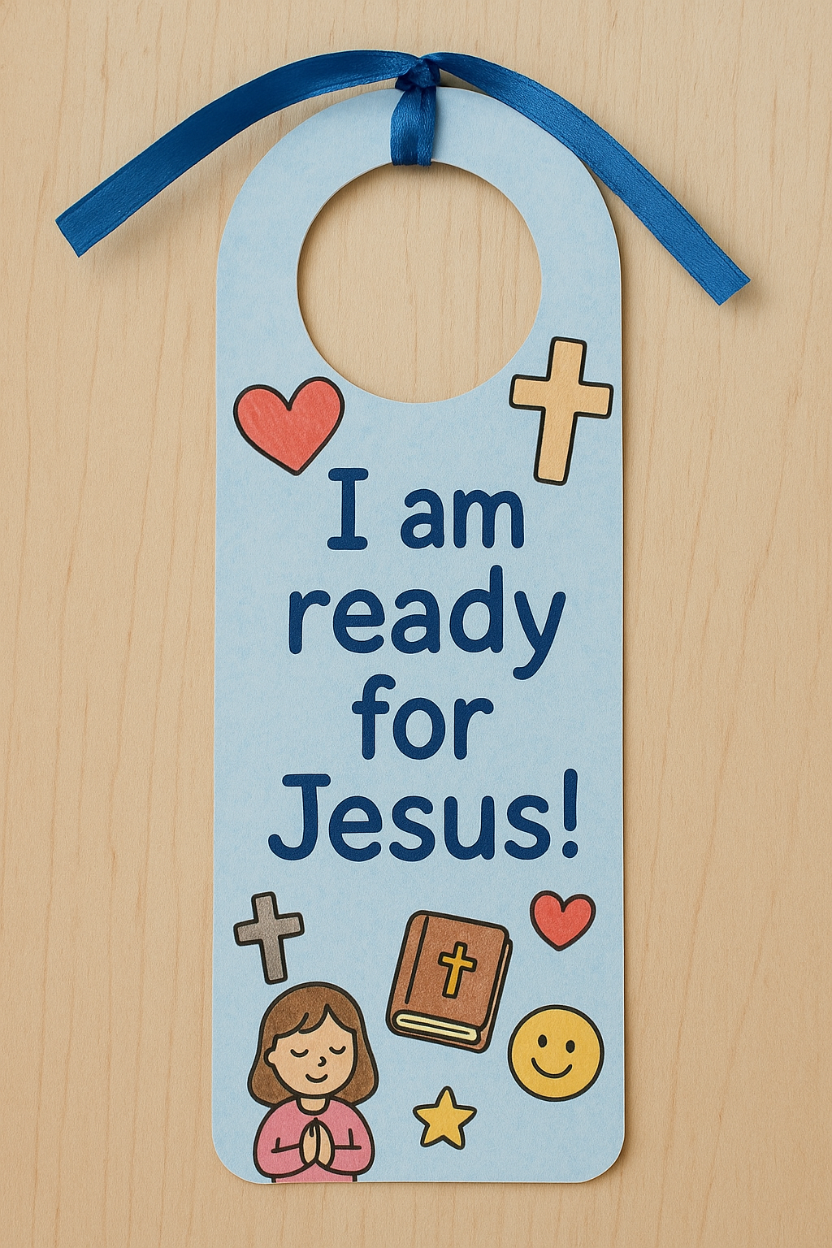
Activity: “Jesus Is Coming” Mini Door Hanger
Materials Needed:
•Cardstock
•Markers
•Ribbon

Slide 16
Instructions:
  Cut a door hanger shape.
  Write: “I am ready for Jesus!”
  Decorate with hearts, crosses, and good deeds.

Slide 17



Closing Prayer
Dear God,
Thank You for being with me everyday. You said we should stay awake and be ready, because we don’t know when You will come. Please help me to keep my heart ready for You. Help me to obey, to be kind, to forgive quickly, and to love others like You do. When I get tired or forget, remind me that You are always near. I want to follow You with all my heart. Jesus, I am ready for You.
Amen.

Slide 18
Live the Word
Kids

