Slide 1




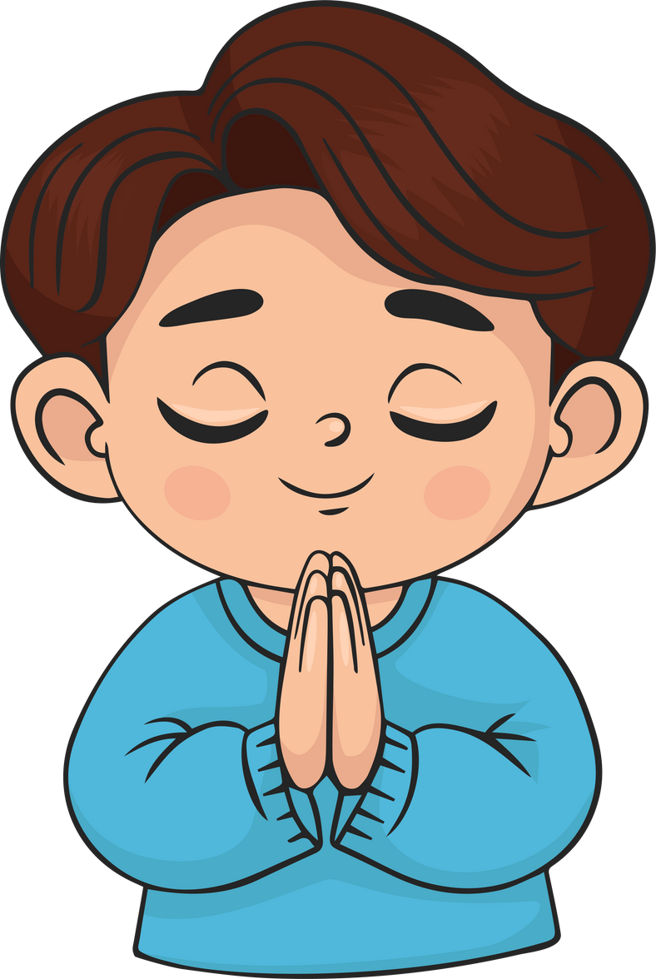
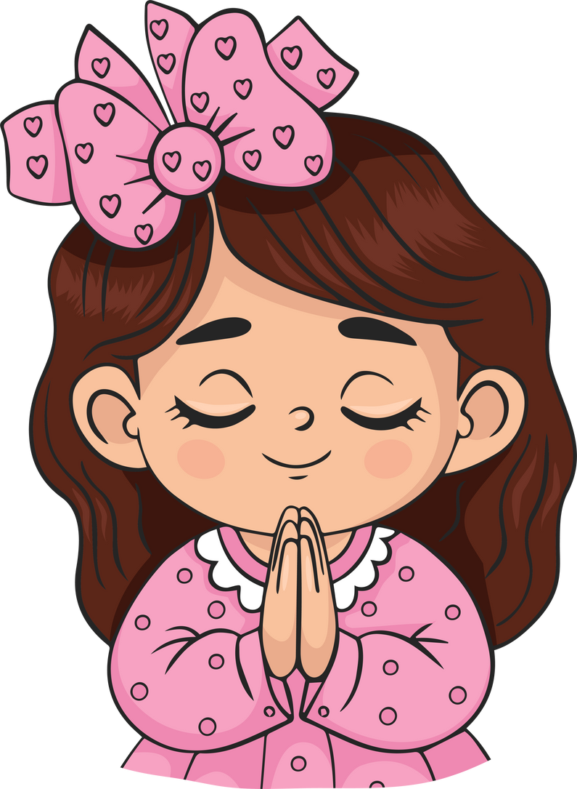
Live the Word
Kids

Slide 2





Solemnity of Christ the King
November 23, 2025 | Cycle C Year I

Slide 3

Solemnity of Christ the King
Luke 23:35-43

Slide 4



Leader: A reading from
the Holy Gospel
according to Luke.
All: Glory to You, Oh Lord.

Slide 5


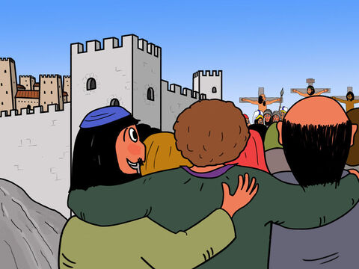
35
The people stood there watching while the Jewish leaders made fun of him: “He saved others; let him save himself if he is the Messiah whom God has chosen!”

Slide 6
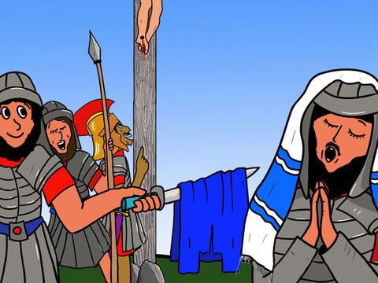
36
The soldiers also made fun of him: they came up to him and offered him cheap wine,

Slide 7
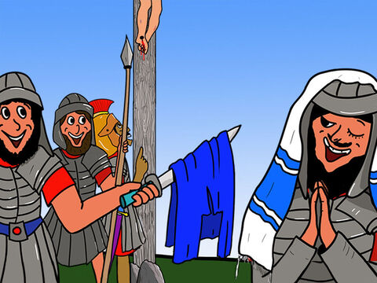
37
and said, “Save yourself if you are the king of the Jews!”

Slide 8
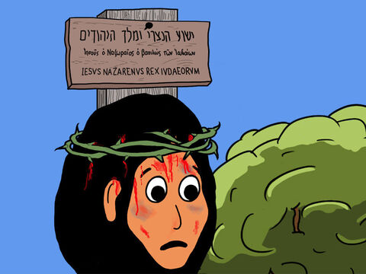
38
Above him were written these words: “This is the King of the Jews.”

Slide 9
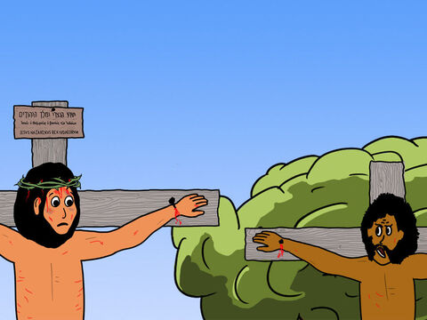
39
One of the criminals hanging there hurled insults at him: “Aren't you the Messiah? Save yourself and us!”

Slide 10
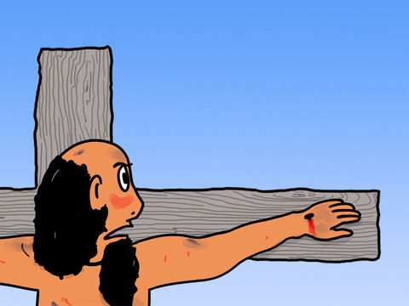
40
The other one, however, rebuked him, saying, “Don't you fear God? You received the same sentence he did.

Slide 11
41
Ours, however, is only right, because we are getting what we deserve for what we did; but he has done no wrong.”

Slide 12
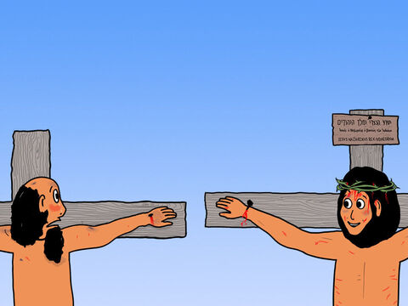
42
And he said to Jesus, “Remember me, Jesus, when you come as King!”

Slide 13
43
  Jesus said to him, “I promise you that today you will be in Paradise with me.”

Slide 14
Leader: The Gospel of the Lord
All: Praise to You,
Lord Jesus Christ

Slide 15


Gospel Message

Slide 16


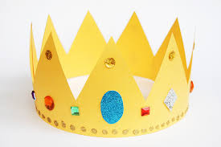
Activity: “Crown of the True King” Craft
Materials Needed:
•Yellow Paper
•Pencil
•Coloring Materials
•Scissors
•Glue

Slide 17
Instructions:
  Cut long strips of yellow paper to make a crown.
  Let the kids decorate by coloring hearts, circles, and diamond.
  Write the word “Christ the King”

Slide 18



Closing Prayer
Jesus, our loving King,
thank You for Your mercy and love.
Help us follow You,
be kind to others,
and stay close to You every day.
Amen.

Slide 19
Live the Word
Kids

