Slide 2
Sixth Sunday of Easter – May 25, 2025
CYCLE C – YEAR I

Slide 3
Context:
In this part of Jesus' Farewell Discourse, He tells His disciples that those who love Him will keep His word, and God will dwell with them. He promises the Holy Spirit will come to teach and remind them of His teachings. Jesus offers His peace and prepares them for His departure, encouraging them not to be afraid but to believe.
Message:
The gospel emphasizes that true love for Jesus is shown through obedience to His word. In return, God dwells with the believer. Jesus promises the Holy Spirit as a teacher and guide, offering His peace to calm fear and anxiety. He prepares His followers for His departure, encouraging trust and faith in God's plan.
Lesson:
Our love for Jesus is shown through obedience, and this love brings us into a close relationship with God. Even in times of uncertainty or loss, we are not alone—the Holy Spirit is our helper and teacher. Jesus offers us a lasting peace that the world cannot give, encouraging us to trust Him and not be afraid.

Slide 4
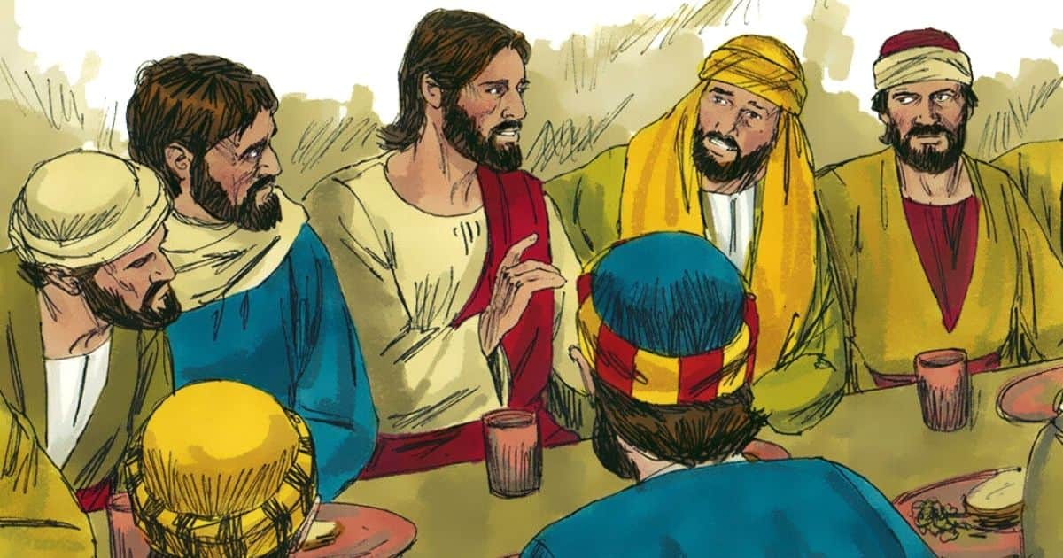
Jesus’ Promises
John 14: 23-29

Slide 5
Leader: A reading from
the Holy Gospel
according to John.
All: Glory to You, Oh Lord.

Slide 6
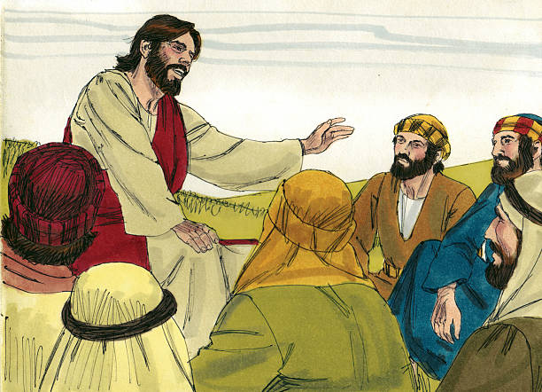
23
Jesus answered him, “Those who love me will obey my teaching. My Father will love them, and my Father and I will come to them and live with them.

Slide 7
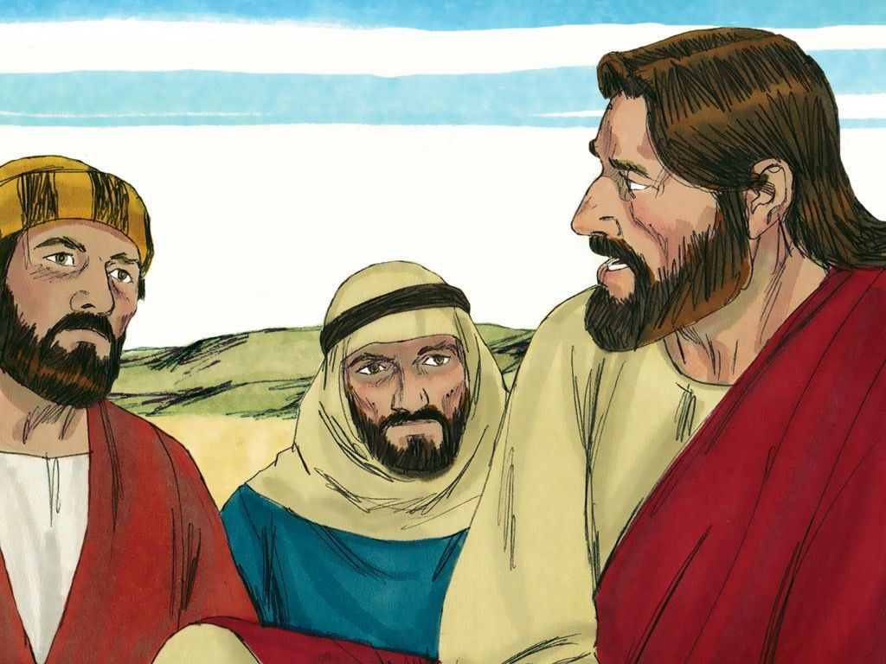
24
Those who do not love me do not obey my teaching. And the teaching you have heard is not mine, but comes from the Father, who sent me.

Slide 8
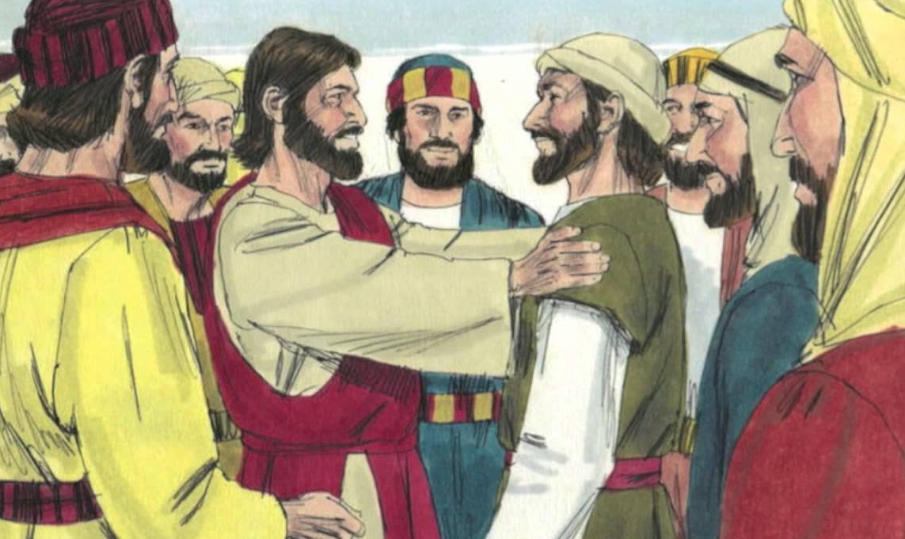
25
“I have told you this while I am still with you.

Slide 9
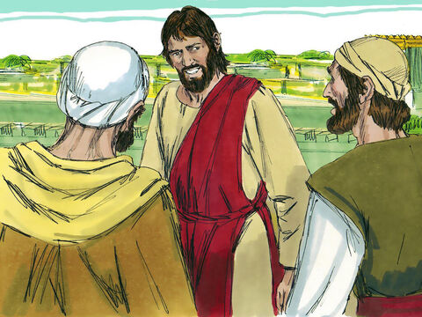
26
The Helper, the Holy Spirit, whom the Father will send in my name, will teach you everything and make you remember all that I have told you.

Slide 10
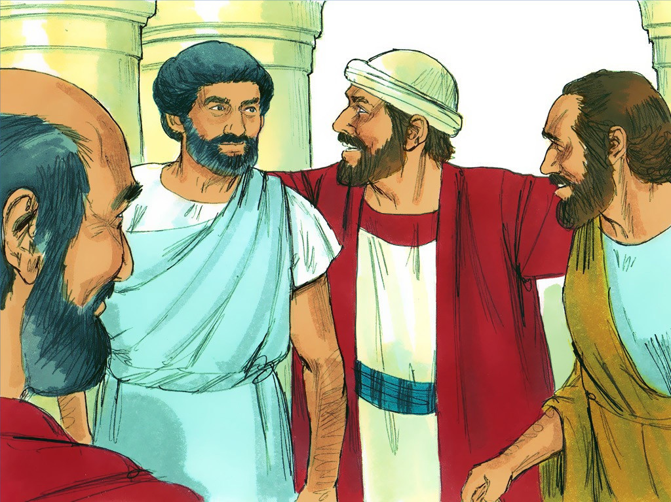
27
“Peace is what I leave with you; it is my own peace that I give you. I do not give it as the world does. Do not be worried and upset; do not be afraid.

Slide 11
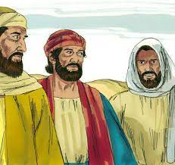
28
You heard me say to you, ‘I am leaving, but I will come back to you.’ If you loved me, you would be glad that I am going to the Father; for he is greater than I.

Slide 12
29
I have told you this now before it all happens, so that when it does happen, you will believe.

Slide 13
Leader: The Gospel of the Lord.
All: Praise to You,
Lord Jesus Christ.

Slide 14
GOSPEL MESSAGE

Slide 15
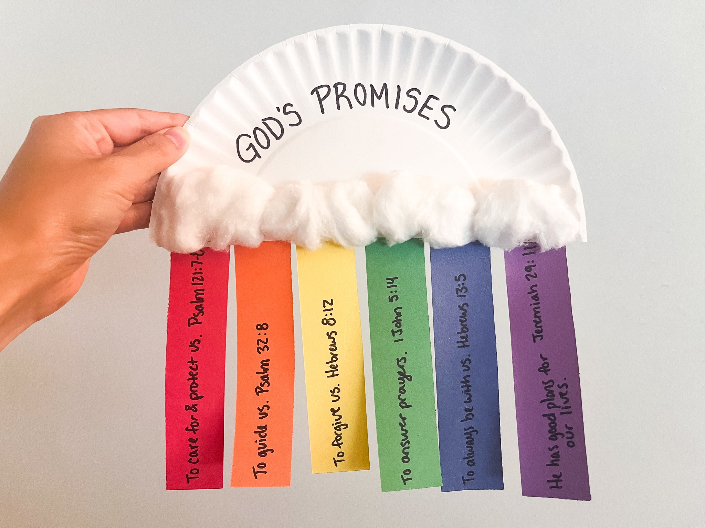
Activity:
God’s Promises!
Colored Paper
Paper plate
Cottons
Markers
Scissors
Glue

Slide 16
Instructions:
Cut out 5 rectangle colored papers.
Cut 1 paper plate in half to form half circle.
Glue your cotton balls into your half circle paper plate.
Write 5 God’s promises.
Glue the cotton balls into the paper plate as well as the colored paper with God’s promises.
You can decorate it to make it look more beautiful.

Slide 17
Closing Prayer
Dear God,
Thank you for loving us so much and showering us with blessings and people who will help us to be closer to you. We will always keep your promises in our hearts. We pray and hope to be more kind and loving just like your Son Jesus Christ.
Amen.

Slide 18
Sixth Sunday of Easter – May 25, 2025
CYCLE C – YEAR I

