Slide 2
Fifth Sunday of Easter – May 18, 2025
CYCLE C – YEAR I

Slide 3
Context:
Jesus was having dinner with His friends. After one friend, Judas, left to do something bad, Jesus told the others He would be leaving soon. Then He gave them an important command: “Love each other the way I have loved you.” He meant they should care for one another with kindness and love. That’s how others will know they are His followers.
Message:
True followers of Jesus are known by their love for one another.Jesus shows that His time to die and return to God has come, and He gives His disciples a new command—to love each other the same way He has loved them: deeply, selflessly, and faithfully. This kind of love is the mark of Christian community and a witness to the world of who Jesus is.
Lesson:
We should love others the way Jesus loves us—with kindness, humility, and sacrifice.This love isn’t just a feeling, but something we show through our actions. When we love like Jesus, people can see that we truly follow Him.

Slide 4
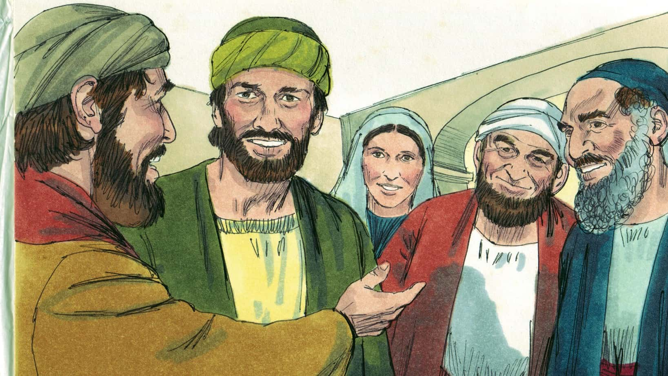
The New Commandment
John 13:31-35

Slide 5
Leader: A reading from
the Holy Gospel
according to John.
All: Glory to You, Oh Lord.

Slide 6
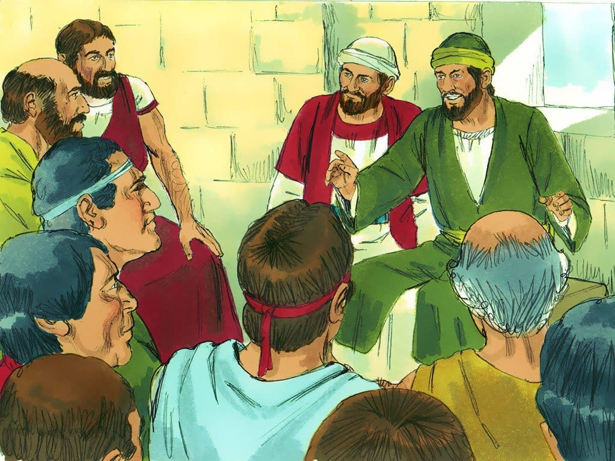
31
After Judas had left, Jesus said, “Now the Son of Man's glory is revealed; now God's glory is revealed through him.

Slide 7
32
And if God's glory is revealed through him, then God will reveal the glory of the Son of Man in himself, and he will do so at once.

Slide 8
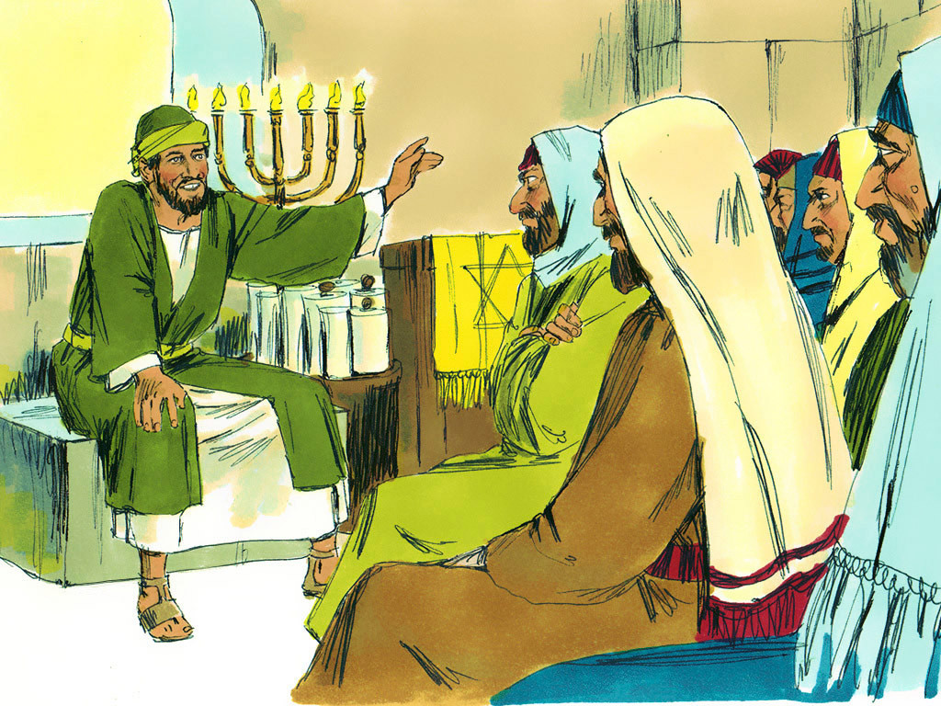
33
My children, I shall not be with you very much longer. You will look for me; but I tell you now what I told the Jewish authorities, ‘You cannot go where I am going.’

Slide 9
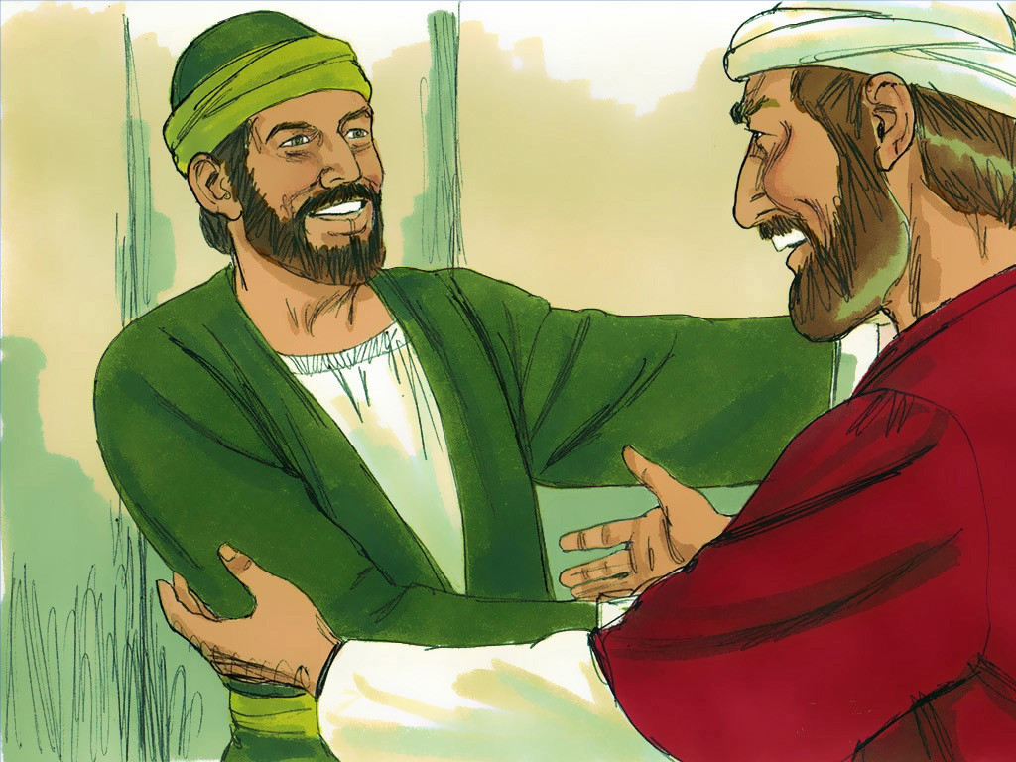
34
And now I give you a new commandment: love one another. As I have loved you, so you must love one another.

Slide 10
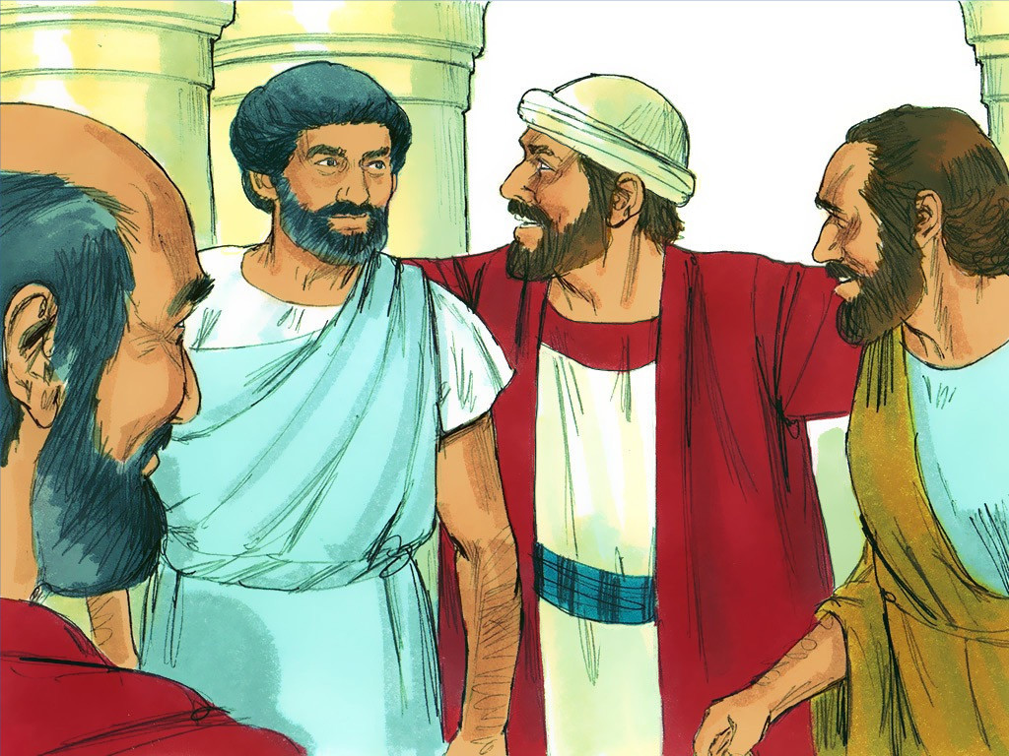
35
If you have love for one another, then everyone will know that you are my disciples.”

Slide 11
Leader: The Gospel of the Lord.
All: Praise to You,
Lord Jesus Christ.

Slide 12
GOSPEL MESSAGE

Slide 13
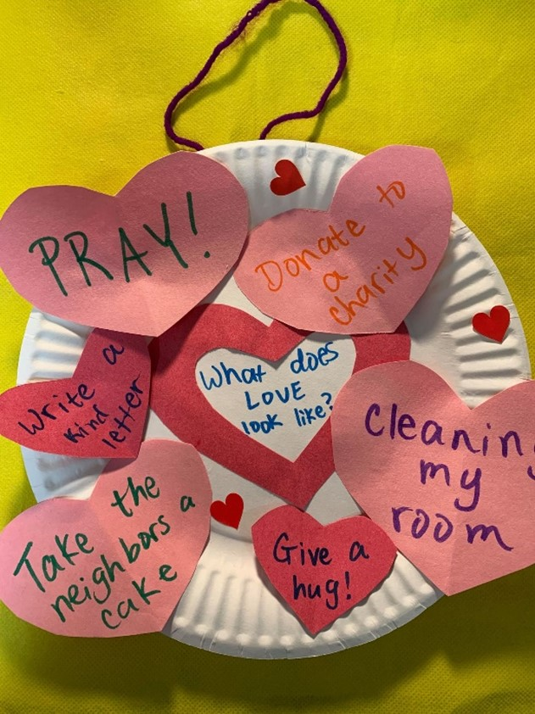
Activity:
Love like Jesus!
Colored Paper
Paper plate
Yarn
Markers
Scissors
Glue

Slide 14
Instructions:
Cut out heart shapes into a colored paper.
Glue your heart shape colored paper into a paper plate (a light shade of color will be better to use)
Write 5 things you will do out of loving others.
Put yarn into the top of your plate and decorate more.
Then place it into your house or at your house’s door.
Lastly pray for your loved ones.

Slide 15
Closing Prayer
Dear God,
Thank you for loving and protecting us always. May You teach us how to love more to others and to do things with love and compassion. Jesus may we encounter You in all of the people we met. Blessed us and help us to have a heart like Yours.
Amen.

Slide 16
Fifth Sunday of Easter – May 18, 2025
CYCLE C – YEAR I

