Slide 2
Fourth Sunday of Easter – May 11, 2025
CYCLE C – YEAR I

Slide 3
Context:
John 10:27–30 is part of Jesus’ teaching where He describes Himself as the Good Shepherd. He says His followers ("sheep") know His voice and follow Him. He gives them eternal life, and no one can take them from His or the Father's hand—showing the security of believers. In verse 30, Jesus says, "I and the Father are one," affirming His divinity and unity with God, which led to conflict with the Jewish leaders.
Message:
John 10:27–30 is that true believers are known and protected by Jesus, who gives them eternal life that cannot be lost. Jesus and the Father are united in power and purpose, ensuring that no one can take believers away from God. It also emphasizes Jesus’ divine identity as one with the Father.
Lesson:
The gospel teaches us that belonging to Jesus brings security, guidance, and eternal life. As the Good Shepherd, He knows His followers personally, leads them, and protects them with a power that no one can overcome. It also teaches that Jesus is divine and fully united with God the Father, affirming His authority and trustworthiness.

Slide 4
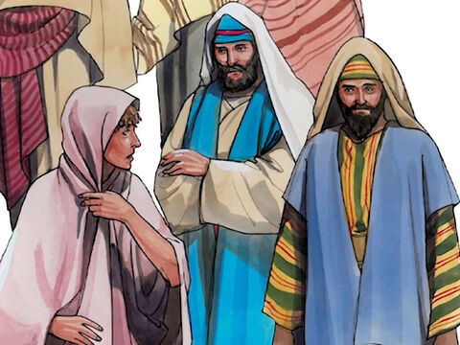
Good Shepherd Sunday
John 10:27-30

Slide 5
Leader: A reading from
the Holy Gospel
according to John.
All: Glory to You, Oh Lord.

Slide 6
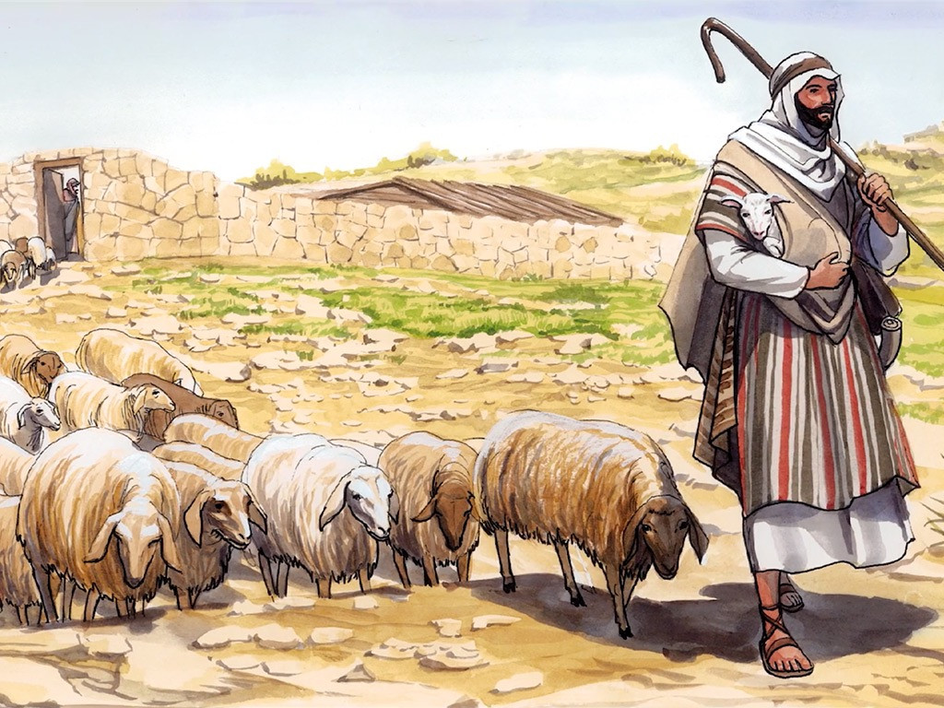
27
My sheep listen to my voice; I know them, and they follow me.

Slide 7
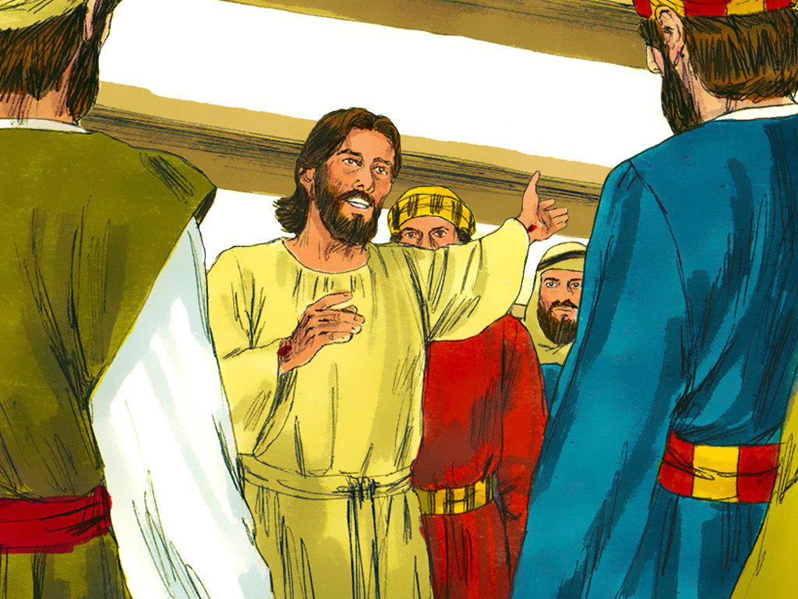
28
I give them eternal life, and they shall never die. No one can snatch them away from me.

Slide 8
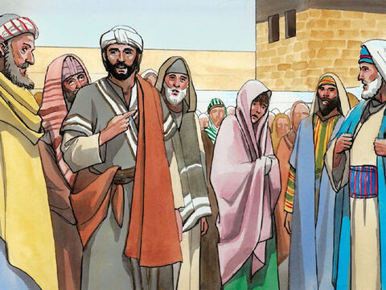
29
What my Father has given me is greater than everything, and no one can snatch them away from the Father's care.

Slide 9
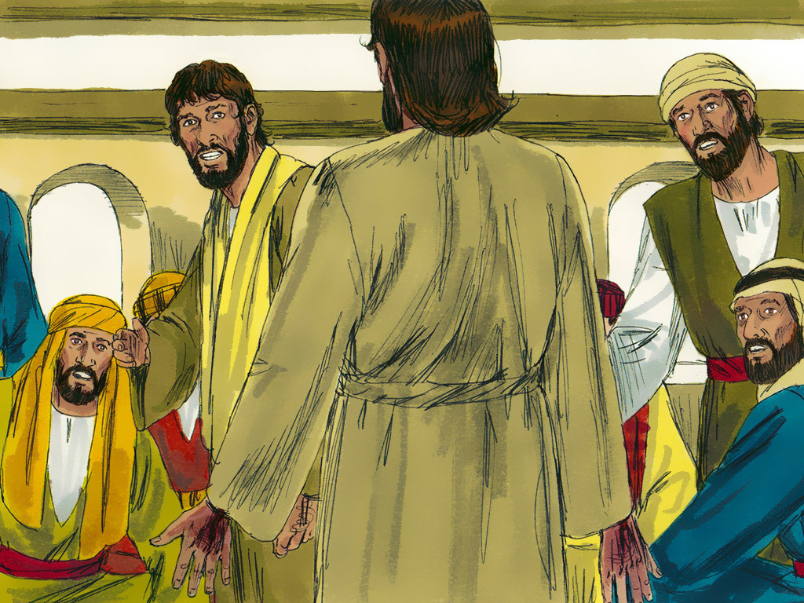
30
The Father and I are one.’

Slide 10
Leader: The Gospel of the Lord.
All: Praise to You,
Lord Jesus Christ.

Slide 11
GOSPEL MESSAGE

Slide 12
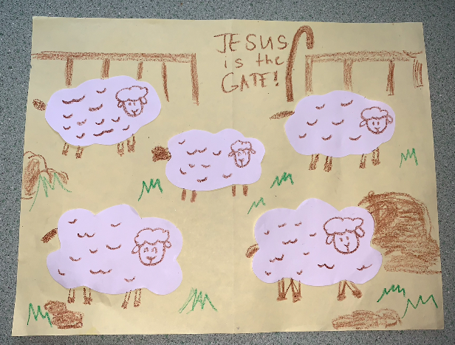
Activity:
Jesus is the Gate!
Colored Paper
Bond Paper
Scissors
Glue
Pen and Crayons

Slide 13
Instructions:
Cut out fluffy sheep outlines from the white paper.
Glue your sheep to the colored paper (a light shade of color will be better to use), leaving one a little separate from the others.
Draw a head and legs on all the sheep.
You can also add some grass and rock on the blank spaces.
Then start drawing a gate on the upper part, on the middle of the gate write the word “JESUS IS THE GATE”
Add a shepherd’s crook beside the word.

Slide 14
Closing Prayer
Dear God,
Lord thank you for guiding and protecting us from harmful things. May we always follow and obey You everytime we do things. Thank you God, for taking care of us, and thinking what is the best for us. Teach us, to be a good follower of You.
Amen.

Slide 15
Fourth Sunday of Easter – May 11, 2025
CYCLE C – YEAR I

