Slide 2
First Sunday of Lent – March 9, 2025
CYCLE C – YEAR I

Slide 3
Context:
This passage describes Jesus' temptation in the wilderness after his baptism. Led by the Holy Spirit, he fasts for 40 days and is tested by the Devil, who challenges him to prove his divine identity by turning stones into bread, worshiping Satan for power, and testing God's protection. Jesus resists each temptation by quoting Scripture, affirming his faithfulness to God. This event highlights Jesus' obedience, spiritual strength, and victory over sin, preparing him for his public ministry.
Message:
The message of this gospel is that faith, obedience, and reliance on God are more powerful than any temptation. Jesus demonstrates that true strength comes from trusting God's word rather than seeking worldly power, material needs, or testing God’s protection. His victory over temptation serves as an example for believers to resist sin and remain faithful to God in all circumstances.
Lesson:
The lesson of this gospel is that we must rely on God’s word and strength to overcome temptation. Just as Jesus resisted the Devil by trusting in Scripture and remaining faithful to God, we are called to do the same in our daily lives. True fulfillment comes from God, not from material things, power, or testing His will.

Slide 4
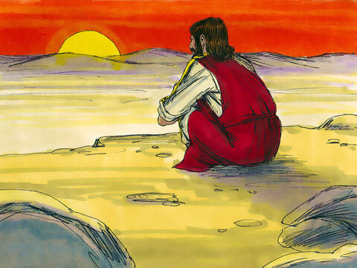
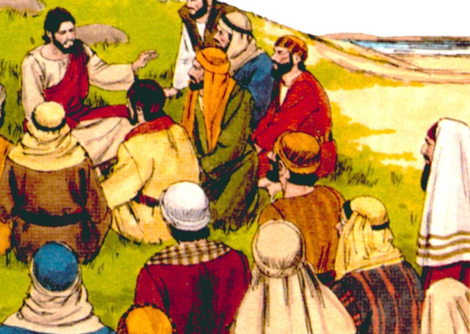
The Temptation of Jesus in the Willderness
Luke 4:1-13

Slide 5
Leader: A reading from
the Holy Gospel
according to Luke.
All: Glory to You, Oh Lord.

Slide 6
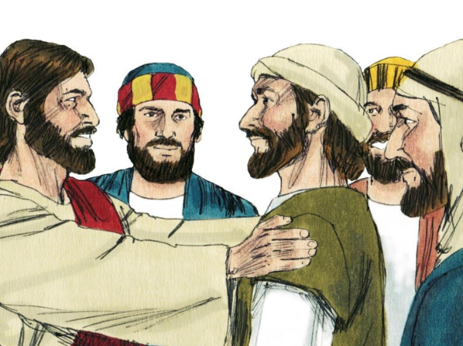
1
Jesus returned from the Jordan full of the Holy Spirit and was led by the Spirit into the desert,

Slide 7
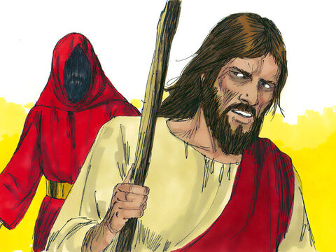
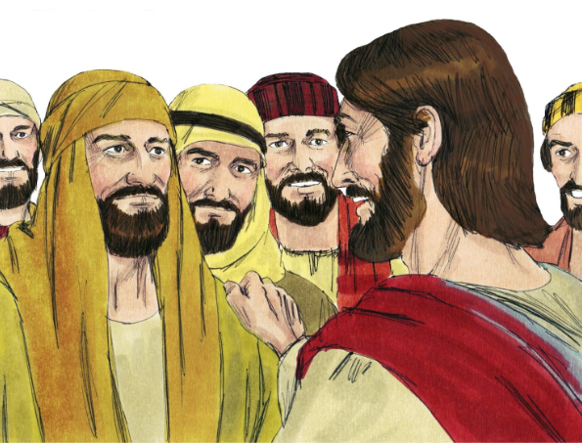
2
where he was tempted by the Devil for forty days. In all that time he ate nothing, so that he was hungry when it was over.

Slide 8
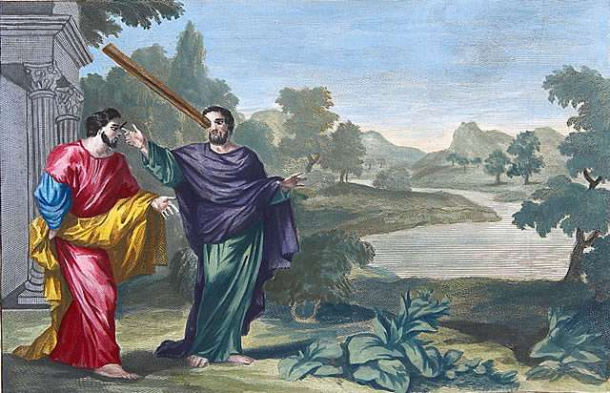
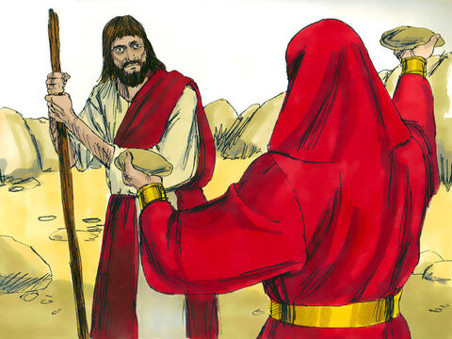
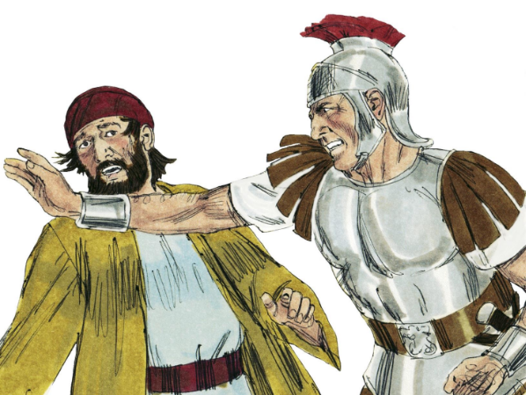
3
The Devil said to him, "If you are God's Son, order this stone to turn into bread."

Slide 9
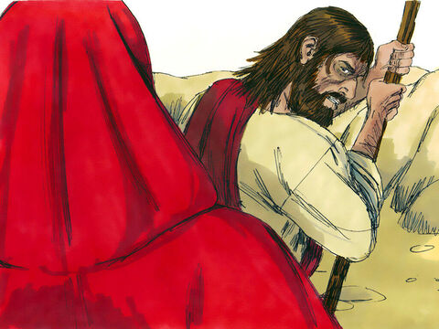
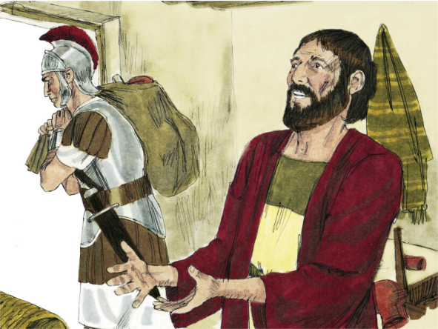
4
But Jesus answered, "The scripture says, "Human beings cannot live on bread alone.' "

Slide 10
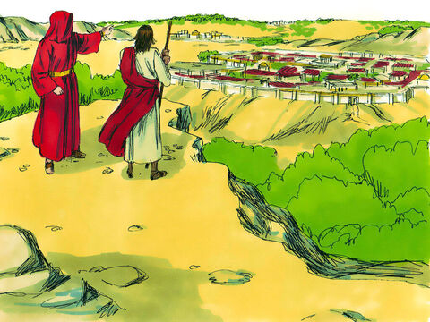
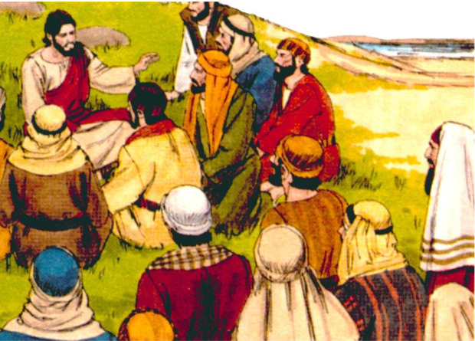
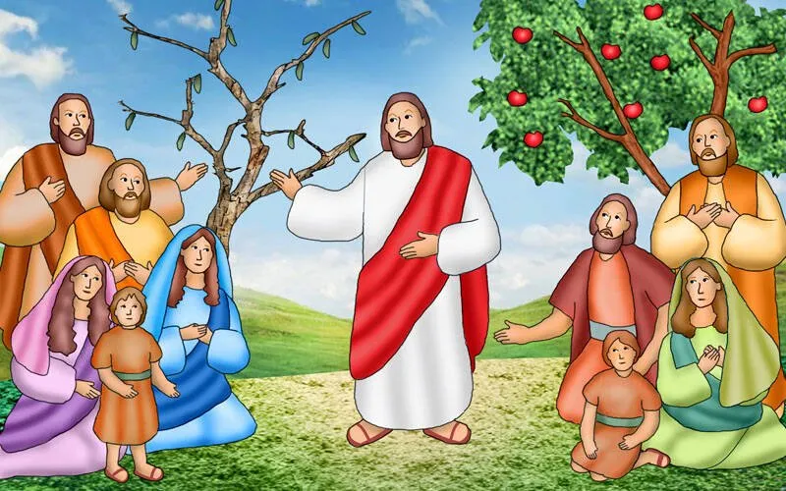
5
Then the Devil took him up and showed him in a second all the kingdoms of the world.

Slide 11
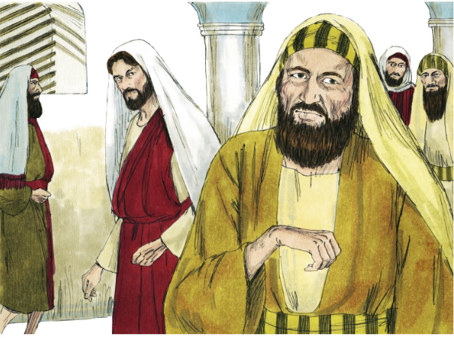
6
"I will give you all this power and all this wealth," the Devil told him. "It has all been handed over to me, and I can give it to anyone I choose.

Slide 12
7
All this will be yours, then, if you worship me."

Slide 13
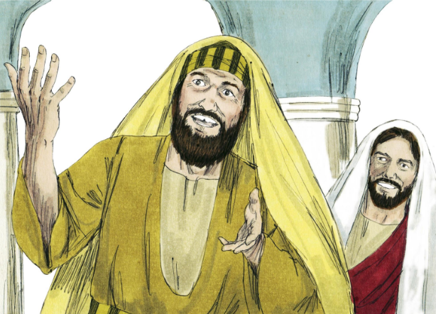
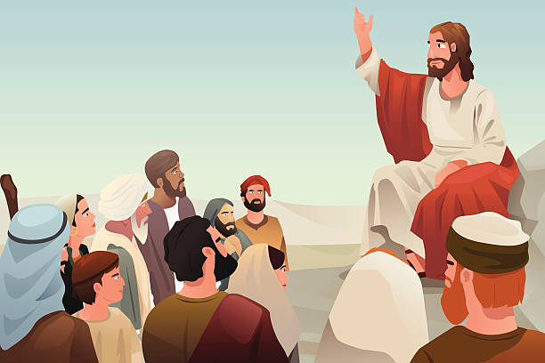
8
Jesus answered, "The scripture says, "Worship the Lord your God and serve only him!' "

Slide 14
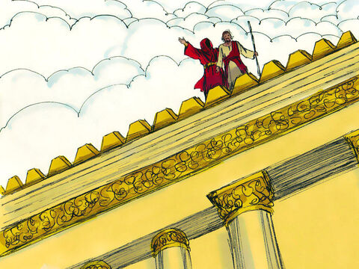
9
Then the Devil took him to Jerusalem and set him on the highest point of the Temple, and said to him, "If you are God's Son, throw yourself down from here.

Slide 15
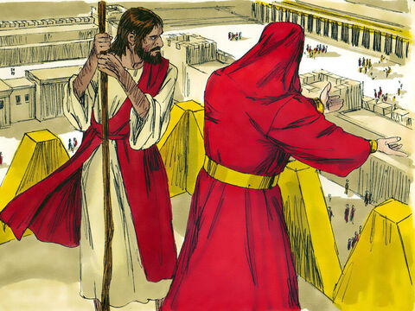
10
For the scripture says, "God will order his angels to take good care of you.'

Slide 16
11
It also says, "They will hold you up with their hands so that not even your feet will be hurt on the stones.' "

Slide 17
12
But Jesus answered, "The scripture says, "Do not put the Lord your God to the test.' "

Slide 18
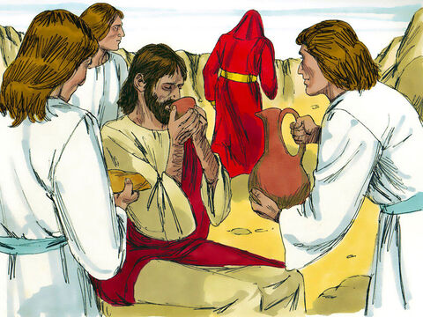
13
When the Devil finished tempting Jesus in every way, he left him for a while.

Slide 19
Leader: The Gospel of the Lord.
All: Praise to You,
Lord Jesus Christ.

Slide 20
GOSPEL MESSAGE

Slide 21
Activity:
Shield of Faith
Materials:
• Paper plates or cardboard
• Scissors
• Pencil
• Crayons
• Glue
• Yarn or Rubber band

Slide 22
Instructions: 1. Cut a paper plate or cardboard into a shield shape.
2. Write "Shield of Faith" at the top.
3. Decorate the shield with drawings of bread, a crown, and a temple to represent the temptations Jesus faced.
4. Attach yarn or a rubber band to the back as a handle.

Slide 23
Closing Prayer
Dear Jesus, Thank You for loving me and showing me how to make good choices. When I feel tempted to do something wrong, please help me to remember Your words and choose what is right. Give me a strong heart to follow You and trust in God always. Keep me safe and help me to love and serve You every day. Amen

Slide 24
First Sunday of Lent – March 9, 2025
CYCLE C – YEAR I

