Slide 2
Third Sunday of Lent – March 23, 2025
CYCLE C – YEAR I

Slide 3
Context:
In this passage, Jesus addresses the misconception that suffering is always a direct punishment for sin. He emphasizes the need for personal repentance, warning that all will perish if they do not turn away from sin. He then shares the parable of the barren fig tree, illustrating God's patience and mercy, yet also stressing the urgency of spiritual transformation before it is too late.
Message:
The message of this gospel reading is a call to repentance and spiritual renewal. Jesus reminds us that tragedies are not necessarily a punishment for sin, but they serve as a warning that life is fragile. The parable of the barren fig tree highlights God's mercy and patience, giving us time to change, but also warns that we must bear the fruits of repentance before it is too late.
Lesson:
The lesson from this gospel reading is that we should not judge others based on their misfortunes but instead examine our own lives and repent. God is patient and merciful, giving us time to change, but we must not take His grace for granted. True repentance leads to spiritual growth, and we must bear good fruit in our lives before it is too late.

Slide 4
The Call to Conversion and God's Mercy
Luke 13:1-9

Slide 5
Leader: A reading from
the Holy Gospel
according to Luke.
All: Glory to You, Oh Lord.

Slide 6
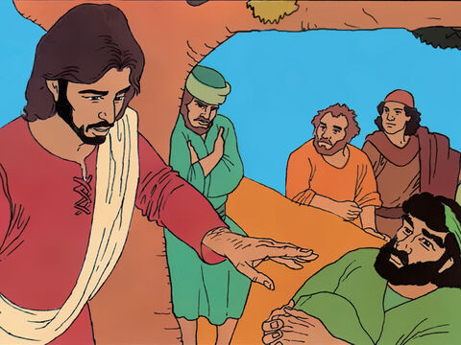
1
At that time some people were there who told Jesus about the Galileans whom Pilate had killed while they were offering sacrifices to God.

Slide 7
2
Jesus answered them, "Because those Galileans were killed in that way, do you think it proves that they were worse sinners than all other Galileans?

Slide 8
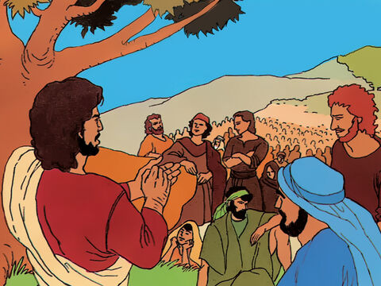
3
No indeed! And I tell you that if you do not turn from your sins, you will all die as they did.

Slide 9
4
What about those eighteen people in Siloam who were killed when the tower fell on them? Do you suppose this proves that they were worse than all the other people living in Jerusalem?

Slide 10
5
No indeed! And I tell you that if you do not turn from your sins, you will all die as they did."

Slide 11
6
Then Jesus told them this parable: "There was once a man who had a fig tree growing in his vineyard. He went looking for figs on it but found none

Slide 12
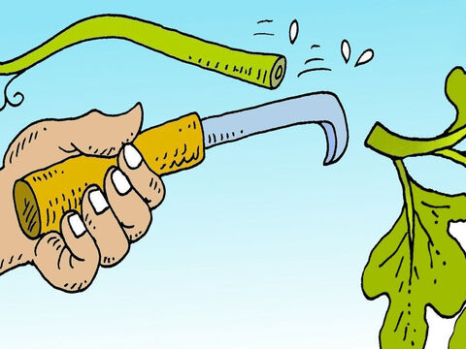
7
So he said to his gardener, "Look, for three years I have been coming here looking for figs on this fig tree, and I haven't found any. Cut it down! Why should it go on using up the soil?'

Slide 13
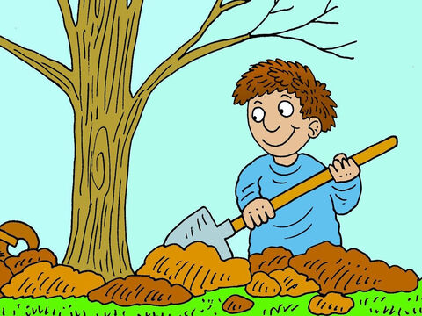
8
But the gardener answered, "Leave it alone, sir, just one more year; I will dig around it and put in some fertilizer.

Slide 14
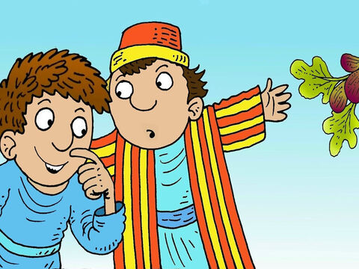
9
Then if the tree bears figs next year, so much the better; if not, then you can have it cut down.' "

Slide 15
Leader: The Gospel of the Lord.
All: Praise to You,
Lord Jesus Christ.

Slide 16
GOSPEL MESSAGE

Slide 17
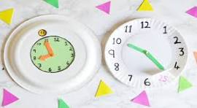
Activity:
God’s Mercy Clock
Materials:
• Paper Plate
• Colored Paper
• Scissors
• Pencil
• Crayons
• Marker
• Thumbtack

Slide 18
Instructions: 1. Take paper plate and use marker to write numbers 1-12around the edge.
2. Use crayons to decorate the clock.
3. Make the clock hands using colored paper then cut the clock hands. (One hand is shorter than the other hand)
4. Use thumbtack to pin the clock to the center of the paper plate.

Slide 19
Closing Prayer
Dear God, Thank You for Your patience and mercy. Help us to turn away from sin and grow in faith. Like the fig tree, nourish our hearts so we may bear good fruit in our lives. Give us the wisdom to use the time You have given us wisely and to seek You with all our hearts.
Lord, strengthen us to live according to Your will, and may we always choose the path of righteousness. We trust in Your grace and love.
Amen.

Slide 20
Third Sunday of Lent – March 23, 2025
CYCLE C – YEAR I

