Slide 2
Eight Sunday in Ordinary Time – March 2, 2025
CYCLE C – YEAR I

Slide 3
Context:
In the Gospel, Jesus teaches that we should not judge others without first examining ourselves. If we want to help someone, we must ensure that we are also doing what is right. Just as a tree is known by its fruit, our hearts are revealed through our actions and words. When our hearts are kind and full of goodness, we naturally share love and kindness with others.
Message:
The message of the Gospel is: "Be Kind and Examine Yourself First." Before pointing out the mistakes of others, we should reflect on our own actions. When our hearts are filled with kindness and goodness, our words and deeds will reflect that. Let us help others with love and strive to be the best person we can be!
Lesson:
Fix yourself first before helping others. Before correcting others, we must ensure that we are also doing what is right. A good heart leads to kind words and actions. When we fill our hearts with goodness, we can truly help others in the right way!

Slide 4
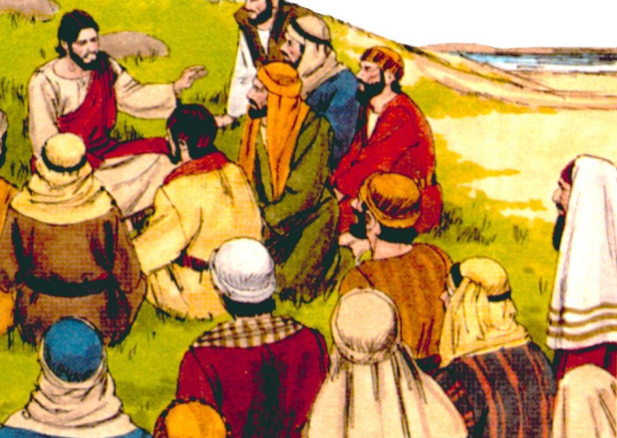
See Clearly, Be Kind
Luke 6:39-45

Slide 5
Leader: A reading from
the Holy Gospel
according to Luke.
All: Glory to You, Oh Lord.

Slide 6
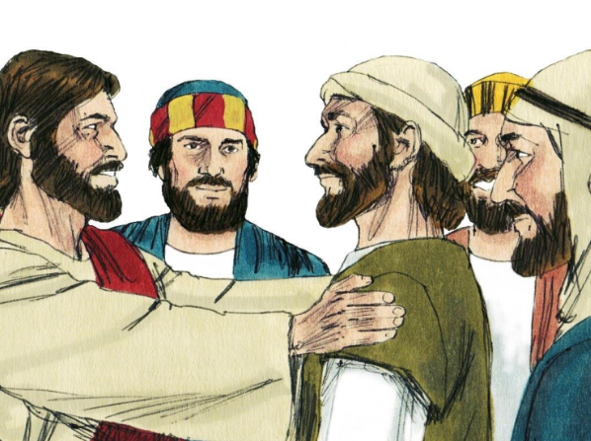
39
And Jesus told them this parable: “One blind man cannot lead another one; if he does, both will fall into a ditch.

Slide 7
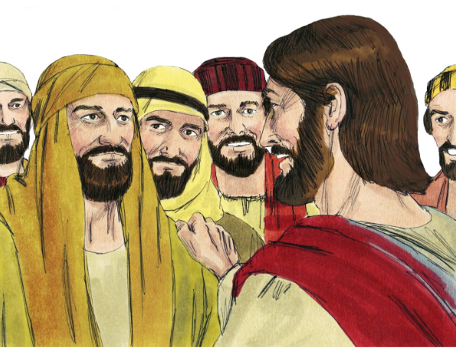
40
No pupils are greater than their teacher; but all pupils, when they have completed their training, will be like their teacher.

Slide 8
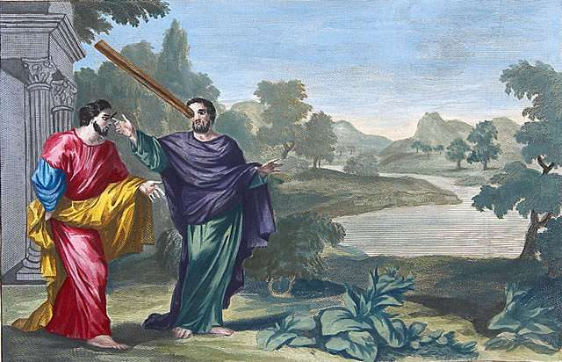
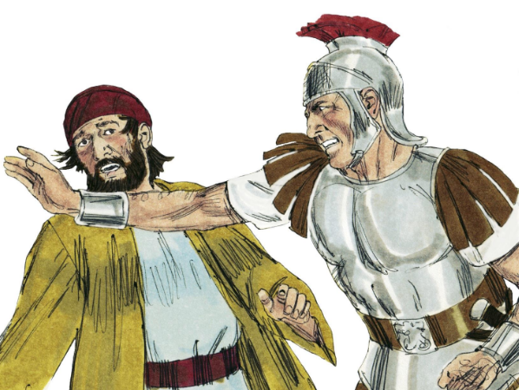
41
“Why do you look at the speck in your brother's eye, but pay no attention to the log in your own eye?

Slide 9
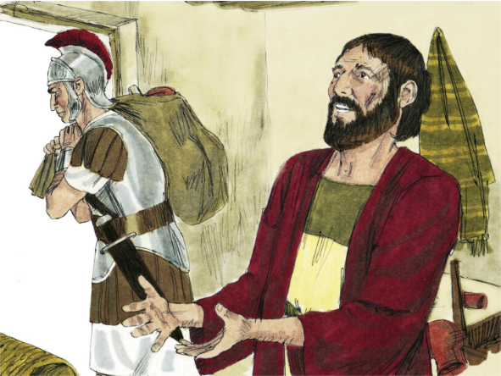
42
How can you say to your brother, ‘Please, brother, let me take that speck out of your eye,’ yet cannot even see the log in your own eye? You hypocrite! First take the log out of your own eye, and then you will be able to see clearly to take the speck out of your brother's eye.

Slide 10
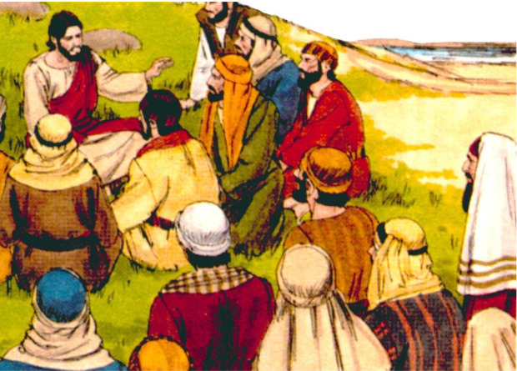
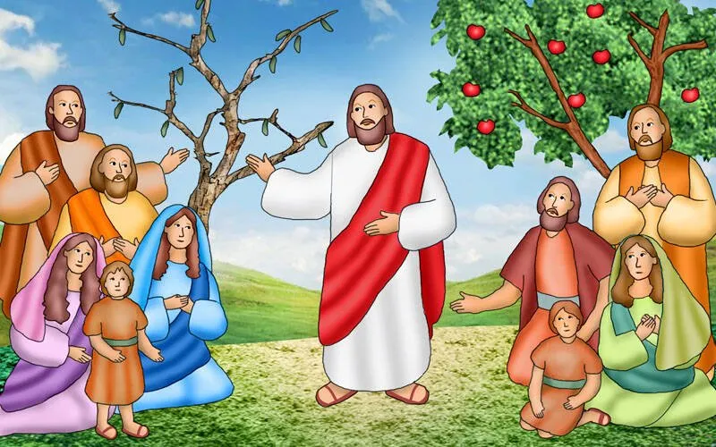
43
“A healthy tree does not bear bad fruit, nor does a poor tree bear good fruit.

Slide 11
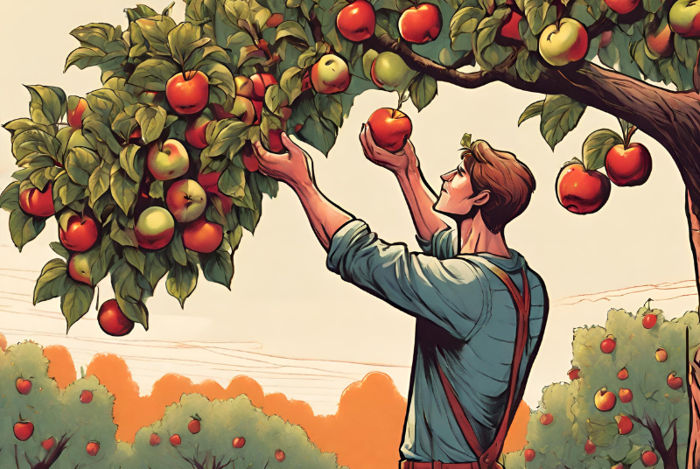
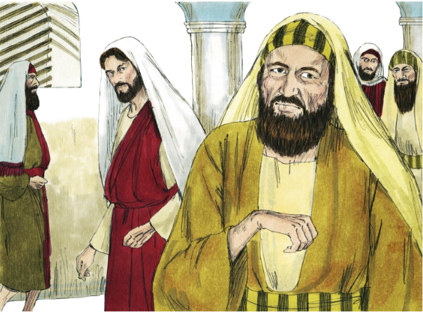
44
Every tree is known by the fruit it bears; you do not pick figs from thorn bushes or gather grapes from bramble bushes.

Slide 12
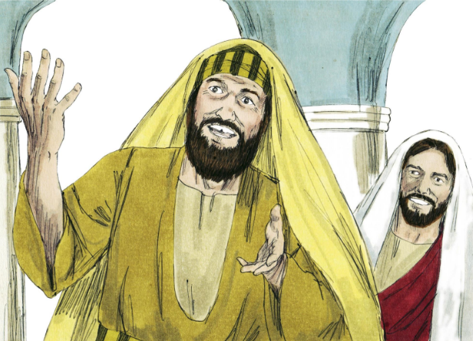
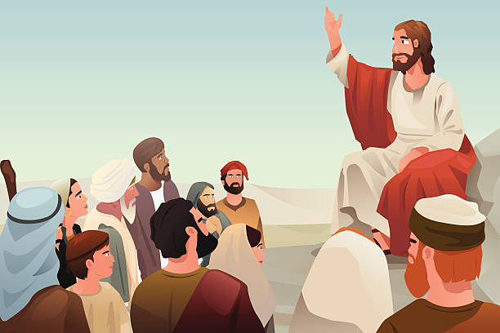
45
A good person brings good out of the treasure of good things in his heart; a bad person brings bad out of his treasure of bad things. For the mouth speaks what the heart is full of.

Slide 13
Leader: The Gospel of the Lord.
All: Praise to You,
Lord Jesus Christ.

Slide 14
GOSPEL MESSAGE

Slide 15
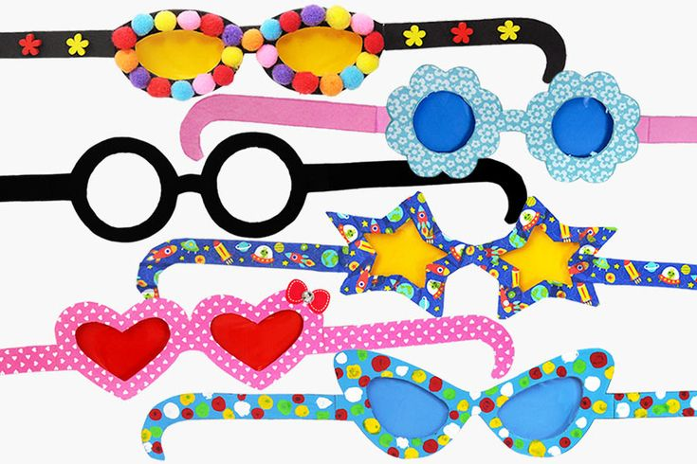
Activity:
Clear Vision Glasses
Materials:
• Papers
• Scissors
• Pencil
• Glue

Slide 16
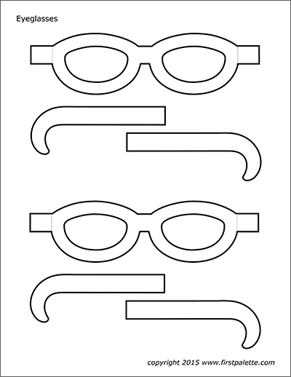
Instructions: 1. Take a piece of paper and draw the Glasses Shape.
2. Cut out the Glasses
3. Attached the glasses and the handle of the glasses.
4. Decorate the Clear Vision Glasses to make it more personal.

Slide 17
Closing Prayer
Dear Jesus, Thank You for Your love and for teaching me how to be kind and wise. Help me to look at myself first before pointing out others’ mistakes. When I see something wrong in someone else, remind me to be patient and loving. Help me remove any selfishness, anger, or pride from my own heart, so, I can see clearly and help others with kindness. Make my heart like a good tree that grows sweet and healthy fruit. Fill me with goodness, so my words and actions show love to my family, friends, and everyone around me. Teach me to speak kind words and to do what is right, because what I say and do comes from what is inside my heart. Jesus, guide me to be a good friend, a good helper, and a good example. Let my heart be full of love, patience, and understanding, so, I can share Your light with others every day.
Amen.

Slide 18
Eight Sunday in Ordinary Time – March 2, 2025
CYCLE C – YEAR I

