Slide 2
Second Sunday of Lent – March 16, 2025
CYCLE C – YEAR I

Slide 3
Context:
The Transfiguration of Jesus reveals his divine glory to Peter, James, and John on a mountain as he prays. His appearance changes, and Moses and Elijah appear, symbolizing the fulfillment of the Law and the Prophets. They discuss his upcoming death in Jerusalem. A cloud overshadows them, and God declares Jesus as His chosen Son, commanding the disciples to listen to him. This event affirms Jesus' divine nature and mission, preparing the disciples for his suffering and resurrection.
Message:
The message of the Transfiguration is that Jesus is the Son of God, chosen to fulfill God's plan through his suffering, death, and resurrection. It calls us to listen to Jesus, trust in his divine authority, and remain faithful even in times of trial. The presence of Moses and Elijah affirms that Jesus fulfills both the Law and the Prophets, revealing God's glory and the path to salvation.
Lesson:
The lesson of the Transfiguration is that we must listen to Jesus and trust in God's plan, even when it involves suffering and sacrifice. It teaches us that prayer strengthens our faith, reveals God's glory, and prepares us for challenges ahead. Just as the disciples saw Christ’s divine nature, we are reminded to seek spiritual transformation in our own lives by staying close to God.

Slide 4
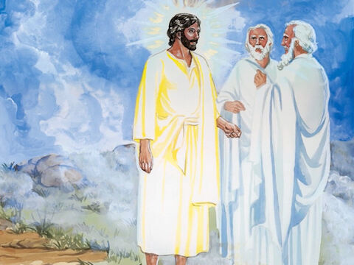
The Transfiguration of Jesus
Luke 9:28b-36

Slide 5
Leader: A reading from
the Holy Gospel
according to Luke.
All: Glory to You, Oh Lord.

Slide 6
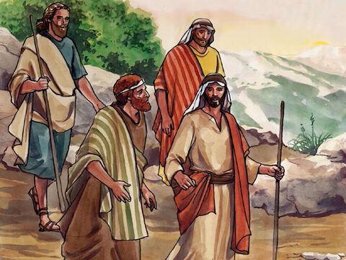
28b
About a week after he had said these things, Jesus took Peter, John, and James with him and went up a hill to pray.

Slide 7
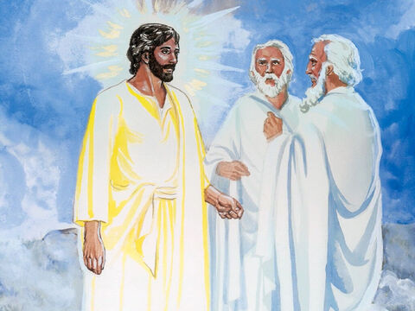
29
While he was praying, his face changed its appearance, and his clothes became dazzling white.

Slide 8
30
Suddenly two men were there talking with him. They were Moses and Elijah,

Slide 9
31
who appeared in heavenly glory and talked with Jesus about the way in which he would soon fulfill God's purpose by dying in Jerusalem.

Slide 10
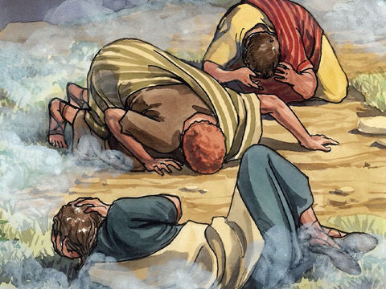
32
Peter and his companions were sound asleep, but they woke up and saw Jesus' glory and the two men who were standing with him.

Slide 11
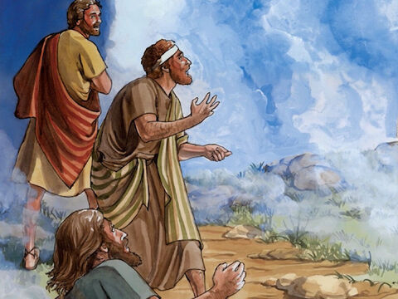
33
As the men were leaving Jesus, Peter said to him, "Master, how good it is that we are here! We will make three tents, one for you, one for Moses, and one for Elijah." (He did not really know what he was saying.)

Slide 12
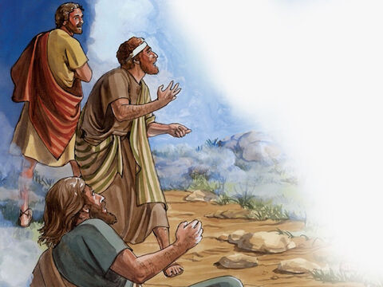
34
While he was still speaking, a cloud appeared and covered them with its shadow; and the disciples were afraid as the cloud came over them.

Slide 13
35
A voice said from the cloud, "This is my Son, whom I have chosen - listen to him!"

Slide 14
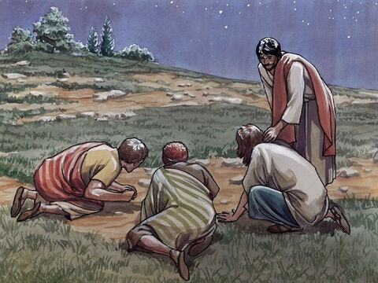
36
When the voice stopped, there was Jesus all alone. The disciples kept quiet about all this and told no one at that time anything they had seen.

Slide 15
Leader: The Gospel of the Lord.
All: Praise to You,
Lord Jesus Christ.

Slide 16
GOSPEL MESSAGE

Slide 17
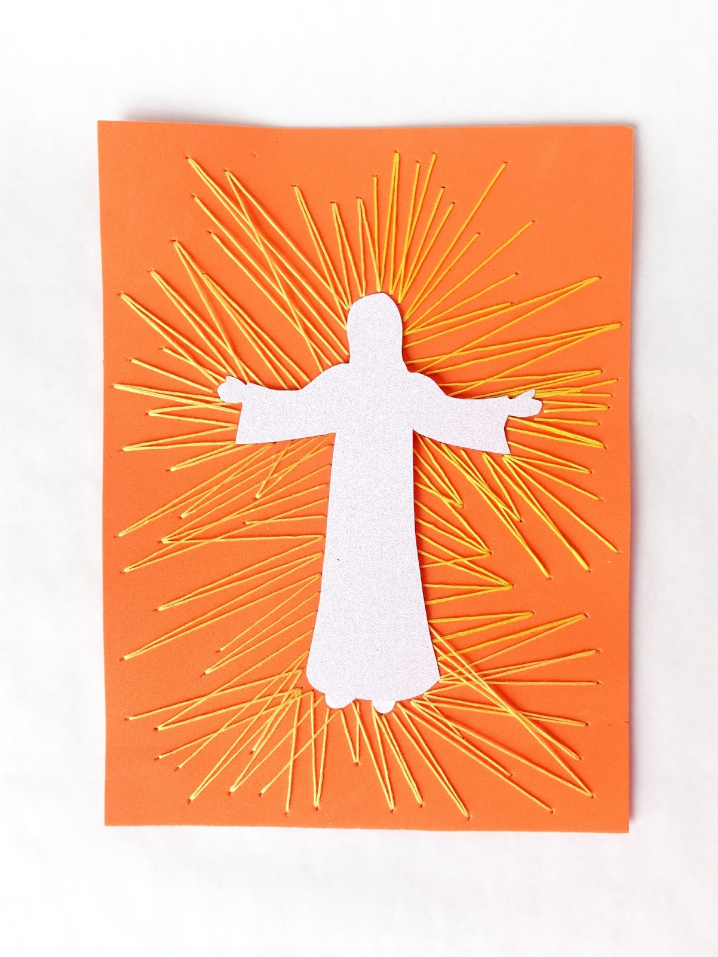
Activity:
Glowing Jesus
Materials:
• Paper (Plain White)
• Colored Paper
• Scissors
• Pencil
• Crayons
• Glue

Slide 18
Instructions: 1. Draw Jesus on white paper then cut it to make an image of Jesus.
2. Glue the image of Jesus on the colored paper.
3. Use crayons to make a glowing effect.
4. Write “The Transfiguration of Jesus”.

Slide 19
Closing Prayer
Thank You for this time of reflection on Your Word. Just as Jesus was transfigured before His disciples, revealing His glory, transform our hearts so that we may see You more clearly and follow You more faithfully. Help us to listen to Your beloved Son, just as You commanded, and to carry His light into our daily lives. May we leave this gathering renewed in faith, strengthened in hope, and filled with Your presence. Keep us close to You always and let Your love shine through us. In Jesus’ name, we pray. Amen.

Slide 20
Second Sunday of Lent – March 16, 2025
CYCLE C – YEAR I

