Slide 2
Solemnity of Pentecost – June 08, 2025
CYCLE C – YEAR I

Slide 3
Context:
After Jesus died on the cross and rose from the dead, His friends—the disciples—were hiding in a room. They were scared and had locked the doors. Suddenly, Jesus appeared right in the room with them! He said, “Peace be with you,” to comfort them and show He was truly alive. Then He showed them the wounds in His hands and side so they would believe it was really Him. The disciples were so happy to see Jesus! He said again, “Peace be with you,” and told them He was sending them out to share God's love, just like the Father had sent Him. Then Jesus breathed on them and said, “Receive the Holy Spirit.”
Message:
The message of John 20:19–23 is about peace, faith, and the power of the Holy Spirit. When Jesus appeared to His disciples after rising from the dead, they were afraid and hiding, but He came to them with love, not anger or judgment. He greeted them with peace, showing that His resurrection brought comfort and hope, not fear. By showing His wounds, He proved He was truly alive, and their sadness turned to joy. Jesus then sent them out to continue His mission, just as God had sent Him. He gave them the Holy Spirit to guide and strengthen them, and to give them the power to forgive and bring healing to others.
Lesson:
John 20:19–23 teaches us that Jesus brings peace even when we are afraid. He came to the disciples when they were scared and gave them comfort and joy. He also showed that He is truly alive and wants us to believe in Him. Jesus then sent His followers to share His message and gave them the Holy Spirit to help them. This passage reminds us that Jesus brings peace in our fear, joy in our doubt, and strength through the Holy Spirit to share His love with the world.

Slide 4
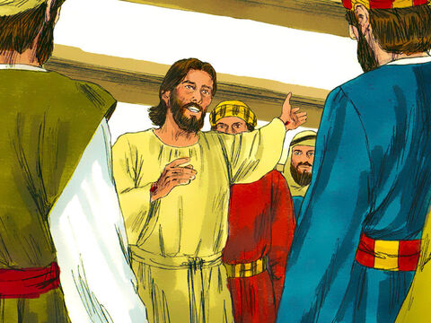
Jesus Appears to His Disciples
John 20:19-23

Slide 5
Leader: A reading from
the Holy Gospel
according to John.
All: Glory to You, Oh Lord.

Slide 6
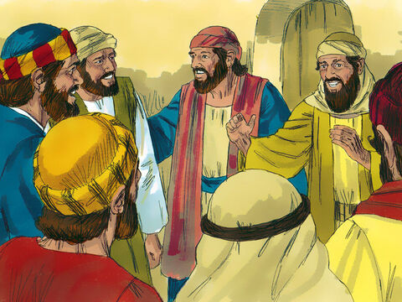
19
It was late that Sunday evening, and the disciples were gathered together behind locked doors, because they were afraid of the Jewish authorities. Then Jesus came and stood among them. “Peace be with you,” he said.

Slide 7
20
After saying this, he showed them his hands and his side. The disciples were filled with joy at seeing the Lord.

Slide 8
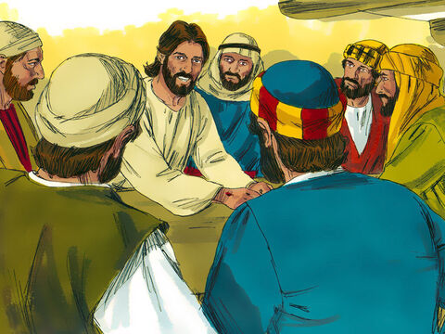
21
Jesus said to them again, “Peace be with you. As the Father sent me, so I send you.”

Slide 9
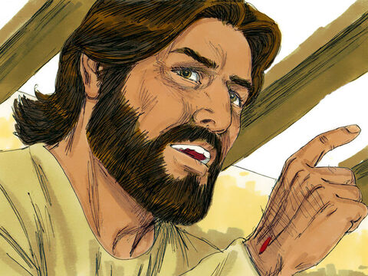
22
Then he breathed on them and said, “Receive the Holy Spirit.

Slide 10
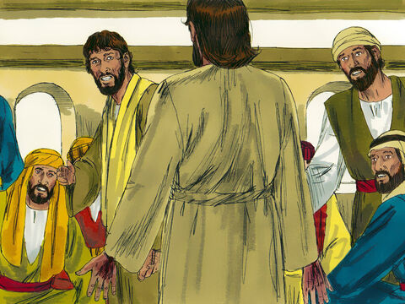
23
If you forgive people's sins, they are forgiven; if you do not forgive them, they are not forgiven.”

Slide 11
Leader: The Gospel of the Lord.
All: Praise to You,
Lord Jesus Christ.

Slide 12
GOSPEL MESSAGE

Slide 13
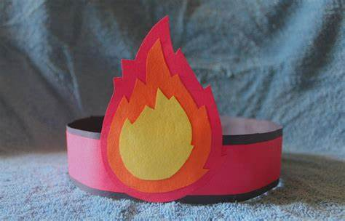
Activity:
My Pentecost Headband
Materials:
Red, orange, and yellow paper (or just color white paper)
Scissors
Glue stick or tape
Stapler (optional)
Crayons or markers

Slide 14
Instructions: 1. Cut a strip of paper (red or any color) about as wide as three fingers. Wrap it around your head to make sure it fits. Tape or staple the ends to make a circle headband.
2. Draw a simple flame shape on yellow paper. Then draw a smaller one on orange, and a tiny one on red. Cut them out and glue them on top of each other (red on top of orange, orange on yellow) to make one flame.
3. Glue or tape the flame to the front of the headband so it sticks up like it’s “on fire.”

Slide 15
Closing Prayer
Dear God,
Thank You for coming to Your friends after You rose from the dead. You said, “Peace be with you,” and gave them the Holy Spirit. Please give me Your peace when I feel scared or alone.
Help me to share Your love and peace with others. Fill my heart with Your Holy Spirit so I can follow You every day.
In Jesus' name, we pray.
Amen.

Slide 16
Solemnity of Pentecost – June 08, 2025
CYCLE C – YEAR I

